Slide 1
Implementation of Leader Election Algorithm Using Sense of Direction
PEIXIN LIU, GUANDA LI, YIRAN HUANG
G. Singh, Efficient leader election using sense of direction. Distributed Computing. 10 (1997) 159 − 165.

Slide 2
Outline
Introduction
Algorithm
Implementation
Experiment
Assessment
Conclusion
Future work

Slide 3
Leader Election with Sense of Direction
A group of processors must choose one among them to be the leader.
Asynchronous complete network
Bidirectional link
Sense of direction(Hamiltonian cycle)
Time complexity: O(log(n))
Message complexity: O(n)
e
d
5
1
1
2
3
4
2
3
5
4
5
2
1
f
4
3
c
3
4
1
2
5
5
4
3
4
3
2
1
a
2
5
b
1

Slide 4
Algorithm
n = power of 2
State: Candidate/Captured/Elected
0
56
8
Every 8 nodes is in a subring
R₅
R₄
R₆
R₃
48
A ring of 64 nodes
16
R₇
R₂
R₀
R₁
40
24
Arrangement of subrings for N = 64 (k = 8)
32

Slide 5

Algorithm
Phase 1: Separate into k rings ( ), elect within rings
Phase 2: elect among k rings by step (2^{l-1} processors per step)
0
56
8
Every 8 nodes is in a subring
R₅
R₄
R₆
R₃
48
A ring of 64 nodes
16
R₇
R₂
R₀
R₁
40
24
Arrangement of subrings for N = 64 (k = 8)
32

Slide 6
Algorithm
Inherit: if j has captured nodes in the set j[1..y] and i captures j, where j = i[x], then i extends its set of captured nodes to i[1..x + y]
i
j
x
y
x + y
i inherits the nodes captured by j

Slide 7
Algorithm
Local Variables
  state_{i}
  level_{i}
  step_{i}
  owner_{i}
  phase_{i}
Messages
  CAPTURE (phase_{i} , level_{i} /step_{i} , i): compare (level_{i}, id_{i})
  ACCEPT (phase_{i} , level_{i} ): accept CAPTURE (phase_{i} , level_{i} /step_{i} , i):
  OWNER (id): send by phase 1 leader
  ACK: ack to OWNER(id)
  INFORM (dist): owner of phase 1
  ELECTED: send by leader

Slide 8
Implementation
Fixed errors in the pseudocode
  Indent
  Messages
Clarified ambiguous description
Implemented cases when n != power of 2

Slide 9
n != power of 2
E.g. n = 10 M = 16 (k = 4)
R₀ = {0, 4, 8}, R₄ = {4, 8, 2}
R₀ = {0, 4, 8, 6, 2}, R₄ = {4, 8, 2, 0, 6}
1
0
2
9
1
3
3
4
8
2
4
R₁
7
5
6
1
0
2
R₀
9
1
3
3
4
8
2
4
7
5
6
A ring of 10 nodes

Slide 10
Experimentation
2 <= n <= 100
Repeat: 10 times
Print out running time and number of messages

Slide 11
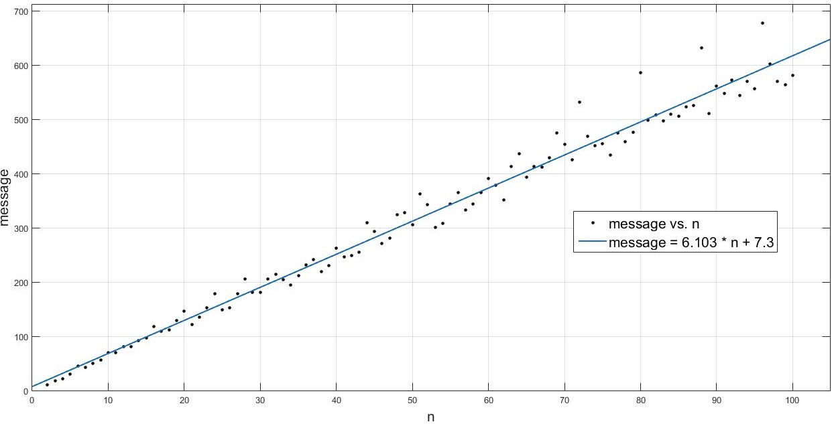
Message complexity
Message = 6.103 * n + 7.3
Message Complexity: O(n)
R-square = 0.9802

Slide 12
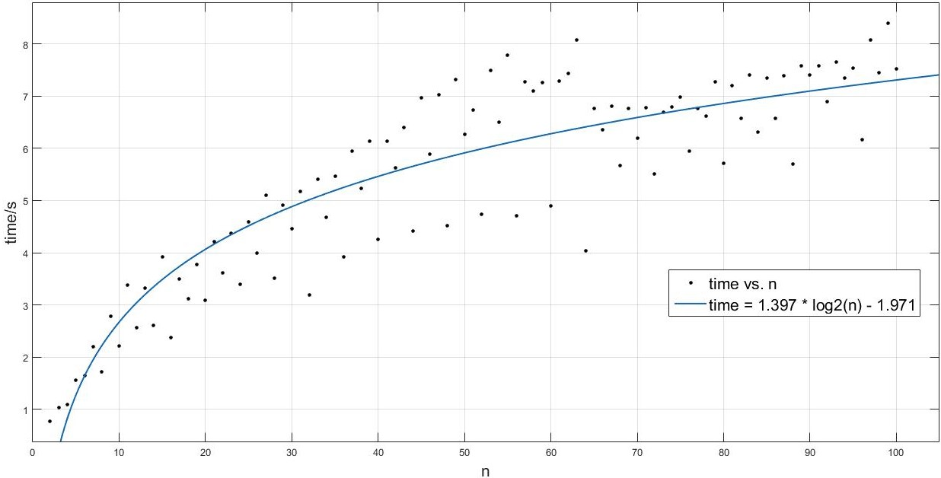
Time complexity
Time= 1.397 * log2(n) – 1.971
Time Complexity: O(log(n))
R-square = 0.8157

Slide 13
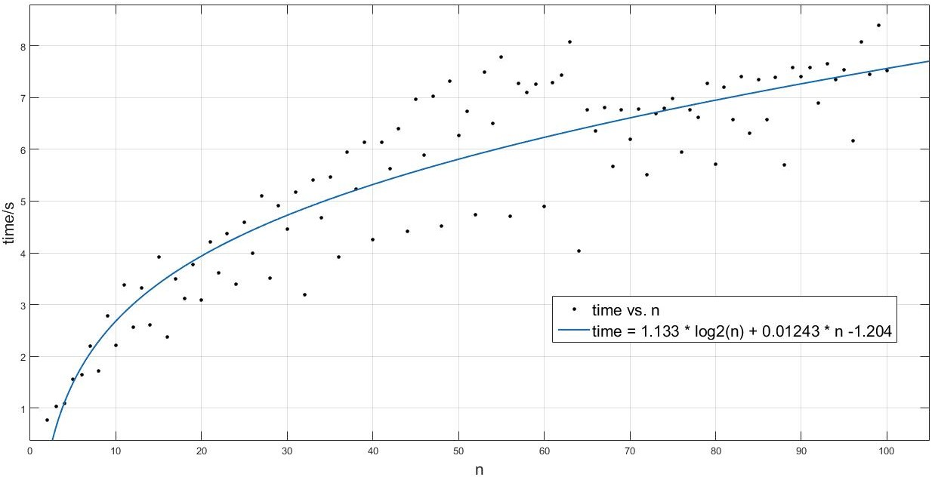
Time complexity
Time= 1.133 * log2(n) + 0.01243 * n – 1.204
Time Complexity: O(log(n))
R-square = 0.8214

Slide 14
Assessment of DistAlgo
DistAlgo enables us to simulate multiple processors on a single machine and send messages between each other
However, it …
  Does not allow us to access attributes or functions of nodes, nor compile global variables
  Offers low-quality randomness
  Lacks API to choose from asynchronous and synchronous message passing

Slide 15
Conclusion
The algorithm solves leader election using a sense of direction on a complete network
We implemented the algorithm in DistAlgo
We verified the time complexity to be O(log(n)), message complexity to be O(n)

Slide 16
Future Work
Simplify our code (too many IF statements now to get status information)
Test on a bigger network with more processors
Test with arbitrary message delay

Slide 17
Thank you & Questions?

