Slide 1
Implementation of Leader Election Algorithm Using Sense of Direction
GUANDA LI, PEIXIN LIU, YIRAN HUANG
Gurdip Singh, Efficient leader election using sense of direction. Distributed Computing. 10 (1997) 159 − 165.

Slide 2
Outline
Introduction
Algorithm
Implementation
Experiment
Assessment
Conclusion
Future work

Slide 3
Leader Election with Sense of Direction
A group of processors must choose one among them to be the leader. [1]
Asynchronous complete network
Bidirectional link
Sense of direction (Hamiltonian cycle)
Time complexity: O(log(n))
Message complexity: O(n)
e
d
5
1
1
2
3
4
2
3
5
4
5
2
1
f
4
3
c
3
4
1
2
5
5
4
3
4
3
2
1
a
2
5
b
1
[1] Hagit Attiya, Jennifer Welch. 2004. Distributed Computing: Fundamentals, Simulations,
and Advanced Topics (2nd. ed.). Wiley, Hoboken, New Jersey.

Slide 4
Algorithm
n = power of 2
State: candidate/captured/elected
0
56
8
Every 8 nodes is in a subring
R₅
R₄
R₆
R₃
48
A ring of 64 nodes
16
R₇
R₂
R₀
R₁
40
24
Arrangement of subrings for N = 64 (k = 8)
32

Slide 5

Algorithm
Phase 1: Separate into k interleafed subrings ( ), elect within subrings
Phase 2: Elect among k subrings by step (2^{l-1} processors per step)
0
56
8
Every 8 nodes is in a subring
R₅
R₄
R₆
R₃
48
A ring of 64 nodes
16
R₇
R₂
R₀
R₁
40
24
Arrangement of subrings for N = 64 (k = 8)
32

Slide 6
Algorithm
Inherit: if j has captured nodes in the set j[1..y] and i captures j, where j = i[x], then i extends its set of captured nodes to i[1..x + y]
i
j
x
y
x + y
i inherits the nodes captured by j

Slide 7
Algorithm
Phase 1: Separate into k interleafed subrings ( ), elect within subrings
Phase 2: Elect among k subrings by step (2^{l-1} processors per step)
0
56
8
Every 8 nodes is in a subring
R₅
R₄
R₆
R₃
48
A ring of 64 nodes
16
R₇
R₂
R₀
R₁
40
24
Arrangement of subrings for N = 64 (k = 8)
32

Slide 8
Algorithm
Local Variables
state_{i}
phase_{i}
level_{i}
step_{i}
owner_{i}
Messages
CAPTURE (phase_{i} , level_{i} /step_{i} , i): compare (level_{i}, id_{i})
ACCEPT (phase_{i} , level_{i} ): accept CAPTURE (phase_{i} , level_{i} /step_{i} , i):
OWNER (id): send by phase 1 leader
ACK: ack to OWNER(id)
INFORM (dist): owner of phase 1
ELECTED: send by leader

Slide 9
Implementation
Fixed errors in the pseudocode
Indent
Messages
Clarified ambiguous description
Implemented case when n != power of 2

Slide 10
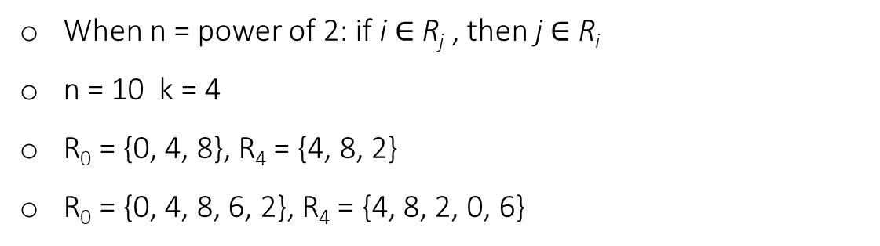
n != power of 2
When n = power of 2: if i $∈$ R_{j} , then j $∈$ R_{i}
n = 10 k = 4
R₀ = {0, 4, 8}, R₄ = {4, 8, 2}
R₀ = {0, 4, 8, 6, 2}, R₄ = {4, 8, 2, 0, 6}
R₁
R₀
1
1
0
2
0
2
9
1
3
9
1
3
3
4
3
4
8
2
4
8
2
4
7
5
7
5
6
6
A ring of 10 nodes

Slide 11
Experimentation
2 <= n <= 100
Repeat: 10 times
Run on PC
Print out running time and number of messages

Slide 12
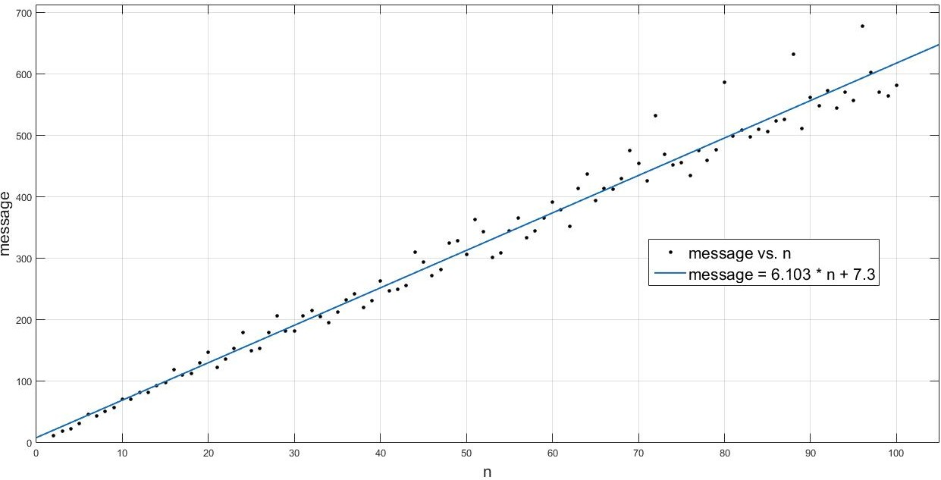
Message complexity
Message = 6.103 * n + 7.3
Message Complexity: O(n)
R-square = 0.9802

Slide 13
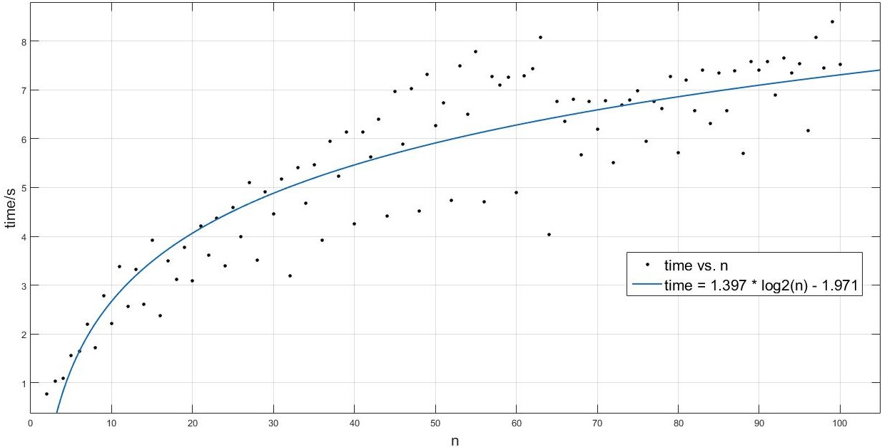
Time complexity
Delay = 0.1s
Time= 1.397 * log2(n) – 1.971
Time Complexity: O(log(n))
R-square = 0.8157

Slide 14
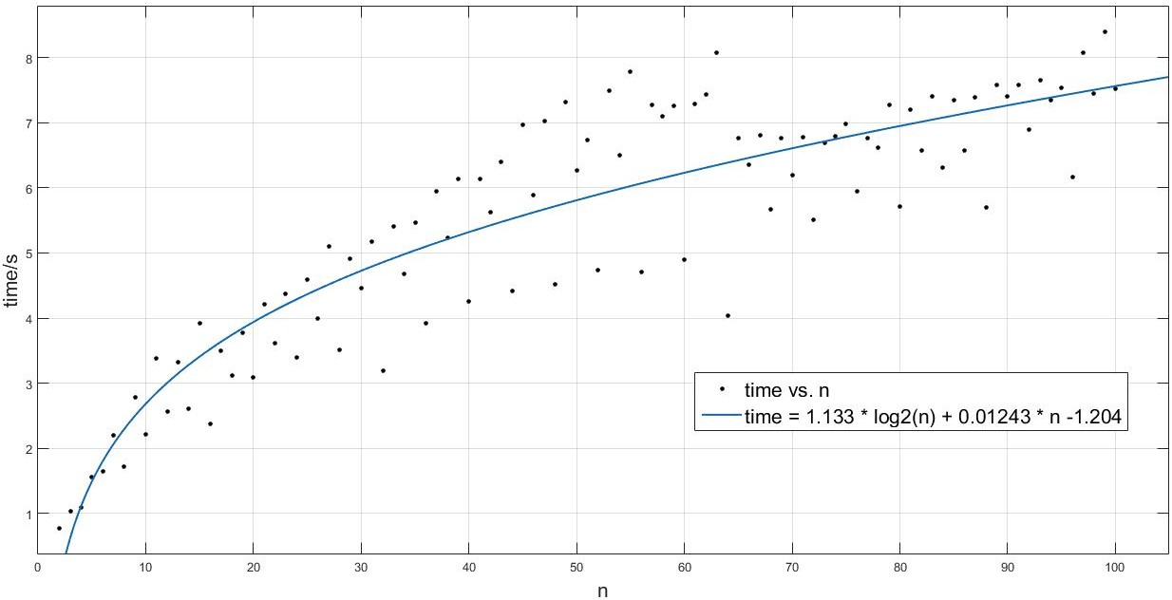
Time complexity
Delay = 0.1s
Time= 1.133 * log2(n) + 0.01243 * n – 1.204
Time Complexity: O(log(n))
R-square = 0.8214

Slide 15
Experimentation
Uncertainty:
Random variable
Unstable computer performance
Inadequate number of processors and repeats

Slide 16
Assessment of DistAlgo
DistAlgo enables us to simulate multiple processors on a single machine and send messages between each other
However, it …
Does not allow us to access attributes or functions of nodes, nor compile global variables
Offers low-quality randomness
Lacks API to choose from asynchronous and synchronous message passing

Slide 17
Conclusion
Gurdip Singh’s algorithm solves leader election using a sense of direction on an asynchronous complete network
We implemented the algorithm in DistAlgo
We verified the time complexity to be O(log(n)) and message complexity to be O(n)

Slide 18
Future Work
Simplify our code (too many IF statements now to get status information)
Test on a bigger network with more processors
Test with arbitrary message delay

Slide 19
Thank you

Slide 20
Questions?

