Slide 1
Implementation of Leader Election Algorithm Using Sense of Direction

Slide 2
Leader election
Intro to leader election

Slide 3
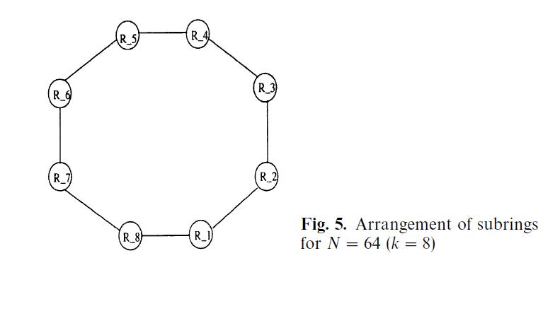
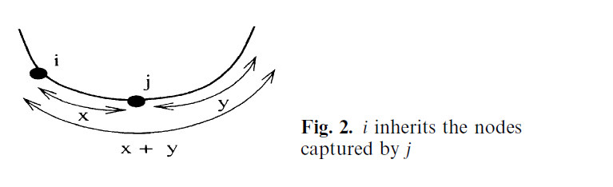
Algorithm
Candidate/Captured/Elected
Phase1/2
Phase 1 Separate into k rings, elect within rings
Phase 2 elect among k rings by step (2^l-1 per step)
Msg: capture, owner, accept……

Slide 4
可以考虑下要不要放pseudo code
Time, message complexity
N != power of 2

Slide 5
Implementation
Fix errors, e.g.
Clarify Ambiguous, e.g.
Implement when n != 2

Slide 6
Experiment
msg (figure 1), verify O(n)

Slide 7
Time (figure 2), verify O(log(n))

Slide 8
Time (figure 3), computational time

Slide 9
Conclusion
算法实现了。。。。目标
我们用DistAlgo实现了n为任意时。。。。
验证了时间、空间。。。。为。。。

Slide 10
Future work

