Slide 1
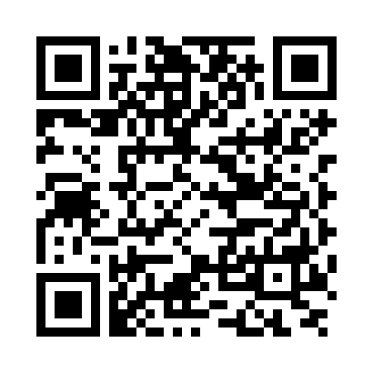
A Bluetooth Chat APP
Nuo Dou, Pei Zhang

Slide 2
Table of Content
Function
Design
Demo
To-dos

Slide 3
Function
Bluetooth chat ---- Text only, one to one.
Choose customized icon for your or your friend. (As a way to differentiate between multiple devices, since picture transmission is not implemented).
Notification and vibration.
History will never lost after restart.
Localization for English, Simplified Chinese and Traditional Chinese.

Slide 4
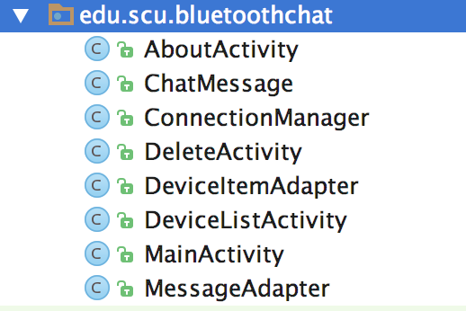
Design – Overview
Activities: MainActivity, DeviceItemListActivity, AboutActivity
Data structure: ChatMessage
Bluetooth connection: ConnectionManager
UI-related: MessageAdapter, DeviceItemAdapter

Slide 5
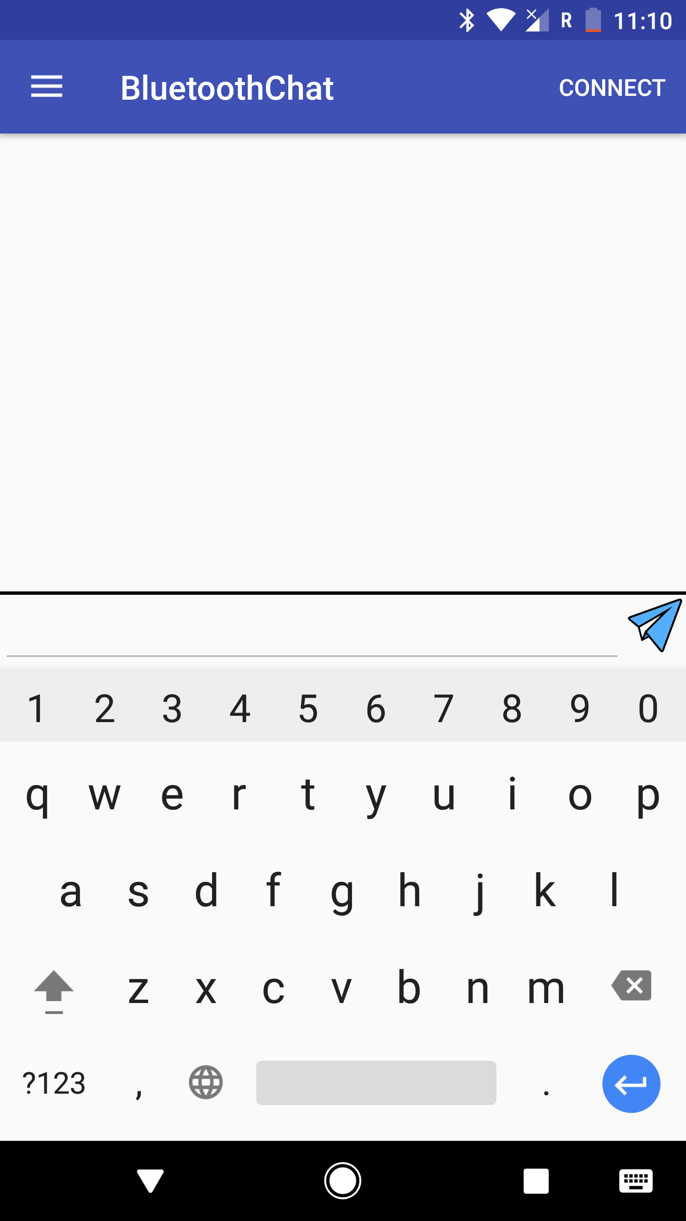
Design – UI Layout
Simplicity is the best.
EditText box is not enabled until connected.
Click CONNECT to connect to other devices.

Slide 6
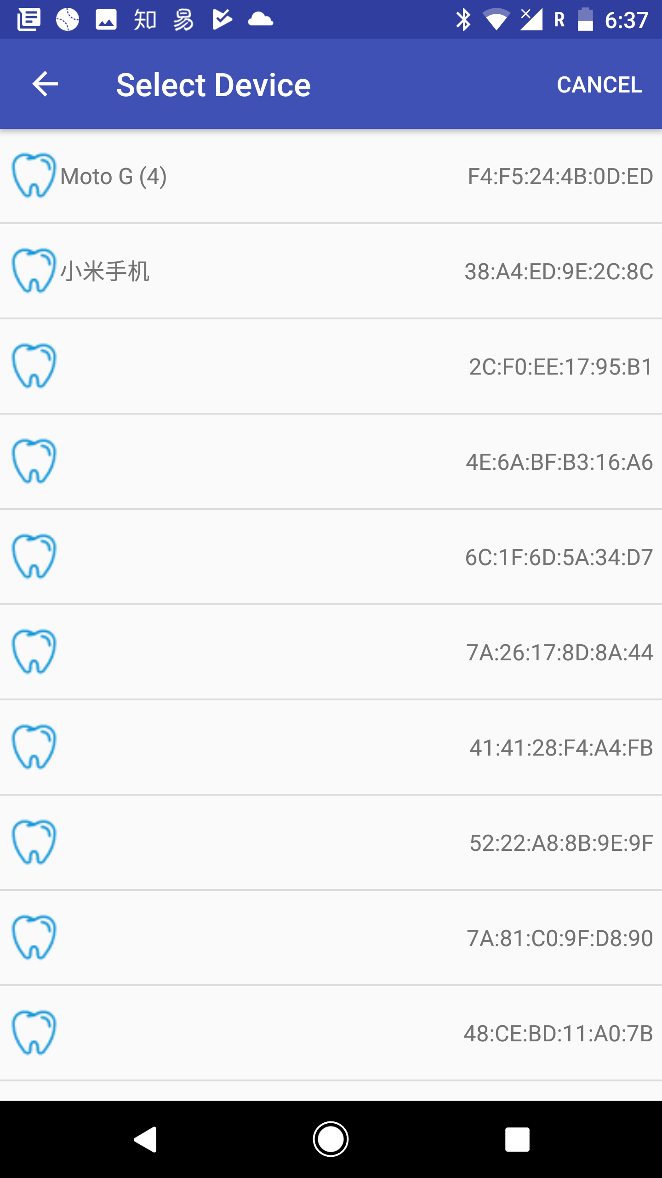
Design – UI Layout
Paired device will be always on the top.
With device icon (Real “BLUETOOTH!”)
Customized icon will be reflected here.
Bluetooth addresses on the right.

Slide 7
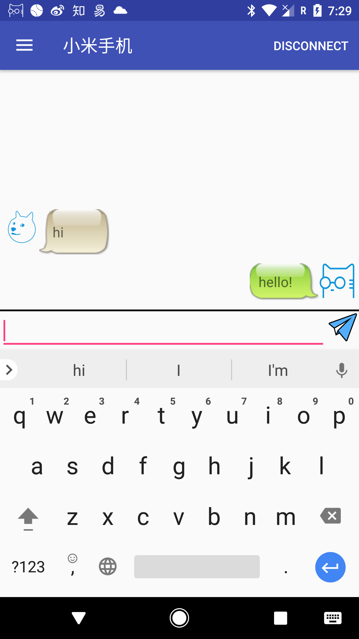
Design – UI Layout
Connected device name is on the top-left.
Chat message with default icons.

Slide 8
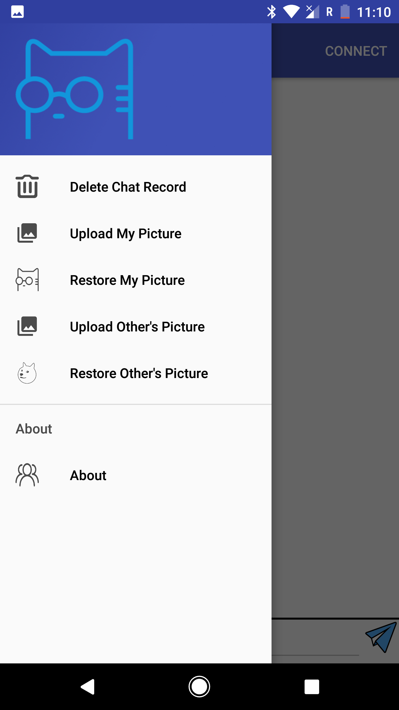
Design – UI Layout
All supported functions are shown in the drawer.
Your customized picture is on the top.

Slide 9
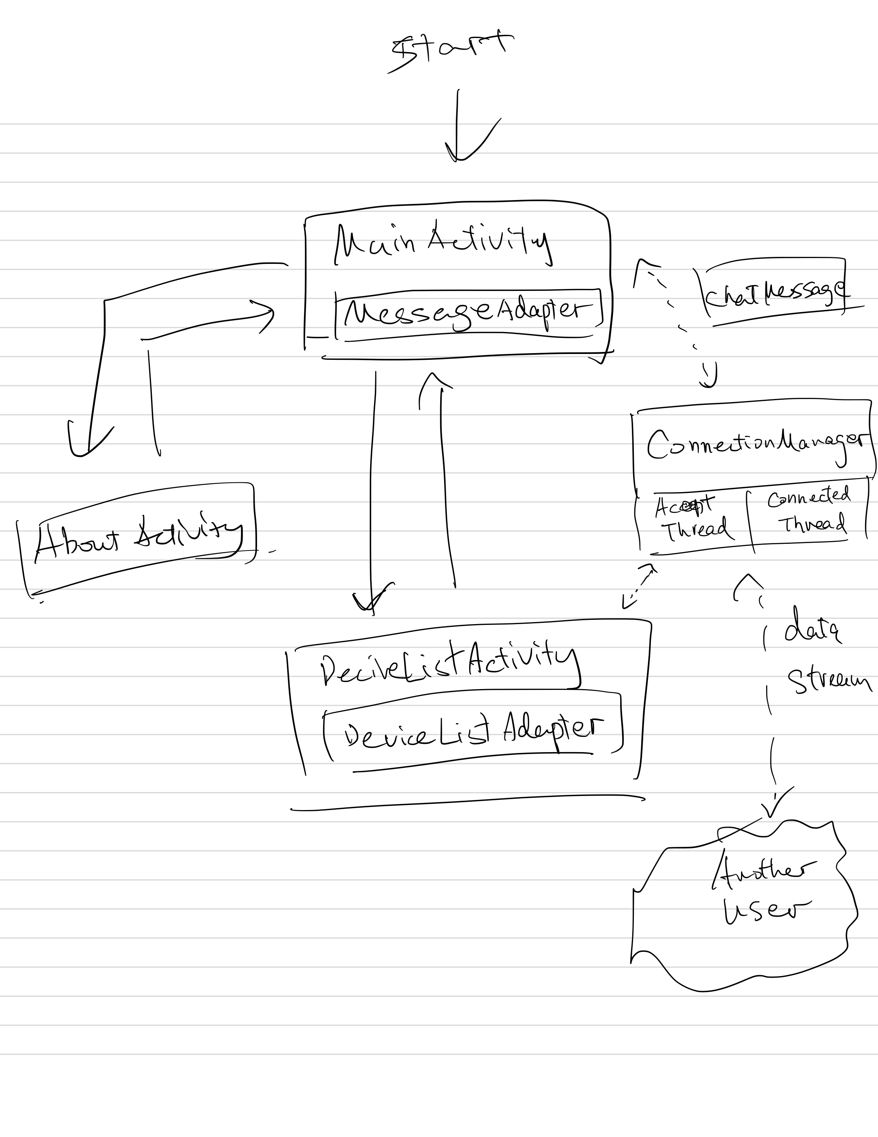
Design – Logic Design

Slide 10
Design – Logic Design
Bluetooth API is called in ConnectionManager.
ConnectionManager uses two threads to maintain the listening and transmitting respectively.
AcceptThread: Listening to other clients connection requests.
ConnectedThread: Maintaining a socket between two devices and send/get data stream from it.
Exposes methods to MainActivity to connect or disconnect.

Slide 11
Design – Logic Design
The MainActivity is implemented on the basis of the official navigation drawer template.
Basic functions are displayed in the drawer.
A handler to handle message from the ConnectedThread, sending and receiving
Using an adapter to print messages on the screen.
Calls methods in ConnectionManager to connect or disconnect.
Implements file-related operation, like user image file and chat history file.

Slide 12
Design – Logic Design
DeviceListActivity shows the Bluetooth devices found.
Gets device names and addresses from ConnectionManager.
Uses an adapter to print devices on the screen.
When an item is selected, return to the MainActivity and start connecting.

Slide 13
Design – from the class to the project
Activity life cycle management
Bluetooth API
Asynchronized tasks
File manipulation
UI – drawer, adapter
Button, EditText, ImageView…
…

Slide 14
Design – Future Design
Multimedia message types: audio, video, meme
Customized UI other than android default UI
Support for group chat
Ad-hoc communication
…

Slide 15
Demo

Slide 16
Thank you

