Slide 1
A BlueTooth Chat APP
Nuo Dou, Pei Zhang

Slide 2
Table of Content
Function
Design
Demo
To-dos

Slide 3
Function
Bluetooth chat ---- Text only, one to one.
Choose customized icon for your or your friend. (As a way to differentiate between multiple devices, since picture transmission is not implenmented).
Notification and vibration.
History will never lost after restart.
Localization for English, Simplified Chinese and Traditional Chinese.

Slide 4
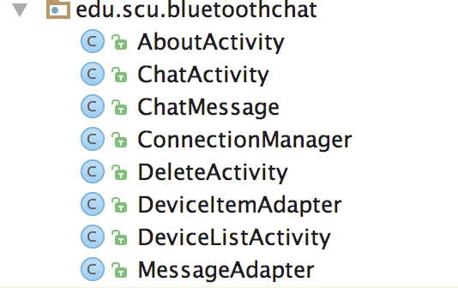
Design – Overview
Activities: AboutActivity, DeviceItemListActivity, AboutActivity
Data structure: ChatMessage
Bluetooth connection: ConnectionManager
UI-related: MessageAdapter, DeviceItemAdapter

Slide 5
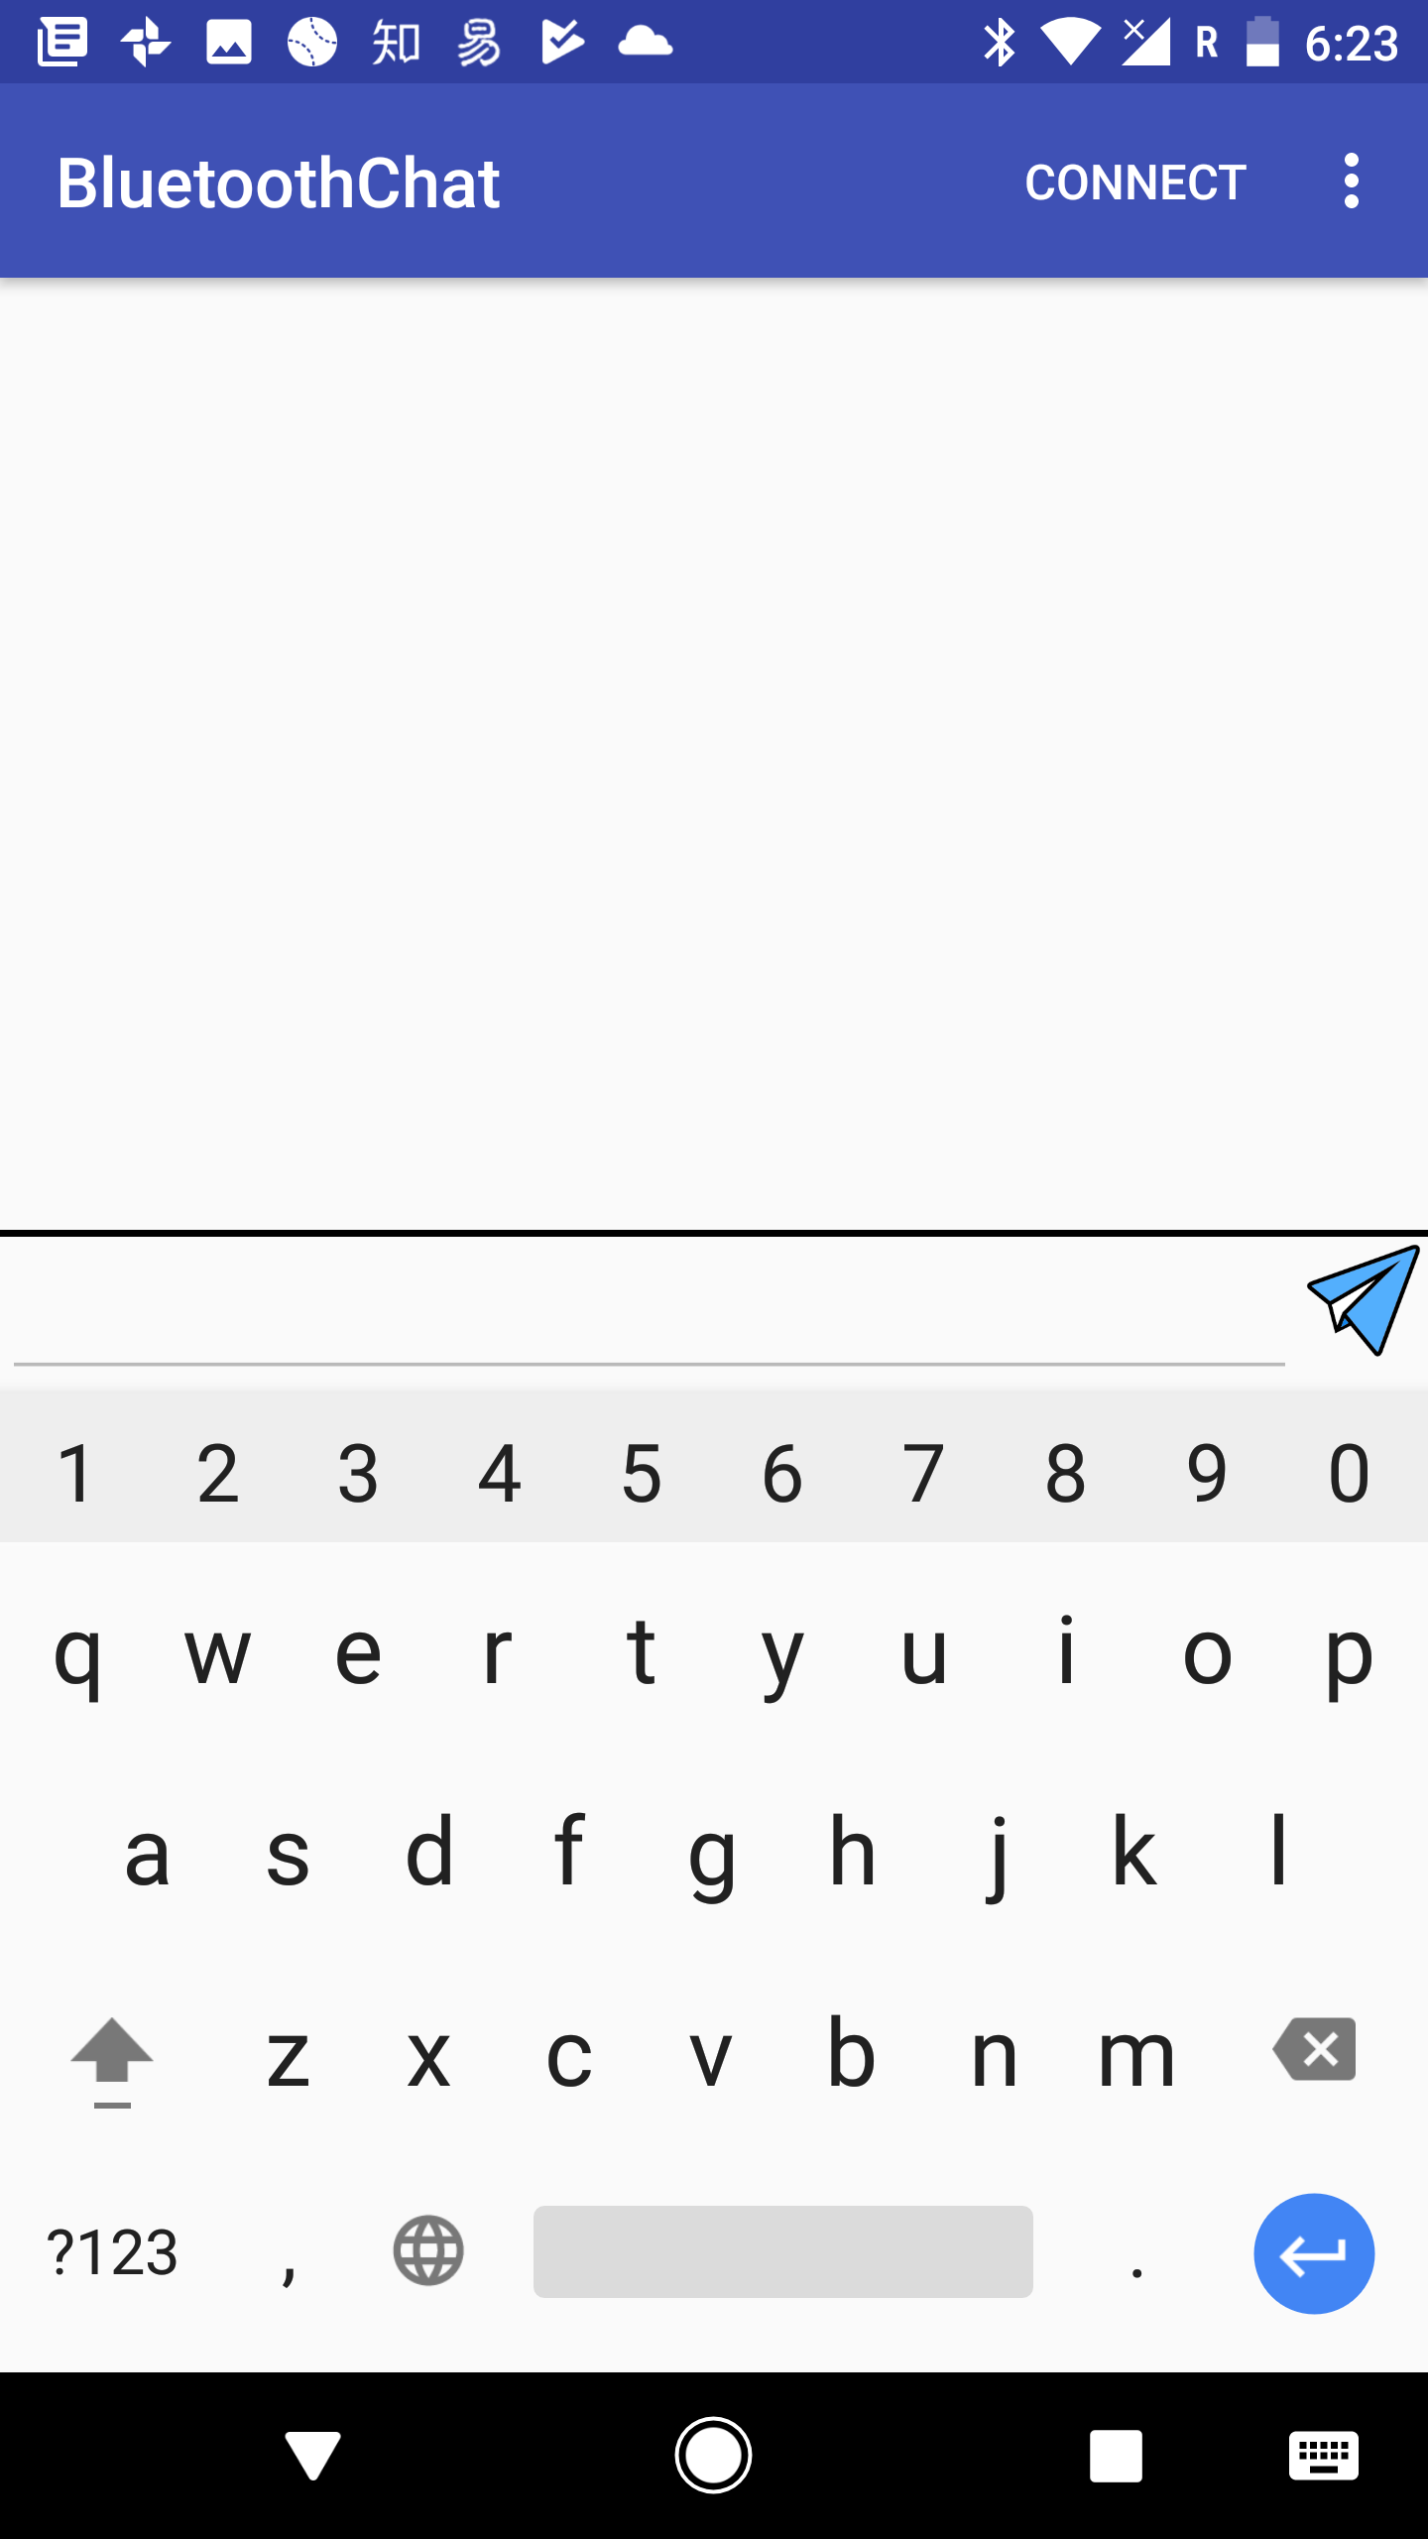
Design – UI Layout
Simplicity is the best.
EditText box is not enabled until connected.
Click CONNECT to connect to other devices.

Slide 6
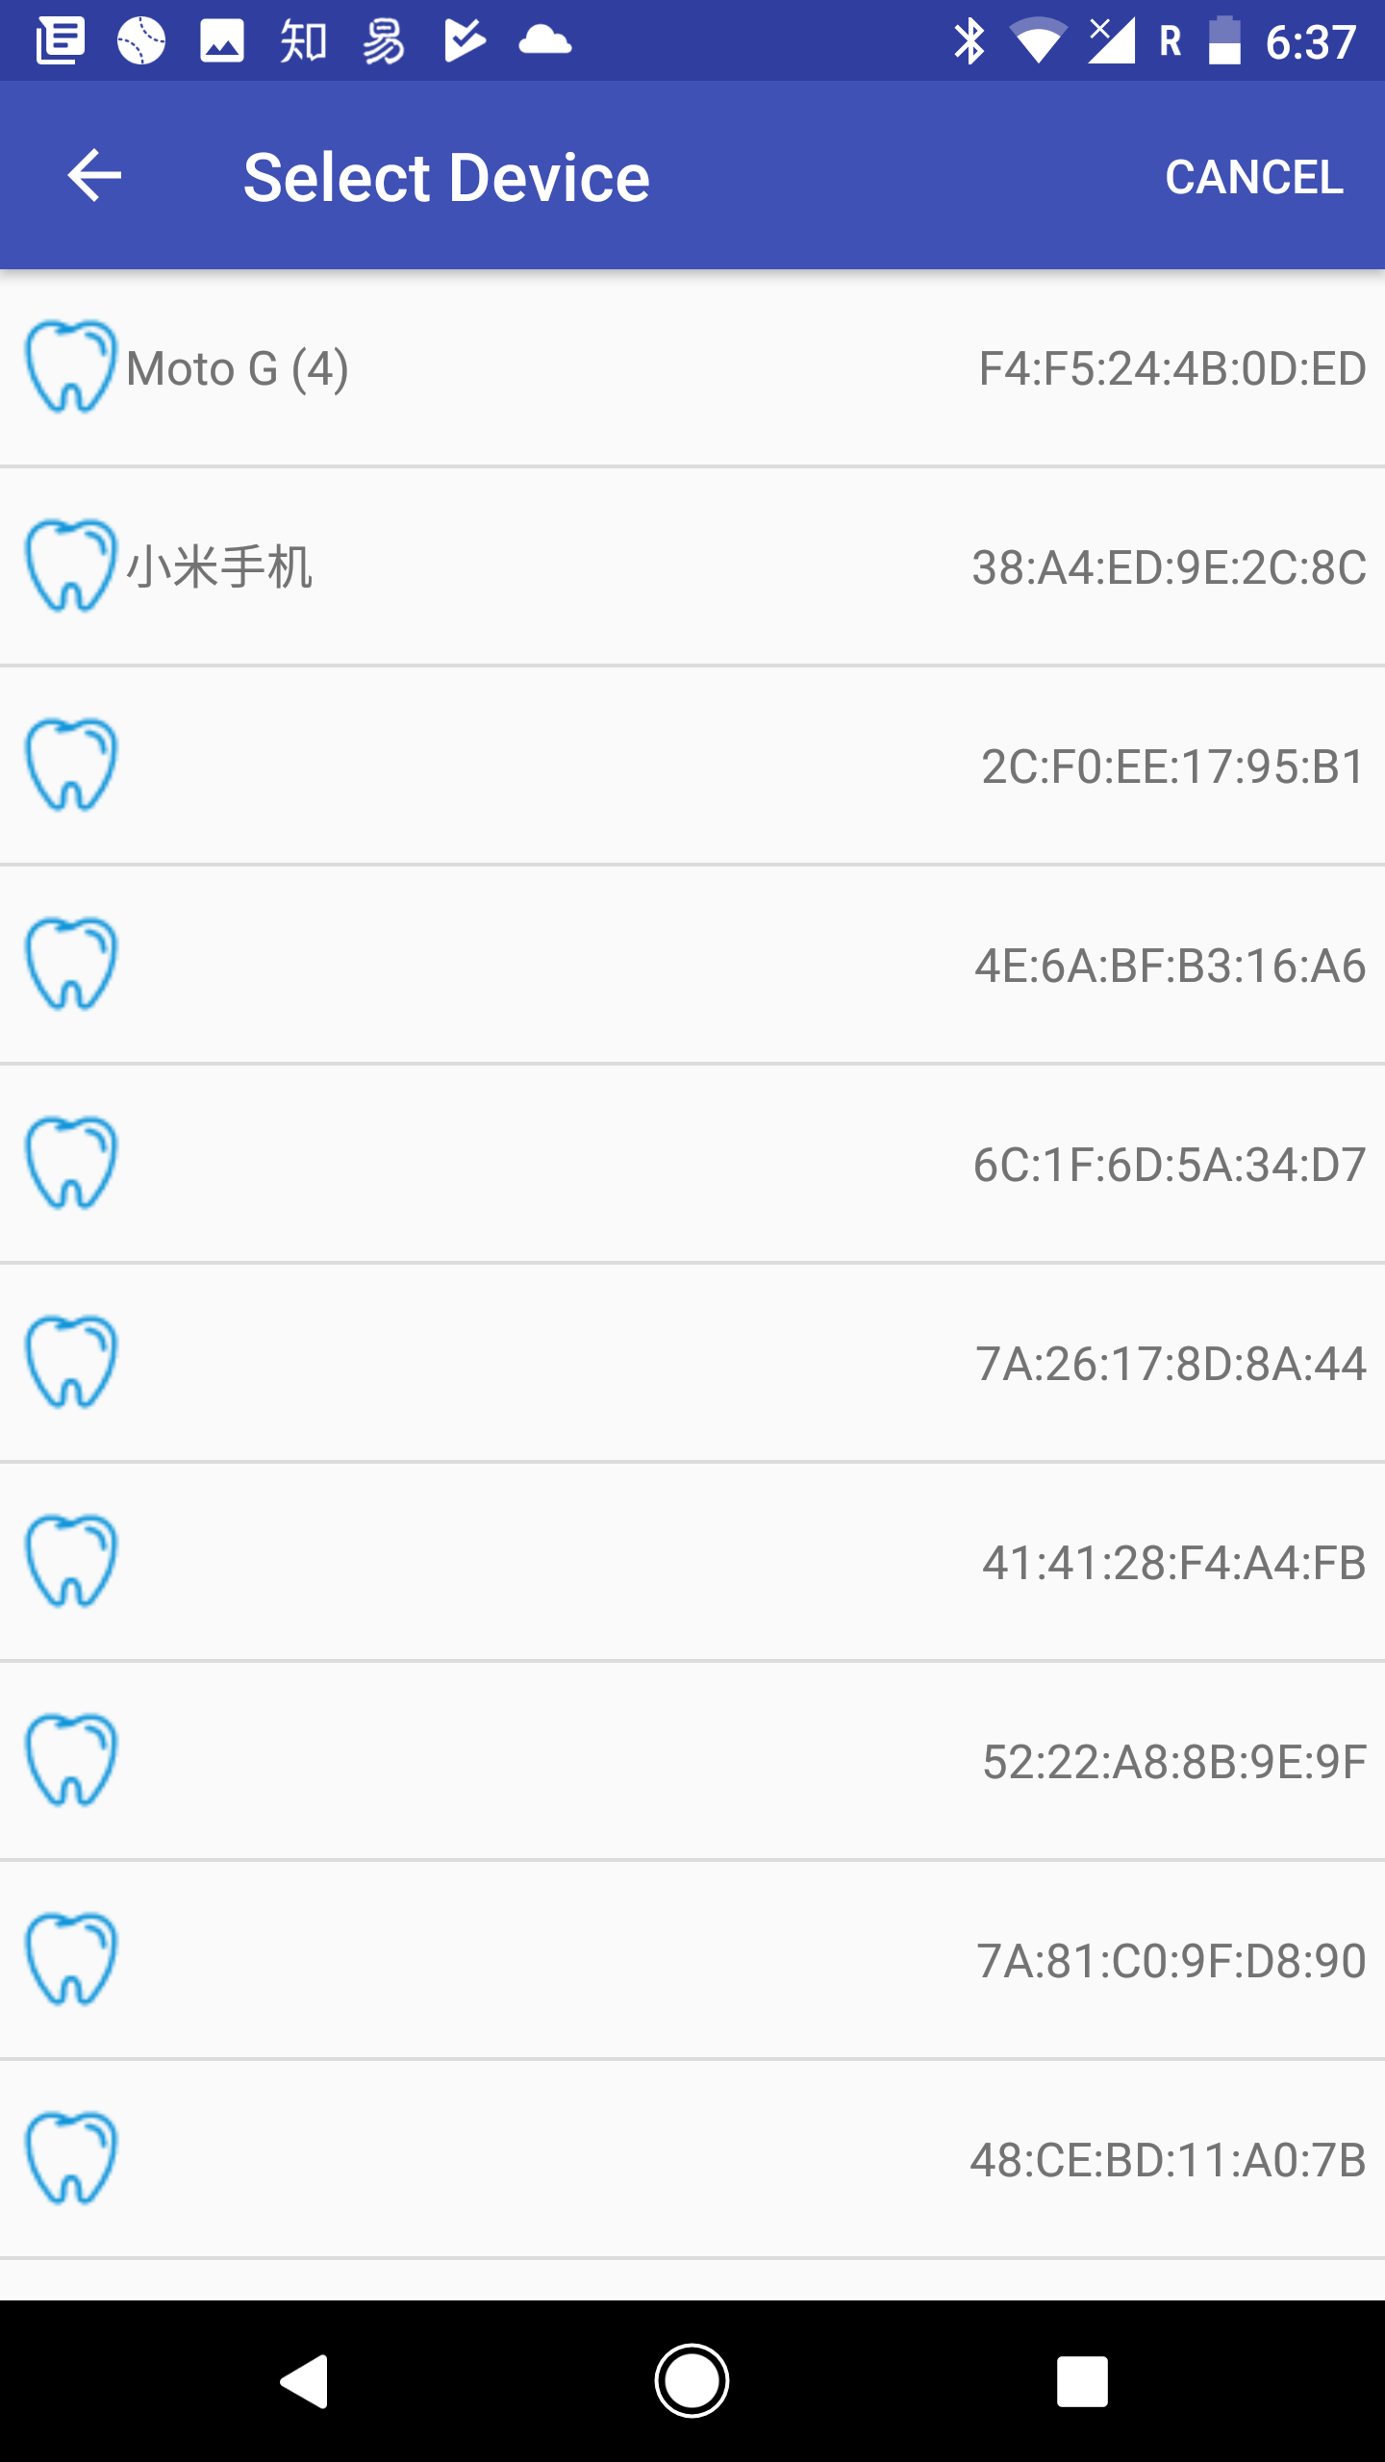
Design – UI Layout
Paired device will be always on the top.
With device icon (Real “BLUETOOTH!”)
Customized icon will be reflected)
Bluetooth address on the right.

Slide 7
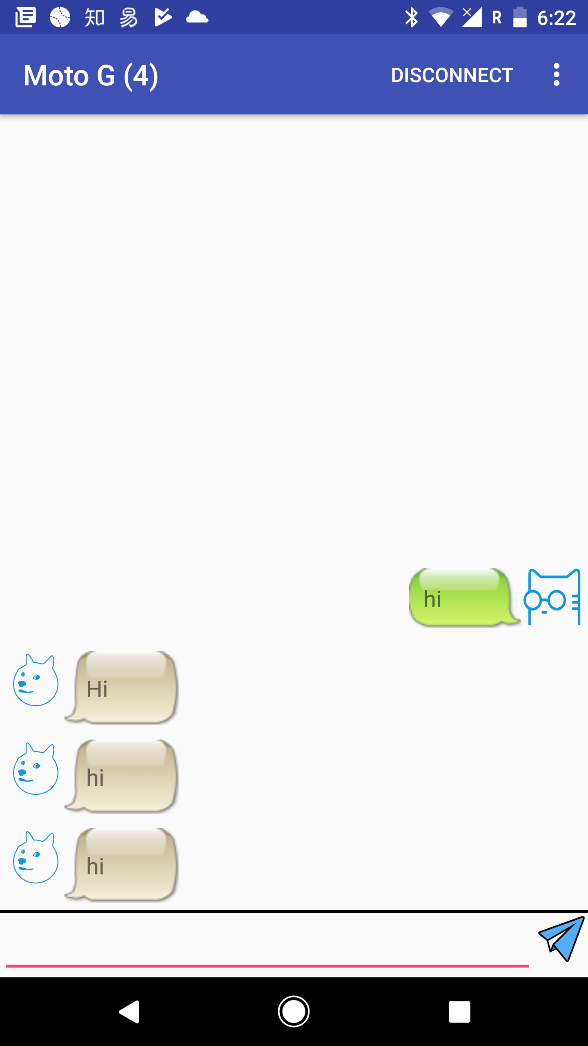
Design – UI Layout
Connected device name is on the left.
Chat message with default icons.

Slide 8
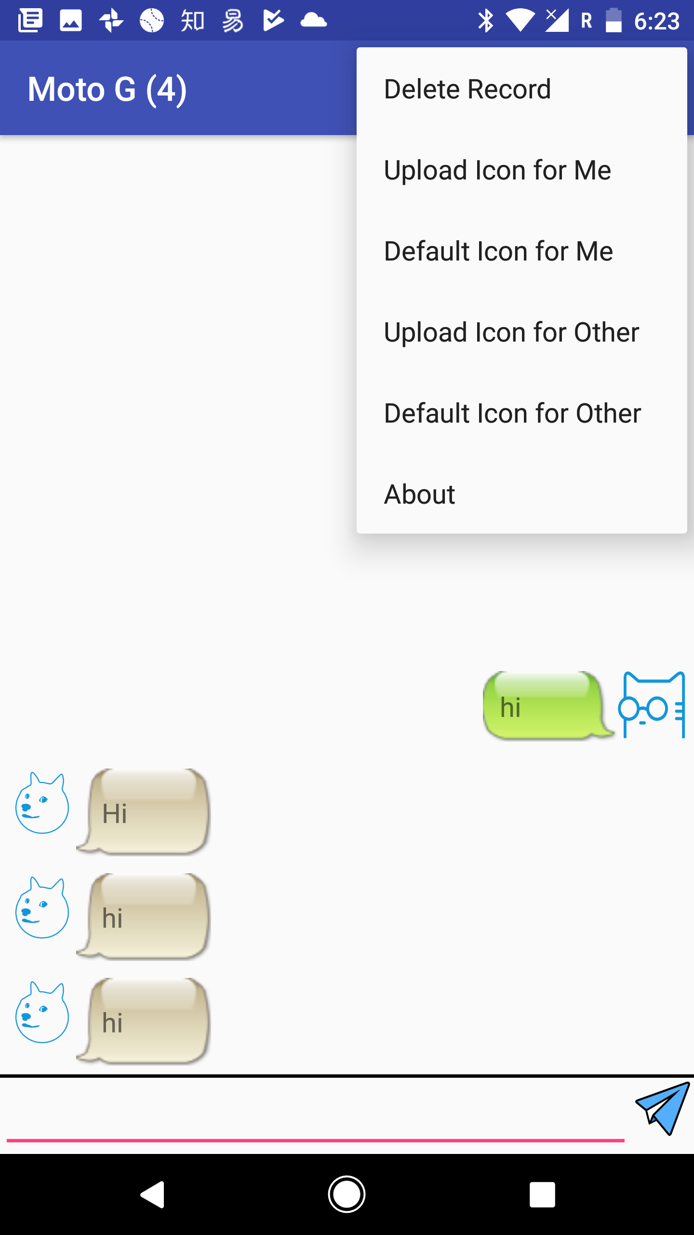
Design – UI Layout
All functions currently supported is here.
Chat record will be stored, also can be deleted.
Upload customized icon for you or your friend.
Restore the default icon for you and your friend.
Check author information in About section.

Slide 9
Design – Logic Design
Core Component: Connection Manager.
AcceptThread: Listening to other devices’ connection requests.
ConnectedThread: Manage input stream and output stream from Bluetooth socket.
ConnectionListener: An interface, for listening to the change of status and messages.

Slide 10
Design – Logic Design
Public functions:
startListen() / stopListen()
connect() / disconnect()

Slide 11
Design – Logic Design

Slide 12
Design – Logic Design

Slide 13
Design – Logic Design

Slide 14
Design – Logic Design

Slide 15
Design – Logic Design

Slide 16
Design – Logic Design

Slide 17
Design – Logic Design

Slide 18
To-dos
Add support for multimedia transmission;
Add support for Google Photos;
Add support for group chat.

