Slide 1
NBA players progression
Discovering the best hidden gems the league has to offer

Slide 2
Introduction
Idea: predict the progression of the different players of the NBA according to their stats, biometrics and age.
Motivation: some teams already failed with Moneyball taken to the extreme (Houston Rockets). It would be interesting to see what factors are the most contributing to a team win within every player of the league. I love basketball since I was a kid and stats and this way I can combine both into this project.
Overview: currently there are two stats called win shares that tries to explain how every player contributes to the victories of their teams, and PER that explain their influence ingame. I would like to try to go beyond that since this stats are heavily influenced by players being in good teams and figure out which players are being underused in losing teams.
Notes:
II. What is a Win Share?
Bill James developed his system such that one win is equivalent to three Win Shares. My system deviates from James's system in three key ways:
In James's system, one win is equivalent to three Win Shares. In my system, one win is equivalent to one Win Share.
James made team Win Shares directly proportional to team wins. In his system, a baseball team that wins 80 games will have exactly 240 Win Shares, a baseball team that wins 90 games will have exactly 270 Win Shares, etc. In my system, a basketball team that wins 50 games will have about 50 Win Shares, give or take.
James did not allow for the possibility of negative Win Shares. In his system, the fewest number of Win Shares a player can have is zero. In my system, a player can have negative Win Shares. I justify this by thinking about it in the following way: a player with negative Win Shares was so poor that he essentially took away wins that his teammates had generated.
III. Crediting Offensive Win Shares to Players
A. 1977-78 to present NBA
Offensive Win Shares are credited to players based on Dean Oliver's points produced and offensive possessions. The formulas are quite detailed, so I would point you to Oliver's book Basketball on Paper for complete details. The process for crediting Offensive Win Shares is outlined below (using LeBron James of the 2008-09 Cleveland Cavaliers as an example):
Calculate points produced for each player. In 2008-09, James had an estimated 2345.9 points produced.
Calculate offensive possessions for each player. James had an estimated 1928.1 offensive possessions in 2008-09.
Calculate marginal offense for each player. Marginal offense is equal to (points produced) - 0.92 * (league points per possession) * (offensive possessions). For James this is 2345.9 - 0.92 * 1.083 * 1928.1 = 424.8. Note that this formula may produce a negative result for some players.
Calculate marginal points per win. Marginal points per win reduces to 0.32 * (league points per game) * ((team pace) / (league pace)). For the 2008-09 Cavaliers this is 0.32 * 100.0 * (88.7 / 91.7) = 30.95.
Credit Offensive Win Shares to the players. Offensive Win Shares are credited using the following formula: (marginal offense) / (marginal points per win). James gets credit for 424.8 / 30.95 = 13.73 Offensive Win Shares.
IV. Crediting Defensive Win Shares to Players
A. 1973-74 to present NBA
Crediting Defensive Win Shares to players is based on Dean Oliver's Defensive Rating. Defensive Rating is an estimate of the player's points allowed per 100 defensive possessions (please see Oliver's book for further details). Here is a description of the process (once again using LeBron James in 2008-09 as an example):
Calculate the Defensive Rating for each player. James's Defensive Rating in 2008-09 was 99.1.
Calculate marginal defense for each player. Marginal defense is equal to (player minutes played / team minutes played) * (team defensive possessions) * (1.08 * (league points per possession) - ((Defensive Rating) / 100)). For James this is (3054 / 19780) * 7341 * ((1.08 * 1.083) - (99.1 / 100)) = 202.5. Note that this formula may produce a negative result for some players.
Calculate marginal points per win. Marginal points per win reduces to 0.32 * (league points per game) * ((team pace) / (league pace)). For the 2008-09 Cavaliers this is 0.32 * 100.0 * (88.7 / 91.7) = 30.95.
Credit Defensive Win Shares to the players. Defensive Win Shares are credited using the following formula: (marginal defense) / (marginal points per win). James gets credit for 202.5 / 30.95 = 6.54 Defensive Win Shares.
V. Putting It All Together
The final step of the process is to add Offensive Win Shares to Defensive Win Shares. In our examples, LeBron James total in 2008-09 is 13.73 + 6.54 = 20.27 Win Shares and Oscar Robertson total in 1964-65 is 14.27 + 2.69 = 16.96 Win Shares.
VI. Does This Work?
Because this metric is designed to estimate a player's contribution in terms of wins, it makes sense to see if the sum of player Win Shares for a particular team closely matches the team win total. For the 2008-09 Cavaliers the sum of player Win Shares is 67.9, while the team win total is 66, an error of 66 - 67.9 = -1.9 wins. For the 1964-65 Royals the sum of player Win Shares is 43.5, while the team total is 48, an error of 48 - 43.5 = 4.5 wins. These errors are actually close to the "typical" error; looking at all NBA teams since the 1962-63 season (the last season we have complete player splits), the average absolute error is 2.74 wins and the root mean squared error is 3.41 wins.

Slide 3
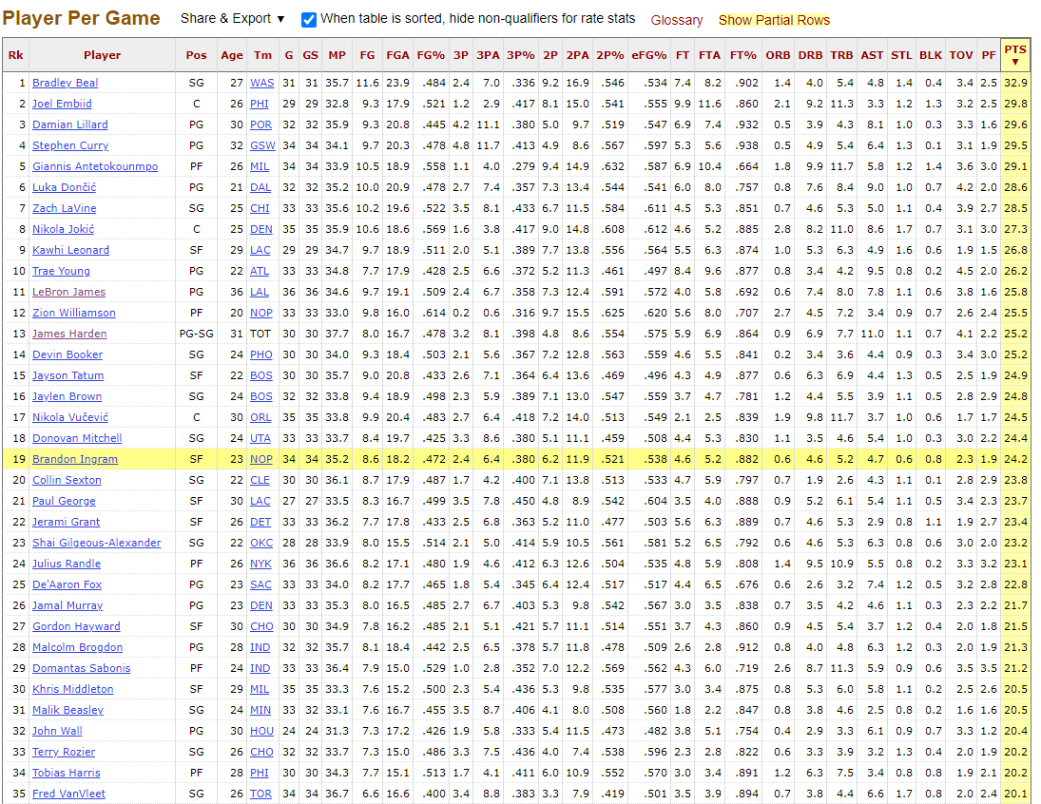
Data
Basketball Reference per game and advanced stats since 1980 (3pt shot invention).
Biometrics if posible (limited data available, worth it?)
Notes:
No wingspan data available, height data limited (specially per season),
Data previous to 1980 not relevant since league has changed drastically (may be worth to limit it to 2000s) 3pt importance is increasing by a lot,
Check specially player progression within the years.
Advanced stats: +/- per 100 poss, offensive/defensive win shares, PER, Usage %, True Shooting %

Slide 4
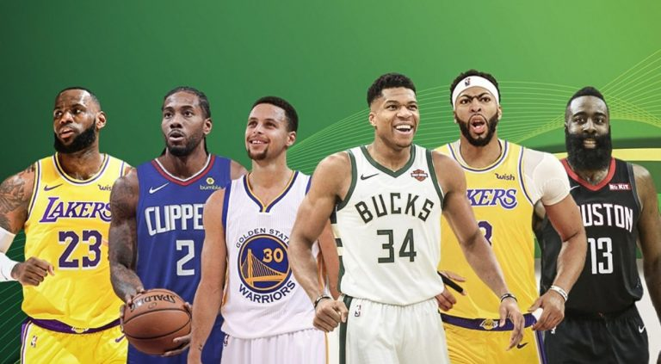

Goal
NOTE:
To change images on this slide, select a picture and delete it. Then click the Insert Picture icon
in the placeholder to insert your own image.
Figure out the hidden gems of the league. Players that give the best bang for their buck.
Specifically players that are being underutilized in losing teams that can contribute in winning teams (Danny Green, Christian Wood, etc.)
Notes:
The main goal is to find the next Danny Green/Jeremy Lin,/Christian Wood/Patty Mills players that don’t stand out but have the potential to do so.
Also figure out which players have been lost because they didn’t get opportunities on winning teams.
Biometrics would help a lot (t-rex have lots of problems late in their careers and huge wingspan players have a lot of potential and more longevity in the league).
Also notice differences between Regular Season and Playoffs (Giannis, Pandemic P VS Kawhi, Robert Horry)

Slide 5
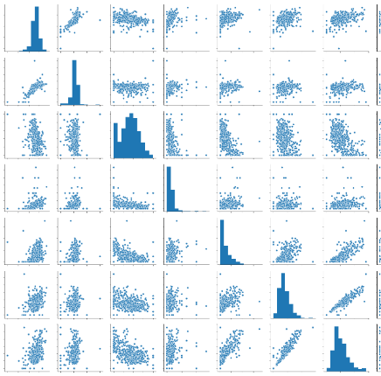
Analysis techniques
Clustering
K-Means
DBSCAN
Etc.

Slide 6
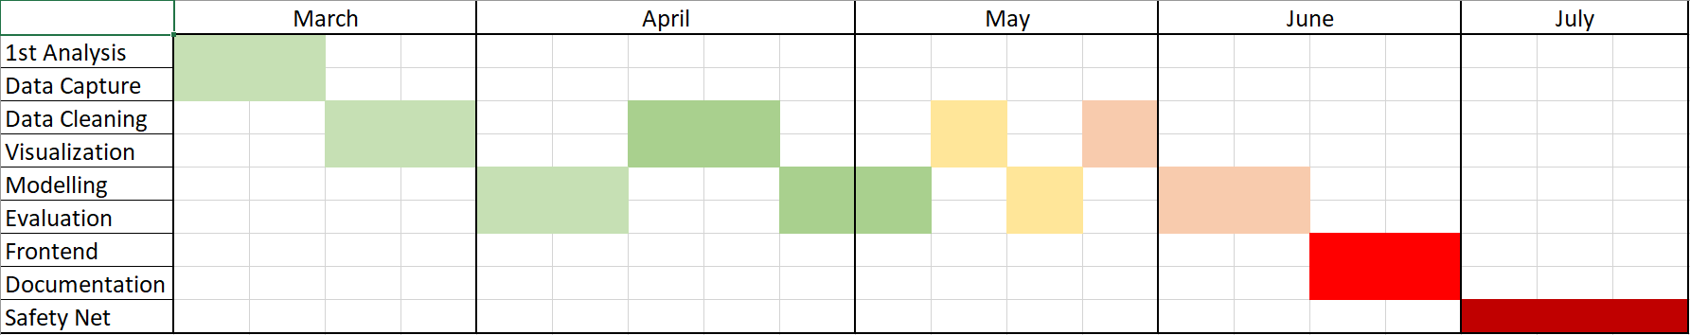
Project planning

Slide 7
Questions & Comments
How do I track progress of a player in time?
How do I figure out when a player can progress or when is he done?
With age and years in the league how do I figure out the best numbers/data?
Notes:
How do I track progress of a player in time?
How do I figure out when a player can progress or when is he done?
With age and years in the league how do I figure out the best numbers/data?

