Slide 1
EE 201C
Homework 2 Solution
Wei Wu
2013ee201c@gmail.com

Slide 2
Homework 2
Part I: HSPICE and S2P method
  (a) Analyze the moments by DC in HSPICE
  (b) Calculate the delay by S2P
  (c) Calculate the delay by HSPICE
Part II: PRIMA algorithm for model order reduction

Slide 3
Homework 2-Part I
[Problem #1] For the same circuit, use DC analysis method in SPICE to get the 0th -3rd moments for C4.
R₅
R₁ = 2mΩ
R₂ = 2mΩ
R₃ = 3mΩ
R₄ = 3mΩ
R₅ = 4mΩ
C₁ = 2nF
C₂ = 2nF
C₃ = 4nF
C₄ = 4nF
C₅ = 2nF
C₅
R₁
n
s
R₄
1v
R₂
C₁
C₄
R₃
C₂
C₃

Slide 4
Homework 2-Part I(a)
1 Calculate the voltage of each node (1,2,3,4,5 and n), which is 0 order moment m0;
2 Replace the capacitor in the circuit with current source with current c*m_{c}
R₅
5
5
R₅
R₁
C₅
1
2
n
1
R₁
2
n
C₅m_{c5}
s
R₂
R₄
s
R₄
1v
C₄
1v
R₂
C₁
3
3
C₄m_{c4}
R₃
C₁m_{c1}
C₂
R₃
4
C₂m_{c2}
4
C₃
C₃m_{c3}

Slide 5
Homework 2-Part I(a)
1 Calculate the voltage of each node (1,2,3,4,5 and n), which is 0 order moment m0;
2 Replace the capacitor in the circuit with current source with current c*m_{c}
3 Repeat Step1-2 for 4 times to calculate the moments m0-4:
 | Node | 1 | 2 | 3 | 4 | n | 5
 | Cap |  | C1 | C2 | C3 | C4 | C5
Itr 1 | Volt(mc0) | 1.000E+00 | 1.000E+00 | 1.000E+00 | 1.000E+00 | 1.000E+00 | 1.000E+00
 | c*mc |  | 2.000E-09 | 2.000E-09 | 4.000E-09 | 4.000E-09 | 2.000E-09
Itr2 | Volt(mc1) | 1.000E+00 | 2.800E-11 | 5.200E-11 | 6.000E-11 | 7.000E-11 | 7.800E-11
 | c*mc |  | 5.600E-20 | 1.040E-19 | 2.400E-19 | 2.800E-19 | 1.560E-19
Itr3 | Volt(mc2) | 1.000E+00 | 1.672E-21 | 3.232E-21 | 3.952E-21 | 4.540E-21 | 5.164E-21
 | c*mc |  | 3.344E-30 | 6.464E-30 | 1.581E-29 | 1.816E-29 | 1.033E-29
Itr4 | Volt(mc3) | 1.000E+00 | N/A | N/A | N/A | N/A | N/A

Slide 6

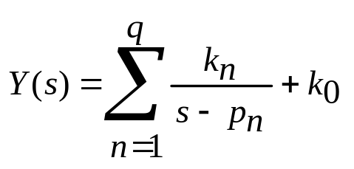

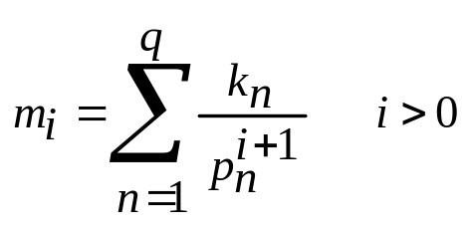
Homework 2-Part I(b) S2P
S2P algorithm- Review
  Problem: Model the delay of given node as a 2-pole system:
  Find the value of p1,p2,k1 and k2
  Step1: p1, p2 can be found by the first 4 order of moment of Y(s).
  Step2: find k1,k2 by fitting the first 2 order of moments from the first 2 order of moments of H(s)
Emrah Acar, Altan Odabasioglu, Mustafa Celik, and Lawrence T. Pileggi. 1999. “S2P: A Stable 2-Pole RC Delay and Coupling Noise Metric”. In Proceedings of the Ninth Great Lakes Symposium on VLSI(GLS '99)

Slide 7
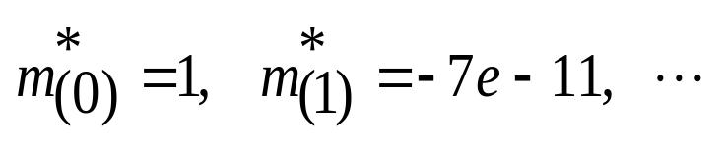
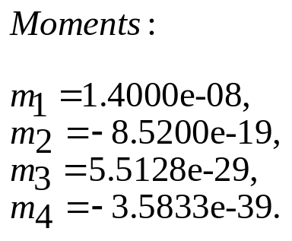
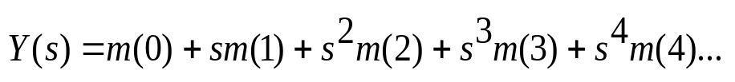
Homework 2-Part I(b) S2P
S2P algorithm
  (1) Reuse the m0* and m1* calculated in part I(a)
  (2) calculate driving point admittance function Y(s) and expand it in terms of poles and residues for first four moments
  Method 1:
  Method 2:
  Get Y(s)
  calculate the Taylor expansion of Y(s)

Slide 8
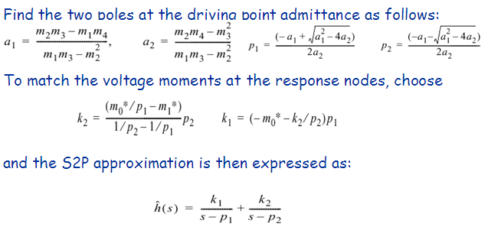
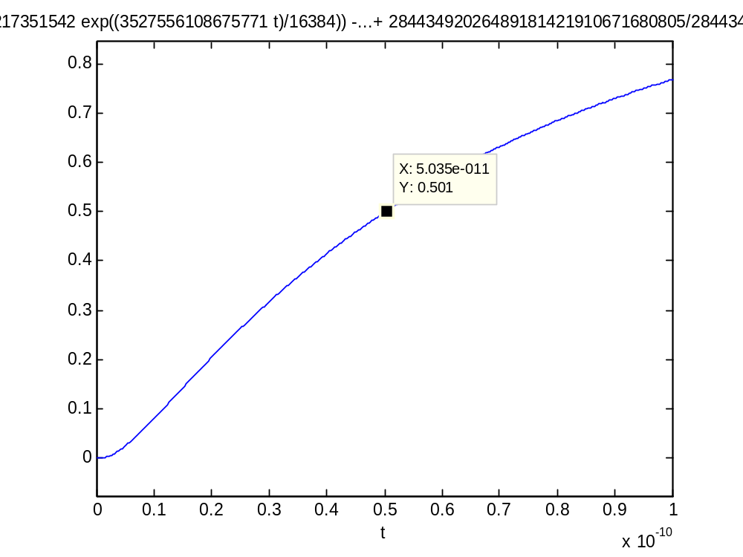
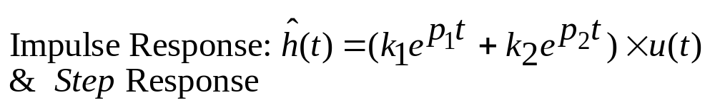
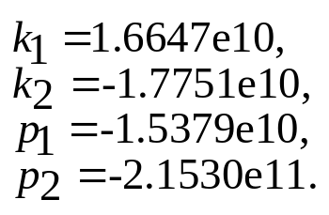

Homework 2-Part I(b) S2P
  Follow the S2P algorithm to get S2P approximation ĥ(s) in frequency domain.

Slide 9
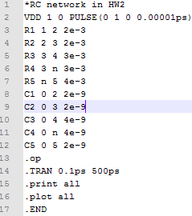
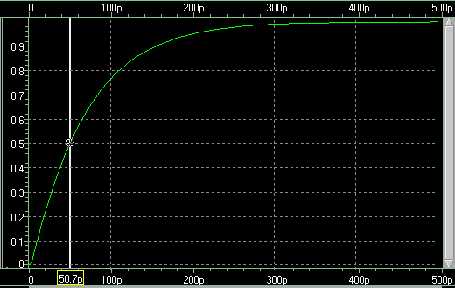
Homework 2-Part I(c) HSPICE
Spice Simulation
Probe the waveform at node n and find the 50% delay = 50.7 ps
(S2P result is 50.35 ps)

Slide 10
Homework 2
Part I: HSPICE and S2P method
  (a) Analyze the moments by DC in HSPICE
  (b) Calculate the delay by S2P
  (c) Calculate the delay by HSPICE
Part II: PRIMA algorithm for model order reduction

Slide 11
Homework 2-Part II
Modify the PRIMA code with single frequency expansion to multiple points expansion. You should use a vector fspan to pass the frequency expansion points. Compare the waveforms of the reduced model between the following two cases:
1. Single point expansion at s=1e4.
2. Four-point expansion at s=1e3, 1e5, 1e7, 1e9.
Elfadel, I.M.; Ling, D.D.; , "A block rational Arnoldi algorithm for multipoint passive model-order reduction of multiport RLC networks," Computer-Aided Design, 1997. Digest of Technical Papers., 1997 IEEE/ACM International Conference on , vol., no., pp.66-71, 9-13 Nov 1997
Odabasioglu, A.; Celik, M.; Pileggi, L.T.; , "PRIMA: passive reduced-order interconnect macromodeling algorithm ," Computer-Aided Design, 1997. Digest of Technical Papers., 1997 IEEE/ACM International Conference on , vol., no., pp.58-65, 9-13 Nov 1997

Slide 12
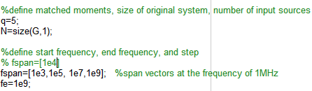

(1) Demo file
Assume m frequency points and match n moments at each freq. point.
f₀
f₁
…………
f_{m}
m₀ m₁ … m_{n}
m₀ m₁ … m_{n}
…………
m₀ m₁ … m_{n}
Single Point Case

Slide 13
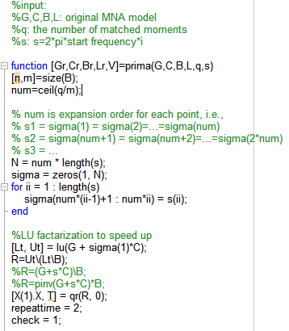
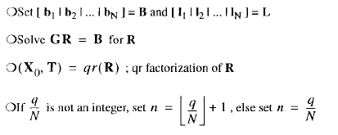
(2) Prima File
For single pole, N=num
f₁ ➔ s(1)
f₂➔ s(2)
…………
f_{m}➔ s(m)
m₀ m₁ … m_{n}
m₀ m₁ … m_{n}
…………
m₀ m₁ … m_{n}
σ₁=s(1)
…
σ_{num}=s(1)
σ_{num+1}=s(2)
…
σ_{2*num}=s(2)
σ_{(m-1)*num+1}=s(m)
…
σ_{m*num}=s(m)

Slide 14
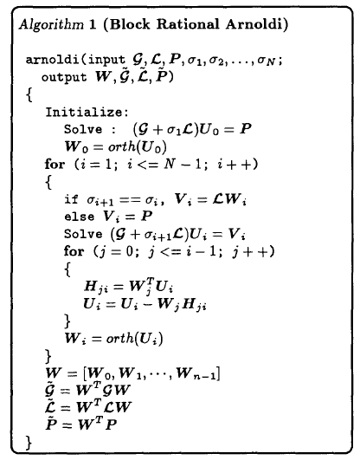
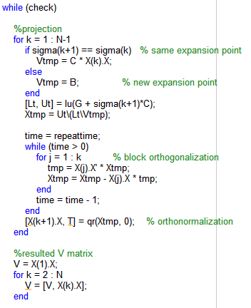
(2) Prima File (cont.)
Generate Vectors in Uq
The rest code do not need to be modified in PRIMA.m file.

Slide 15
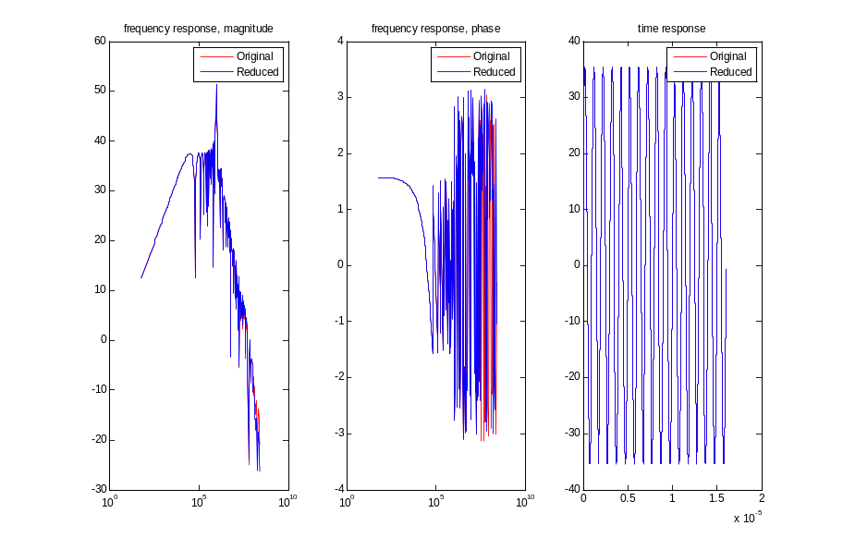
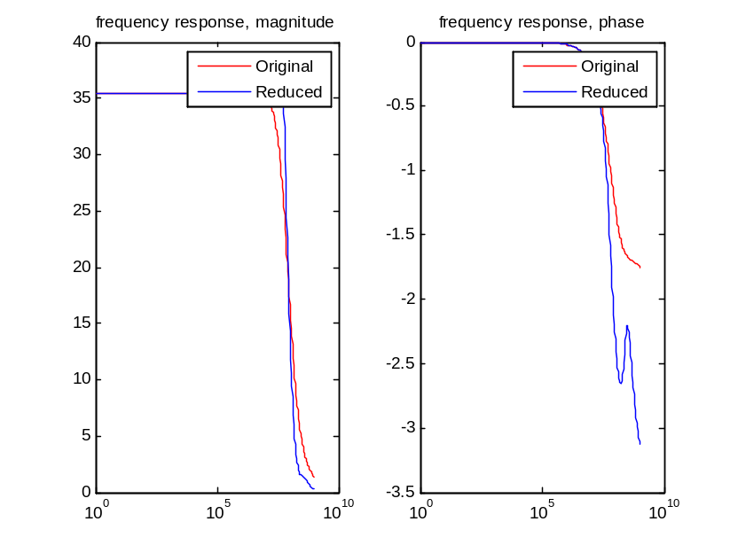
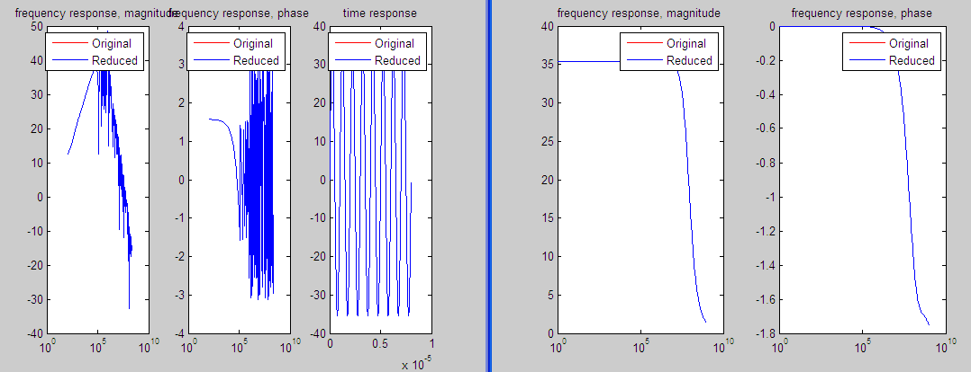
Example: GC9 (G is 11x11) input file
Single Point Expansion: Gr is 6x6
Four Points Expansion: Gr is 10x10
Impulse response for single point expansion

Slide 16
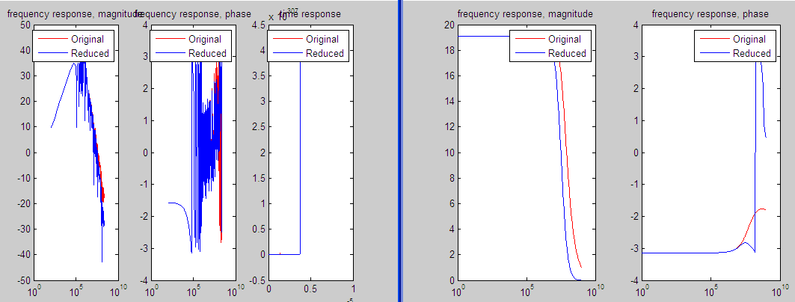
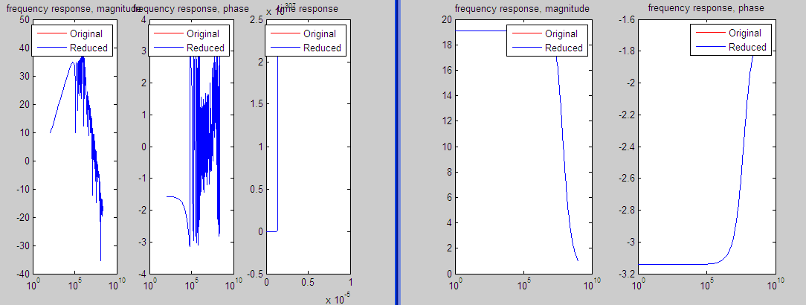
Example GC8 (G is 449x449) example
Single Point Expansion: Gr is 6x6
Four Points Expansion: Gr is 24x24

Slide 17
Thanks

