Slide 1
CS 6650 - A4
Peihsuan Lin
Tzu-Yu Huang

Slide 2
01
System Architecture

Slide 3
Overview
Kafka
POST review
Client
SwaggerAPI
Server
POST album
GET review
DynamoDB
MultiThread Client
Single Client (POST)
Review Client (GET)
Album Servlet
Review Servlet
Notes:
So this is the overview of the architecture of our whole project. The basic flow is we start threads in the client and make requests through SwaggerAPI.
For the main components of the server part we have an Album servlet that handles all requests related to albums and a Review Servlet that handles all requests related to likes/dislikes.
We also made a switch from RabbitMQ to Kafka, so the POST album and Get review requests interacts directly with the database, while the POST review requests doesn't and lets Kafka handle that
Next we're gonna talk about some changes we did this time focusing on assignment 4

Slide 4
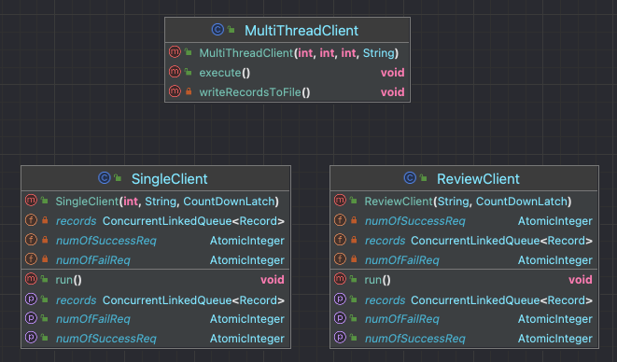
Client - Main Components
MultiThread Client: Creates all the threads for making requests
Single Client: A single thread that handles all the POST album/review requests
Review Client: A single thread that handles making GET review requests
Notes:
For the main components of the Client, we added a new class Review Client, which handles a single thread making GET review requests. And we also have our old friends which is the Multithread Client where we create all the threads for making requests, and the Single Client class, that handles all the POST requests including posting a new album and likes/dislikes.

Slide 5
Client - Three new GET threads
MultiThread Client
Single Client
Review Client
Start 3 GET review threads after the first thread group had finished
Start a CountDownLatch to keep track of running POST threads
Call .countDown() when requests are finished
Keep sending GET review requests until all POST requests are finished (CountDownLatch is down to zero)
Notes:
So to handle the three new GET threads that we want to be continuously running, we start first them in the MultiThread Client class right after the first thread group has finished. We also start a countDownLatch here to keep track of the POST threads that are currently running.
In the single client class where we do all the POST requests, we just simply call .countDown() when requests are finished.
This way, we can just keep the review client running and sending GET review requests until the CountDownLatch is down to zero, which means all of the POST threads has already ended, that's when we should also end the three GET threads.

Slide 6
Client - Random albumId
MultiThread Client
Single Client
Review Client
Keeps a BlockingQueue with all the existing albumIds
POST a new album, then add the new albumId to the BlockingQueue
Get albumIds from the BlockingQueue
albumId should always be valid
Notes:
The next part is to choose the albumId for the GET requests. To ensure we get a random albumId that is valid for each request, we basically keep track of all the albumIds available to use, and we chose to use a BlockingQueue in the MultiThread Client class to do that. So when we POST a new album, we add the new albumId to the blockingQueue. And when we want to make a GET review request, we just get the albumId from the queue, so it is guaranteed to always exist and be a different id.

Slide 7
Refactor to Kafka
kafka cluster
broker1
likes-topic
dislikes-topic
producer
consumer
broker2
likes-topic
dislikes-topic
…..
Notes:
We switched our message queue for album reviews from rabbitmq to Kafka to enhance the performance.
Ideally there should be multiple brokers to prevent one from crashing, for this assignment, I create a single broker, where each consists of two topics, one for storing like reviews, the other is for dislike reviews.
The review server will post likes or not to message queue, and then concurrently process messages from Kafka to our DynamoDB.

Slide 8
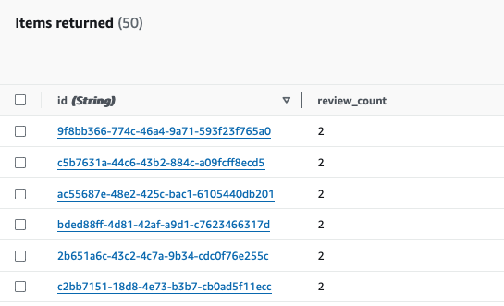
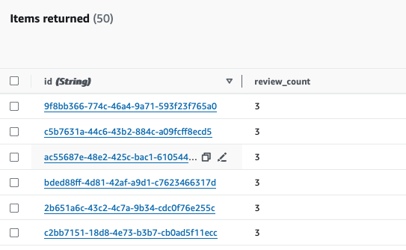
DataBase Overview
likeTable
DislikeTable
Notes:
Key is the albumId, a random generated UUID, and the second column counts the review time.

Slide 9
02
Results

Slide 10
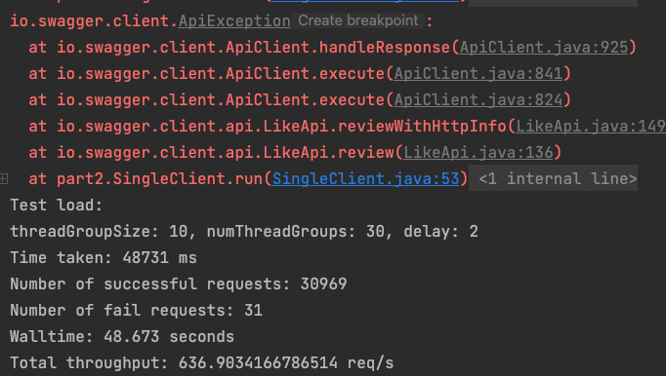
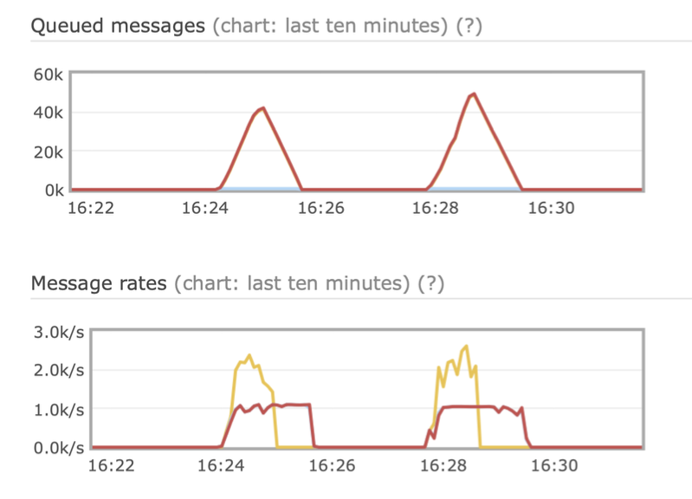
Metrics with RabbitMQ

Slide 11
Kafka experiments
broker | partition | Consumer threads | throughput
1 | 1 | 3 | 845 req/s
1 | 3 | 3 | 1043 req/s
1 | 3 | 6 | 1071 req/s

Slide 12
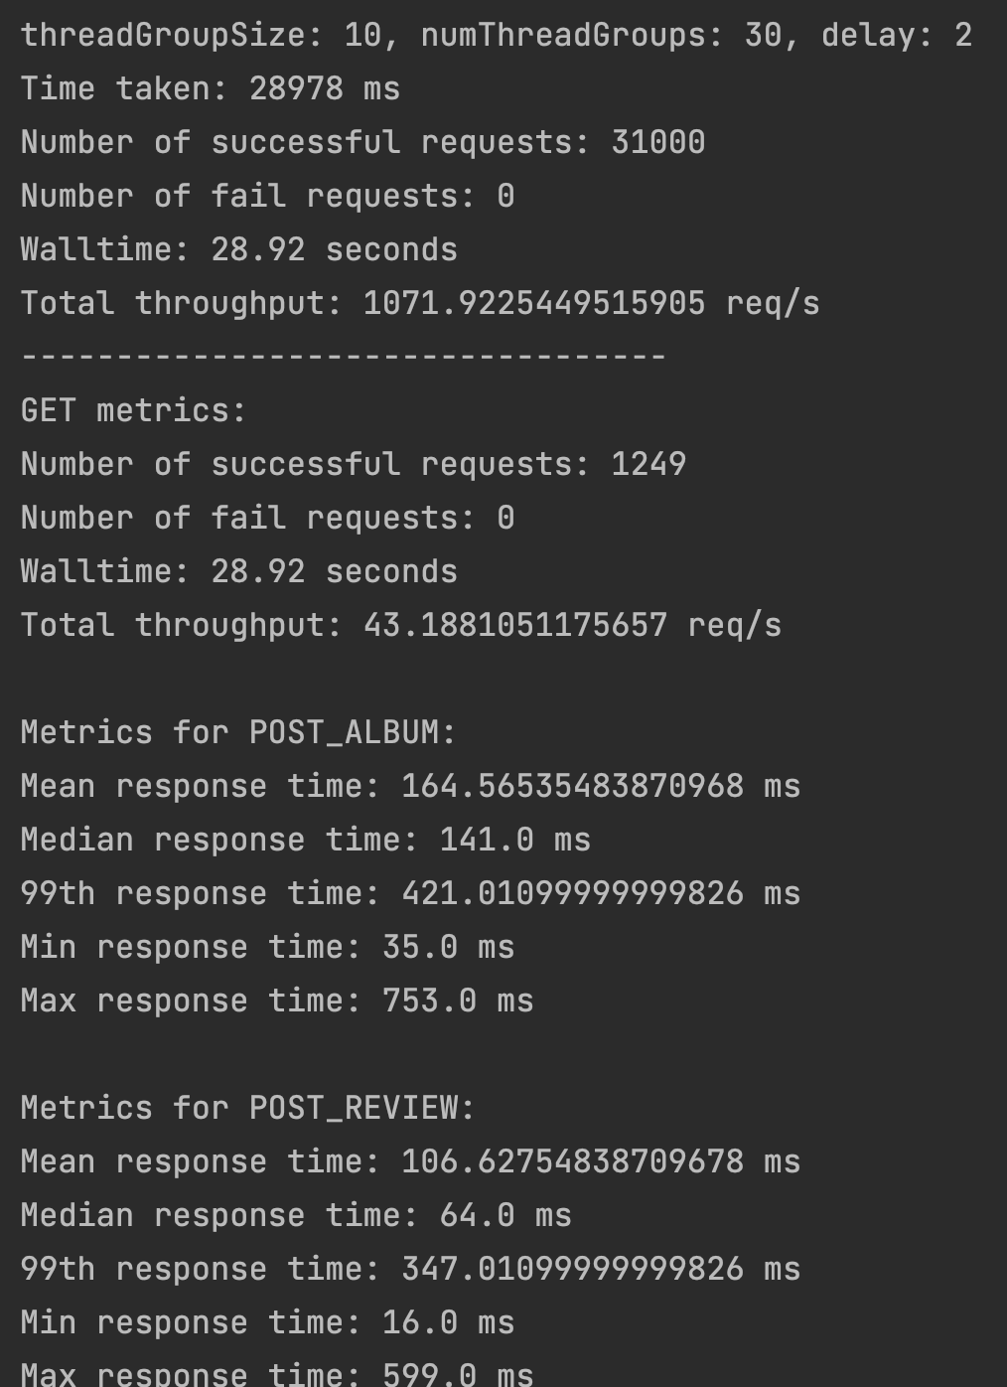
Metrics with Kafka
Overall Throughput: 1071 req/s
GET Throughput: 43 req/s

Slide 13
Thank You!
Any Questions?
(please say no)

