Slide 1
Front End Development

Slide 2
HTML 5
http://www.whatwg.org/specs/web-apps/current-work/multipage/index.html#contents
http://www.w3schools.com/html/html5_intro.asp

Slide 3
HTML5 is a work in progress, but it is getting closer – as of August 2013 – HTML5 is a Candidate Recommendation.
Reasonably stable, but some of the information here may change by the time HTML5 reaches W3C Recommendation (ETA: ~2 years)
We're working with the bleeding edge here. It's the responsibility of every developer to stay current!

Slide 4
What is HTML5?
Proposed by Opera
Started under the Web Hypertext Application Technology Working Group (WHATWG)
Not a W3C Working Group
Presented their work so far to the W3C HTML Working Group
Became known as HTML5

Slide 5
"One vocabulary, two serializations"
HTML is SGML-based
XHTML 1.0 was HTML 4 reimagined as XML
XHTML 2.0 is effectively in limbo
HTML5 is itself an abstract vocabulary, with two forms of syntax
HTML (new, not SGML-based, no DTD)
XML (no DTD, uses an XML namespace)

Slide 6
Using HTML5
Can I use HTML5 today?
Yes – many of us have been for a while now
...Sort of! (or mostly, partly, kinda…)
Not all modern browsers implement all APIs
Markup designed to be backwards-compatible, but “older” browsers need a little help...

Slide 7
IE & HTML5 Markup
...and by “older”, we mean "lte IE8"
Older IE versions don't recognize the new tags by default
Some clever JavaScript gets around that
html5shiv - http://code.google.com/p/html5shiv/
modernizr – http://modernizr.com

Slide 8
Changes from previous versions
Doctype
<!DOCTYPE html>
DOCTYPE associates a XML document with the DTD
DOCTYPE in a document served as text/html determines the layout mode. (quirks mode / standards mode)
When <meta content = "text/html">, the shortest doctype that is sufficient is <!DOCTYPE html>
This doctype will even work in older browsers (IE 6) which do not support HTML 5. (it just triggers standards mode)

Slide 9
Changes

Slide 10
New HTML 5 elements http://www.whatwg.org/specs/web-apps/current-work/multipage/index.html#contents
Use specific tags instead of a <div> wherever relevant
Eg: <header>, <footer>, <nav> etc.
This header, footer etc. are not limited to be used only as the page header / footer. For instance these can used as the header or footer for a blog post etc.
Don’t use <div> if there is a better tag for the job
Tags are intended to represent something – ie have semantic meaning

Slide 11
<article> & <section>
The article element represents a complete, or self-contained, composition in a document, page, application, or site and that is, in principle, independently distributable or reusable, e.g. in syndication. This could be a forum post, a magazine or newspaper article, a blog entry, a user-submitted comment, an interactive widget or gadget, or any other independent item of content.
From <http://www.whatwg.org/specs/web-apps/current-work/multipage/sections.html>
The section element represents a generic section of a document or application. A section, in this context, is a thematic grouping of content, typically with a heading.
From <http://www.whatwg.org/specs/web-apps/current-work/multipage/sections.html>
Use <article> instead of a <section> when the content might be syndicated (reproduced in the web)

Slide 12
<aside>
To replace the sidebar.
The aside element represents a section of a page that consists of content that is tangentially related to the content around the aside element, and which could be considered separate from that content. Such sections are often represented as sidebars in printed typography.
From <http://www.whatwg.org/specs/web-apps/current-work/multipage/sections.html>

Slide 13
<details>
click to toggle content through just html without javascript.
Eg:
<details>
<summary> This is visible </summary>
<p>This is hidden and shown when clicking on summary</p>
</details>

Slide 14
<aside> HTML 5 enabling script (html5shiv) </aside>
To be able to style unknown elements in older IE browsers (<IE8), use HTML5 enabling script
http://remysharp.com/2009/01/07/html5-enabling-script/
Not required in browsers other than IE because Firefox and WebKit both render new/unknown element and allow you style them out of the box

Slide 15
HTML 5 Forms
(in the primitive stages, available only in a few browsers as of now)
<input type='email'> : built in email validation
<input type='url'> : URL validation
<input type='tel' pattern=""> : telephone number validation, pattern attribute has the regular expression
<input type='color'> : color picker, only works in Opera as of now
<input type='search' results> : search box
<input type='number'> : number ticker is displayed
<input type='range' min='' max=''> : range inputs, sliders, min attribute has the minimum value of the range and the maximum value has the max value.

Slide 16
HTML 5 attributes examples
<input type='text' placeholder='Enter your name' > : placeholder for textboxes
<input type='text' placeholder='Enter your name' required> : required inputs
<input type='text' pattern='\d{1,3}' required>: for regular expressions
<input type='text' name='something'>
<input type='submit' formnovalidate> : removes validation in the form

Slide 17
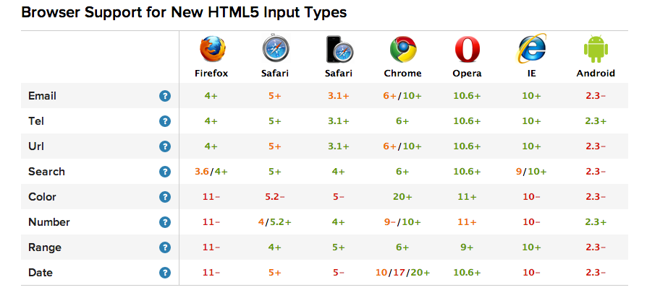
HTML 5 attributes examples
For more examples and the current state of html5 forms,
http://www.wufoo.com/html5/

Slide 18
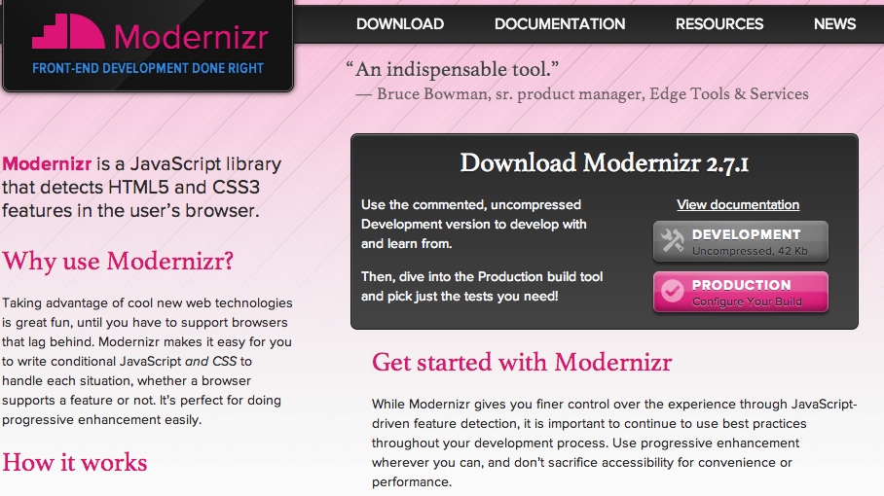
HTML 5 - Feature Detection
Modernizr: Javascript library that detects support for HTML5 and CSS3 features
http://modernizr.com/

Slide 19
HTML 5 - History API
The HTML5 history API is a standardized way to manipulate the browser history via script.
From <http://diveintohtml5.info/history.html>
Notes:
Part of this API — navigating the history — has been available in previous versions of HTML. The new parts in HTML5 include a way to add entries to the browser history, to visibly change the URL in the browser location bar (without triggering a page refresh), and an event that fires when those entries are removed from the stack by the user pressing the browser’s back button. This means that theURL in the browser location bar can continue to do its job as a unique identifier for the current resource, even in script-heavy applications that don’t ever perform a full page refresh.

Slide 20
HTML 5 - Local Storage
Save the 'state'
Eg: writing a long comment in a blog post and comment is saved every 5 seconds, so comment is restored even when reload the page
Difference between cookies and local storage
Assign key-value pairs
Cookies are pushed to server every single request
Cookies have limits > 4 kb
Cookies expire
Specific for the browser
Browser Support: IE8 and above
Eg:
<script>
localStorage.setItem('name', 'my name');
localStorage.getItem('name');
localStorage.removeItem('name');
localStorage.clear();
</script>
Save objects in local storage by using JSON.stringify, read the object by using JSON.parse

Slide 21
HTML 5 APIs

Slide 22
DOM Enhancements
document.getElementsByClassName()
element.getElementsByClassName() // Scoped version
Supported in all modern browsers

Slide 23
Video
Previously, no standard way of showing video on the Web
Various plugins (like Flash) used instead
HTML5 fixes this problem with the <video> element
Allows for fallbacks for browsers that don't support the tag
Supported in all modern browsers

Slide 24
Video
<video width="w" height="h" controls>
<source src="movie.ogg" type="video/ogg" />
<source src="movie.mp4" type="video/mp4" />
<!-- A fallback Flash plugin could be used here, or a notice that the Video tag is unsupported -->
</video>
"Controls" attr indicates we should show them
Nested source elements are checked for browser support

Slide 25
Video
In the DOM, <video> has a number of methods, attributes, and listeners
Methods: v.play(), v.pause(), v.load()
Properties: v.currentSrc, v.currentTime, v.duration
Events: onplay, onpause, progress, error

Slide 26
Audio
Same problem as video exists with audio
Very similar solution: the <audio> tag
Supported in all modern browsers

Slide 27
Audio
<audio controls="controls">
<source src="song.mp3" type="audio/mpeg" />
<source src="song.ogg" type="audio/ogg" />
<!-- Plugin-based fallback or notification -->
</audio>

Slide 28
Geolocation http://www.w3schools.com/html/html5_geolocation.asp
Support for getting the user's current position
User must opt-in, first
Can make best-guess via IP address, but will use GPS data on mobile devices if available.
Supported in all modern browsers

Slide 29
Geolocation
Feature detection on navigator.geolocation
navigator object represents the current browser
Attempt to get the user's position

Slide 30
Geolocation
navigator.geolocation.getCurrentPosition(successCallback[, failureCallback])
Position object is passed to the success callback
Error object is passed to the failure callback
navigator.geolocation.watchPosition(successCallback[, failureCallback])
will call the success callback whenever new information arrives, or until .clearWatch() is called.

Slide 31
Geolocation
Getting lat/long:
positionObj.coords.latitude
positionObj.coords.longitude
Getting error info
errorObj.code can be compared to four constants...
errorObj.PERMISSION_DENIED
errorObj.POSITION_UNAVAILABLE
errorObj.TIMEOUT
errorObj.UNKNOWN_ERROR

Slide 32
Canvas API http://www.w3schools.com/html/html5_canvas.asp
Used to draw graphics dynamically within a <canvas> tag, using JavaScript
Content inside the <canvas> tag will be rendered for those browsers that don't support it
Unsupported in Opera

Slide 33
Canvas API Uses
Real-time animations
Any situation that requires pixel-by-pixel manipulation

Slide 34
Canvas API
Create the <canvas> in markup
Find the appropriate canvas element in the DOM (hint: give it an id)
Get the context object of the canvas: canvasElement.getContext("2d")
Start drawing!

Slide 35
Canvas API: Drawing Examples
context.fillStyle – Get/set the current color or style object to draw with
.createLinearGradient(), .createPattern and similar can be used instead of colors
context.strokeStyle – As above, with strokes
context.fillRect(x, y, w, h) – Draw a filled rectangle using the current fillStyle

Slide 36
Canvas API: Path Examples
context.beginPath() - Starts a new path, clearing the old
context.moveTo(x, y) - Move to a given point without drawing
context.lineTo(x, y) – Draw a line to a given point
context.arc(x, y, radius, startAngle, endAngle, isClockwise) – Draw a circle/arc

Slide 37
Canvas API: Path Examples
context.fill() - Fills the current path with fillStyle
context.stroke() - Draws the stroke of the current path with strokeStyle
Reference:
http://www.w3schools.com/html5/html5_ref_canvas.asp

Slide 38
Other APIs
Server-side Events – Tell the browser to listen to the server for incoming messages, and respond via listeners
Drag & Drop – Standards-based API for dragging and dropping elements
App Cache – Control which content is cached via a cache manifest file
Web Workers – Mutlithreaded JavaScript
Web Storage – Access to a local, persistent, domain-specific data store

Slide 39
CSS 3
http://www.w3schools.com/css/css3_intro.asp

Slide 40


CSS 3 properties
Border-radius
Apply rounded corners to a box
Eg:
Width: 200px;
border-radius: 20px;
Increase the radius(more than half of the width) to make it into a circle
Eg:
Width: 200px;
Border-radius: 100px;

Slide 41
Box-Shadow
To apply a shadow
Syntax:
box-shadow: X-offset y-offset blur spread color;
Eg: box-shadow: 1px 1px 5px 1px black;

Slide 42
Prefixr
For Browser compatibility
http://prefixr.com/
Creates all the vendor prefixes for styles without prefixes
Has APIs for different editors
http://prefixr.com/api/usage/ - Use prefixr in your favorite code editor

Slide 43
CSS 3 Gradients
Apply gradients to your background
Syntax
background: linear-gradient(direction, color, color);
Eg:
background: linear-gradient(top, black, white);
*Use prefixr to get the prefixised version
.box {
background: -webkit-linear-gradient(top, black, white);
background: -moz-linear-gradient(top, black, white);
background: -o-linear-gradient(top, black, white);
background: -ms-linear-gradient(top, black, white);
background: linear-gradient(top, black, white);
}
*not supported by IE

Slide 44
CSS 3 – Media Queries
To display content differently for different resolutions
Expressions can be added to media type to check for certain conditions and apply different stylesheets
Eg:
@media screen and (min-width: 600px) and (max-width: 900px) {
.class {
background: #333;
}
}
Notes:
http://www.w3.org/TR/css3-mediaqueries/
http://webdesignerwall.com/tutorials/css3-media-queries

Slide 45
CSS 3 Transitions
Effects which allow property changes in CSS values to occur smoothly over a specified duration
http://nettuts.s3.amazonaws.com/581_cssTransitions/demos.html
http://net.tutsplus.com/tutorials/html-css-techniques/css-fundametals-css-3-transitions/

Slide 46
Object Oriented JavaScript

Slide 47
Primitives and Objects
Almost everything in JS are objects except primitives
Primitives
String
Number
Boolean
Undefined
Null
Reference types (objects)
Object
Array
Function
Date
RegExp
Objects have Properties
Eg: “hello”.length

Slide 48
Creating Objects
var person = new Object();
person.name = “John Doe”;
person.score = 150;
person.sayHi = function() {
return “Hi”;
};
Notes:
Older way of creating objects
Functions are also properties of objects
Person object has three members

Slide 49
Creating Objects contd.,
var person = {
name: “John Doe”,
score: 150,
sayHi: function() {
return “Hi”;
}
};
Notes:
More popular way of creating objects
Advantages over the previous way of creating objects:
Javascript can execute a single complex statement faster than multiple simple statement
Better organization. Everything involving an object is in one chunk of code.
much less to type

Slide 50
The ‘this’ keyword
When used inside a function, ‘this’ refers to the object in which the function operates
The ‘this’ keyword refers to the head (window) object in nested functions
The ‘this’ keyword inside a prototype method refers to a constructor instance
Notes:
http://net.tutsplus.com/tutorials/javascript-ajax/fully-understanding-the-this-keyword/
file:///Users/rplotka/Dropbox/Documents/Documents/AAA%20-%20Work/AAA%20-%20RPI/Teaching/2014%2001-Spring/ITWS4200-Web_Science(WSII)/Lectures/ITWS4200-WebScience-W2C1-Pres02-FrontEnd-Ex1.html
<!DOCTYPE html><html lang="en"><body><script>
var foo = 'foo';
var myObject = {foo: 'I am myObject.foo'};
var sayFoo = function() {
console.log(this['foo']);
};
￼￼// give myObject a sayFoo property and have it point to sayFoo function
myObject.sayFoo = sayFoo;
myObject.sayFoo(); // logs 'I am myObject.foo' 12
sayFoo(); // logs 'foo'
</script></body></html>

Slide 51
Constructor functions
In JS, all functions are also objects
We can create a new object by calling the constructor function using the new keyword
person = function(a,b,c) { var name = a; // x is a private property of example person.score = b; // defines a public property this.height = c; // a better way of defining a public property }
var John = new person(‘John’, 25, 172);
var Joe = new person(‘Joe’, 50, 176);
Notes:
In JavaScript, all functions are also objects. Whether the function behaves like a function or behaves like an object constructor depends on how you call it.You can create a new object by calling its constructor function using the new keyword.
When you call a function using 'new', it behaves exactly the same way as if you were to call one of the built in objects the same way or were to use the shortcut {} notation to define your new object. The difference is that within a constructor function you don't just define the properties and methods to be associated with the object, you can also run code that sets the values of those properties and methods based on parameters passed to the constructor function. Constructor functions also allow you to define private properties and methods as well as public ones unlike the alternative notations where all of the properties and methods you define are public. Anything defined as private will only be available to be referenced from within methods belonging to the object itself.

Slide 52
The constructor method
There is a constructor function that exists for all objects regardless of how they were created
var today, tomorrow; tomorrow = new Date(); tomorrow.setDate(tomorrow.getDate()+1); today = new tomorrow.constructor();
Notes:
In this example we demonstrate how the constructor method to create a new object of the same type as an existing object without needing to know in advance how that other object was created. Here we have 'today' being created as a new Date object without specifically defining it as being a Date but instead defining it as being of the same type as 'tomorrow' which we previously defined as being a Date. Now in this particular code simply specifying new Date() would be simpler and so you wouldn't use the constructor method in code that is this simple. Where you would use it is where you have code intended to process a number of different types of object where you want to create a new object of the same type as the one you are currently processing.

Slide 53
instanceOf
The instanceOf operator provides us with a way to test which constructor function was used to create a given object.
var a, b, c, d; a = {}; b = new Date(); c = new a(); d = new a.constructor(); if (a instanceOf Date) alert('false'); if (a instanceOf Object) alert('true'); if (b instanceOf Date) alert('true'); if (c instanceOf Object) alert('false'); if (d instanceOf Object) alert('true');
Notes:
Four different objects are created in different ways
Use a few if statements that use the instanceOf operator to test whether specific constructor functions were used to create those objects.
The output is three alerts all of which contain the text 'true'.
The first instanceOf will not run because 'a' was created using the Object constructor function and not the Date constructor function.
The other false result is because 'c' was created using the 'a' constructor function and even though 'a' itself is an instanceOf an Object, 'c' is an instance of 'a'.

Slide 54
Data and Accessor properties
A data property is a property that can get and set a value. Data properties contain the value and writable properties in their descriptors.
An accessor property calls a user-provided function every time that the property value is set or retrieved. The descriptor for an accessor property contains a get attribute, a set attribute, or both.
Notes:
http://www.gotojavascript.com/2012/04/object-properties-and-methods.html

Slide 55
Getters and Setters
Properties and methods of an object are available throughout the life of an object
Instead of directly accessing properties, you get better control of property by making them private using getter and setter methods
var person1; person = function() { var name; this.getName = function() { return name; } this.setName = function(x) { name = x; } } person1 = new person() person1.setName(‘John Doe'); alert(person1.getName());
Notes:
private string myField; //"private" means access to this is restricted
public string getMyField()
{
//include validation, logic, logging or whatever you like here
return this.myField;
}
public void setMyField(string value)
{
//include more logic
this.myField = value;
}
Pros & Cons
Better control for your app.

Slide 56
Prototype / inheritance
To create an object that will be used as a template for creating new objects
If we want an object2 to inherit from another object1, we attach object1 to object2’s prototype
Notes:
In this example we will create a new object called XDate which will inherit from the built in Date object and add some extra methods - to add days, and to calculate the difference between two dates in days and business days. By doing this instead of directly augmenting the Date object we allow the Date object to retain its original functionality and allow for if a browser later implements one of the methods we are adding but in a different way to how we have done it. With the following code in place we can just change any "new Date" references to "new XDate" in order to make available these extra methods without having changed the way Date works.
var XDate = {};XDate.prototype = Date;XDate.prototype.constructor = XDate; XDate.prototype.addDays = function(days) { this.setDate(this.getDate()+days);
} XDate.prototype.dayDiff = function(d2) { return Math.floor(Math.abs(this-d2)/(24*60*60*1000));
} XDate.prototype.busDayDiff = function(d2) { var d, t, w1, w2; d = this.dayDiff(d2); t= d%7; if (this < d2) {
w1= this.getDay(); w2= d2.getDay();
} else {
w2= this.getDay(); w1= d2.getDay();
} if (w1 > w2) t-=2;
if ((w1 == 0 && w2 == 6) || w1 == 6) t--; return Math.abs((Math.floor(d/7)*5)+t);
}

Slide 57
Prototype Chaining
Each object has an internal link to another object called its prototype.
That prototype object has a prototype of its own, and so on until an object is reached with null as its prototype.
null, by definition, has no prototype, and acts as the final link in this prototype chain.
Notes:
https://developer.mozilla.org/en-US/docs/JavaScript/Guide/Inheritance_and_the_prototype_chain?redirect=no#Inheritance_with_the_prototype_chain

