Slide 1
API

Slide 2
Application Programming Interfaces (APIs)
Programming hooks, specifications, or guidelines published by firms that tell other programs how to get a service to perform a task such as send or receive data
Empowering developers to build against your platform doesn’t just create value for partners; the API provider wins as well by expanding the ecosystem, increasing retention, and driving up the value of the platform.
Notes:
What are they?
What do they do?

Slide 3
ReST
Representational State Transfer (ReST)
Architectural style for distributed hypermedia systems
Resource Based
Representations
Six Constraints
Uniform Interface
Stateless – “each request from client to server must contain all of the information necessary to understand the request, and cannot take advantage of any stored context on the server”
Cacheable
Client-Server
Layered System
Code on Demand (optional)
Notes:
Roy Fielding, doctoral dissertation - http://www.ics.uci.edu/~fielding/pubs/dissertation/rest_arch_style.htm

Slide 4
Resource Based
Things vs Actions
Nouns are good
Resources are identified by URIs
A same resource can have multiple URIs
Conceptual mapping of resource (ie)
Most recent manual version
Manual for version number 1.2.3
Notes:
http://www.ics.uci.edu/~fielding/pubs/dissertation/rest_arch_style.htm - Section 5.2.1.1

Slide 5
Representations
A document that captures the current or intended state of a resource.
A representation is a sequence of bytes, plus representation metadata to describe those bytes.
Part of the resource state
Transferred between client and Server
Typically JSON or XML
Notes:
http://www.ics.uci.edu/~fielding/pubs/dissertation/rest_arch_style.htm - Section 5.2.1.2
Example:
Resource : Person (John Doe)
Service: Contact Information (GET)
Representation:
name, address, phone number
JSON or XML format

Slide 6
Constraint 1: Uniform Interface
Uniform Interface between Client and Servers, simplifies and decouples the architecture
Resource-Based
Manipulation of Resources through representations
Self-descriptive messages
Notes:
http://www.ics.uci.edu/~fielding/pubs/dissertation/rest_arch_style.htm - Section 5.2.1.2
http://en.wikipedia.org/wiki/Representational_State_Transfer
The uniform interface constraint defines the interface between clients and servers. It simplifies and decouples the architecture, which enables each part to evolve independently. The four guiding principles of the uniform interface are:
Resource-Based
Individual resources are identified in requests using URIs as resource identifiers. The resources themselves are conceptually separate from the representations that are returned to the client. For example, the server does not send its database, but rather, some HTML, XML or JSON that represents some database records expressed, for instance, in Finnish and encoded in UTF-8, depending on the details of the request and the server implementation.
Manipulation of Resources Through Representations
When a client holds a representation of a resource, including any metadata attached, it has enough information to modify or delete the resource on the server, provided it has permission to do so.
Self-descriptive Messages
Each message includes enough information to describe how to process the message. For example, which parser to invoke may be specified by an Internet media type (previously known as a MIME type). Responses also explicitly indicate their cache-ability.
Hypermedia as the Engine of Application State (HATEOAS)
Clients deliver state via body contents, query-string parameters, request headers and the requested URI (the resource name). Services deliver state to clients via body content, response codes, and response headers. This is technically referred-to as hypermedia (or hyperlinks within hypertext).
Aside from the description above, HATEOS also means that, where necessary, links are contained in the returned body (or headers) to supply the URI for retrieval of the object itself or related objects. We'll talk about this in more detail later.
The uniform interface that any REST services must provide is fundamental to its design.

Slide 7
Constraint 2: Stateless
No client context is stored on the server between requests.
Each request from any client contains all of the information necessary to service the request, and session state is held in the client.
Session state can be transferred by the server to another service such as a database to maintain a persistent state for a period of time and allow authentication.
Notes:
statelessness is key.
The necessary state to handle the request is contained within the request itself, whether as part of the URI, query-string parameters, body, or headers.
The URI uniquely identifies the resource and the body contains the state (or state change) of that resource. Then after the server does it's processing, the appropriate state, or the piece(s) of state that matter, are communicated back to the client via headers, status and response body.
In REST, the client must include all information for the server to fulfill the request, resending state as necessary if that state must span multiple requests.
Statelessness enables greater scalability since the server does not have to maintain, update or communicate that session state. Additionally, load balancers don't have to worry about session affinity for stateless systems.
So what's the difference between state and a resource? State, or application state, is that which the server cares about to fulfill a request—data necessary for the current session or request. A resource, or resource state, is the data that defines the resource representation—the data stored in the database, for instance. Consider application state to be data that could vary by client, and per request. Resource state, on the other hand, is constant across every client who requests it.
Ever had back-button issues with a web application where it went AWOL at a certain point because it expected you to do things in a certain order? That's because it violated the statelessness principle. There are cases that don't honor the statelessness principle, such as three-legged OAuth, API call rate limiting, etc. However, make every effort to ensure that application state doesn't span multiple requests of your service(s).

Slide 8
Constraint 3: Client - Server
Representations are transferred between client and server
A uniform interface separates clients from servers
Separation of concerns
Eg:
clients are not concerned with data storage, which remains internal to each server, so that the portability of client code is improved.
Servers are not concerned with the user interface or user state, so that servers can be simpler and more scalable.
Notes:
The uniform interface separates clients from servers.
This separation of concerns means that, for example, clients are not concerned with data storage, which remains internal to each server, so that the portability of client code is improved.
Also: Data structure internal to the application may remain private – only data required for action needs to be sent – ie DocuBuilderXML and a content package for a componenet with document location, and styling but no proprietary info as it is not necessary for the transaction
Servers are not concerned with the user interface or user state, so that servers can be simpler and more scalable.
Servers and clients may also be replaced and developed independently, as long as the interface is not altered.

Slide 9
Constraint 4: Cacheable
Server responses (representations) are Cacheable
Implicitly
If its not denoted and the client caches something
Explicitly
Server specifies what to cache
Negotiated
Server, clients negotiates the terms of caching
Notes:
As on the World Wide Web, clients can cache responses. Responses must therefore, implicitly or explicitly, define themselves as cacheable, or not, to prevent clients reusing stale or inappropriate data in response to further requests. Well-managed caching partially or completely eliminates some client–server interactions, further improving scalability and performance.

Slide 10
Constraint 5: Layered system
Client can’t assume direct connection to server
Software or Hardware layers between client and Servers
Improves scalability
Notes:
A client cannot ordinarily tell whether it is connected directly to the end server, or to an intermediary along the way. Intermediary servers may improve system scalability by enabling load-balancing and by providing shared caches. Layers may also enforce security policies.

Slide 11
Constraint 6: Code on Demand
Optional constraint
Transfer of logic to client in the form of code
Client executes transferred logic
Example
Java applets
Executable Javascript snippets
Notes:
Servers are able to temporarily extend or customize the functionality of a client by transferring logic to it that it can execute. Examples of this may include compiled components such as Java applets and client-side scripts such as JavaScript.
Complying with these constraints, and thus conforming to the REST architectural style, will enable any kind of distributed hypermedia system to have desirable emergent properties, such as performance, scalability, simplicity, modifiability, visibility, portability and reliability.
NOTE: The only optional constraint of REST architecture is code on demand. If a service violates any other constraint, it cannot strictly be referred to as RESTful.

Slide 12
API Examples

Slide 13
Facebook Graph API
Overview of the Facebook API Explorer
https://developers.facebook.com/blog/post/517/
Getting started guide and Video
https://developers.facebook.com/docs/getting-started/graphapi/
Try a few queries in the Graph API explorer.
Notes:
http://www.youtube.com/watch?v=WteK95AppF4

Slide 14
Twitter API
Use the Twitter console explorer to explore the variety of data that can be pulled from Twitter.
https://dev.twitter.com/rest/public
Explore the API.
https://dev.twitter.com/rest/tools/console
http://net.tutsplus.com/tutorials/other/diving-into-the-twitter-api/
Notes:
https://dev.twitter.com/rest/public

Slide 15
Web API design
Notes:
http://info.apigee.com/Portals/62317/docs/web%20api.pdf

Slide 16
"pragmatic" REST
"pragmatic" definition:
Dealing with things sensibly and realistically in a way that is based on practical rather than theoretical considerations.
"Outside-in" approach
`What are we trying to achieve with an API?
The API's job is to make the developer as successful as possible. The orientation for APIs is to think about design choices from the application developer's point of view.

Slide 17
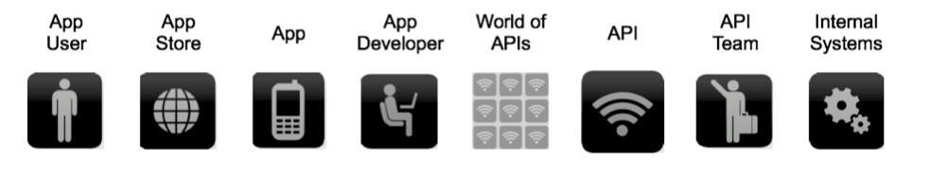
API ~ WiFi
APIs should be like the wifi. Any device can connect to it and use all the functionalities.
What is the design with optimal benefit for the app developer?

Slide 18
Nouns are good
Simple and intuitive base URL
Affordance is a design property that communicates how something should be used without requiring document.
There should be only 2 base URLs per resource.
Example: /dogs /dogs/1234

Slide 19
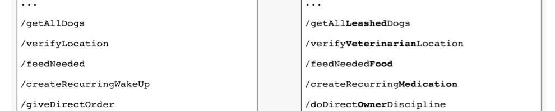
Nouns - good; verbs - bad
Keep verbs out of base URLs
This will lead to:
Long list of URLs
No consistent pattern
Which will make it difficult for developers to learn and use.

Slide 20
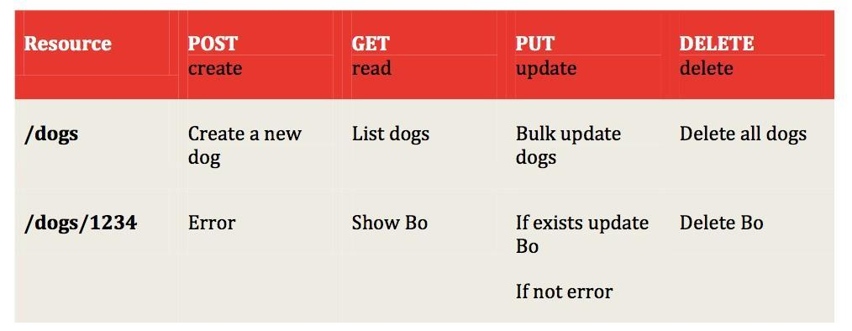
Nouns - good; verbs - bad

Slide 21
Plural & concrete nouns
Use either plural or singular names but be consistent.
Ex: Foursquare: /checkins GroupOn: /deals Zappos: /product
Concrete names are better than abstract
Ex: API that access content in various form - blogs, videos, news articles and so on.
Abstract names: /items or /assets
Concrete names: /blogs, /videos, /news

Slide 22
Simplify associations
Problem
Resources always have association relationships to other resources.
Ex: Get all the dogs who belong to owner 13.
The relationships can be more complex which leads to URLs with multi-level depth.
Ex: /resource/identifier/resource/identifier/resource
In this case: /owner/13/dogs
Solution: sweep complexity behind HTTP "?"
Ex: /dogs?owner=13&color=merle

Slide 23
Error handling
Web API is a black box for developer
error codes become a key tool to provide context and visibility to use APIs
Best practices for designing error codes:
Use HTTP status codes
Make the messages you return in the payload as verbose as possible

Slide 24
Error handling
Use HTTP status code
Try and map the status codes to relevant standards-based codes
The are around 70 HTTP status codes. Use only those which are very common
Ie
http://www.w3.org/Protocols/rfc2616/rfc2616-sec6.html
https://dev.twitter.com/docs/error-codes-responses

Slide 25
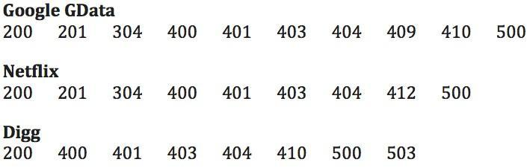
Error handling
How many status codes should we use? The are only 3 real outcomes:
Everything worked - success
The application did something wrong - client error
The API did something wrong - server error

Slide 26
Error handling
Start using with few (say 3) codes and add as per the requirement. But should not be more than 8.
Sample codes:
201 - Created
304 - Not Modified
404 - Not Found
403 - Forbidden
401 - Unauthorised
It is important that the code that is returned is something that can be consumed and acted upon by the developer.
Click here to get the complete list of HTTP error codes.

Slide 27
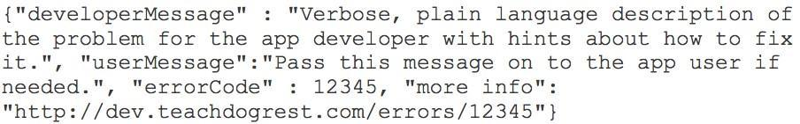
Error handling
Additional information in response message
Use plain language to describe the error
Link to more information page related to the error in the description is highly recommended

Slide 28
Versioning
Never release an API without a version and make the version mandatory.
Facebook: ?v=1.0
How to think about versioning?
Specify the version with a 'v' prefix
'v' tag should have the highest scope: (ex: /v1/dogs)
Avoid dot notation in versions (ex: v1, v2)

Slide 29
Pagination
Support partial response by adding optional fields in a comma delimited list
Linkedin: /people:(id,first-name,last-name,industry)
Facebook: /joe.smith/friends?fields=id,name,picture
Google: ?fields=title,media:group(media:thumbnail)
Use limit and offset to make it easy for developers to paginate objects
Facebook: offset 50 and limit 25
Linkedin: start 50 and count 25
Twitter: page 3 and rpp 25 (records per page)

Slide 30
Non resource responses
Use verbs not nouns for all the APIs that do not return a resource. For example:
Calculate
Translate
Convert
/convert?from=EURO&to=USD&amount=100
Separate out a section of documentation for all the non resource returning requests.

Slide 31
Multiple formats
Support more than one format for returning resources.
Google data: ?alt=json
FourSquare: /venue.json (recommended)
Recommendations:
Use JSON as default format
Follow JavaScript conventions for naming attributes:
Use medial capitalization (aka CamelCase)
Use uppercase or lowercase depending on the object.

Slide 32
Tips for search
Global search
/search?q=foo+bar (Google approach)
Scoped search
/owners/5283/dogs?q=foo+bar
Note: Parameter 'q' indicates a search query.

Slide 33
Subdomain for APIs
Consolidate all API requests in a single subdomain.
api.facebook.com
graph.facebook.com
api.foursquare.com
api.twitter.com s
tream.twitter.com
search.twitter.com

Slide 34
Authentication
Recommendation: Use the latest OAuth
Google & Facebook: OAuth 2.0
Twitter: OAuth 1.0a
PayPal: Permission service API

Slide 35
References
http://www.ics.uci.edu/~fielding/pubs/dissertation/rest_arch_style.htm
http://info.apigee.com/Portals/62317/docs/web%20api.pdf
http://www.w3.org/Protocols/rfc2616/rfc2616-sec10.html
http://net.tutsplus.com/tutorials/other/diving-into-the-twitter-api/
http://www.youtube.com/watch?v=WteK95AppF4
https://developers.google.com/accounts/docs/OAuth2
- also contained within the presentation notes

