Slide 1
数论Number theory
最大公因数，最小公倍数，进制

Slide 2
最小公倍数
一些数字的最小公倍数(Least Common Multiple)指的是最小的整数N使得N能被所有这些数字整除。
在通分时，我们常求所有分母的最小公倍数，这个也被我们称为最小公分母(Least Common Denominator)。

Slide 3
最大公因数
一些数的最大公因数(Greatest Common Divisor)是最大的正整数N使得这些数均能被N整除。

Slide 4
题目
两个数a,b已知它们的最大公因数是39，最小公因数是1287，这两个数的乘积是多少？

Slide 5
重要的结论：LCM*GCD
最大公因数*最小公倍数是多少？

Slide 6
进制
进制(Base)指的是针对一个数字，他的每一位代表多少。我们通常使用十进制(Decimal)，意思是每到10就进一位。所以我们个位代表的是1，然后十位是10¹=10，百位是10²=100，以此类推。
那么比如众多电脑用的是二进制(Binary)，那么就是每到2就进一位，所以自然只会有0，1这两个数字出现。例如各位还是1，十位代表2，百位代表4，千位是8。

Slide 7
题目
在b进制下，22乘以33等于1056，请问b是多少？

Slide 8
数组中的特殊值
针对一组数字，将其从小到大排序好后，有以下四个值：
中位数(Median)：指的是排序后处于数组中间的那个数。若没有正当中的数字则取中间的两个数的平均值
众数(Mode)：出现次数最多的数字，可以是多个。
极差/全距(Range)：最大的数字减最小的数字。
平均值(Mean)：所有数字加起来后除以数字的数量。

Slide 9
题目
AMC 8, 2023, Problem 20
Two integers are inserted into the list 3,3,8,11,28 to double its range. The mode and median remain unchanged. What is the maximum possible sum of two additional numbers?

Slide 10
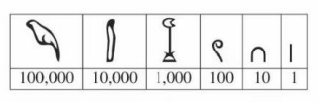

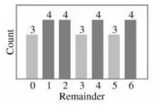
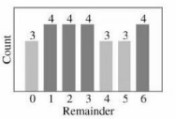
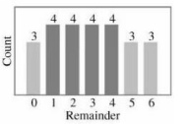
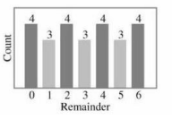
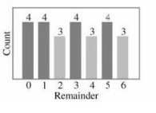
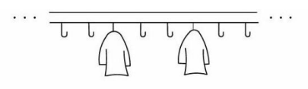
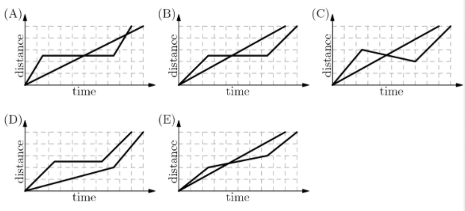
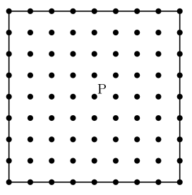
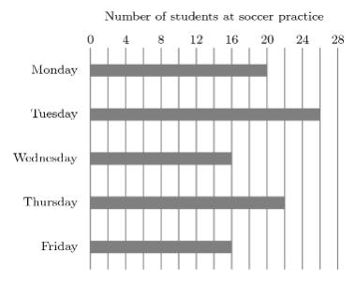
综合题目（数论）
AMC 8, 2019, Problem 23
After Euclid High School's last basketball game, it was determined that 1/4 of the team's points were scored by Alexa and 2/7 were scored by Brittany. Chelsea scored 15 points. None of the other 7 team members scored more than 2 points What was the total number of points scored by the other 7 team members?

Slide 11
续
AMC 8, 2018, Problem 25
How many perfect cubes lie between 2⁸+1 and 2¹⁸+1, inclusive?

Slide 12
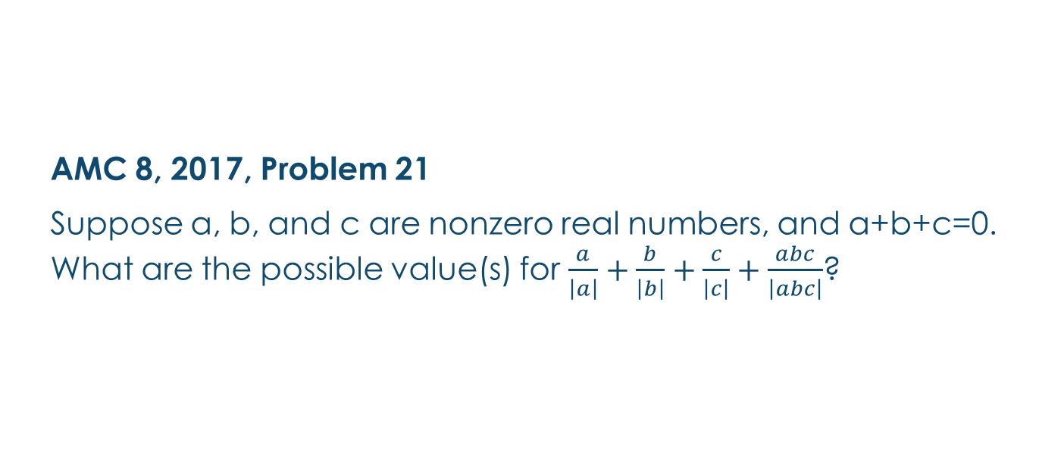
续
AMC 8, 2017, Problem 21
Suppose a, b, and c are nonzero real numbers, and a+b+c=0. What are the possible value(s) for $\frac{a}{\left|a\right|}+\frac{b}{\left|b\right|}+\frac{c}{\left|c\right|}+\frac{abc}{\left|abc\right|}$?

Slide 13
续（逻辑题）
4. AMC 8, 2019, Problem 19
In a tournament there are six teams that play each other twice. A team earns 3 points for a win, 1 point for a draw, and 0 points for a loss. After all the games have been played it turns out that the top three teams earned the same number of total points. What is the greatest possible number of total points for each of the top three teams?

Slide 14
课后作业
1. AMC 8, 2016, Problem 20
The least common multiple of a and b is 12, and the least common multiple of b and c is 15. What is the least possible value of the least common multiple of a and c?
2. AMC 8, 2016, Problem 24
The digits 1, 2, 3, 4, and 5 are each used once to write a five-digit number PQRST. The three-digit number PQR is divisible by 4, the three-digit number QRS is divisible by 5, and the three-digit number RST is divisible by 3. What is P?
3. AMC 8, 2018, Problem 21
How many positive three-digit integers have a remainder of 2 when divided by 6, a remainder of 5 when divided by 9, and a remainder of 7 when divided by 11?
4. AMC 8, 2017, Problem 24
Mrs. Sanders has three grandchildren, who call her regularly. One calls her every three days, one calls her every four days, and one calls her every five days. All three called her on December 31, 2016. On how many days during the next year did she not receive a phone call from any of her grandchildren?

