Slide 1




Randomness in Computing
LECTURE 7
Last time
Randomized quicksort
Markov’s inequality
Variance
Today
Variance, covariance
Chebyshev’s inequality
Variance of Binomial and Geometric RVs
CS
537
Sofya Raskhodnikova;Randomness in Computing

Slide 2
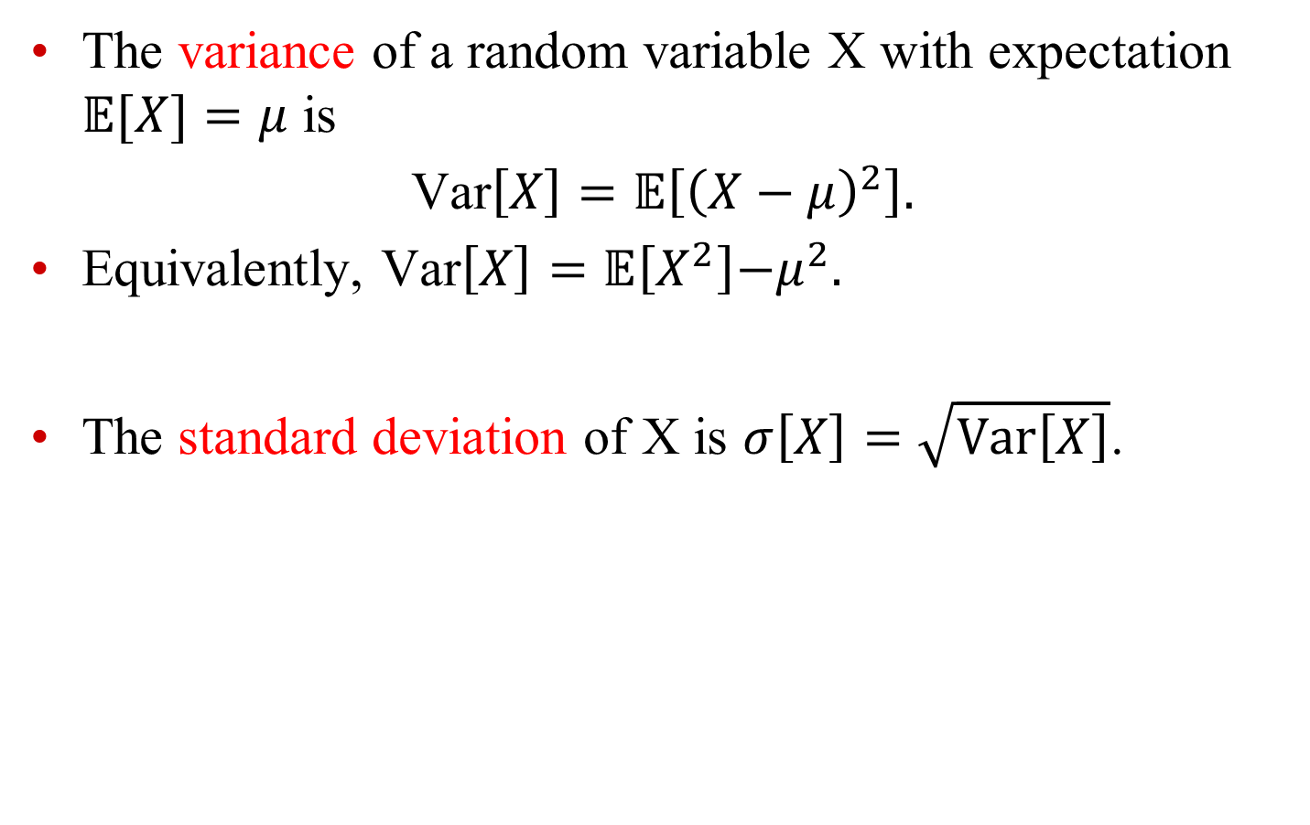
Recall: variance
The variance of a random variable X with expectation $𝔼[X]=μ$ is
Var$\left[X\right]=𝔼\left[{\left(X−μ\right)}^{2}\right].$
Equivalently, Var$\left[X\right]=𝔼\left[X^{2}\right]{−μ}^{2}.$
The standard deviation of X is $σ\left[X\right]=\sqrt{Var\left[X\right]}$.

Slide 3
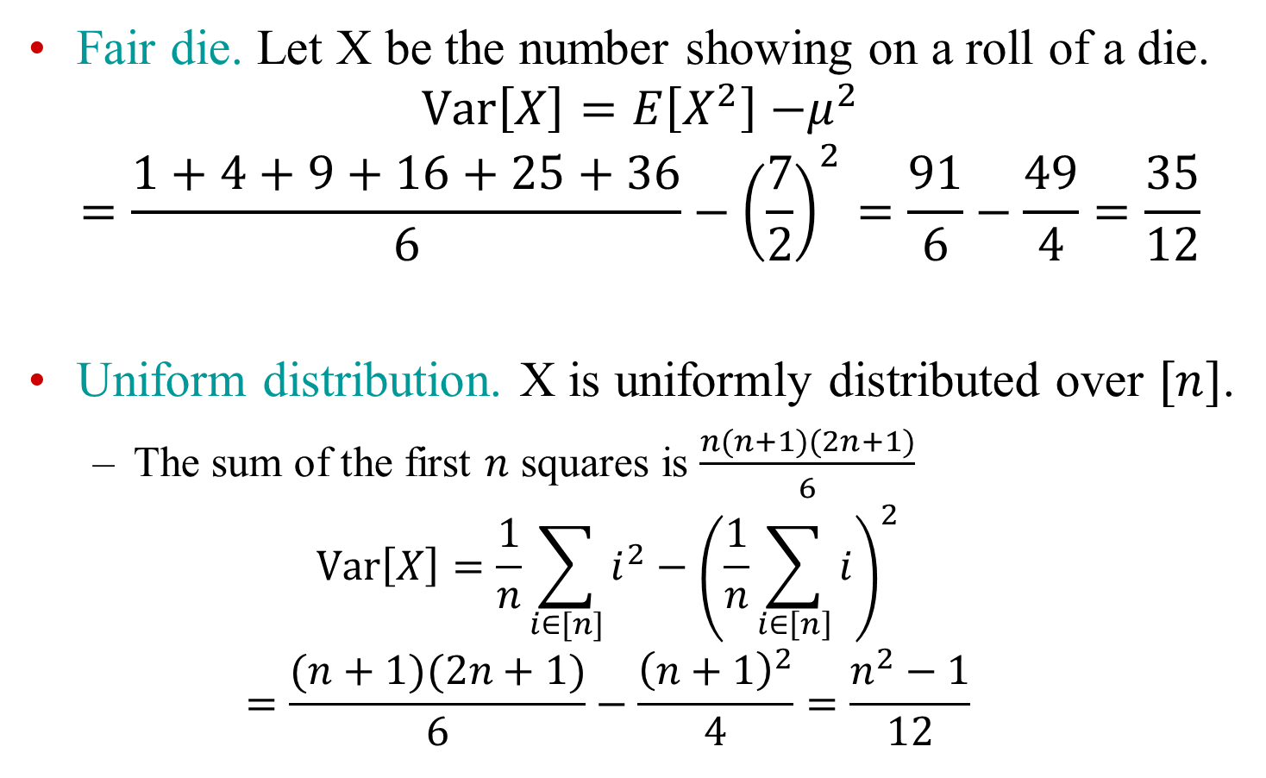
Compute expectation and variance
Fair die. Let X be the number showing on a roll of a die.
$$Var\left[X\right]=E\left[X^{2}\right]{−μ}^{2}$$
$$=\frac{1+4+9+16+25+36}{6}−{\left(\frac{7}{2}\right)}^{2}=\frac{91}{6}−\frac{49}{4}=\frac{35}{12}$$
Uniform distribution. X is uniformly distributed over $[n]$.
  The sum of the first $n$ squares is $\frac{n(n+1)(2n+1)}{6}$
  $$Var\left[X\right]=\frac{1}{n}\sum_{i∈[n]}{i^{2}}−{\left(\frac{1}{n}\sum_{i∈\left[n\right]}{i}\right)}^{2}$$
  $$=\frac{(n+1)(2n+1)}{6}−\frac{{\left(n+1\right)}^{2}}{4}=\frac{n^{2}−1}{12}$$
Notes:
1/6(1+4+9+16+25+36)-(7/2)^2=91/6-49/4=35/12; sum of first n squares is n(n+1)(2n+1)/6: (n+1)(2n+1)/6-(n+1)^2/4= (n^2-1)/12.

Slide 4
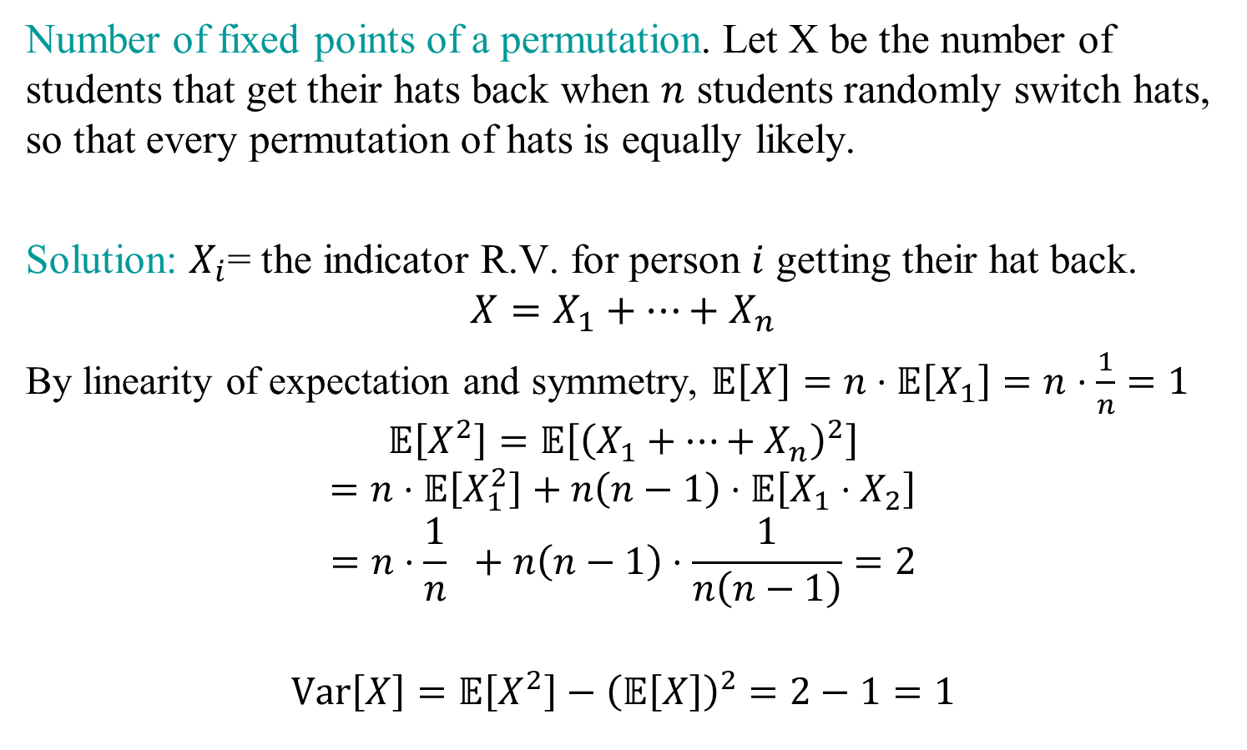
Compute expectation and variance
Number of fixed points of a permutation. Let X be the number of students that get their hats back when $n$ students randomly switch hats, so that every permutation of hats is equally likely.
Solution: $X_{i}$= the indicator R.V. for person $i$ getting their hat back.
$$X=X_{1}+…+X_{n}$$
By linearity of expectation and symmetry, $𝔼\left[X\right]=n⋅𝔼\left[X_{1}\right]=n⋅\frac{1}{n}=1$
$$𝔼\left[X^{2}\right]=𝔼\left[{\left(X_{1}+…+X_{n}\right)}^{2}\right]$$
$$=n⋅𝔼\left[X_{1}^{2}\right]+n\left(n−1\right)⋅𝔼\left[X_{1}⋅X_{2}\right]$$
$$=n⋅\frac{1}{n} +n\left(n−1\right)⋅\frac{1}{n\left(n−1\right)}=2$$
$$Var\left[X\right]=𝔼\left[X^{2}\right]−{\left(𝔼\left[X\right]\right)}^{2}=2−1=1$$
Notes:
1/6(1+4+9+16+25+36)-(7/2)^2=91/6-49/4=35/12; sum of first n squares is n(n+1)(2n+1)/6: (n+1)(2n+1)/6-(n+1)^2/4= (n^2-1)/12.

Slide 5
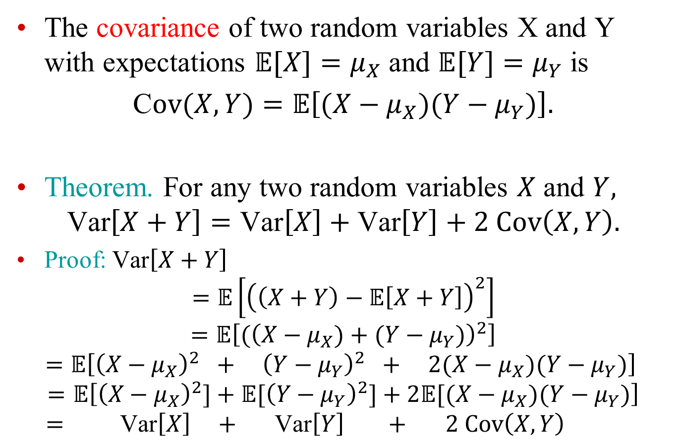
Random variables: covariance
The covariance of two random variables X and Y with expectations $𝔼[X]=μ_{X}$ and $𝔼[Y]=μ_{Y}$ is
C$ov(X,Y)=𝔼\left[(X−μ_{X})(Y−μ_{Y})\right].$
Theorem. For any two random variables $X$ and $Y,$
$$\text{Var}\left[X+Y\right]=\text{Var}\left[X\right]+\text{Var}\left[Y\right]+2 Cov\left(X,Y\right).$$
Proof: $\text{Var}\left[X+Y\right]$
$$=𝔼\left[{\left(\left(X+Y\right)−𝔼\left[X+Y\right]\right)}^{2}\right]$$
$$=𝔼\left[{(\left(X−μ_{X})+(Y−μ_{Y})\right)}^{2}\right]$$
$$=𝔼\left[{\left(X−μ_{X}\right)}^{2} + {\left(Y−μ_{Y}\right)}^{2} + 2(X−μ_{X})(Y−μ_{Y})\right]$$
$$=𝔼\left[{\left(X−μ_{X}\right)}^{2}]+𝔼[{\left(Y−μ_{Y}\right)}^{2}]+2𝔼[(X−μ_{X})(Y−μ_{Y})\right]$$
$$= \text{Var}\left[X\right] + \text{Var}\left[Y\right] + 2 Cov\left(X,Y\right)$$

Slide 6
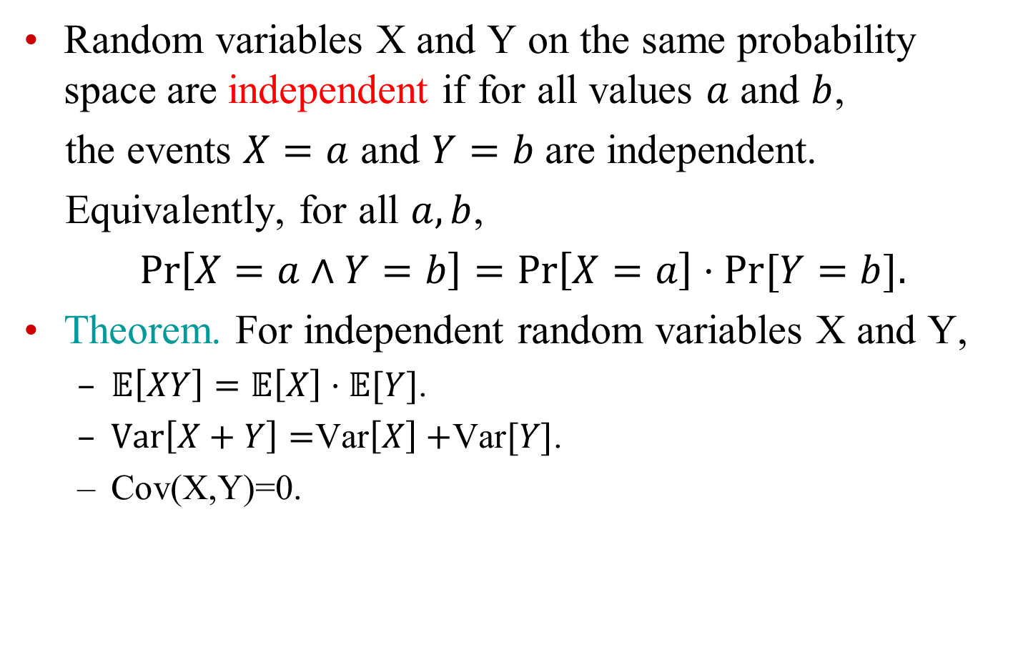
Independent RVs
Random variables X and Y on the same probability space are independent if for all values $a$ and $b$,
the events $X=a$ and $Y=b$ are independent.
Equivalently, for all $a,b$,
$\operatorname{Pr}\left[X=a∧Y=b\right]=\operatorname{Pr}\left[X=a\right]⋅Pr[Y=b].$
Theorem. For independent random variables X and Y,
  $𝔼\left[XY\right]=𝔼\left[X\right]⋅𝔼[Y]$.
  $Var\left[X+Y\right]=$Var$\left[X\right]+$Var$[Y]$.
  Cov(X,Y)=0.

Slide 7

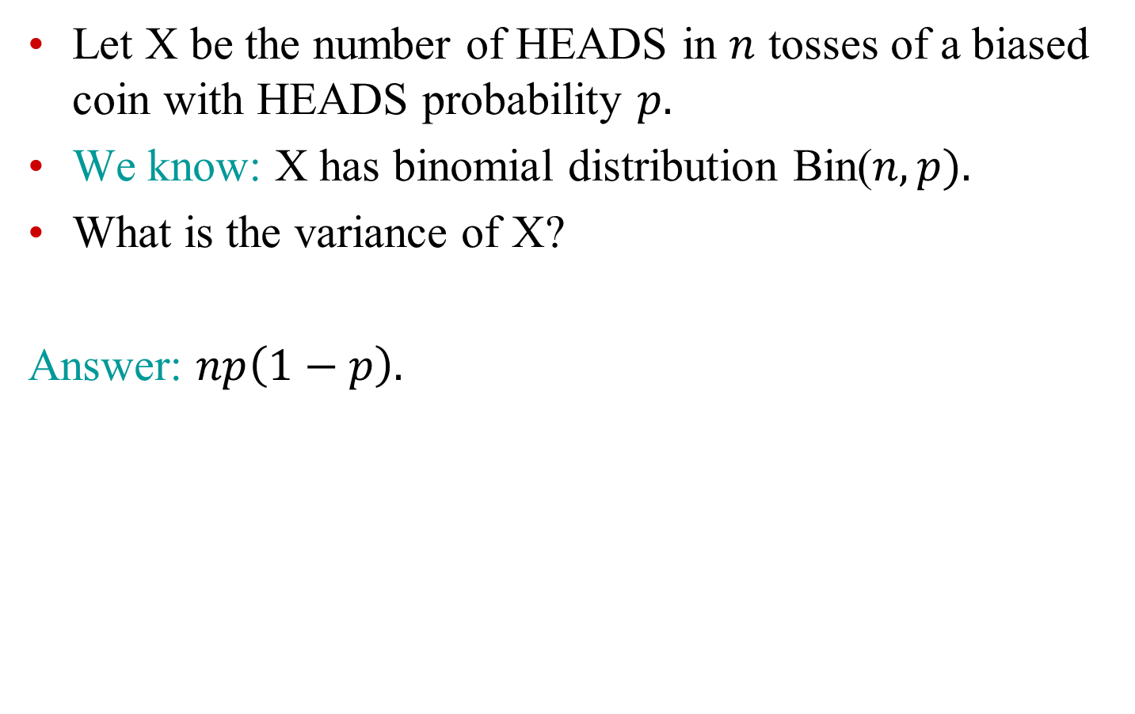
Example: $n$ coin tosses
Let X be the number of HEADS in $n$ tosses of a biased coin with HEADS probability $p.$
We know: X has binomial distribution Bin($n,p).$
What is the variance of X?
Answer: $np\left(1−p\right).$
Notes:
Np(1-p)

Slide 8
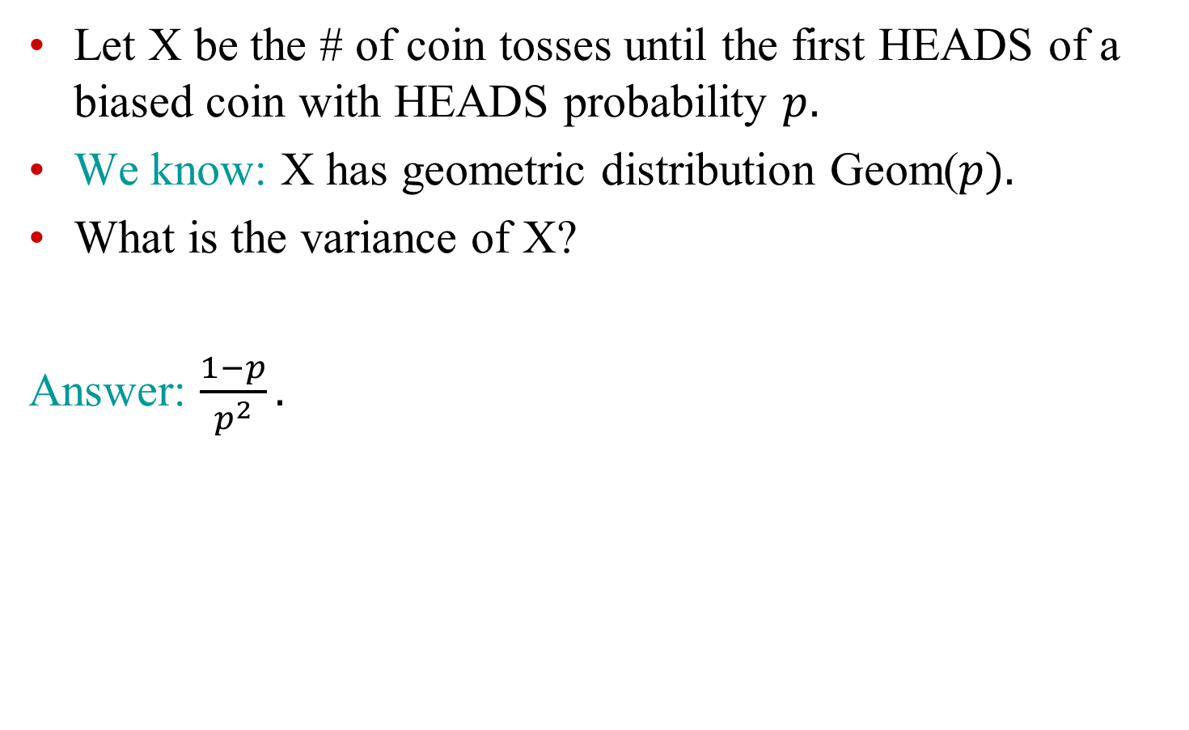
Example: Geometric RV
Let X be the # of coin tosses until the first HEADS of a biased coin with HEADS probability $p.$
We know: X has geometric distribution Geom($p).$
What is the variance of X?
Answer: $\frac{1−p}{p^{2}}.$

Slide 9
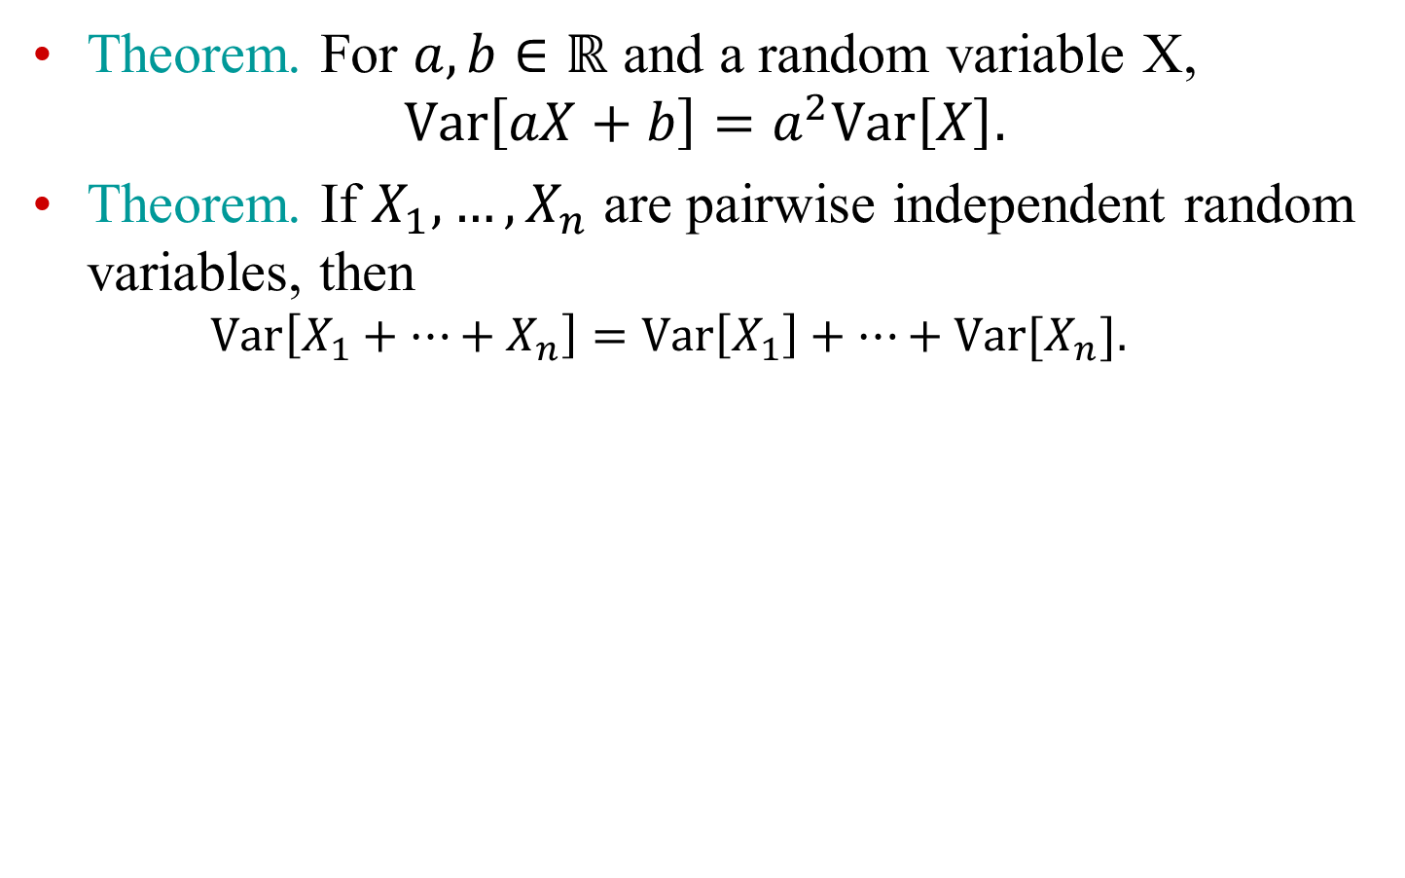
Variance: additional facts
Theorem. For $a,b∈ℝ$ and a random variable X,
$$Var\left[aX+b\right]=a^{2}Var\left[X\right].$$
Theorem. If $X_{1},…, X_{n}$ are pairwise independent random variables, then
  $$Var\left[X_{1}+…+X_{n}\right]=Var\left[X_{1}\right]+…+Var[X_{n}].$$

Slide 10

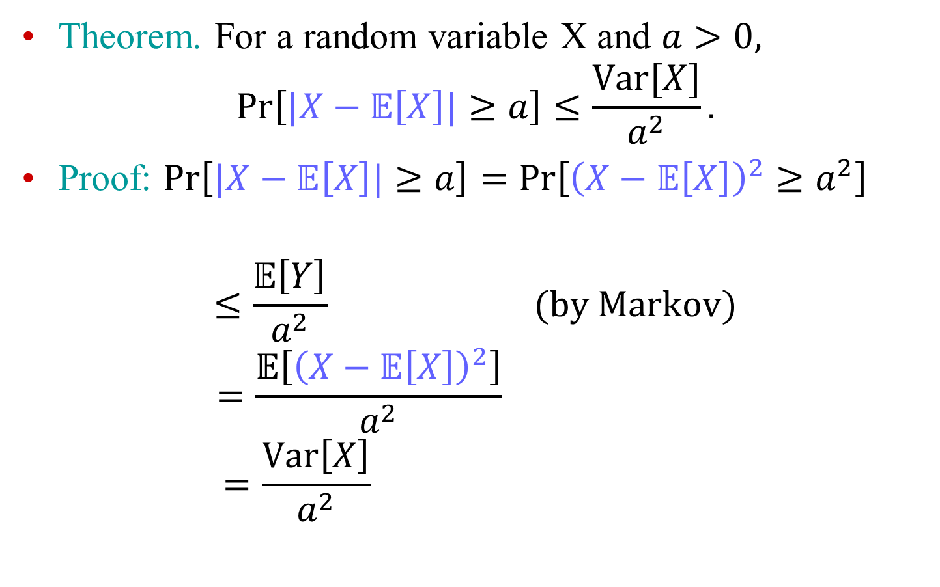
Chebyshev’s Inequality
Theorem. For a random variable X and $a>0,$
$$\operatorname{Pr}\left[|X−𝔼\left[X\right]|≥a\right]≤\frac{Var[X]}{a^{2}}.$$
Proof: $\operatorname{Pr}\left[|X−𝔼\left[X\right]|≥a\right]=\operatorname{Pr}\left[{\left(X−𝔼\left[X\right]\right)}^{2}≥a^{2}\right]$
$$≤\frac{𝔼\left[Y\right]}{a^{2}} (by Markov)$$
$$=\frac{𝔼\left[{\left(X−𝔼\left[X\right]\right)}^{2}\right]}{a^{2}}$$
$$=\frac{Var\left[X\right]}{a^{2}}$$
$$Y≥0$$

Slide 11
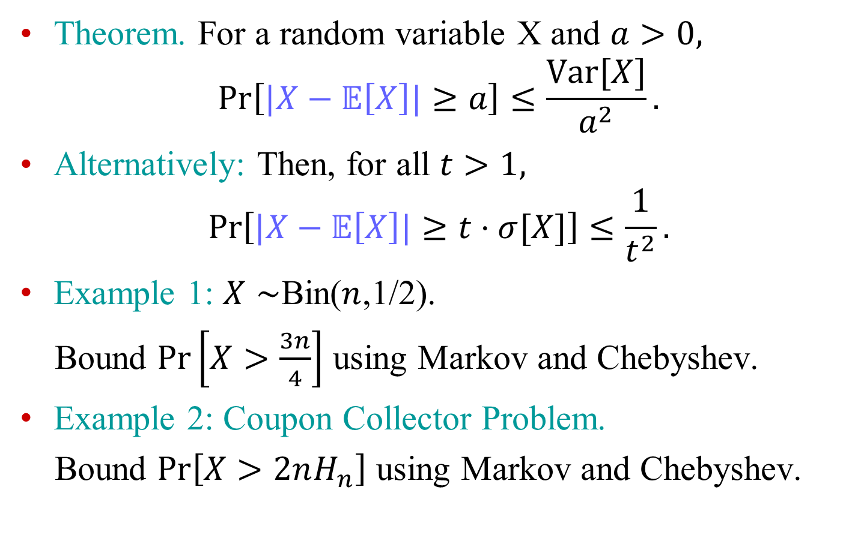
Chebyshev’s Inequality
Theorem. For a random variable X and $a>0,$
$$\operatorname{Pr}\left[|X−𝔼\left[X\right]|≥a\right]≤\frac{Var[X]}{a^{2}}.$$
Alternatively: Then, for all $t>1,$
$$\operatorname{Pr}\left[|X−𝔼\left[X\right]|≥t⋅σ[X]\right]≤\frac{1}{t^{2}}.$$
Example 1: $X∼$Bin($n$,1/2).
Bound $\operatorname{Pr}\left[X>\frac{3n}{4}\right]$ using Markov and Chebyshev.
Example 2: Coupon Collector Problem.
Bound $\operatorname{Pr}\left[X>2nH_{n}\right]$ using Markov and Chebyshev.

