Slide 1




Randomness in Computing
LECTURE 5
Last time
Bernoulli and binomial RVs
Jensen’s inequality
Conditional expectation
Today
Conditional expectation
Branching process
Geometric RVs
Coupon collector problem
CS
537
Sofya Raskhodnikova;Randomness in Computing

Slide 2
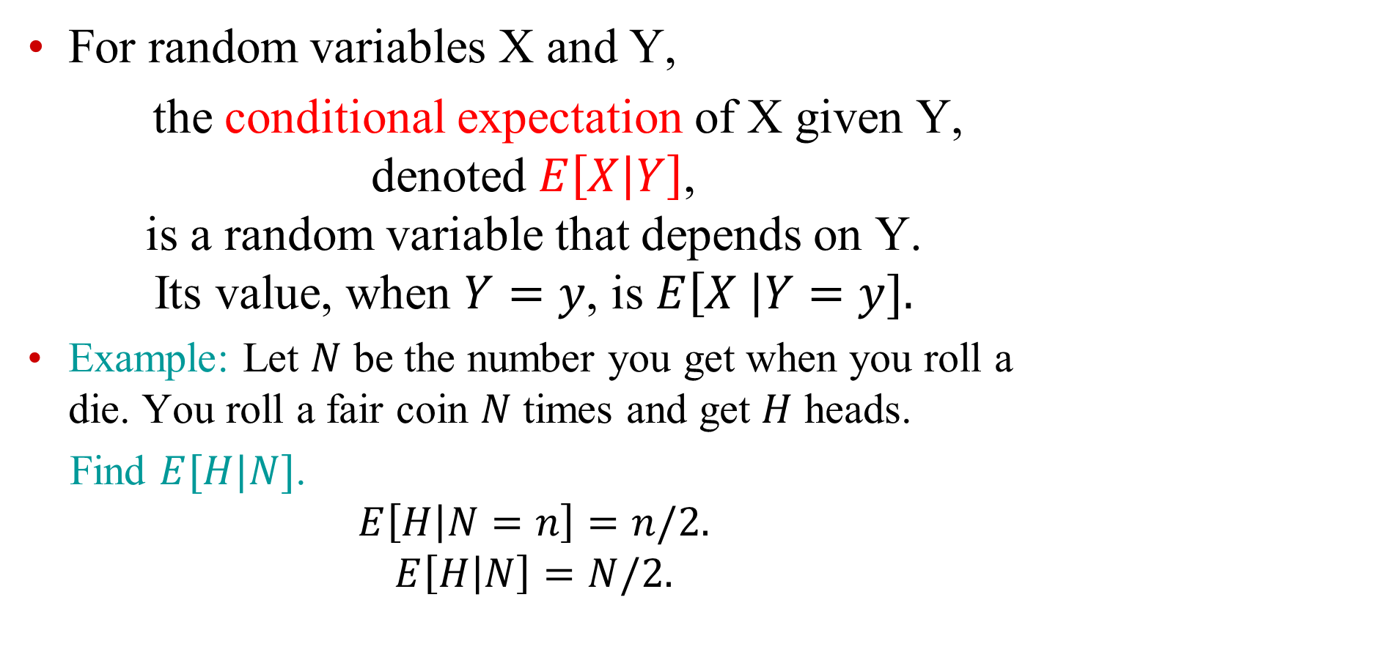
Conditional expectation: definition
For random variables X and Y,
the conditional expectation of X given Y, denoted $E\left[X | Y\right]$, is a random variable that depends on Y. Its value, when $Y=y$, is $E\left[X \right|Y=y].$
Example: Let $N$ be the number you get when you roll a die. You roll a fair coin $N$ times and get $H$ heads.
Find $E[H|N]$.
$$E\left[H | N=n\right]=n/2.$$
$$E\left[H | N\right]=N/2.$$

Slide 3
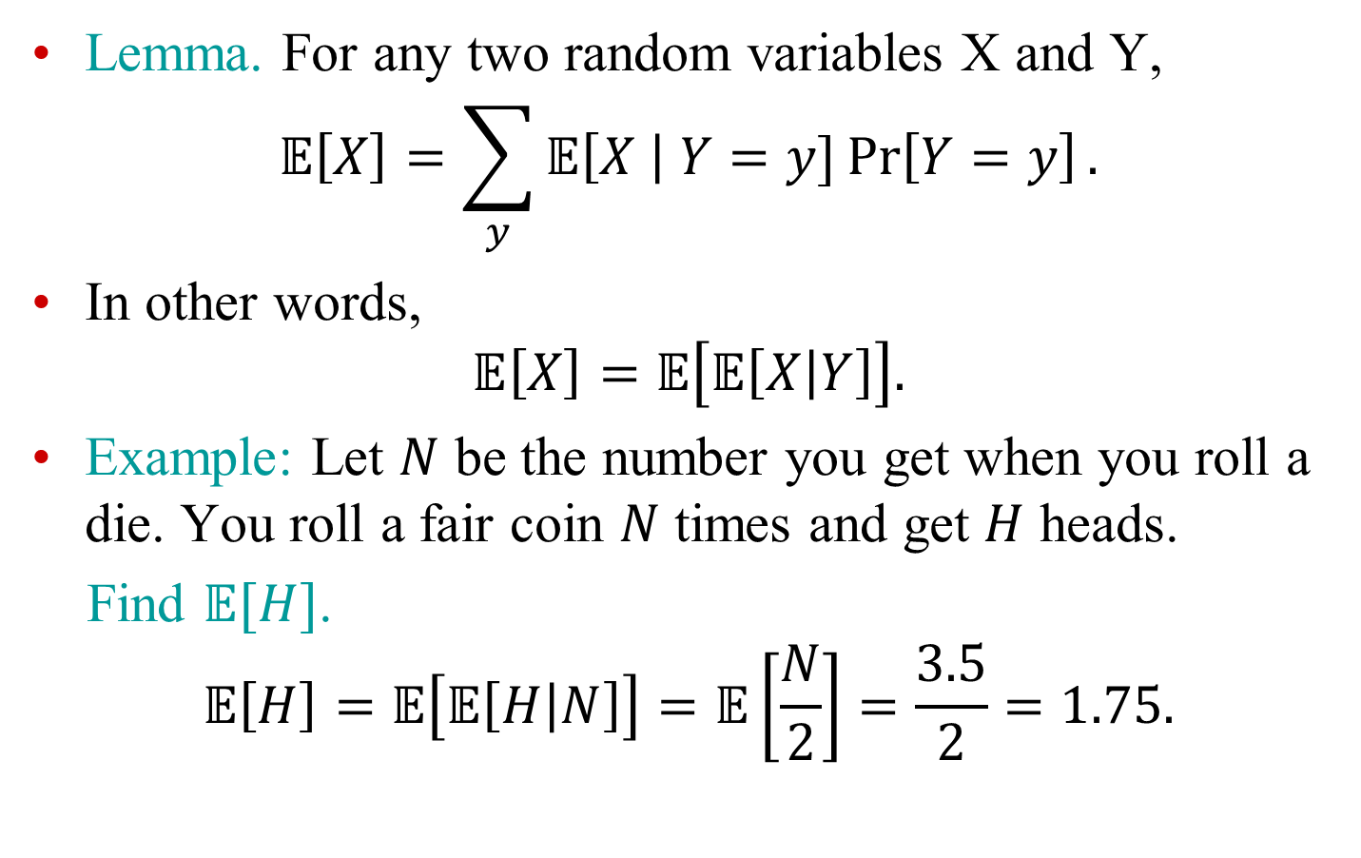
Law of total expectation: compact form
Lemma. For any two random variables X and Y,
$$𝔼\left[X\right]=\sum_{y}{𝔼\left[X \right| Y=y]}\operatorname{Pr}\left[Y=y\right].$$
In other words,
$$𝔼\left[X\right]=𝔼\left[𝔼\left[X | Y\right]\right].$$
Example: Let $N$ be the number you get when you roll a die. You roll a fair coin $N$ times and get $H$ heads.
Find $𝔼[H]$.
$$𝔼\left[H\right]=𝔼\left[𝔼\left[H | N\right]\right]=𝔼\left[\frac{N}{2}\right]=\frac{3.5}{2}=1.75.$$

Slide 4
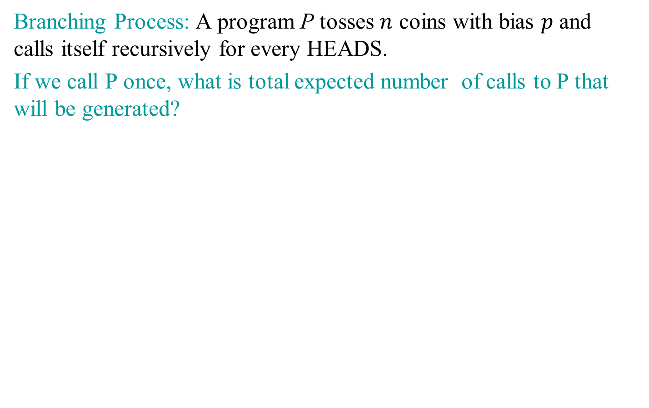
Law of total expectation: application
Branching Process: A program P tosses $n$ coins with bias $p$ and calls itself recursively for every HEADS.
If we call P once, what is total expected number of calls to P that will be generated?

Slide 5
Branching process

Slide 6
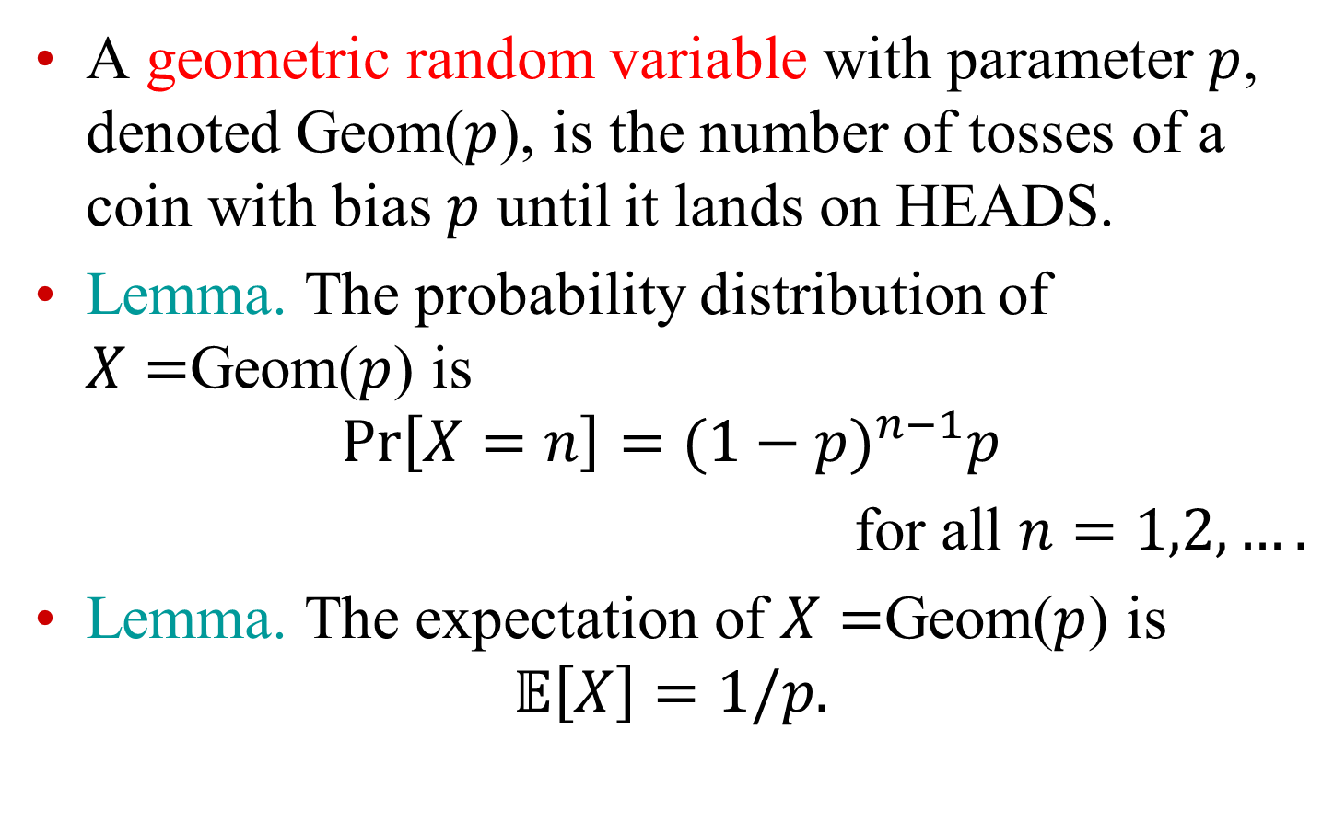
Geometric random variables
A geometric random variable with parameter $p$, denoted Geom($p$), is the number of tosses of a coin with bias $p$ until it lands on HEADS.
Lemma. The probability distribution of $X=$Geom($p$) is
$$\operatorname{Pr}\left[X=n\right]={(1−p)}^{n−1}p$$
for all $n=1,2,….$
Lemma. The expectation of $X=$Geom($p$) is
$$𝔼\left[X\right]=1/p.$$

Slide 7
Exercise
What is the distribution of the number of rolls of a die until you see a 6?
What is the expected number of rolls until you see a 6?
Notes:
Geom(1/6)

Slide 8
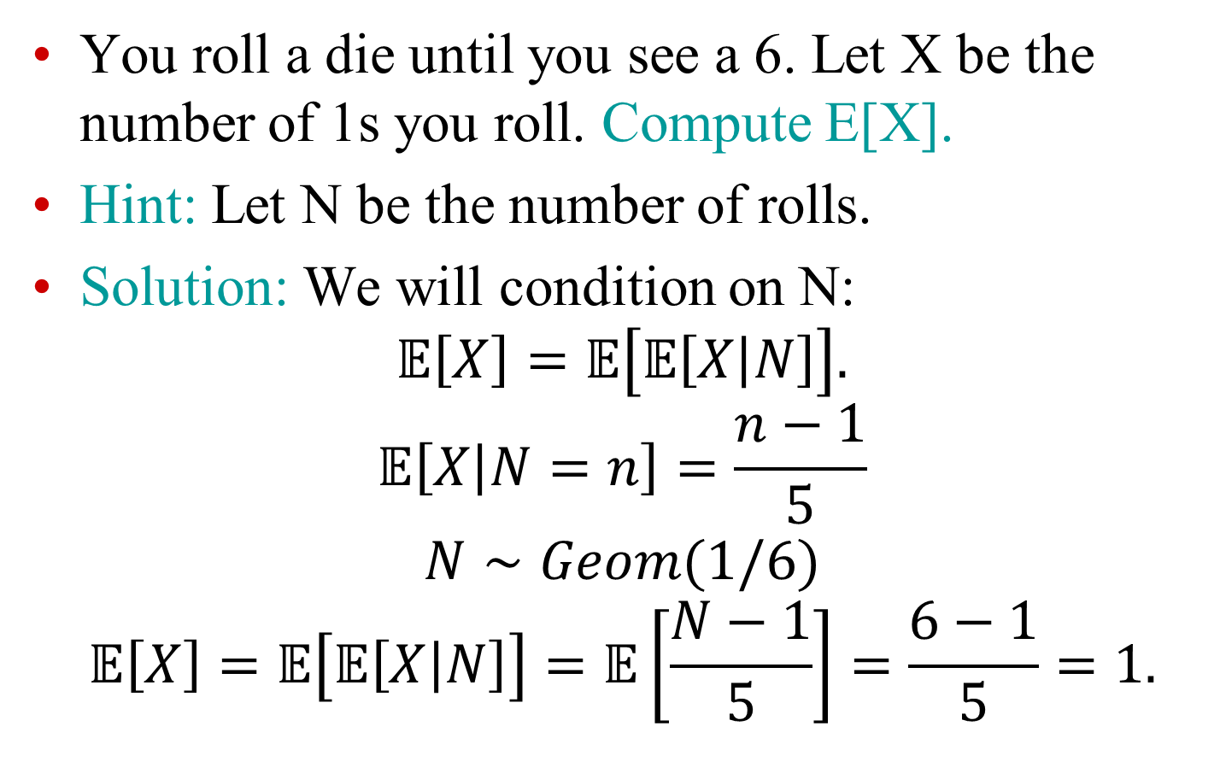
Exercise
You roll a die until you see a 6. Let X be the number of 1s you roll. Compute E[X].
Hint: Let N be the number of rolls.
Solution: We will condition on N:
$$𝔼\left[X\right]=𝔼\left[𝔼\left[X | N\right]\right].$$
$$𝔼\left[X | N=n\right]=\frac{n−1}{5}$$
$$N∼Geom(1/6)$$
$$𝔼\left[X\right]=𝔼\left[𝔼\left[X | N\right]\right]=𝔼\left[\frac{N−1}{5}\right]=\frac{6−1}{5}=1.$$

Slide 9
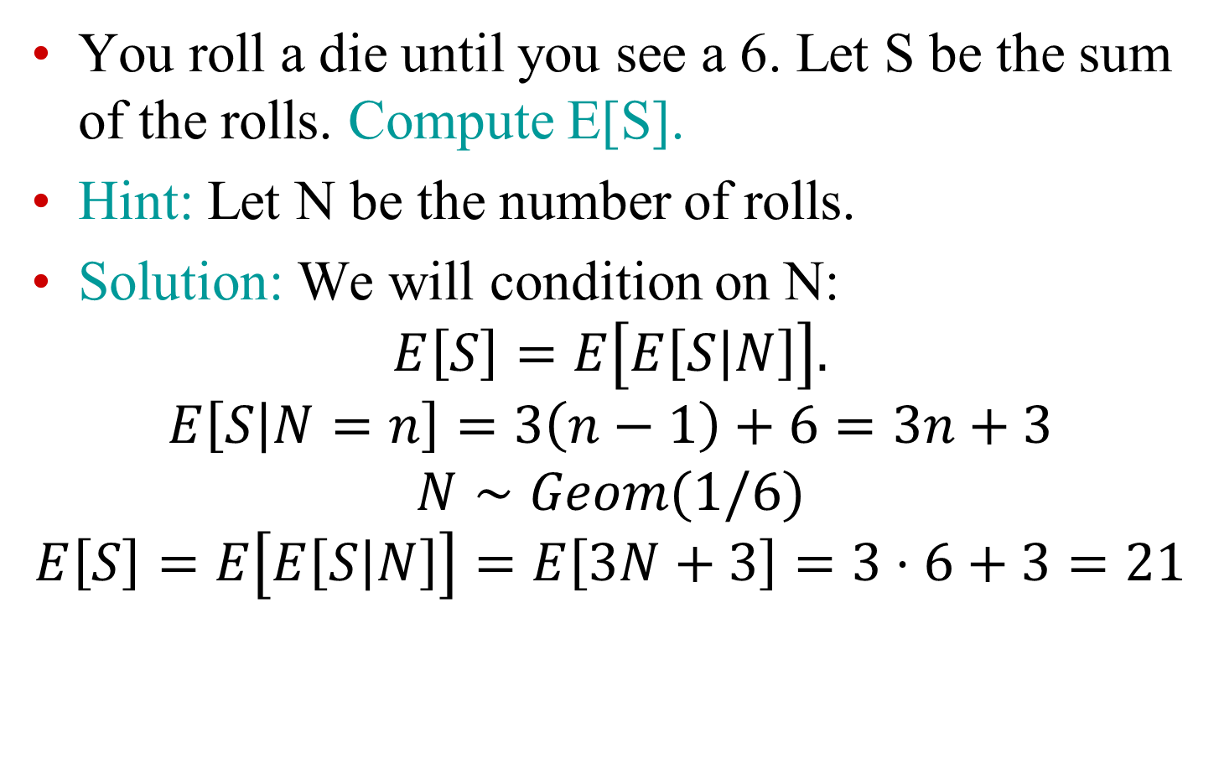
Exercise
You roll a die until you see a 6. Let S be the sum of the rolls. Compute E[S].
Hint: Let N be the number of rolls.
Solution: We will condition on N:
$$E\left[S\right]=E\left[E\left[S | N\right]\right].$$
$$E\left[S | N=n\right]=3\left(n−1\right)+6=3n+3$$
$$N∼Geom(1/6)$$
$$E\left[S\right]=E\left[E\left[S | N\right]\right]=E\left[3N+3\right]=3⋅6+3=21$$

Slide 10
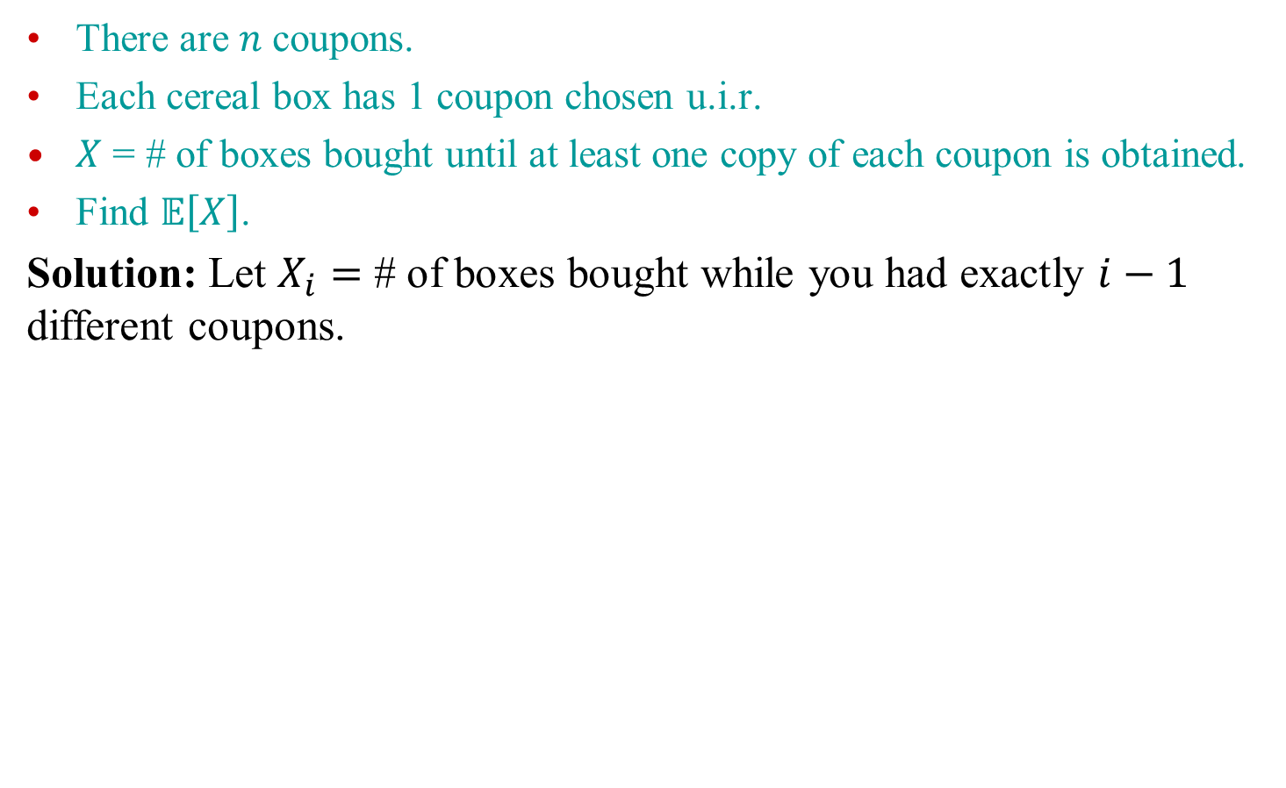
Coupon Collector’s Problems
There are $n$ coupons.
Each cereal box has 1 coupon chosen u.i.r.
$X$ = # of boxes bought until at least one copy of each coupon is obtained.
Find $𝔼\left[X\right]$.
Solution: Let $X_{i}=$ # of boxes bought while you had exactly $i−1$ different coupons.

Slide 11

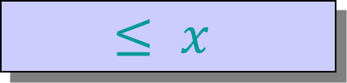

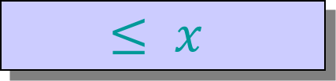



Quicksort: divide and conquer
Find a pivot element
Divide: Find the correct position of the pivot by comparing it to all elements.
Conquer: Recursively sort the two parts, resulting from removing the pivot.
pivot
1
$$n$$
A:
$$≤ x$$
$$x$$
$$≥x$$
$$≤ x$$
$$x$$
$$≥x$$
sort
sort
Sofya Raskhodnikova; based on notes by E. Demaine and C. Leiserson

Slide 12

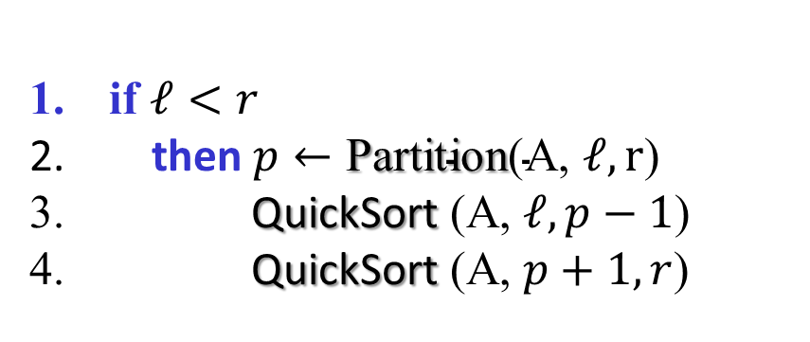

Quicksort
QuickSort(array A, positive integers $ℓ, r$)
if $ℓ<r$
then $p←\text{Partition}\text{(}\text{A}\text{, }ℓ, \text{r}\text{)}$
QuickSort (A, $ℓ, p−1$)
QuickSort (A, $p+1, r$)
Initial call:
QuickSort (A, 1, $n$)
Sofya Raskhodnikova; based on notes by E. Demaine and C. Leiserson

Slide 13
Example of partitioning
6
10
13
5
8
3
2
11
$$i$$
j
Sofya Raskhodnikova; based on notes by E. Demaine and C. Leiserson

Slide 14
Example of partitioning
6
10
13
5
8
3
2
11
$$i$$
j
Sofya Raskhodnikova; based on notes by E. Demaine and C. Leiserson

Slide 15
Example of partitioning
6
10
13
5
8
3
2
11
$$i$$
j
Sofya Raskhodnikova; based on notes by E. Demaine and C. Leiserson

Slide 16
Example of partitioning
6
10
13
5
8
3
2
11
6
5
13
10
8
3
2
11
$$i$$
j
Sofya Raskhodnikova; based on notes by E. Demaine and C. Leiserson

Slide 17
Example of partitioning
6
10
13
5
8
3
2
11
6
5
13
10
8
3
2
11
$$i$$
j
Sofya Raskhodnikova; based on notes by E. Demaine and C. Leiserson

Slide 18
Example of partitioning
6
10
13
5
8
3
2
11
6
5
13
10
8
3
2
11
$$i$$
j
Sofya Raskhodnikova; based on notes by E. Demaine and C. Leiserson

Slide 19
Example of partitioning
6
10
13
5
8
3
2
11
6
5
13
10
8
3
2
11
6
5
3
10
8
13
2
11
$$i$$
j
Sofya Raskhodnikova; based on notes by E. Demaine and C. Leiserson

Slide 20
Example of partitioning
6
10
13
5
8
3
2
11
6
5
13
10
8
3
2
11
6
5
3
10
8
13
2
11
$$i$$
j
Sofya Raskhodnikova; based on notes by E. Demaine and C. Leiserson

Slide 21
Example of partitioning
6
10
13
5
8
3
2
11
6
5
13
10
8
3
2
11
6
5
3
10
8
13
2
11
6
5
3
2
8
13
10
11
$$i$$
j
Sofya Raskhodnikova; based on notes by E. Demaine and C. Leiserson

Slide 22

Example of partitioning
6
10
13
5
8
3
2
11
6
5
13
10
8
3
2
11
6
5
3
10
8
13
2
11
6
5
3
2
8
13
10
11
$$i$$
j
Sofya Raskhodnikova; based on notes by E. Demaine and C. Leiserson

Slide 23
Example of partitioning
6
10
13
5
8
3
2
11
6
5
13
10
8
3
2
11
6
5
3
10
8
13
2
11
6
5
3
2
8
13
10
11
$$i$$
j
Sofya Raskhodnikova; based on notes by E. Demaine and C. Leiserson

Slide 24

Example of partitioning
6
10
13
5
8
3
2
11
6
5
13
10
8
3
2
11
6
5
3
10
8
13
2
11
6
5
3
2
8
13
10
11
2
5
3
6
8
13
10
11
$$i$$
Sofya Raskhodnikova; based on notes by E. Demaine and C. Leiserson

Slide 25

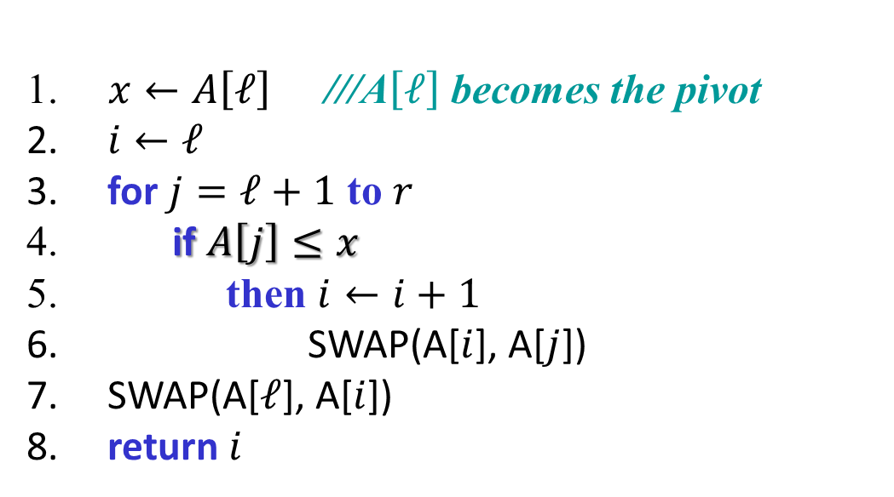





Partitioning algorithm
Partition (array A, positive integers $ℓ, r$)
$x←A\left[ℓ\right]$ ///A$\left[ℓ\right]$ becomes the pivot
$i←ℓ$
for $j=ℓ+1$ to $r$
if $A\left[j\right]≤x$
then $i←i+1$
SWAP(A[$i$], A[$j$])
SWAP(A[$ℓ$], A[$i$])
return $i$
$x$
$$≤x$$
$$≥x$$
?
$$ℓ$$
$$i$$
j
r
Sofya Raskhodnikova; based on notes by E. Demaine and C. Leiserson

