Slide 1




Randomness in Computing
LECTURE 6
Last time
Conditional expectation
Branching process
Geometric RVs
Coupon collector problem
Today
Randomized quicksort
Markov’s inequality
Variance
CS
537
Sofya Raskhodnikova;Randomness in Computing

Slide 2







Quicksort: divide and conquer
Find a pivot element
Divide: Find the correct position of the pivot by comparing it to all elements.
Conquer: Recursively sort the two parts, resulting from removing the pivot.
pivot
1
$$n$$
A:
$$≤ x$$
$$x$$
$$≥x$$
$$≤ x$$
$$x$$
$$≥x$$
sort
sort
Sofya Raskhodnikova; based on notes by E. Demaine and C. Leiserson

Slide 3
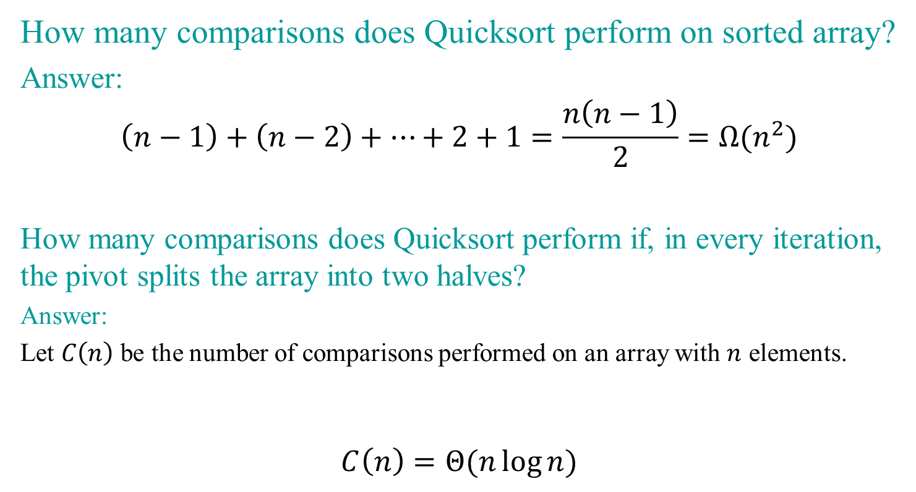
Exercise
How many comparisons does Quicksort perform on sorted array?
Answer:
$$\left(n−1\right)+\left(n−2\right)+…+2+1=\frac{n\left(n−1\right)}{2}=Ω(n^{2})$$
How many comparisons does Quicksort perform if, in every iteration, the pivot splits the array into two halves?
Answer:
Let $C\left(n\right)$ be the number of comparisons performed on an array with $n$ elements.
$$C\left(n\right)=Θ(n\log{n)}$$

Slide 4
Randomized Quicksort
BIG IDEA:
Partition around a random element.
Analysis is similar when the input arrives in random order.
But randomness in the input is unreliable.
Rely instead on random number generator.

Slide 5
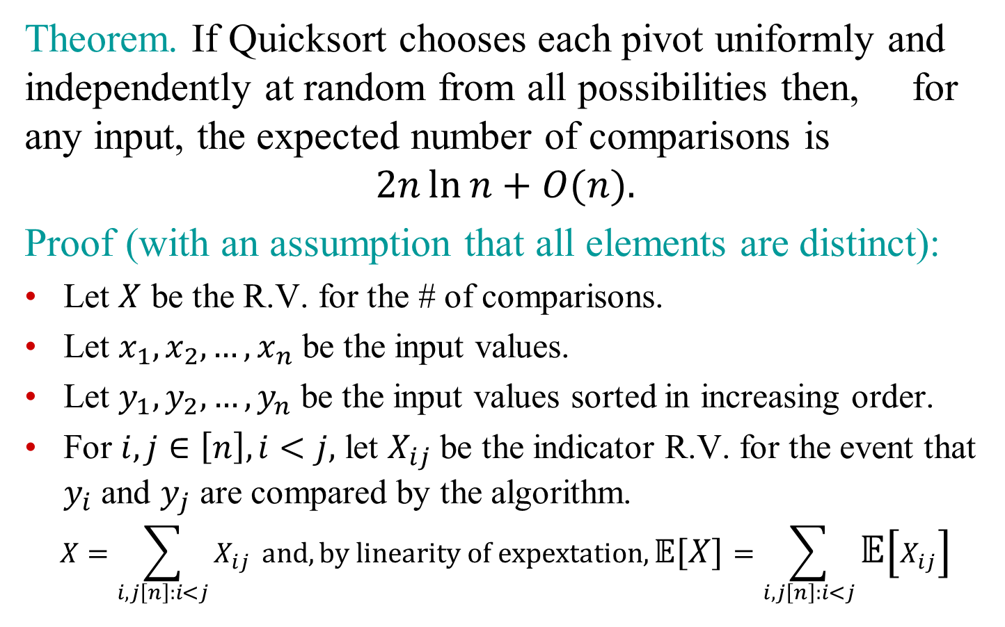
Analysis of Randomized Quicksort
Theorem. If Quicksort chooses each pivot uniformly and independently at random from all possibilities then, for any input, the expected number of comparisons is
$$2n\ln{n}+O(n).$$
Proof (with an assumption that all elements are distinct):
Let $X$ be the R.V. for the # of comparisons.
Let $x_{1},x_{2},…, x_{n}$ be the input values.
Let $y_{1},y_{2},…, y_{n}$ be the input values sorted in increasing order.
For $i,j∈\left[n\right], i<j,$ let $X_{ij}$ be the indicator R.V. for the event that $y_{i}$ and $y_{j}$ are compared by the algorithm.
$$X=\sum_{i,j\left[n\right]:i<j}{X_{ij}} and, by linearity of expextation, 𝔼[X]=\sum_{i,j\left[n\right]:i<j}{𝔼\left[X_{ij}\right]}$$

Slide 6
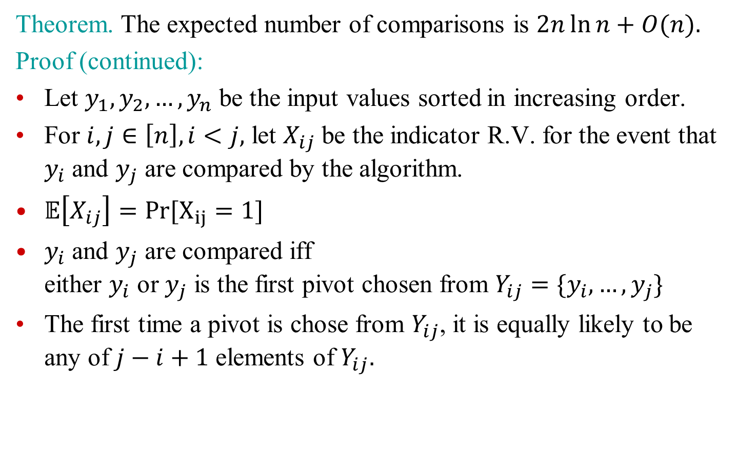
Analysis of Randomized Quicksort
Theorem. The expected number of comparisons is $2n\ln{n}+O(n).$
Proof (continued):
Let $y_{1},y_{2},…, y_{n}$ be the input values sorted in increasing order.
For $i,j∈\left[n\right], i<j,$ let $X_{ij}$ be the indicator R.V. for the event that $y_{i}$ and $y_{j}$ are compared by the algorithm.
$𝔼\left[X_{ij}\right]=Pr[X_{ij}=1]$
$y_{i}$ and $y_{j}$ are compared iff either $y_{i}$ or $y_{j}$ is the first pivot chosen from $Y_{ij}=\{y_{i},…,y_{j}\}$
The first time a pivot is chose from $Y_{ij}$, it is equally likely to be any of $j−i+1$ elements of $Y_{ij}.$

Slide 7
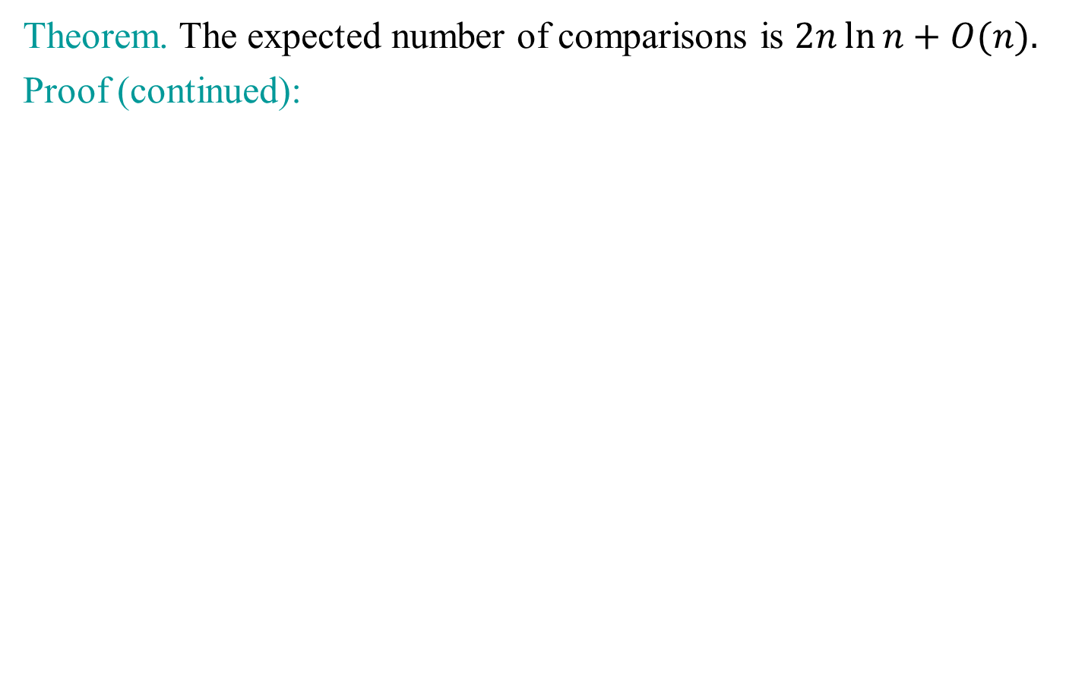
Analysis of Randomized Quicksort
Theorem. The expected number of comparisons is $2n\ln{n}+O(n).$
Proof (continued):

Slide 8
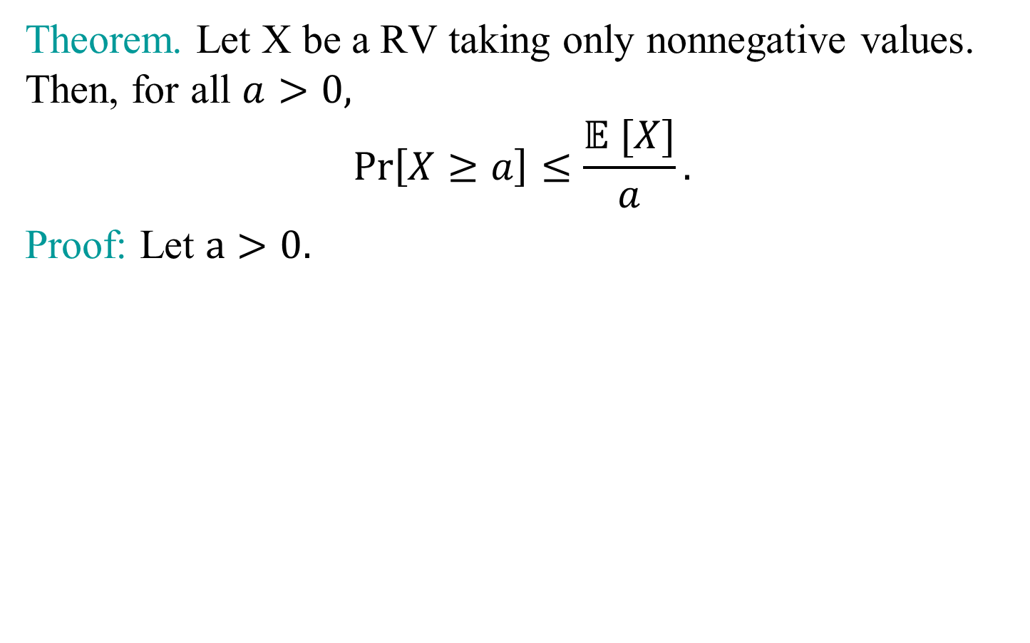
Markov’s Inequality
Theorem. Let X be a RV taking only nonnegative values. Then, for all $a>0,$
$$\operatorname{Pr}\left[X≥a\right]≤\frac{𝔼 [X]}{a}.$$
Proof: Let $a>0.$

Slide 9
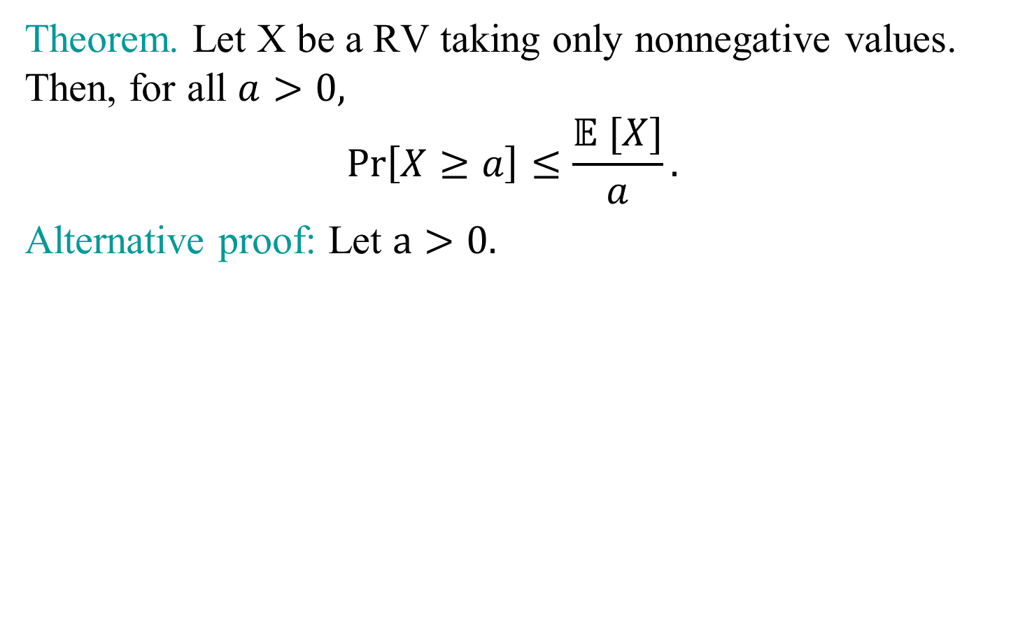
Markov’s Inequality
Theorem. Let X be a RV taking only nonnegative values. Then, for all $a>0,$
$$\operatorname{Pr}\left[X≥a\right]≤\frac{𝔼 [X]}{a}.$$
Alternative proof: Let $a>0.$

Slide 10
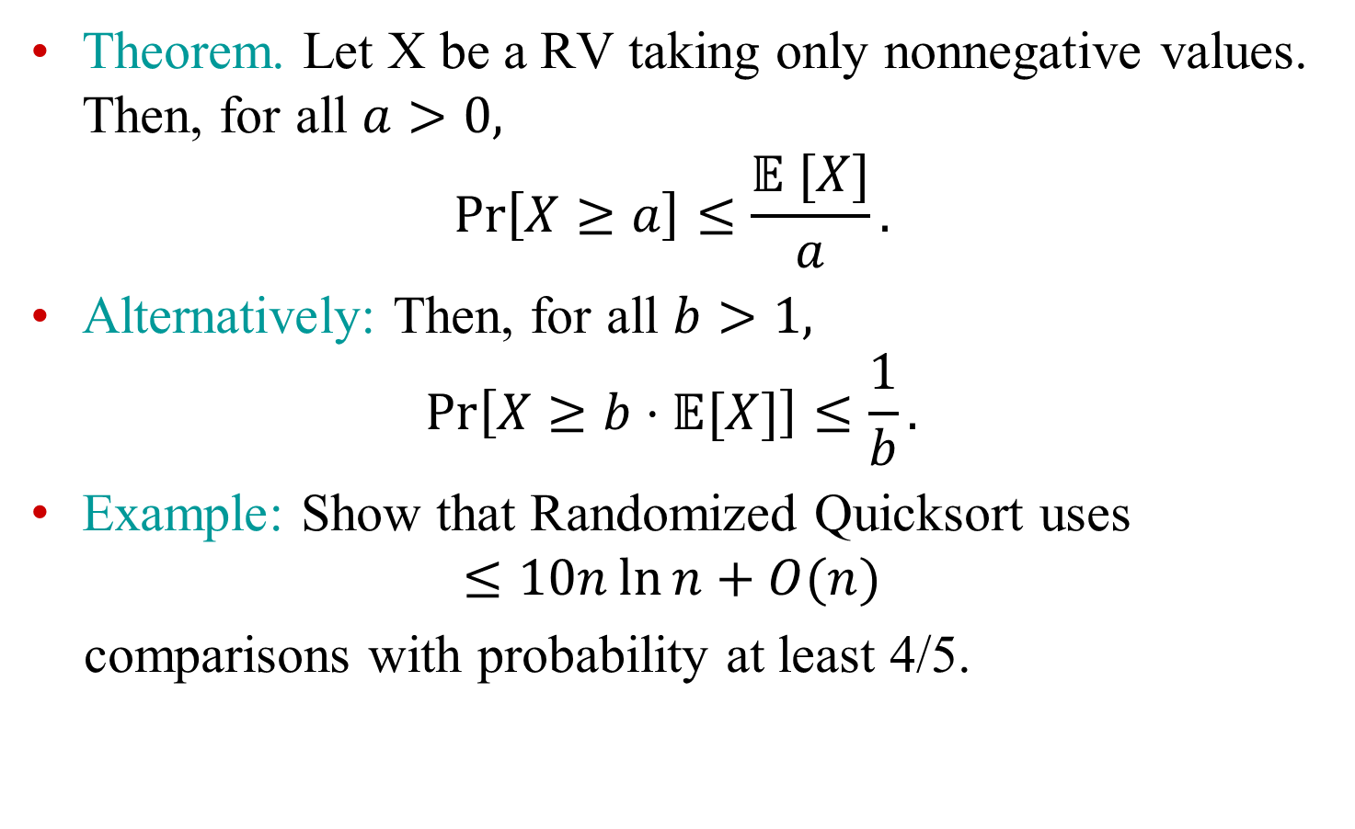
Markov’s Inequality
Theorem. Let X be a RV taking only nonnegative values. Then, for all $a>0,$
$$\operatorname{Pr}\left[X≥a\right]≤\frac{𝔼 [X]}{a}.$$
Alternatively: Then, for all $b>1,$
$$\operatorname{Pr}\left[X≥b⋅𝔼[X]\right]≤\frac{1}{b}.$$
Example: Show that Randomized Quicksort uses
$$≤10n\ln{n}+O(n)$$
comparisons with probability at least 4/5.

Slide 11
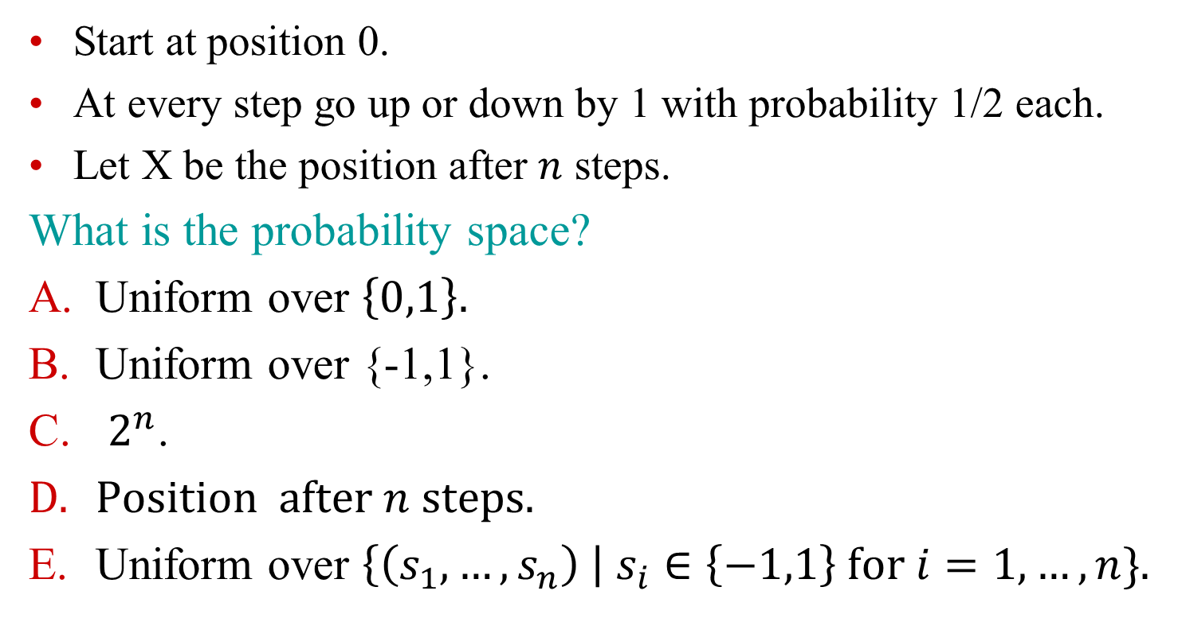
Bernoulli random walk
Start at position 0.
At every step go up or down by 1 with probability 1/2 each.
Let X be the position after $n$ steps.
What is the probability space?
Uniform over $\left\{0,1\right\}.$
Uniform over {-1,1}.
$2^{n}$.
Position after $n$ steps.
Uniform over $\left\{\left(s_{1},…,s_{n}\right) \right| s_{i}∈\left\{−1,1\right\} for i=1,…,n\}$.

Slide 12
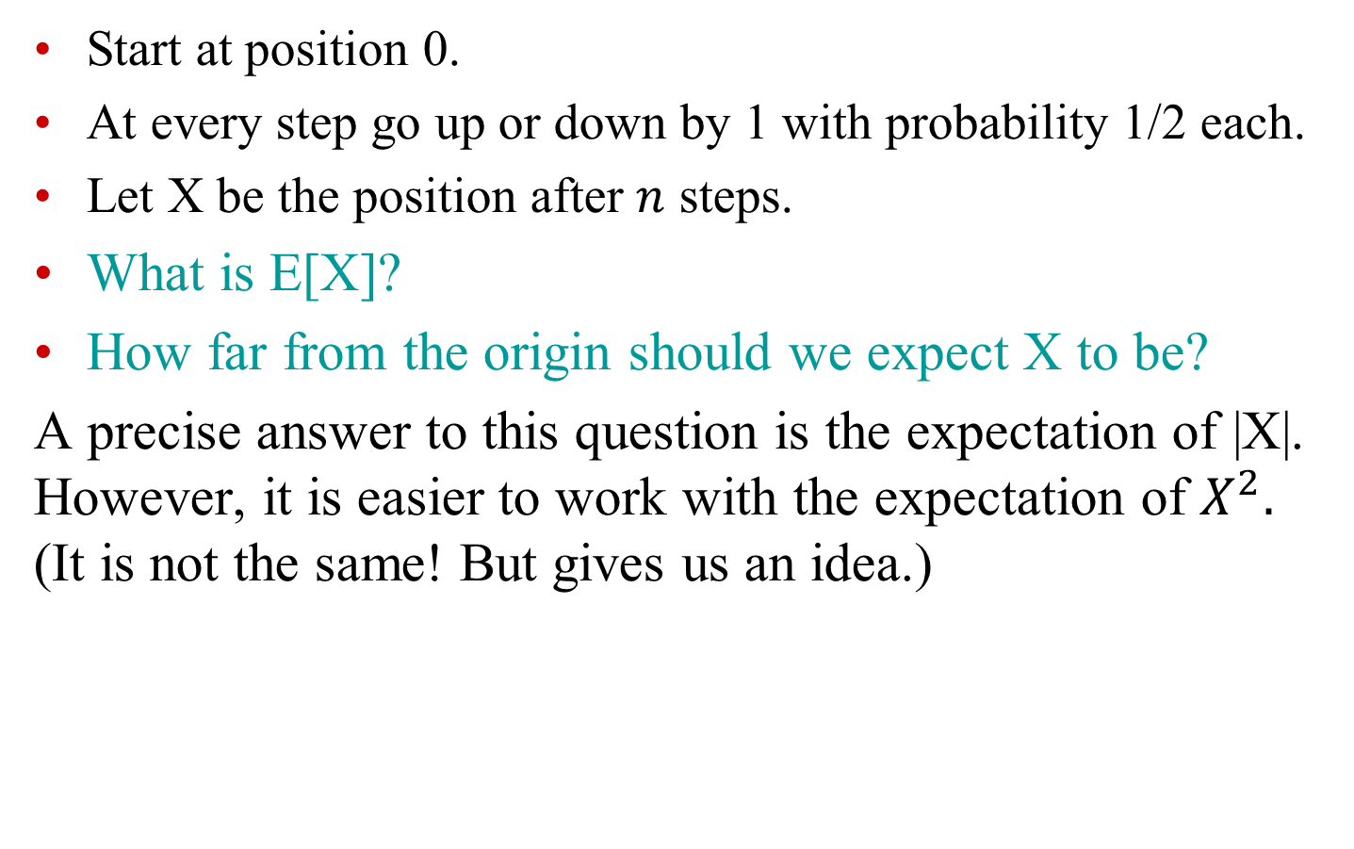
Bernoulli random walk
Start at position 0.
At every step go up or down by 1 with probability 1/2 each.
Let X be the position after $n$ steps.
What is E[X]?
How far from the origin should we expect X to be?
A precise answer to this question is the expectation of |X|. However, it is easier to work with the expectation of $X^{2}.$ (It is not the same! But gives us an idea.)

Slide 13
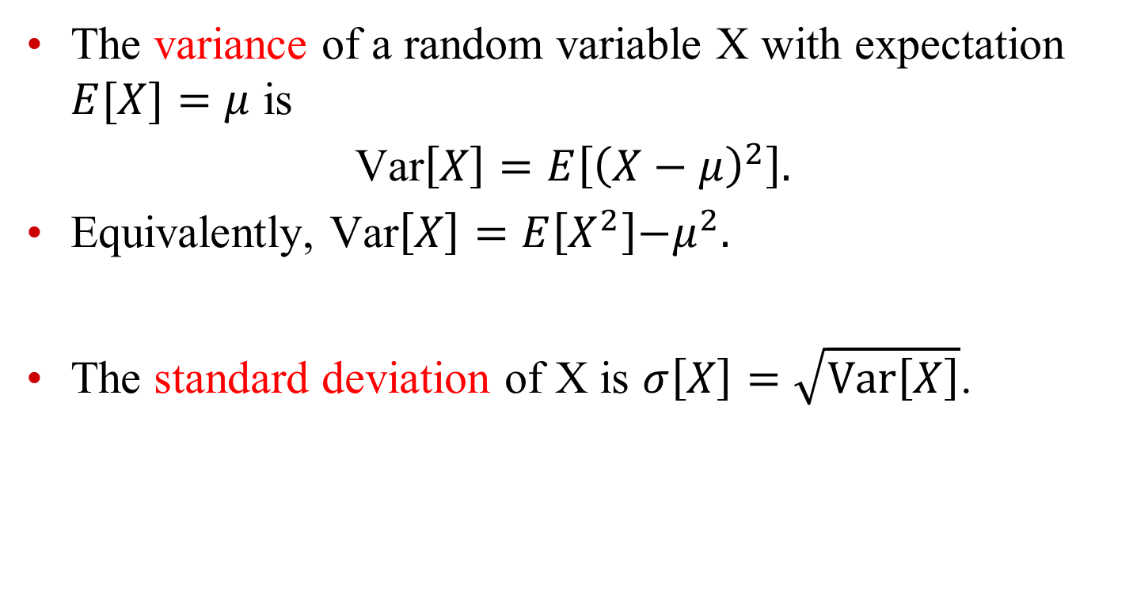
Random variables: variance
The variance of a random variable X with expectation $E[X]=μ$ is
Var$\left[X\right]=E\left[{\left(X−μ\right)}^{2}\right].$
Equivalently, Var$\left[X\right]=E\left[X^{2}\right]{−μ}^{2}.$
The standard deviation of X is $σ\left[X\right]=\sqrt{Var\left[X\right]}$.

Slide 14
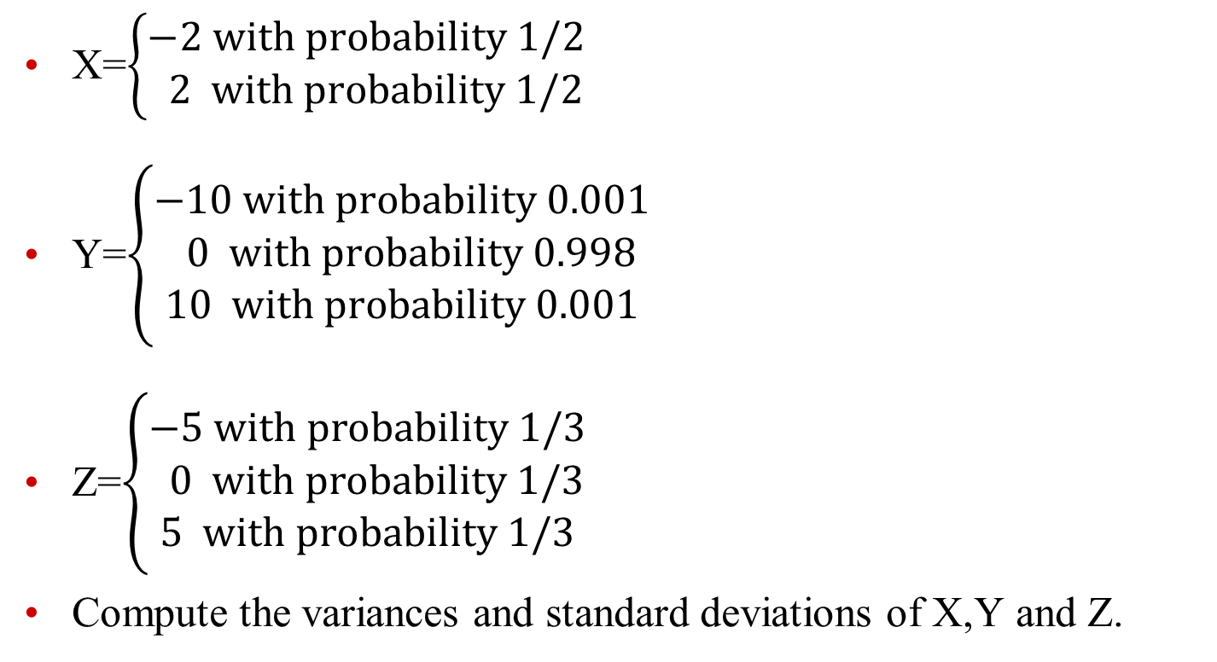
Variance as a measure of spread
X=$\left\{\begin{aligned}−2 with probability 1/2 \\ 2 with probability 1/2\end{aligned}\right.$
Y=$\left\{\begin{aligned}\begin{aligned}−10 with probability 0.001 \\ 0 with probability 0.998\end{aligned} \\ 10 with probability 0.001\end{aligned}\right.$
Z=$\left\{\begin{aligned}\begin{aligned}−5 with probability 1/3 \\ 0 with probability 1/3\end{aligned} \\ 5 with probability 1/3\end{aligned}\right.$
Compute the variances and standard deviations of X,Y and Z.
Example from Mathematics: a Discrete introduction by E. Scheinerman
Notes:
Vars: 4, 0.2, 16.67; s.dev.: 2, 0.447, 4.08

Slide 15
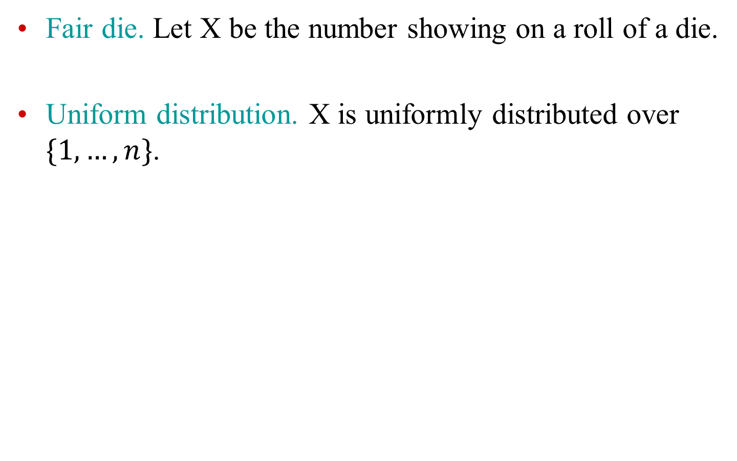
Compute expectation and variance
Fair die. Let X be the number showing on a roll of a die.
Uniform distribution. X is uniformly distributed over $\{1,…,n\}$.
Notes:
1/6(1+4+9+16+25+36)-(7/2)^2=91/6-49/4=35/12; sum of first n squares is n(n+1)(2n+1)/6: (n+1)(2n+1)/6-(n+1)^2/4= (n^2-1)/12.

Slide 16
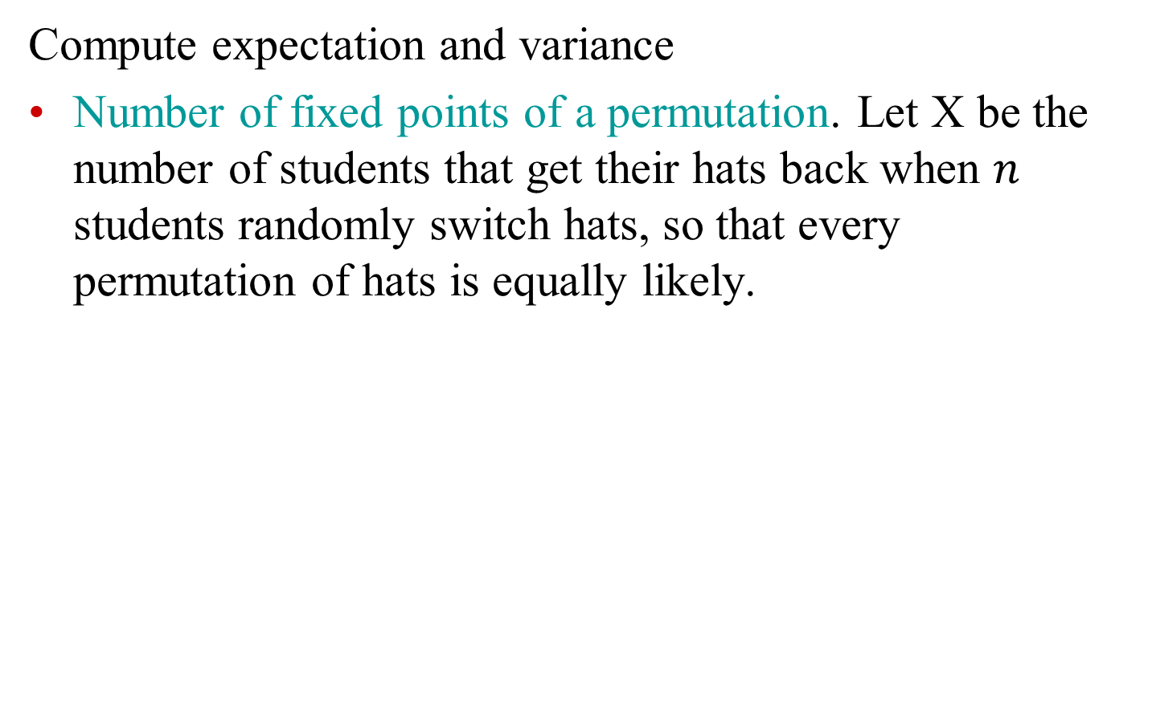
Exercise
Compute expectation and variance
Number of fixed points of a permutation. Let X be the number of students that get their hats back when $n$ students randomly switch hats, so that every permutation of hats is equally likely.
Notes:
1/6(1+4+9+16+25+36)-(7/2)^2=91/6-49/4=35/12; sum of first n squares is n(n+1)(2n+1)/6: (n+1)(2n+1)/6-(n+1)^2/4= (n^2-1)/12.

Slide 17
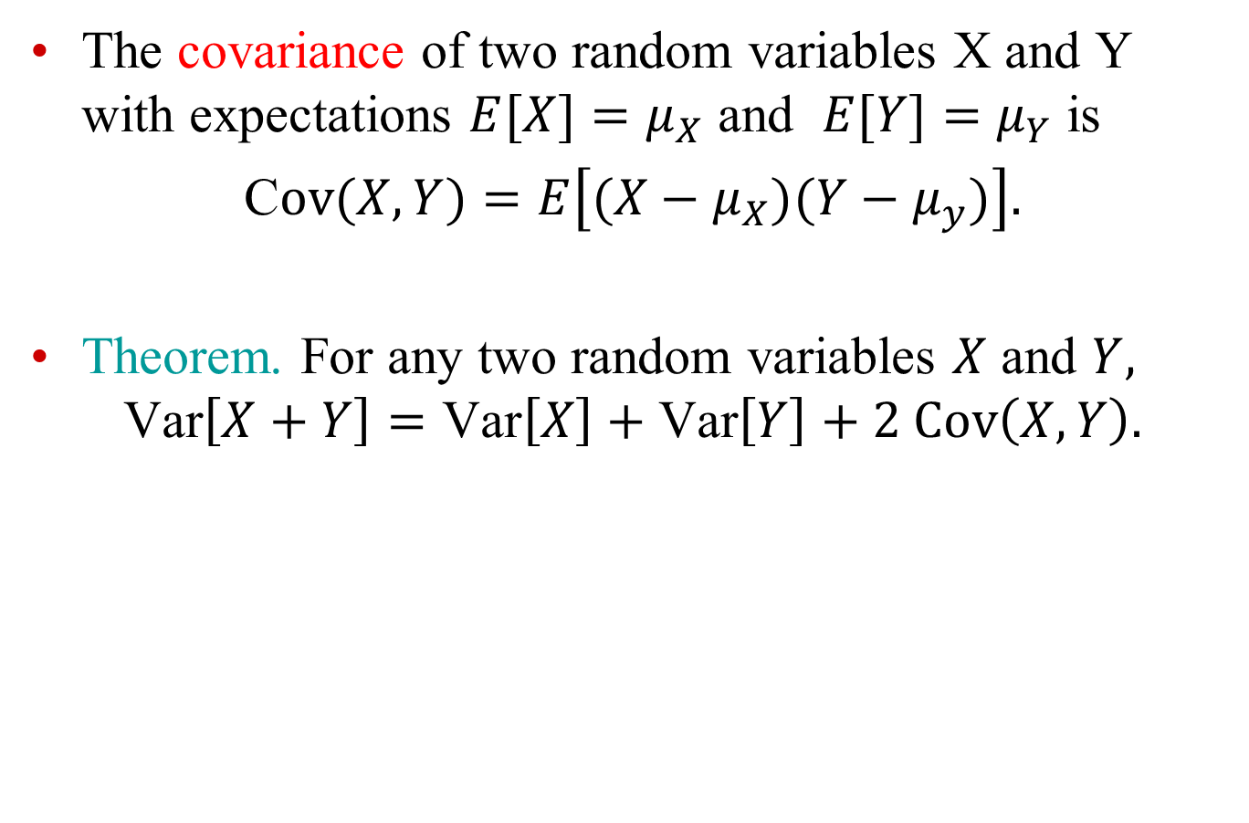
Random variables: covariance
The covariance of two random variables X and Y with expectations $E[X]=μ_{X}$ and $E[Y]=μ_{Y}$ is
C$ov(X,Y)=E\left[(X−μ_{X})(Y−μ_{y})\right].$
Theorem. For any two random variables $X$ and $Y,$
$$\text{Var}\left[X+Y\right]=\text{Var}\left[X\right]+\text{Var}\left[Y\right]+2 Cov\left(X,Y\right).$$

Slide 18
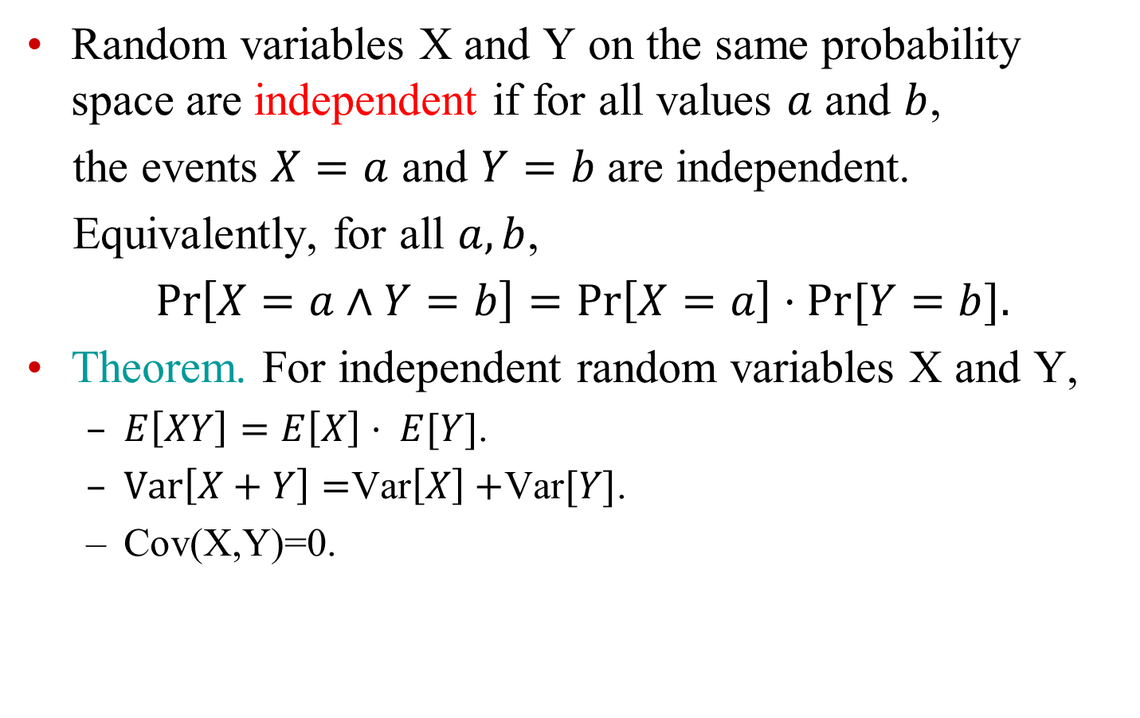
Independent RVs
Random variables X and Y on the same probability space are independent if for all values $a$ and $b$,
the events $X=a$ and $Y=b$ are independent.
Equivalently, for all $a,b$,
$\operatorname{Pr}\left[X=a∧Y=b\right]=\operatorname{Pr}\left[X=a\right]⋅Pr[Y=b].$
Theorem. For independent random variables X and Y,
  $E\left[XY\right]=E\left[X\right]⋅ E[Y]$.
  $Var\left[X+Y\right]=$Var$\left[X\right]+$Var$[Y]$.
  Cov(X,Y)=0.

Slide 19

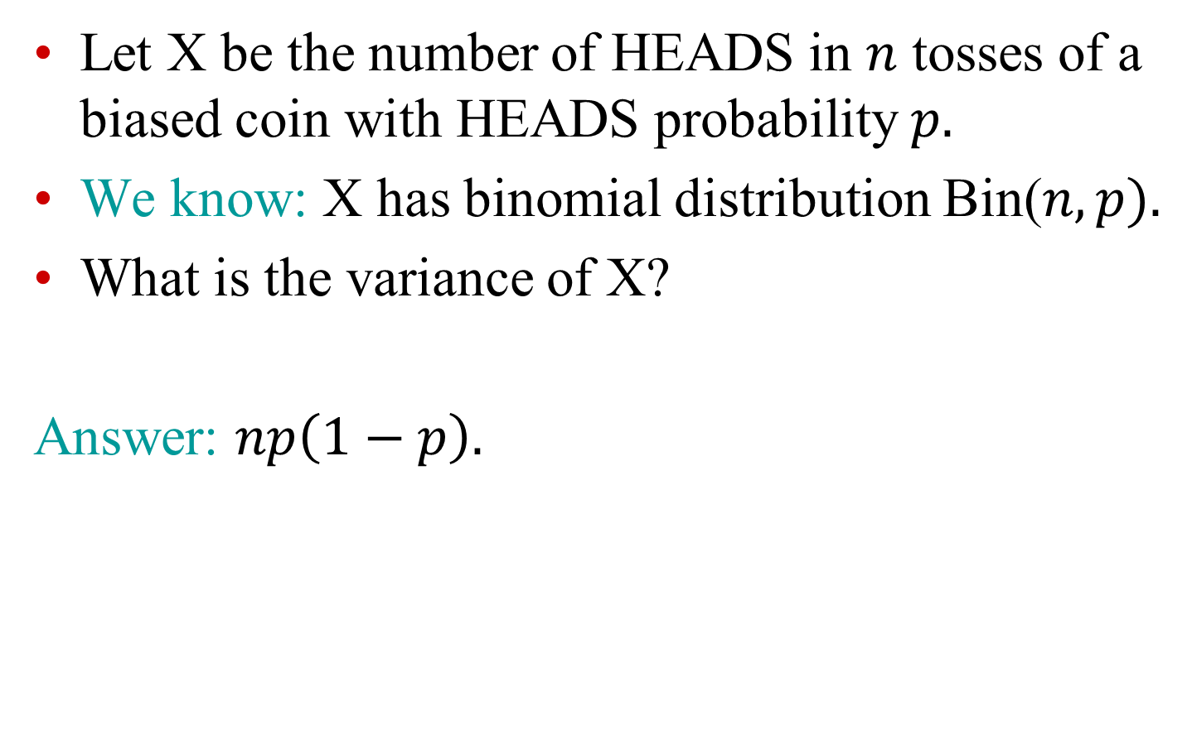
Example: $n$ coin tosses
Let X be the number of HEADS in $n$ tosses of a biased coin with HEADS probability $p.$
We know: X has binomial distribution Bin($n,p).$
What is the variance of X?
Answer: $np\left(1−p\right).$
Notes:
Np(1-p)

Slide 20
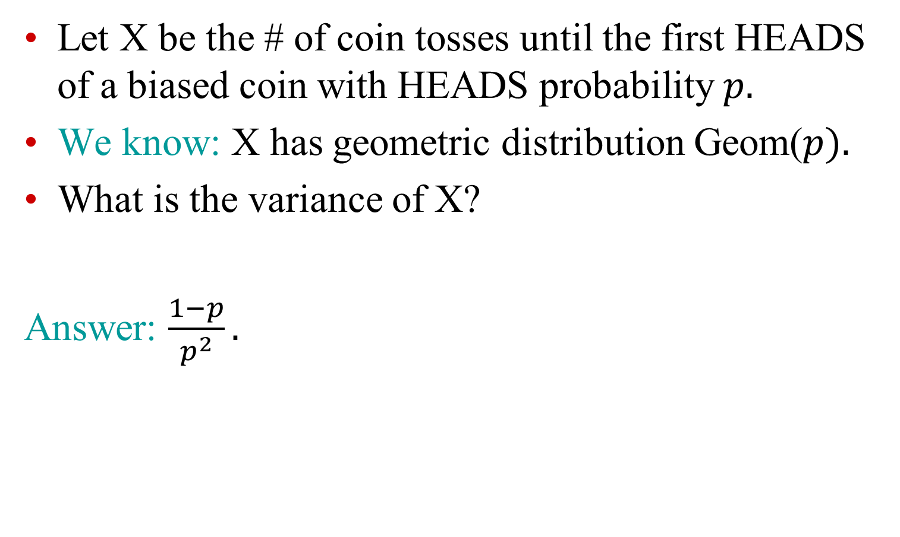
Example: Geometric RV
Let X be the # of coin tosses until the first HEADS of a biased coin with HEADS probability $p.$
We know: X has geometric distribution Geom($p).$
What is the variance of X?
Answer: $\frac{1−p}{p^{2}}.$

Slide 21
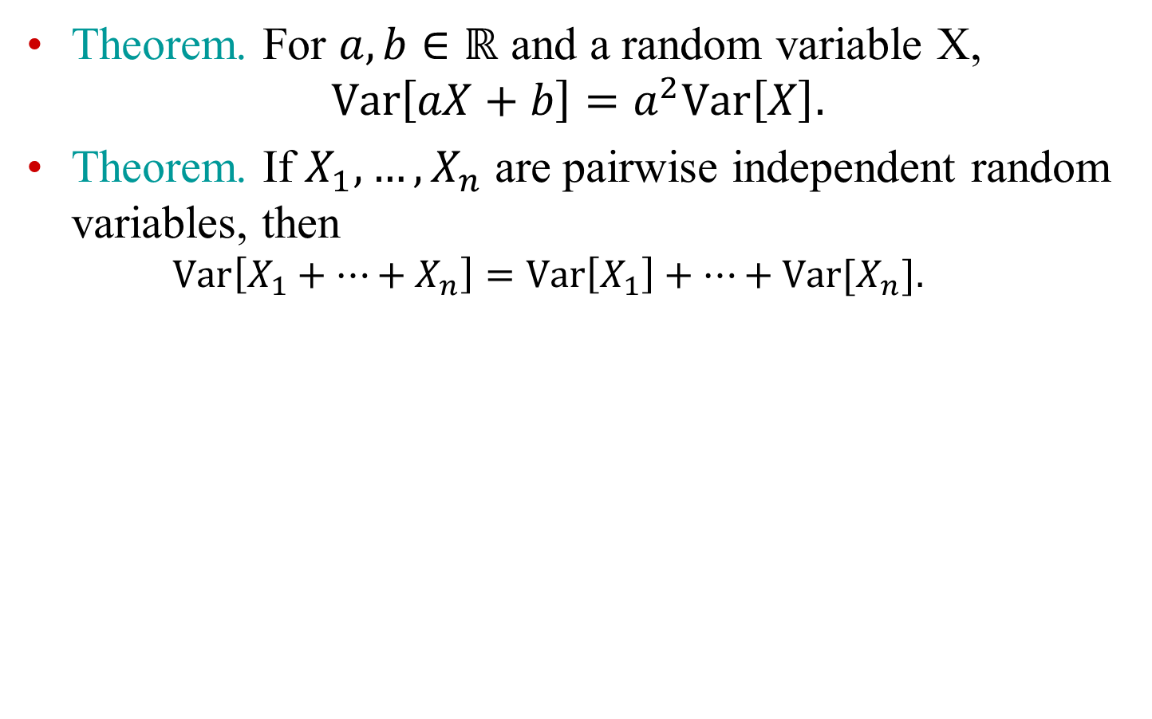
Variance: additional facts
Theorem. For $a,b∈ℝ$ and a random variable X,
$$Var\left[aX+b\right]=a^{2}Var\left[X\right].$$
Theorem. If $X_{1},…, X_{n}$ are pairwise independent random variables, then
  $$Var\left[X_{1}+…+X_{n}\right]=Var\left[X_{1}\right]+…+Var[X_{n}].$$

Slide 22
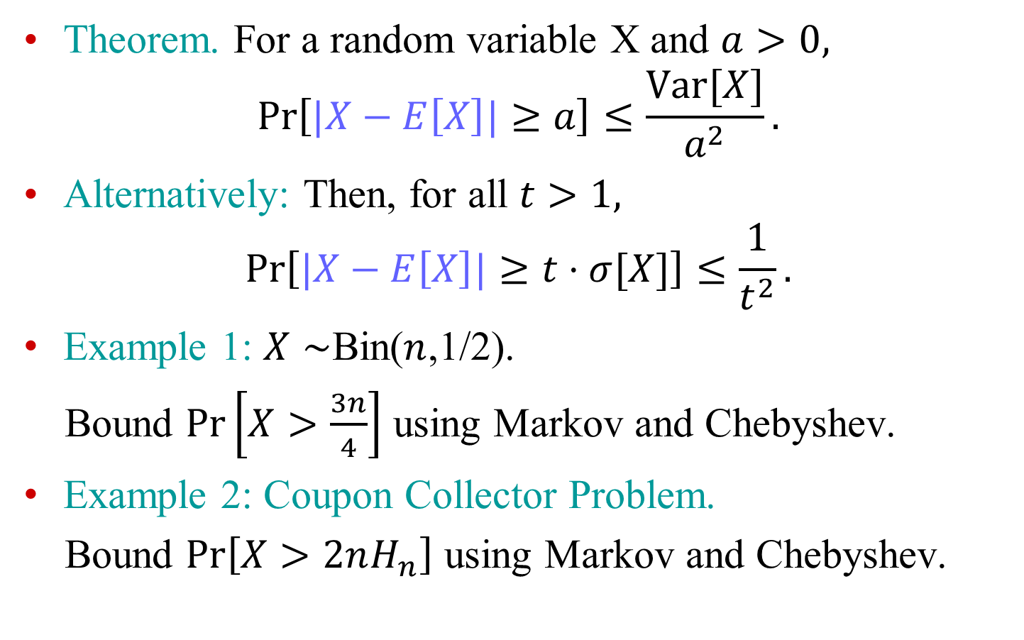
Chebyshev’s Inequality
Theorem. For a random variable X and $a>0,$
$$\operatorname{Pr}\left[|X−E\left[X\right]|≥a\right]≤\frac{Var[X]}{a^{2}}.$$
Alternatively: Then, for all $t>1,$
$$\operatorname{Pr}\left[|X−E\left[X\right]|≥t⋅σ[X]\right]≤\frac{1}{t^{2}}.$$
Example 1: $X∼$Bin($n$,1/2).
Bound $\operatorname{Pr}\left[X>\frac{3n}{4}\right]$ using Markov and Chebyshev.
Example 2: Coupon Collector Problem.
Bound $\operatorname{Pr}\left[X>2nH_{n}\right]$ using Markov and Chebyshev.

