Slide 1
AnnotSV ANNOVAR result merging
PeiMiao Chien
許書睿老師

Slide 2
Outline
TWBiobank 1496 WGS data
AnnotSV_ANNOVAR merge

Slide 3
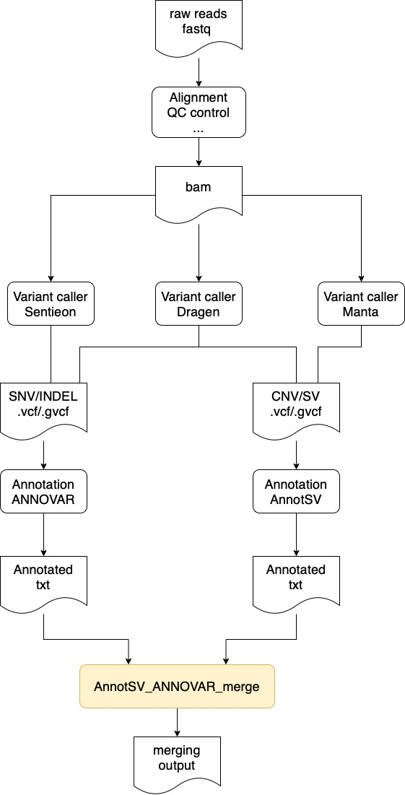
AnnotSV_ANNOVAR merge
vcf
vcf

Slide 4
ANNOVAR annotation format
hg19
refGene,cytoBand,knownGene,ensGene,gnomad211_genome,avsnp150,TaiwanBiobank_official,gnomad211_exome,clinvar_20210123,dbnsfp41a,dbscsnv11,gwava,TWB1496_AF
hg38
refGene,cytoBand,knownGene,ensGene,gnomad30_genome,avsnp150,gnomad211_exome,clinvar_20210123,icgc28,dbnsfp41a
Taiwan Genome https://genomes.tw/#/
One variant one row
Chr | Start | End | Ref | Alt | Gene.knownGene | GeneDetail.knownGene
chr22 | 10737302 | 10737302 | C | T | U2;FRG1FP | dist=1019;dist=202086
chr22 | 10737326 | 10737326 | - | CT | U2;FRG1FP | dist=1043;dist=202062
chr22 | 10737369 | 10737369 | C | T | U2;FRG1FP | dist=1086;dist=202019
chr22 | 10737402 | 10737402 | A | G | U2;FRG1FP | dist=1119;dist=201986
chr22 | 10737416 | 10737416 | T | A | U2;FRG1FP | dist=1133;dist=201972

Slide 5
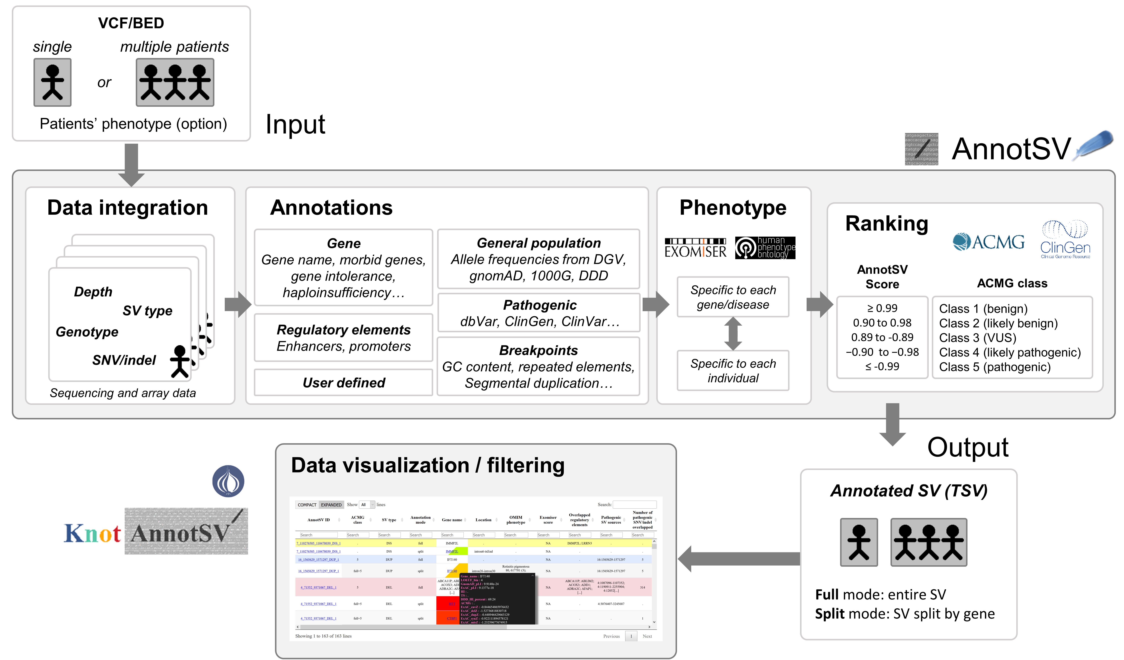
AnnotSV

Slide 6
AnnotSV annotation output format
One annotation one row
Split mode
SV_chrom | SV_start | SV_end | SV_length | SV_type | Samples_ID | REF | ALT | QUAL | FORMAT | MDD0026 | Gene_name
22 | 10711935 | 15938517 | 5226582 | <DUP> | MDD0026 | N | <DUP> | 150 | GT:SM:CN:BC:PE | ./1:2.36715:5:53:25,5 | BMS1P17
22 | 10711935 | 15938517 | 5226582 | <DUP> | MDD0026 | N | <DUP> | 150 | GT:SM:CN:BC:PE | ./1:2.36715:5:53:25,5 | BMS1P18
22 | 10711935 | 15938517 | 5226582 | <DUP> | MDD0026 | N | <DUP> | 150 | GT:SM:CN:BC:PE | ./1:2.36715:5:53:25,5 | BMS1P22
22 | 10711935 | 15938517 | 5226582 | <DUP> | MDD0026 | N | <DUP> | 150 | GT:SM:CN:BC:PE | ./1:2.36715:5:53:25,5 | DUXAP8
22 | 10711935 | 15938517 | 5226582 | <DUP> | MDD0026 | N | <DUP> | 150 | GT:SM:CN:BC:PE | ./1:2.36715:5:53:25,5 | FRG1FP
22 | 10711935 | 15938517 | 5226582 | <DUP> | MDD0026 | N | <DUP> | 150 | GT:SM:CN:BC:PE | ./1:2.36715:5:53:25,5 | LOC102723769
22 | 10711935 | 15938517 | 5226582 | <DUP> | MDD0026 | N | <DUP> | 150 | GT:SM:CN:BC:PE | ./1:2.36715:5:53:25,5 | OR11H1
22 | 10711935 | 15938517 | 5226582 | <DUP> | MDD0026 | N | <DUP> | 150 | GT:SM:CN:BC:PE | ./1:2.36715:5:53:25,5 | POTEH
22 | 10711935 | 15938517 | 5226582 | <DUP> | MDD0026 | N | <DUP> | 150 | GT:SM:CN:BC:PE | ./1:2.36715:5:53:25,5 | POTEH-AS1
Full mode
SV_chrom | SV_start | SV_end | SV_length | SV_type | Samples_ID | REF | ALT | QUAL | FORMAT | MDD0026 | AnnotSV_ranking_score | AnnotSV_ranking_criteria | ACMG_class
22 | 10711935 | 15938517 | 5226582 | <DUP> | MDD0026 | N | <DUP> | 150 | GT:SM:CN:BC:PE | ./1:2.36715:5:53:25,5 | 1 | 1A (+0.00);2A (cf P_gain_source, +1.00);3A (10 genes, +0.00);5F (+0.00) | 5
Technical standards for the interpretation and reporting of constitutional copy-number variants: a joint consensus recommendation of the American College of Medical Genetics and Genomics (ACMG) and the Clinical Genome Resource (ClinGen)
https://pubmed.ncbi.nlm.nih.gov/31690835/

Slide 7
AnnotSV

Slide 8
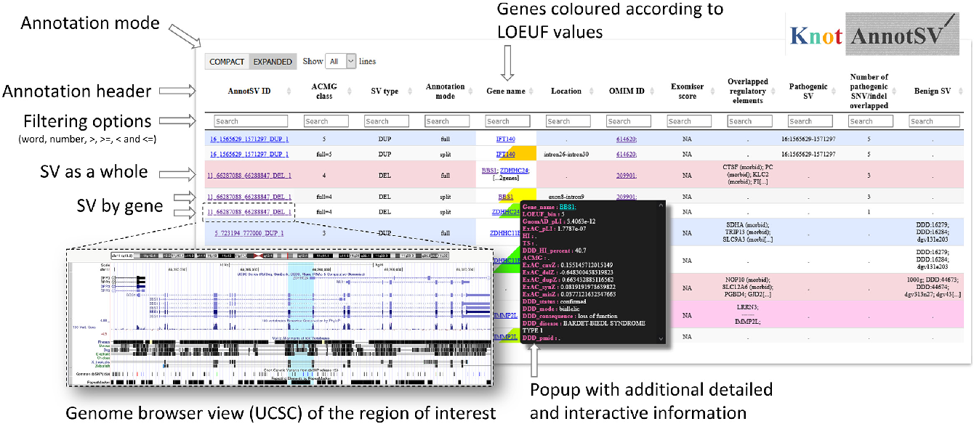

KnotAnnotSV

Slide 9
Merging output format
Chr | Start | End | Ref | Alt | … | Sample1_sv
1 | 1 | 100 | A | <DEL> | XXXX | 0/1
Chr | Start | End | Ref | Alt | … | Sample1_cnv
1 | 1 | 100 | A | <DEL> | OOO | 0/1
1 | 1 | 100 | A | <DEL> | △△△ | 0/1
Chr | Start | End | Ref | Alt | … | Sample2_cnv
1 | 1 | 100 | A | <DEL> | OOO | 1/1
1 | 1 | 100 | A | <DEL> | △△△ | 1/1
Chr | Start | End | Ref | Alt | … | Sample1 | Sample2
1 | 1 | 100 | A | <DEL> | XXXX,OOO, △△△ | 0/1 | 1/1

Slide 10
Merging output format
Based on AnnotSV : Gene_name
ANNOVAR : Gene.refGene
Sample Genotype
Chr | Start | End | Ref | Alt | Annotsv…ANNOVAR | Sample1 | Sample2 | Counts | Candidate_gene_filter
1 | 1 | 1 | A | <DEL> | XXXX,OOO, △△△ | 0/1 | 1/1 | 2 | +
1 | 2 | 2 | C | <DUP> | ▀ ▀ ▀ | . | 0/1 | 1 | -
How many samples in this cohort got this variant

Slide 11

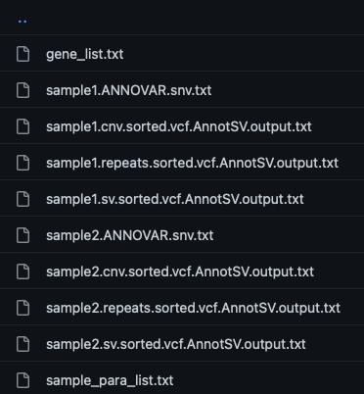
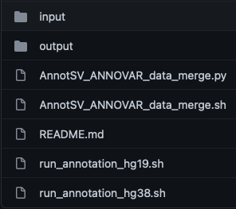


Operation steps
1
Github:https://github.com/peimiaochien/AnnotSV_ANNOVAR_data_merge.git
2
Making input files
4
rename the files
/staging/reserve/paylong_ntu/AI_SHARE/GitHub/Germline_variant/A1_Panel
/staging/reserve/paylong_ntu/AI_SHARE/GitHub/ANNOTATION/AnnotSV/run_AnnotSV.sh
3
Put input files into folder
5
Generate sample_para_list.txt
6
Generate gene_list.txt

Slide 12
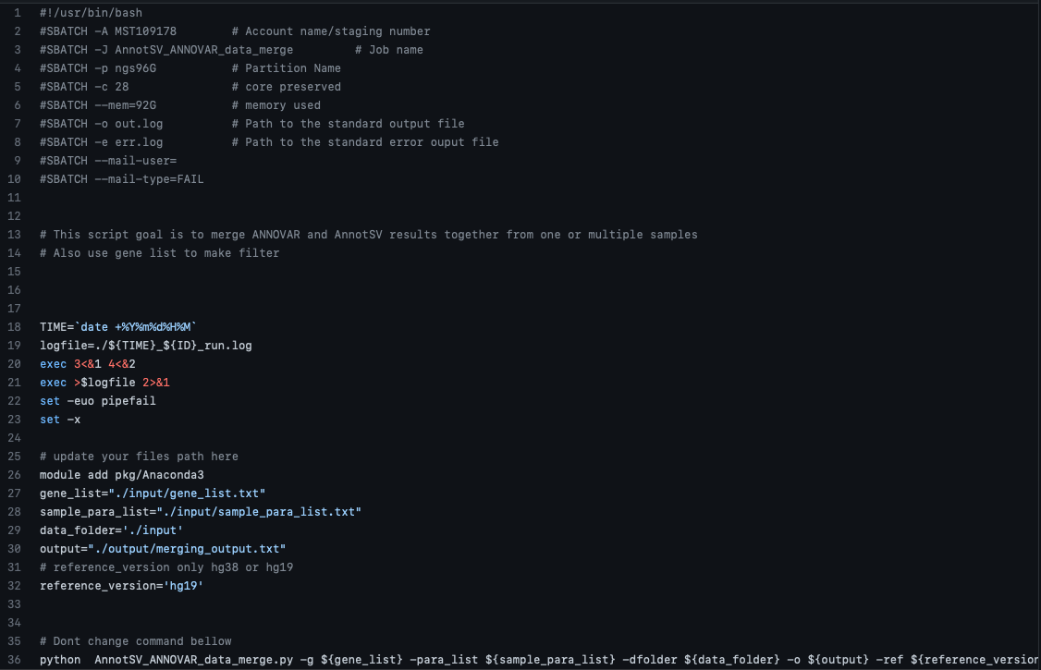
Based on your data size and samples amount
7
Renew information in shell

Slide 13
Summary
ACMG class
Allele frequency
Sample Genotype
Chr | Start | End | Ref | Alt | Annotsv…ANNOVAR | Sample1 | Sample2 | Counts | Candidate_gene_filter
1 | 1 | 1 | A | <DEL> | XXXX,OOO, △△△ | 0/1 | 1/1 | 2 | +
1 | 2 | 2 | C | <DUP> | ▀ ▀ ▀ | . | 0/1 | 1 | -
Merging different type variant information
Pathogenic information filter
Merging all information in the cohort

