Slide 1

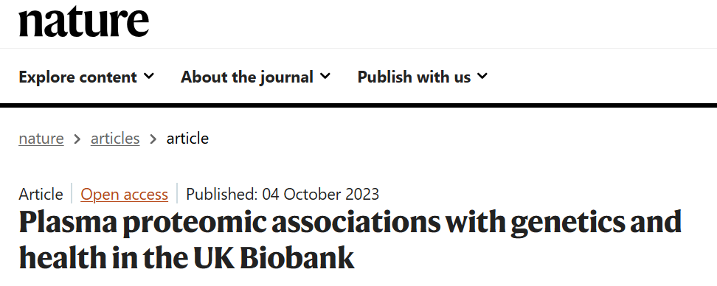
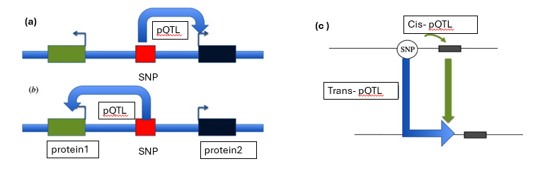
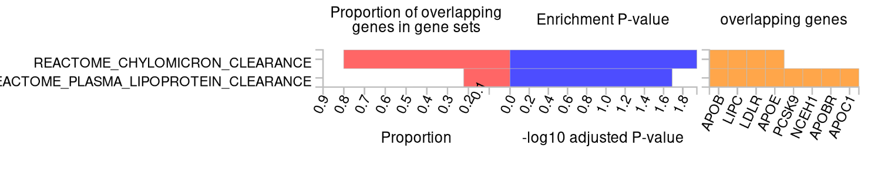
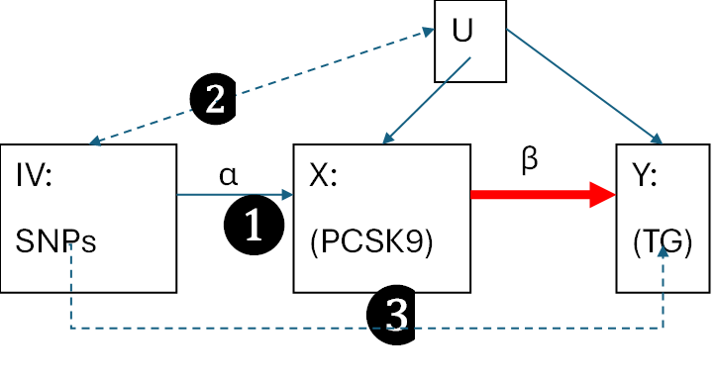
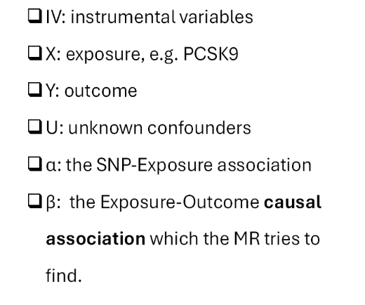
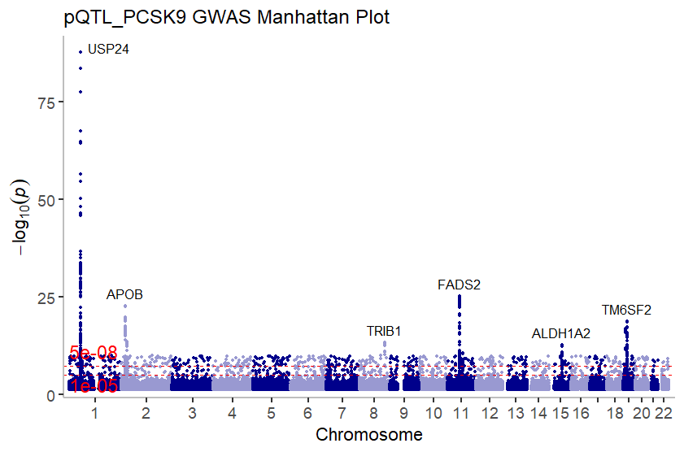
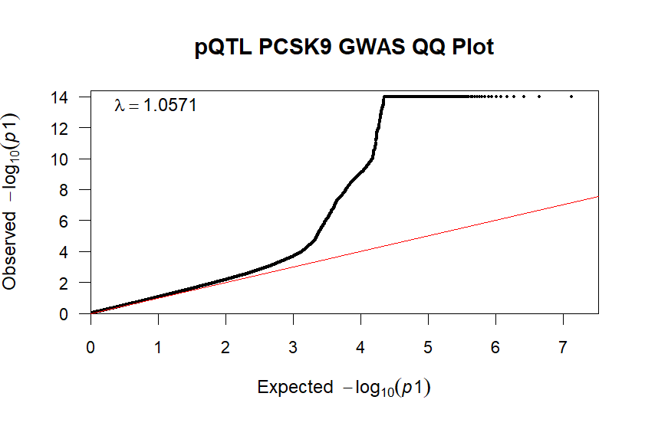
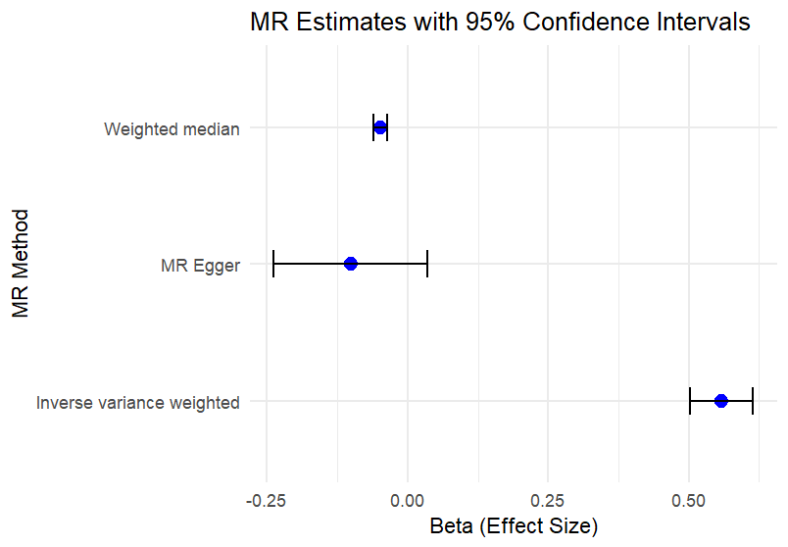
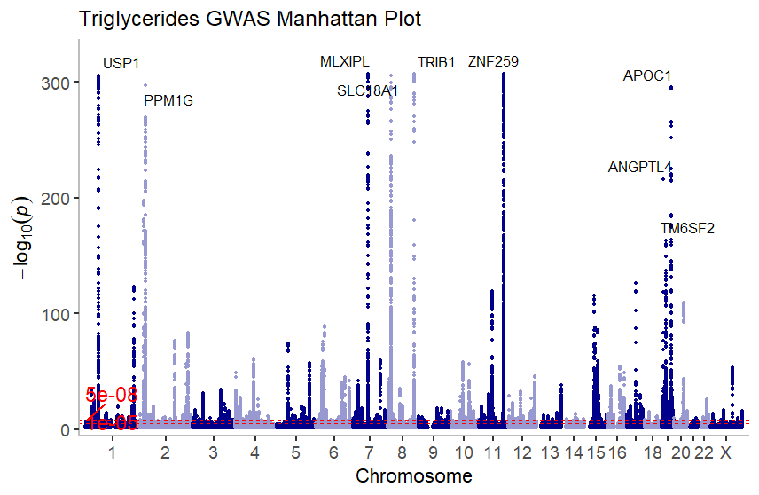
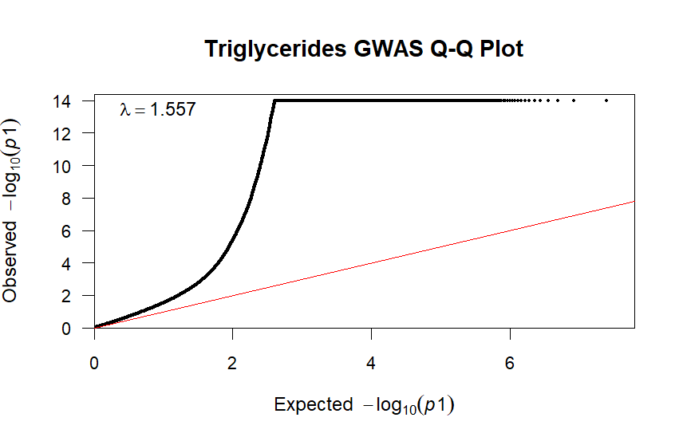

Disentangling the functions and pathways from the genetic associated with plasma proteomics
Ng Pei Ming (PI: Y2110746)
Supervisor: Prof. Pan Hong
Project Code: BME499_JAN25
I. Introduction/Abstract
II. Background
In (a) and (b), the pQTL is located within 1 MB of Protein 1 or Protein 2 on the same chromosome; therefore, it is a cis- pQTL [1].
In (c), the pQTL is located on a different chromosome from the targeted protein. It is a trans- pQTL [1].
Plasma Proteomics Project in the UK Biobank (UKB-PPP)
Protein quantitative trait loci (pQTL) are the genetic variants significantly associated with protein changes.
Figure 1 illustrates cis- pQTL and trans- pQTL.
III. Research Questions
IV. Methodology
Table 1 illustrates the sample size of UKB-PPP
R programming
Manhattan and QQ Plot of PCSK9 and Triglycerides
Genome-wide Significance
of P < 1.7 × 10⁻¹¹
Sample size | 54,219 UK Biobank participants
Protein count | 2,923 unique proteins
Primary genetic associations identified | 14,287
Proportion of novel associations | Approximately 81%
Platform used | Olink Explore 3072
R programming
Mendelian Randomization (MR)
The causality between the exposure (PCSK9)
and outcome (TG)
Objective
The objective of this study is to understand the protein quantitative trait locus (pQTL) by studying the latest research results in UKB-PPP and investigating protein-trait causality through a Mendelian Randomization study [2].
Figure 2 illustrates the results of FUMA (Functional Mapping and Annotation of Genetic Associations).
PCSK9
Figure 3 illustrates that Mendelian Randomization relies on three core assumptions: relevance, independence, and exclusion restriction.
Triglyceride
V. Results & Discussion
VI. Conclusion
GWAS Results and Mendelian Randomization
Mendelian randomization assumptions II might be violated if the instrument is influenced by horizontal pleiotropy.
As a result, this could lead to invalid instrumental variables.
Robust Mendelian Randomization methods, such as IVW, Weighted Median, and MR-Egger, were used to address potential pleiotropy.
Weak instruments (SNPs with small effect sizes) can bias causal estimates.
Figure 4 and 5 illustrates Manhattan and QQ plot of pQTL PCSK9 respectively.
Figure 8 illustrates MR Estimates with 95% Confidence Intervals against Beta
Figure 6 and 7 illustrates Manhattan and QQ plot of Triglycerides respectively.
GWAS Results
Manhattan Plot and QQ Plot
Table 2 illustrates the test results for different criteria in MR
FUMA functional annotation
Method | beta | se | p-value | Assumption | Result | Interpretation
MR Egger | -0.1017 | 0.0696 | 0.145 | Directional pleiotropy | Fail | No strong causal effect, possible pleiotropic bias
Weighted median | -0.0486 | 0.0058 | 6.37 x 10^-17 | At least 50% of the weight comes from valid instruments | Successful | Significant association. Robust to some invalid instruments
Inverse variance weighted | 0.5581 | 0.0287 | 2.83 x 10^-84 | All valid instruments | Successful | Significant association
Mendelian Randomization
Result: PCSK9 may not directly influence
TG levels
References:
[1] Sun, B.B., Chiou, J., Traylor, M. et al. Plasma proteomic associations with genetics and health in the UK Biobank. Nature 622, 329–338 (2023). https://doi.org/10.1038/s41586-023-06592-6
[2] Hajar R. PCSK 9 Inhibitors: A Short History and a New Era of Lipid-lowering Therapy. Heart Views. 2019 Apr-Jun;20(2):74-75. doi: 10.4103/HEARTVIEWS.HEARTVIEWS_59_19. PMID: 31462965; PMCID: PMC6686613. https://pmc.ncbi.nlm.nih.gov/articles/PMC6686613/
Notes:
Note:
Do not change the format and color of the poster.
Upload your poster at Canvas > Assignments> Poster.
Print the poster in A1 sized on PP Paper (with no backboard) and bring on Oral Presentation day.

