Slide 1
系統設計書—組套
Product Owner | 孫培然
Scrum Master | 黃浩軒
Scrum Team | 張書綺、黃浩軒、柏升偉、陳睿謙
2019.09.02編制

Slide 2
系統設計大綱
UI & Event Binding
ViewModel
View Service
WebAPI Controller
Model Service
Stored Procedure

Slide 3
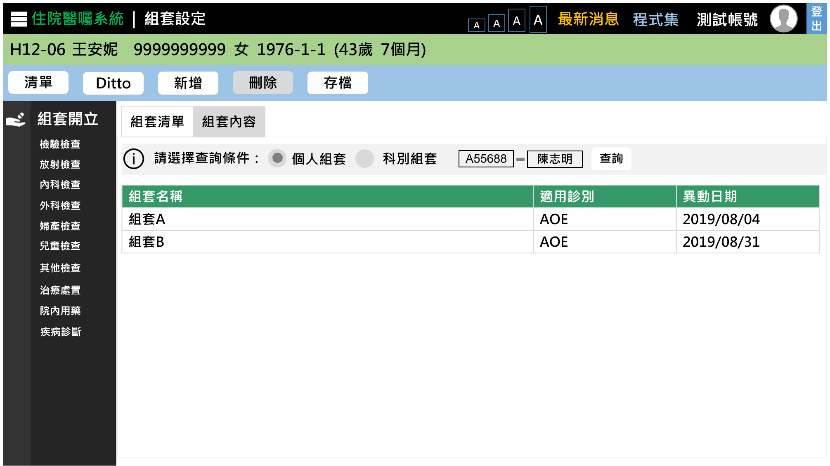
1. UI & Event Binding (1/12)-個人
序 | 事件名稱
1 | onListClick($event)
2 | onDittoClick($event)
3 | onAddClick($event)
4 | onRemoveClick($event)
5 | onSaveClick ($event)
6 | onOptionChange($event)
7 | onSearchClick($event)
8 | onRowSelect($event)
9 | onDrChange($event)
❶
❷
❸
❹
❺
按下搜尋後，秀出醫師姓名
❻
❾
❼
❽
單按一下，跳至該組套的組套內容
續下頁，選擇科別組套介面設計

Slide 4
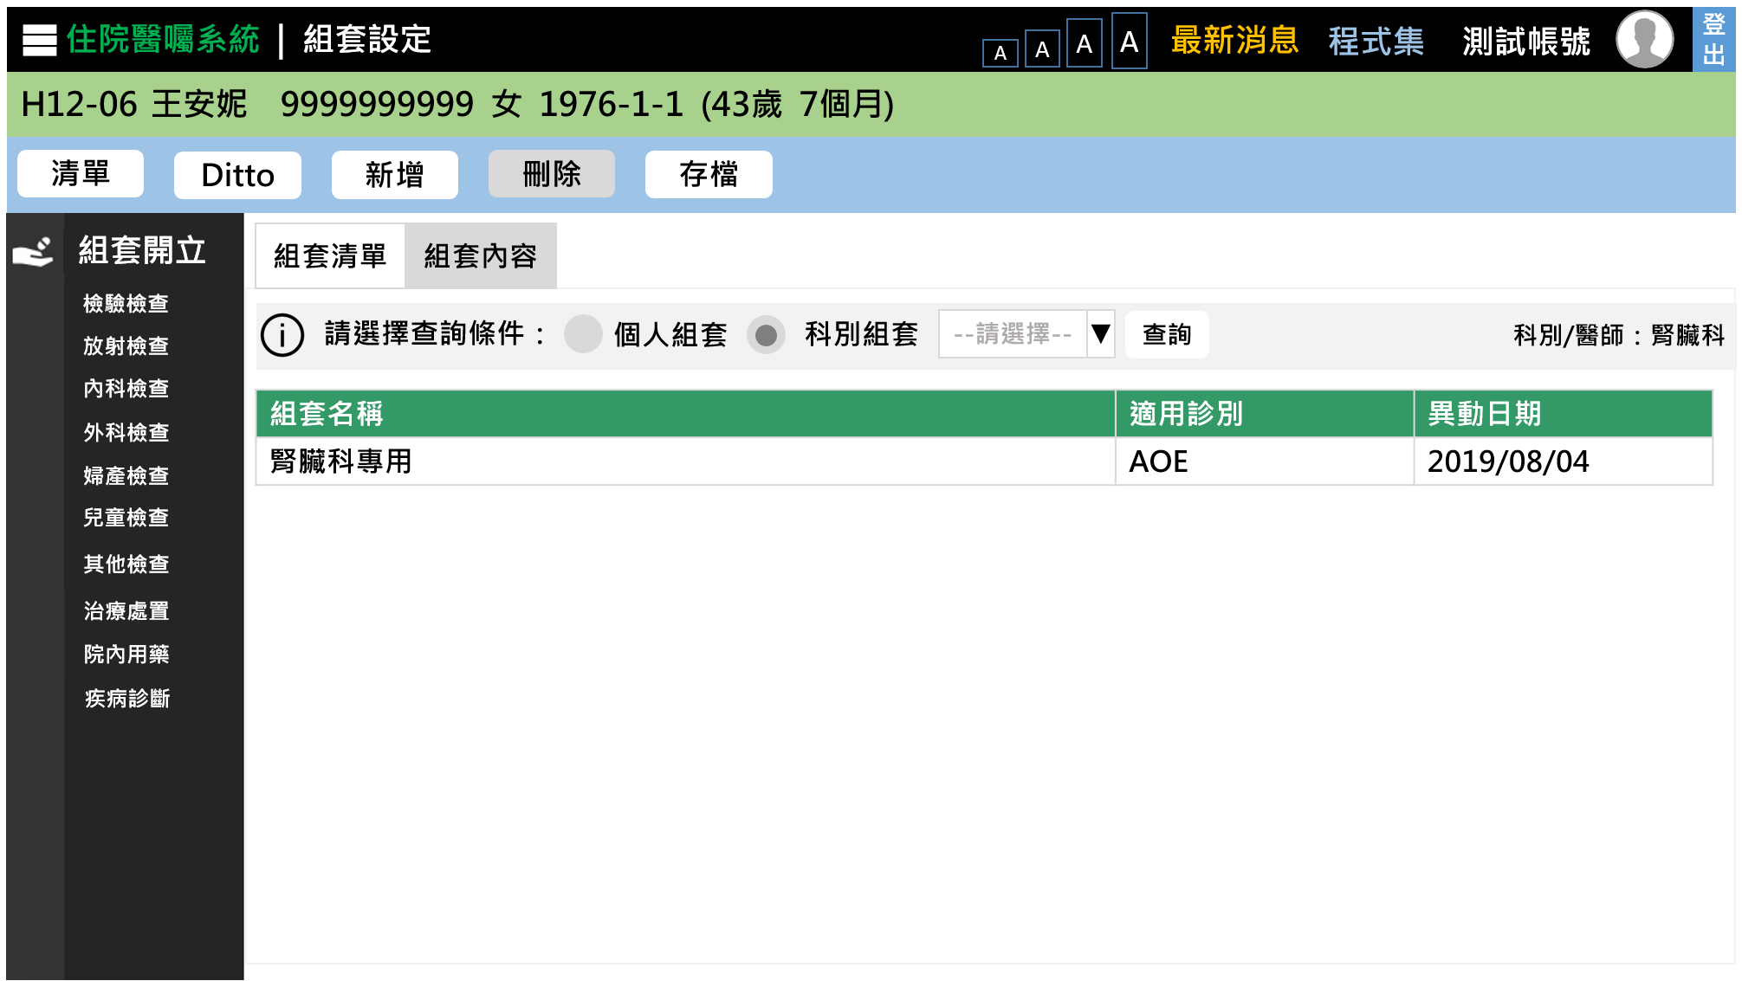
1. UI & Event Binding (1/12)-科別
序 | 事件名稱
1 | onListClick($event)
2 | onDittoClick($event)
3 | onAddClick($event)
4 | onRemoveClick($event)
5 | onSaveClick ($event)
6 | onOptionChange($event)
7 | onDivChange ($event)
8 | onSearchClick($event)
9 | onRowSelect($event)
❶
❸
❹
❺
❶
❷
❹
❷
❸
❺
❻
❻
❼
❼
❽
❽
❾
❾

Slide 5
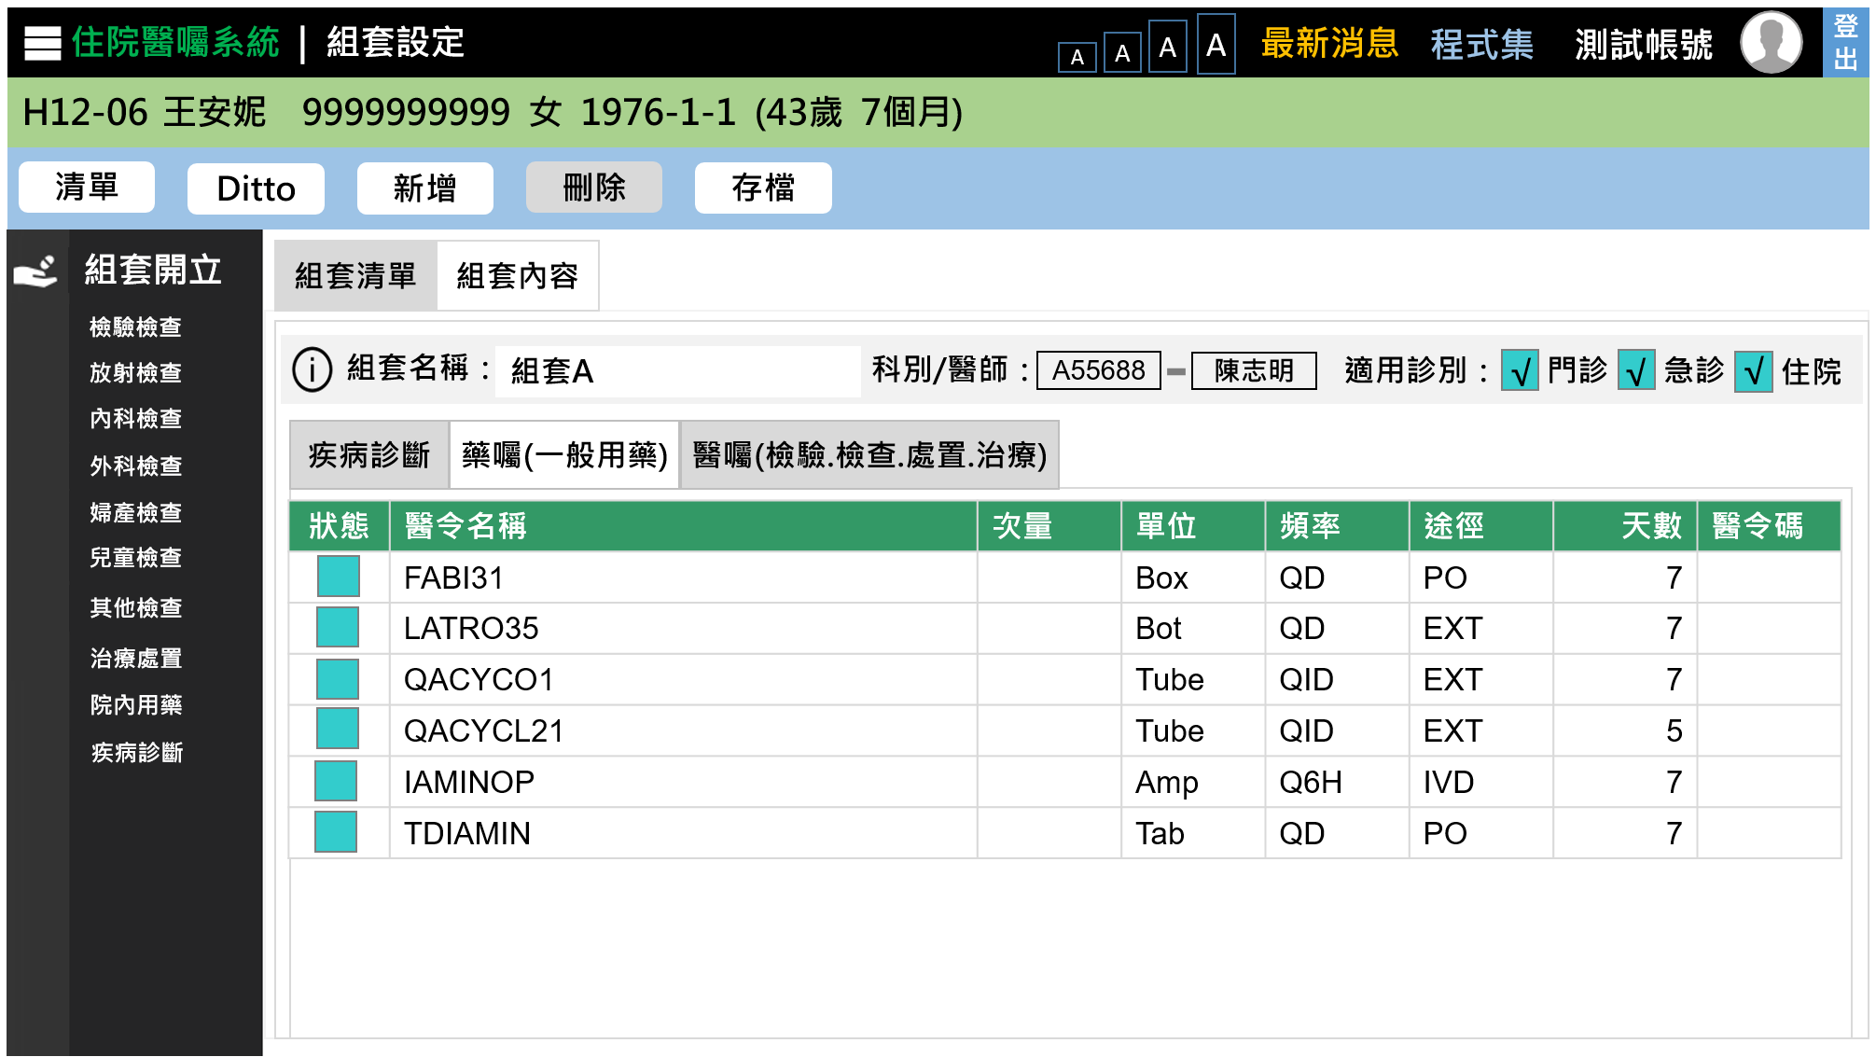
1. UI & Event Binding (2/12)
序 | 事件名稱
1 | onDosageQtyChange($event)
2 | onDosageUnitChange($event)
3 | onUsageClick($event)
4 | onWayClick($event)
5 | onUsedDaysChange($event)
6 | onStatusClick($event)
❷
❸
❹
❺
❶
Change& Click用法差別
1.Change是用在單點擊，即可更改表格中內容
2.Click事件，是用於點擊後，他還會跳出一個視窗上使用者選取
❻
按下可以更改欄位內容

Slide 6
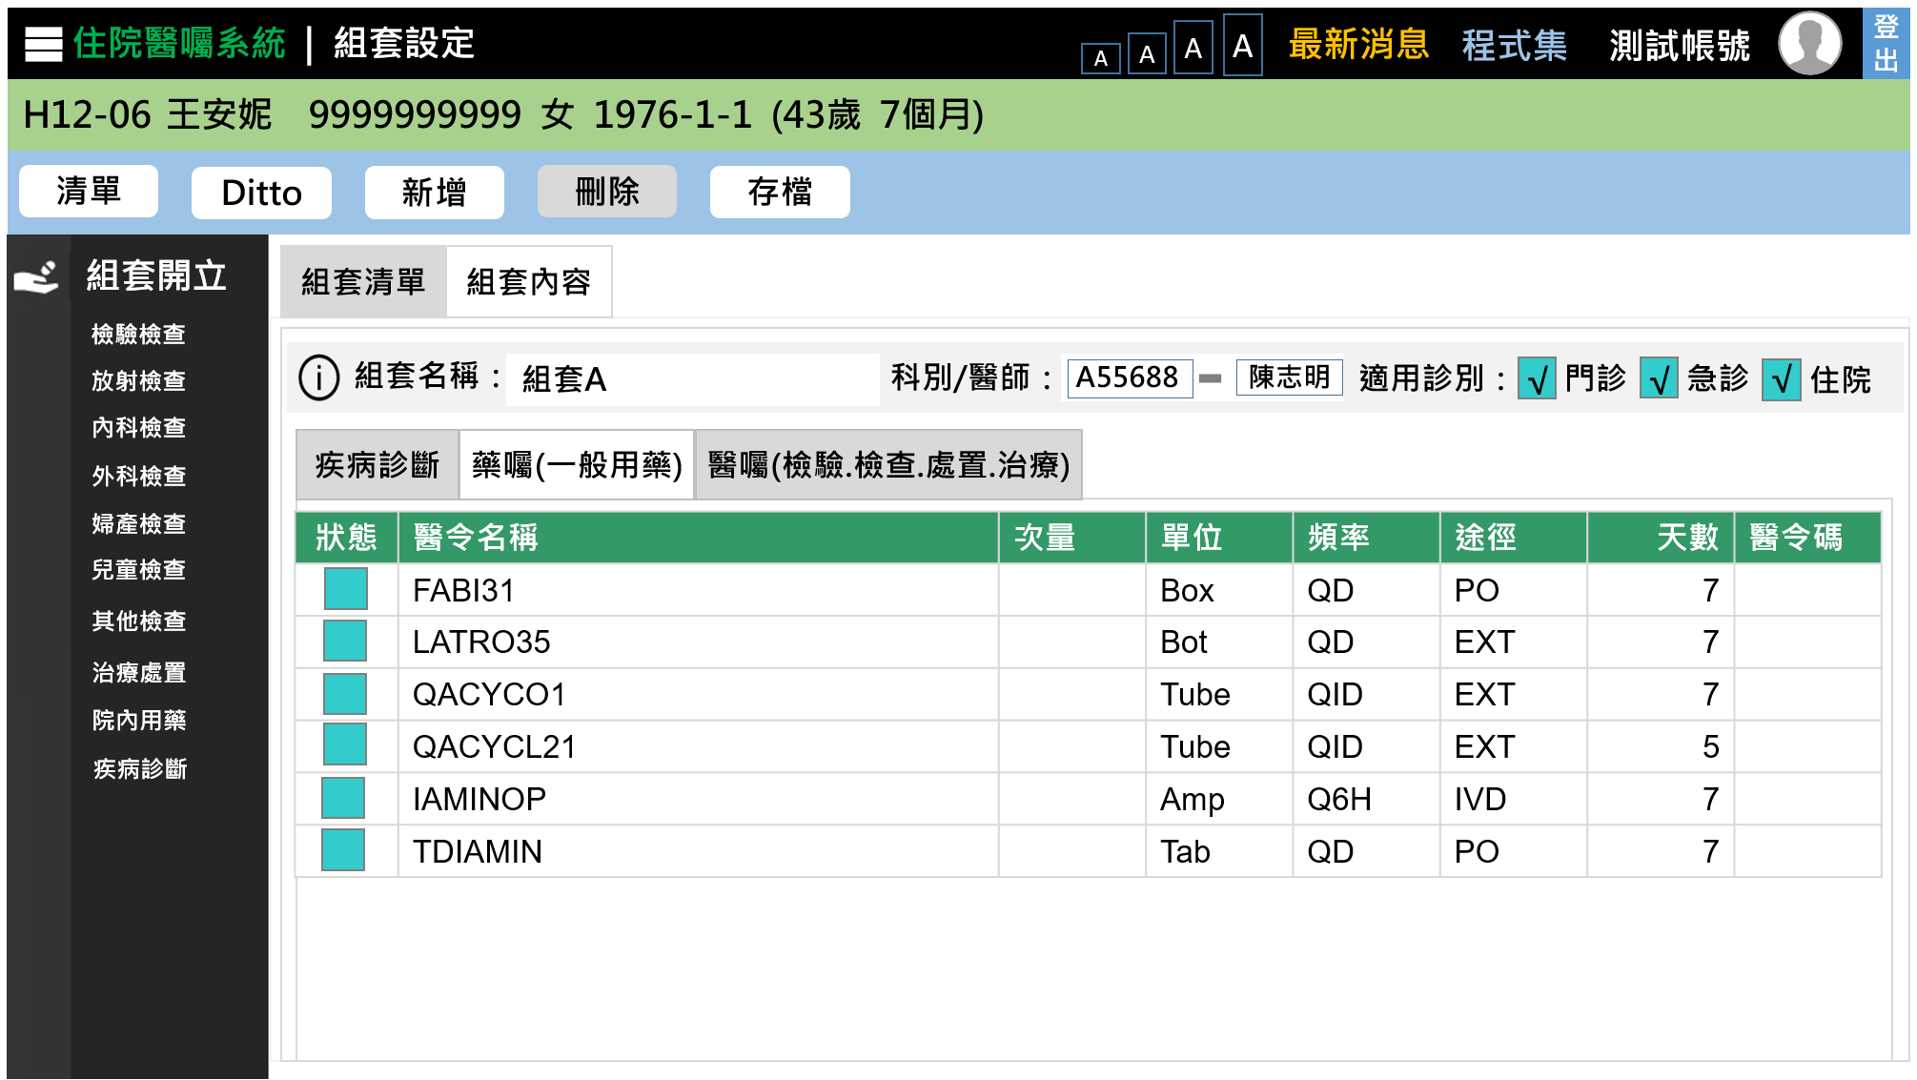
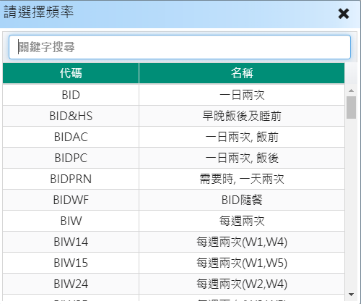
1. UI & Event Binding (2/12) – 頻率
序 | 事件名稱
1 | onDosageQtyChange($event)
2 | onDosageUnitChange($event)
3 | onUsageClick($event)
4 | onWayClick($event)
5 | onUsedDaysChange($event)
6 | onStatusClick($event)
7 | onUsageSelect($event)
8 | onWaySelect($event)
❷
❸
❹
❺
❼
❶
❻
按下頻率後彈跳出視窗，即可更改頻率

Slide 7
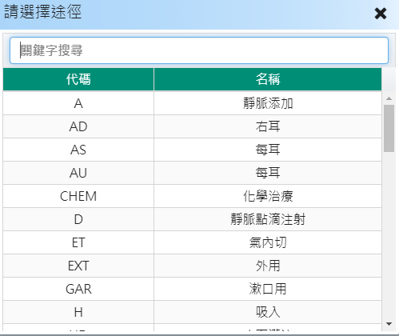
1. UI & Event Binding (2/12) – 途徑
序 | 事件名稱
1 | onDosageQtyChange($event)
2 | onDosageUnitChange($event)
3 | onUsageClick($event)
4 | onWayClick($event)
5 | onUsedDaysChange($event)
6 | onStatusClick($event)
7 | onUsageSelect($event)
8 | onWaySelect($event)
❷
❸
❹
❺
❽
❶
❻
按下途徑後彈跳出視窗，即可更改途徑

Slide 8
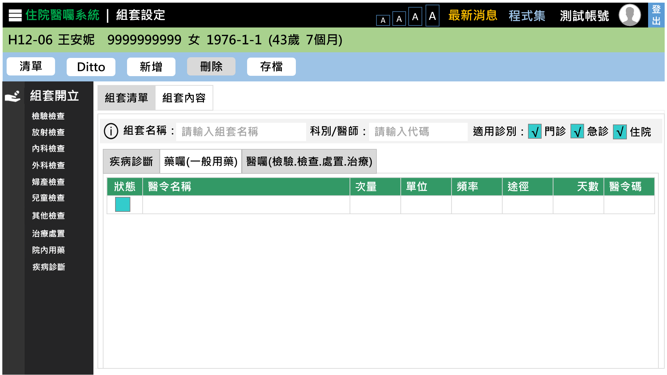
1. UI & Event Binding (3/12)
序 | 事件名稱
1 | onAddClick($event)
❶

Slide 9
1. UI & Event Binding (4/12)
序 | 事件名稱
1 | onDittoClick($event)
❶
Ditto：
tempNo = null

Slide 10
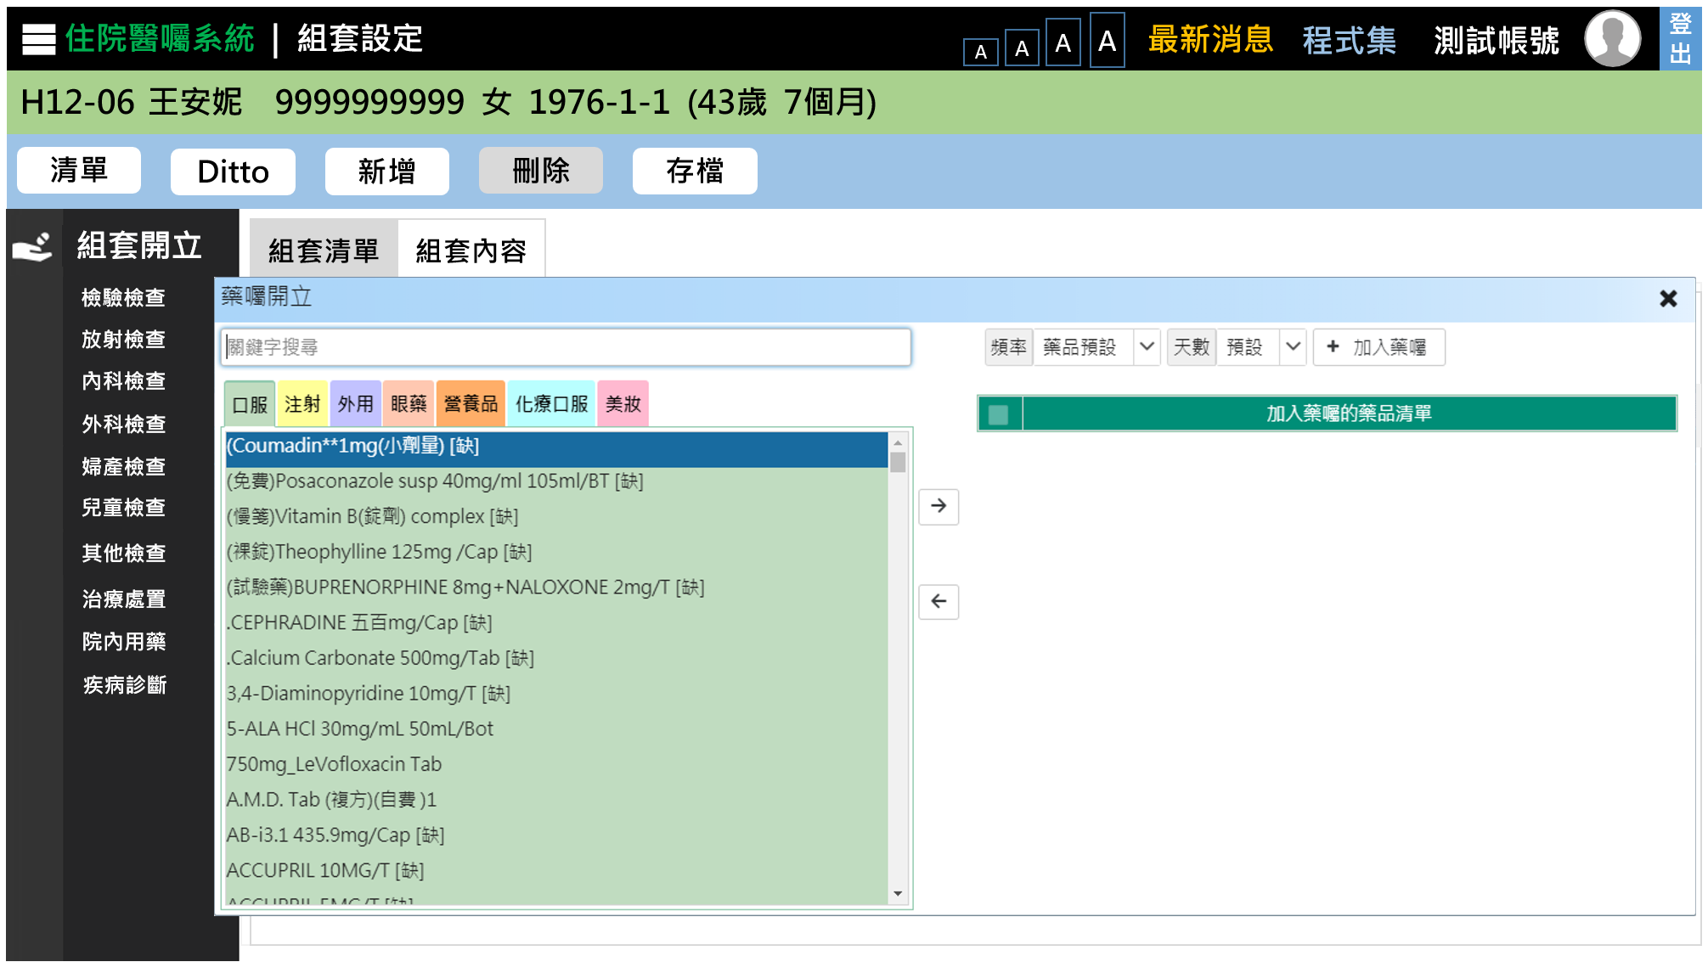
1. UI & Event Binding (5/12)
序 | 事件名稱
1 | onTabChange($event)
2 | onSearchKeyUp($event)
3 | onAddToCartClick($event)
4 | onRemoveClick($event)
5 | onOrderClick($event)
❷
❺
❶
❸
❹
❸

Slide 11
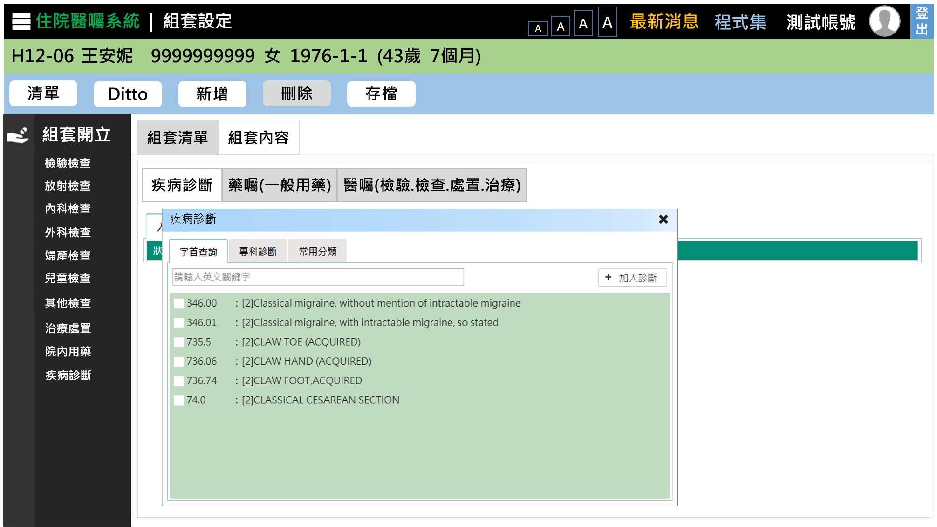

1. UI & Event Binding (6/12)-字首查詢
序 | 事件名稱
1 | onSearchKeyUp($event)
2 | onAddClick($event)
3 | onOrderClick($event)
4 | onTabChange($event)
❹
❸
❶

Slide 12
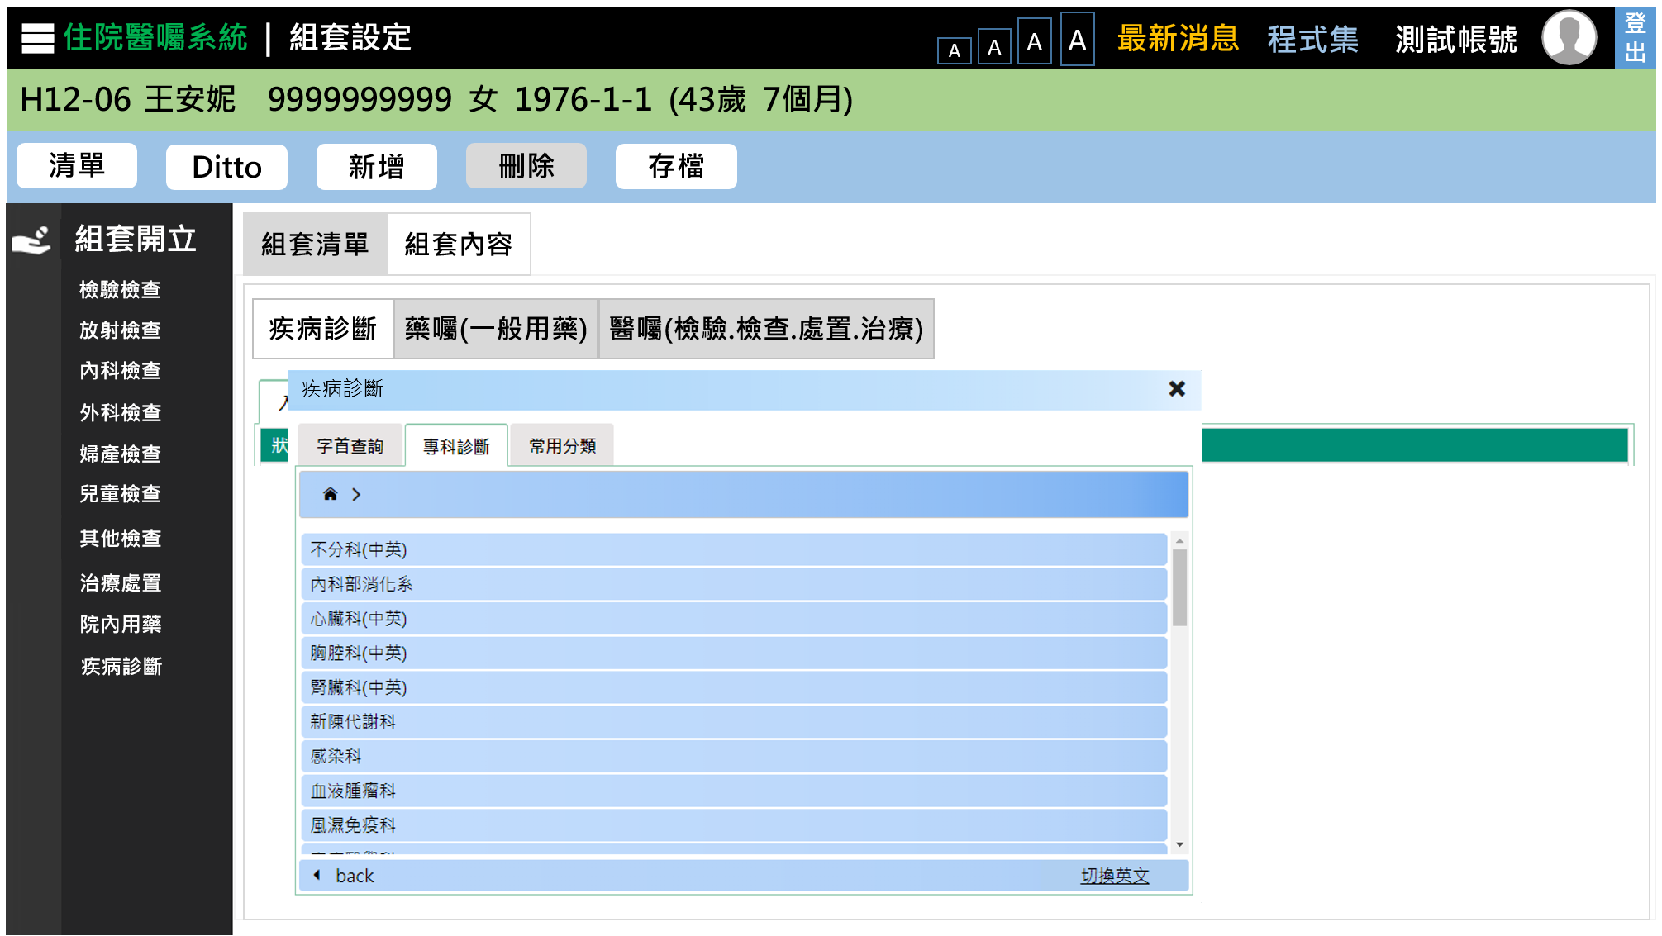
1. UI & Event Binding (6/12)-專科診斷
序 | 事件名稱
1 | onHomeClick($event)
2 | onShortCutClick($event)
3 | onNextClick($event)
4 | onBackClick($event)
5 | onLangChange($event)
❶
功能列點擊
這邊產生breadcrum內容
❸
選項點擊
點「英文」:切換英文
再點一次:「切換中文」
❹
❺

Slide 13
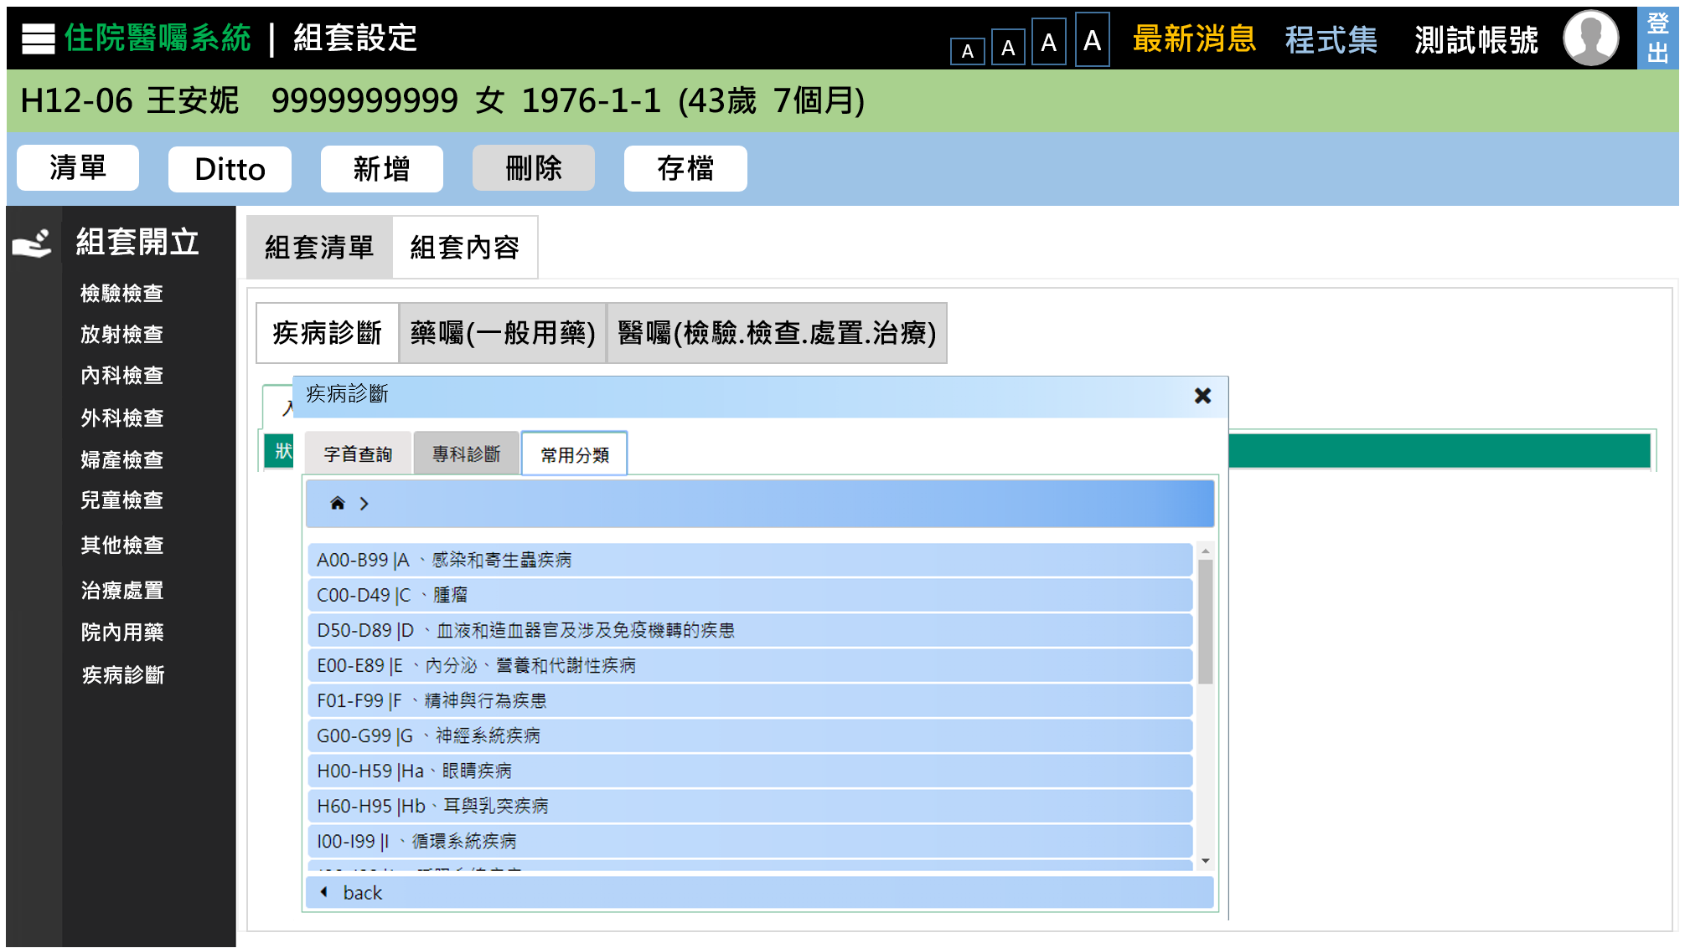
1. UI & Event Binding (6/12)-常用分類
序 | 事件名稱
1 | onHomeClick($event)
2 | onShortCutClick($event)
3 | onNextClick($event)
4 | onBackClick($event)
功能列點擊
❶
產生breadcrum內容
❸
選項點擊
❹

Slide 14
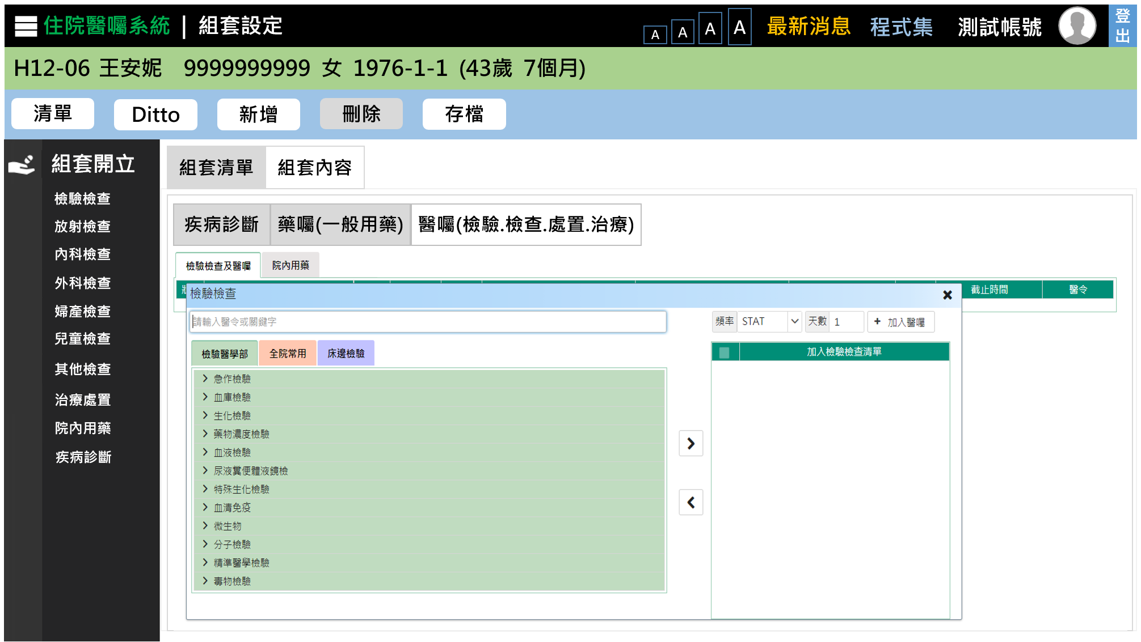
1. UI & Event Binding (7/12)
序 | 事件名稱
1 | onSearchKeyUp($event)
2 | onTabChange ($event)
3 | onAddToCartClick($event)
4 | onRemoveClick($event)
5 | onOrderClick($event)
❺
❶
❷
❸
「檢驗檢查」至「治療處置」方法皆同表格所示
❸
❹

Slide 15
2. ViewModel(1/2)
MedOrderTemplate
Name | DataType
+ tempNo : | number
+ ownerNo : | string
+ tempName : | string
+ context : | order
+ systemUser : | number
+ system time : | Date
ExamOrder
Name | DataType
+ medCode : | string
+ medName : | string
+ dosageQty : | number
+ useDays : | number
+ usage : | string
+ way : | string
DrugOrder
Name | DataType
+ medCode : | string
+ medName : | string
+ dosageQty : | number
+ dosageUnit : | number
+ useDays : | number
+ usage : | string
+ way : | string
Order
Name | DataType
+ examOrder : | examOrder
+ drugOrder : | drugOrder
+ diagOrder : | diagOrder
DiagOrder
Name | DataType
+ diagCode : | string
+ diagName : | string
+ diagType : | string
+ remark : | string
Notes:
MedOrderTemplate
/**組套編號 */
public TempNo: number;
/**醫師/科別代號*/
public OwnerNo: string;
/**組套名稱*/
public TempName: string;
/**組套內容 */
Public Context: string;
/**最後異動人員 */
Public SystemUse: number;
/**最後異動時間*/
Public System time: Date
2

Slide 16
2. ViewModel(2/2)
DiagTreeInfo
Name | DataType
+ treeNode : | number
+ chtNodeName : | string
+ engNodeName : | string
+ diagCode : | string
+ parentTreeNode : | number
+ seqNo : | number
OptionInfo
Name | DataType
+ divNo : | string
+ divName : | string
+ drNo : | string
+ drName : | string
Notes:
MedOrderTemplate
/**組套編號 */
public TempNo: number;
/**醫師/科別代號*/
public OwnerNo: string;
/**組套名稱*/
public TempName: string;
/**組套內容 */
Public Context: string;
/**最後異動人員 */
Public SystemUse: number;
/**最後異動時間*/
Public System time: Date
2

Slide 17
3. View Service
Page | Description | Property / Event | View Service | Input | Output
個人組套 | 組套存檔 | onSaveClick ($event) | setMedTempList() | tempNo | True, False
 | 按下搜尋 | onSearchClick($event) | onSearch() | OptionInfo[] | MedOrderTemplate[]
 | 組套選取 | onRowSelect ($event) | getSetRowItem() | tempNo | MedOrderTemplate[]
 | 科別/醫師資訊 | onDrChange($event) | getDrInfo() | ownerNo | OptionInfo[]
藥囑開立 | 關鍵字搜尋 | onSearchKeyUp($event) | getFormName() | searchTerm | DrugOrder[]
 | 加入預選清單 | onAddToCartClick($event) | getDrugCodeInfo() | medCode | DrugOrder[]
 | 加入藥囑清單 | onOrderClick($event) |  | DrugOrder[] | DrugOrder[]
醫囑開立 | 關鍵字搜尋 | onSearchKeyUp($event) | getKeyword() | searchTerm | ExamOrder[]
 | 加入預選清單 | onAddToCartClick($event) | getOrderCodeInfo() | medCode | ExamOrder[]
 | 加入醫囑清單 | onOrderClick($event) |  | ExamOrder[] | ExamOrder[]
診斷 開立 | 關鍵字搜尋 | onSearchKeyUp($event) | getKeywordDiagList() | searchTerm | DiagOrder[]
 | 診斷樹點擊 | onNextClick($event) |  | treeNode | DiagTreeInfo[]
 | 加入診斷清單 | onOrderClick($event) |  | DiagOrder[] | DiagOrder[]

Slide 18
4. WebAPI Controller
Description | Method | URL(/webApi/MedOrderTemplate/) | Input | Output
取得組套清單 | GET | getMedTempList | ownerNo | MedOrderTemplate[]
取得組套資訊 | GET | getSetListInfo | medCode | MedOrderTemplate[]
組套存檔 | POST | setMedOrderTemplate | tempNo | True, False
Description | Method | URL(/webapi/admMedOrder/drugOrder) | Input | Output
取得藥囑清單 | GET | getDrugOrderList | ownerNo | DrugOrder[]
取得藥品資訊 | GET | getDrugCodeInfo | medCode | DrugOrder[]
取得藥品清單 | GET | getDrugList |  | DrugOrder[]

Slide 19
4. WebAPI Controller
Description | Method | URL(/webapi/diagRecord/) | Input | Output
取得診斷資訊 | GET | getDiagRecordInfo | ownerNo | DiagOrder[]
取得診斷清單 | GET | getDiagOrderList | ownerNo | DiagOrder[]
Description | Method | URL(/webapi/admMedOrder/drugOrder/) | Input | Output
取得醫囑資訊 | GET | getExamOrders | ownerNo | ExamOrder[]
取得醫囑清單 | GET | getExamOrderList | ownerNo | ExamOrder[]

Slide 20
5. Model Service
Description | Service Function | Input | Output
取得組套清單 | getMedTempList() | ownerNo | MedOrderTemplate[]
取得組套資訊 | getSetListInfo() | medCode | MedOrderTemplate[]
組套存檔 | setMedTempList() | tempNo | True, False
取得藥囑清單 | getDrugOrderList() | ownerNo | DrugOrder[]
取得藥品資訊 | getDrugCodeInfo() | medCode | DrugOrder[]
取得藥品清單 | getDrugList() |  | DrugOrder[]
取得診斷資訊 | getDiagRecordInfo() | ownerNo | DiagOrder[]
取得醫囑 | getExamOrders() | ownerNo | ExamOrder[]

Slide 21
6. Stored Procedure
Description | Service Function | Input | Output
取得組套清單 | getMedTempList() | ownerNo | MedOrderTemplate[]
取得組套資訊 | getSetListInfo() | medCode | MedOrderTemplate[]
組套存檔 | setMedTempList() | tempNo | True, False
取得藥囑清單 | getDrugOrderList() | ownerNo | DrugOrder[]
取得藥品資訊 | getDrugCodeInfo() | medCode | DrugOrder[]
取得藥品清單 | getDrugList() |  | DrugOrder[]
取得診斷清單 | getDiagRecordInfo() | ownerNo | DiagOrder[]
取得醫囑清單 | getExamOrders() | ownerNo | ExamOrder[]

