Slide 1
系統設計書— 母乳開立
Product Owner | 孫培然
Scrum Master | 郭政芃
Scrum Team | 羅惠君、陳睿謙、馬文彬
2019.09.17 編制

Slide 2
系統設計大綱
UI & Event Binding
ViewModel
View Service
WebAPI Controller
Model Service
Stored Procedure

Slide 3
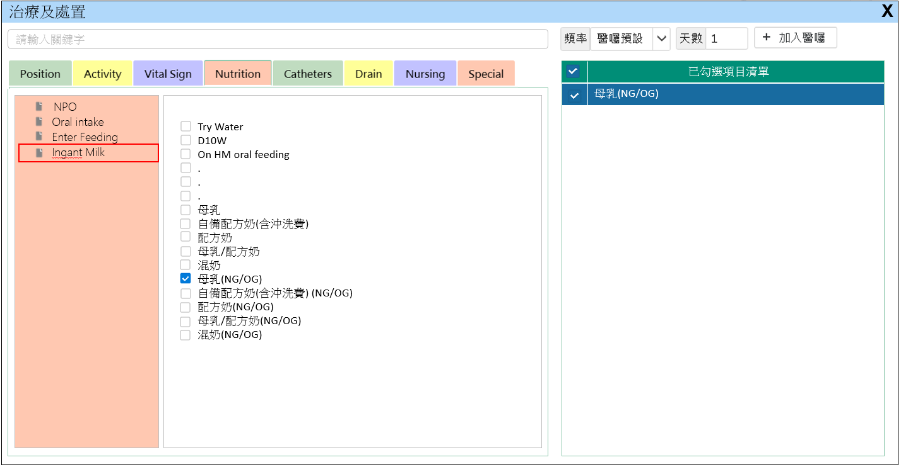
1. UI & Event Binding (1/3)
序 | 事件名稱
1 | onTabChange($event)
2 | onNodeSelect($event)
3 | onAddListClick($event)
4 | onOrderClick($event)
1
4
2
3

Slide 4
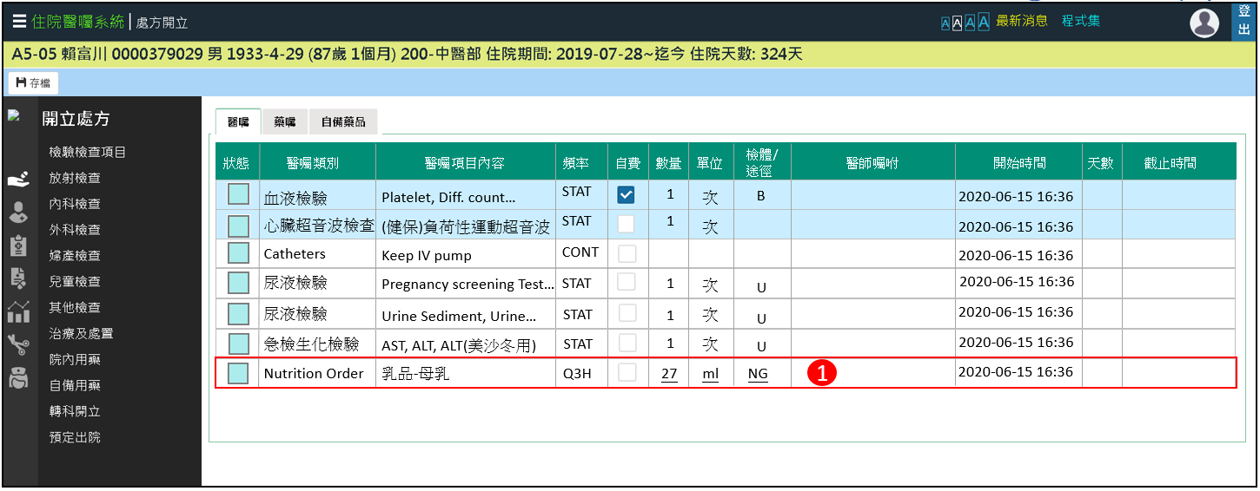
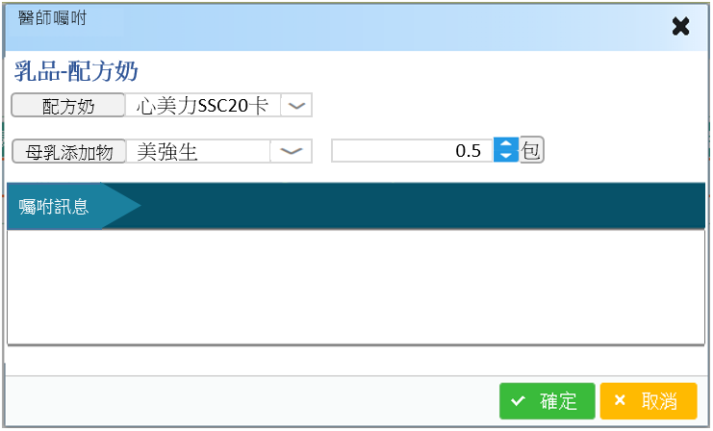
1. UI & Event Binding (2/3)
序 | 事件名稱
1 | onAdviseEditClick($event)
2 | onOkClick($event)
3 | onCancelClick($event)
2
3

Slide 5
2. ViewModel (1/2)
ExamOrderInfo
Name |  | DataType
+ orderNo | : | number
+ visitNo | : | number
+ visitType | : | string
+ medType | : | number
+ medName | : | string
+ usageNo | : | number
+ usage | : | string
+ wayNo | : | number
+ way | : | string
+ isOnCost | : | boolean
+ isSelf | : | boolean
+ chargeType | : | string
+ advise | : | string
+ medDesc | : | string
ExamOrderInfo(.cont)
Name |  | DataType
+ orderUser | : | number
+ orderTime | : | datetime
+ orderLoc | : | string
+ preExecLoc | : | string
+ startUser | : | number
+ startTime | : | datetime
+ endUser | : | number
+ endTime | : | datetime
+ confirmUser | : | number
+ confirmTime | : | datetime
+ expandTime | : | datetime
+ tranTime | : | datetime
+ tranStatus | : | number
+ LinkNo | : | number
ExamOrderInfo(.cont)
Name |  | DataType
+ examDt | : | ExamDt[]
Notes:
MedOrderTemplate
/**組套編號 */
public TempNo: number;
/**醫師/科別代號*/
public OwnerNo: string;
/**組套名稱*/
public TempName: string;
/**組套內容 */
Public Context: string;
/**最後異動人員 */
Public SystemUse: number;
/**最後異動時間*/
Public System time: Date
2

Slide 6
2. ViewModel (2/2)
ExamDt
Name |  | DataType
+ medCode | : | string
+ Dosage | : | number
+ DosageUnit | : | string
TreeNode(PrimeNG)
Name |  | DataType
+ data | : | any
+ expandedIcon | : | any
+ collapsedIcon | : | any
+ children | : | TreeNode[]
Notes:
MedOrderTemplate
/**組套編號 */
public TempNo: number;
/**醫師/科別代號*/
public OwnerNo: string;
/**組套名稱*/
public TempName: string;
/**組套內容 */
Public Context: string;
/**最後異動人員 */
Public SystemUse: number;
/**最後異動時間*/
Public System time: Date
2

Slide 7
3. View Service
Page | Description | Property / Event | View Service | Input | Output
母乳開立 | 頁面初始預設帶入 | ngOnInit() | getExamOrderList() | visitNo | ExamOrderInfo[]
 | 取得治療處置Tree | showContent(item) | getTreatOrder() | nodeCode | TreeNode[]

Slide 8
4. WebAPI Controller
Description | Method | URL(/webapi/admMedOrder/examOrder/) | Input | Output
取得非藥品清單 | GET | getExamOrderList() | visitNo | ExamOrderInfo[]
Description | Method | URL(/webapi/admMedOrder/medSet/) | Input | Output
取得醫囑項目樹結構檔 | GET | getTreatOrder() | nodeCode | TreeNode[]

Slide 9
5. Model Service
Description | Service Function | Input | Output
取得非藥品清單 | getExamOrderList() | visitNo | ExamOrderInfo[]
取得醫囑項目樹結構檔 | getTreatOrder() | nodeCode | TreeNode[]

Slide 10
6. Stored Procedure
Description | Service Function | Input | Output
取得出院清單 | getExamOrders() | visitNo | ExamOrderInfo[]
取得醫囑項目樹結構檔 | getMedTree() | nodeCode | TreeNode[]

