Slide 1
系統設計書—生殖醫療中心
Product Owner
Scrum Master
Scrum Team
2020.12.30編制

Slide 2
系統設計大綱
UI & Event Binding
ViewModel
View Service
WebAPI Controller
Model Service
Stored Procedure
流程圖
關聯圖

Slide 3
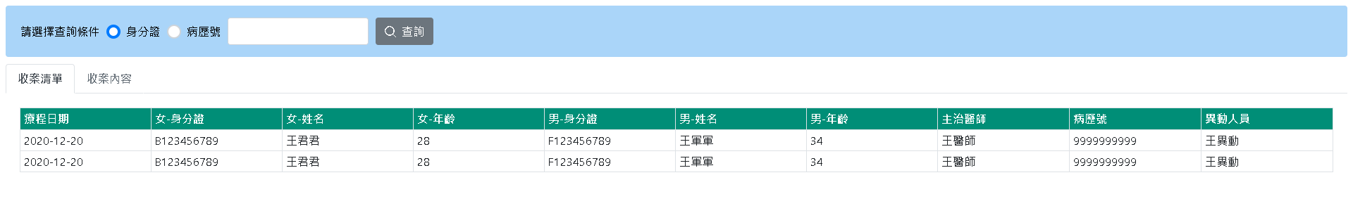
1. UI & Event Binding (1/15)-查詢收案
序 | 事件名稱
1 | onSearchClick($event)
2 | onTabClick($event)
3 | onRowDbClick($event)
1
2
3

Slide 4
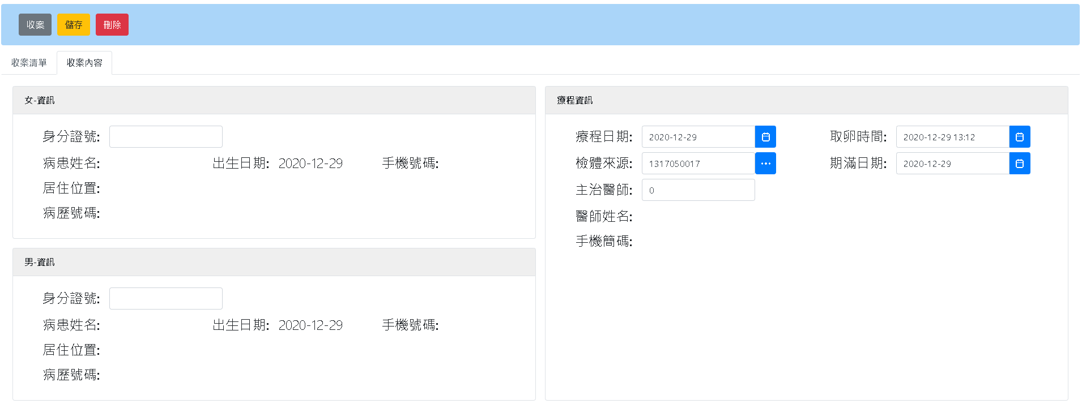
1. UI & Event Binding (2/15)-收案
序 | 事件名稱
1 | onAddClick($event)
2 | onSaveClick($event)
3 | onDeleteClick($event)
4 | onEnterPtInfoSearch($event)
5 | onTreatDateChange ($event)
6 | onOpuTimeChange ($event)
7 | onHospListClick($event)
8 | onEndDateChange($event)
9 | onEnterDrInfoSearch($event)
1
2
3
按下enter後，搜尋病患資訊
4
5
6
7
8
9
按下enter後，搜尋醫師資訊
4

Slide 5
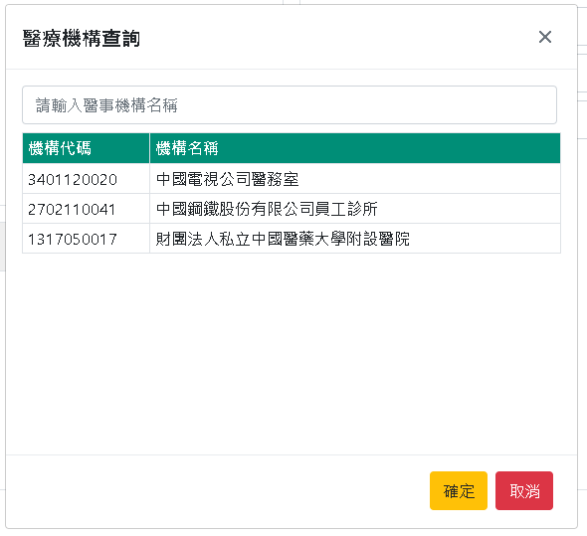
1. UI & Event Binding (3/15)-收案
序 | 事件名稱
1 | onInPutChange($event)
2 | onRowSelect($event)
3 | onSaveClick($event)
4 | onCancelClick($event)
透過關鍵字篩選醫療機構清單
1
2
3
4

Slide 6
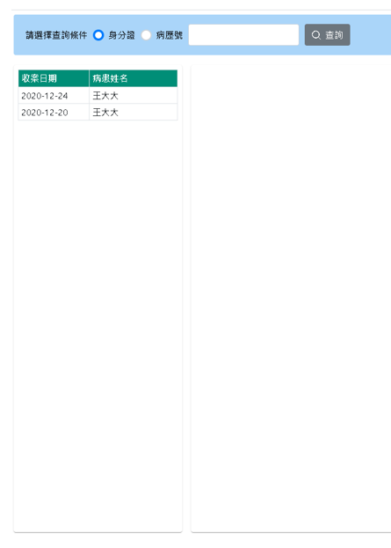
1. UI & Event Binding (4/15)-療程紀錄
序 | 事件名稱
1 | onSearchClick($event)
2 | onRowSelect($event)
1
2
選擇收案清單後，帶入右側資訊

Slide 7
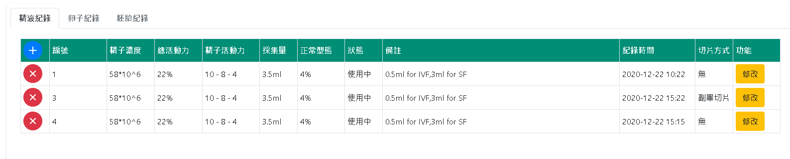
1. UI & Event Binding (5/15)-療程紀錄
序 | 事件名稱
1 | onTabClick($event)
2 | onAddClick($event)
3 | onDeleteClick($event)
4 | onModifyClick($event)
1
2
3
4

Slide 8
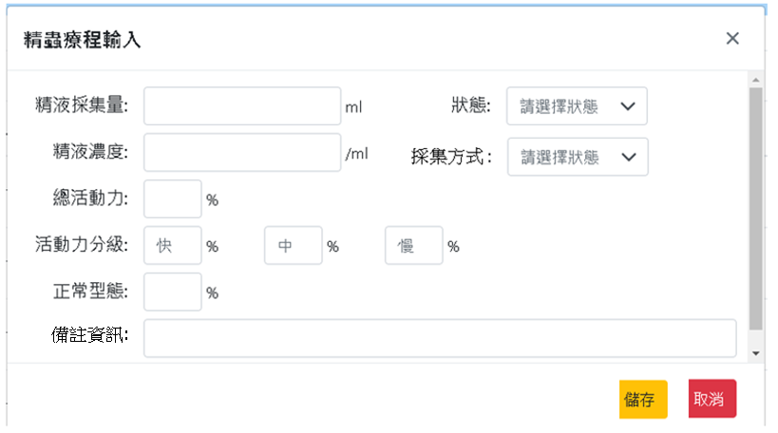
1. UI & Event Binding (6/15)-療程紀錄
序 | 事件名稱
1 | onStatusSelect($event)
2 | onMethodSelect ($event)
3 | onSaveClick($event)
4 | onCancelClick($event)
1
2
3
4

Slide 9
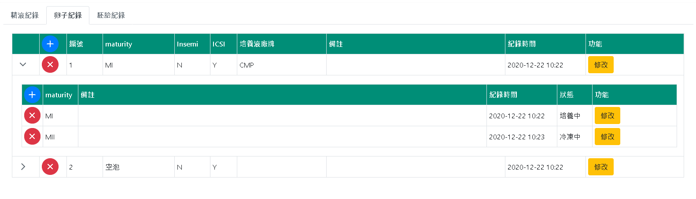
1. UI & Event Binding (7/15)-療程紀錄
序 | 事件名稱
1 | onAddClick($event)
2 | onRowExpand ($event)
3 | onDeleteClick($event)
4 | onModifyClick($event)
5 | onAddHistoryClick($event)
6 | onDeleteHistoryClick($event)
7 | onModifyHistoryClick($event)
1
2
4
3
5
6
7

Slide 10
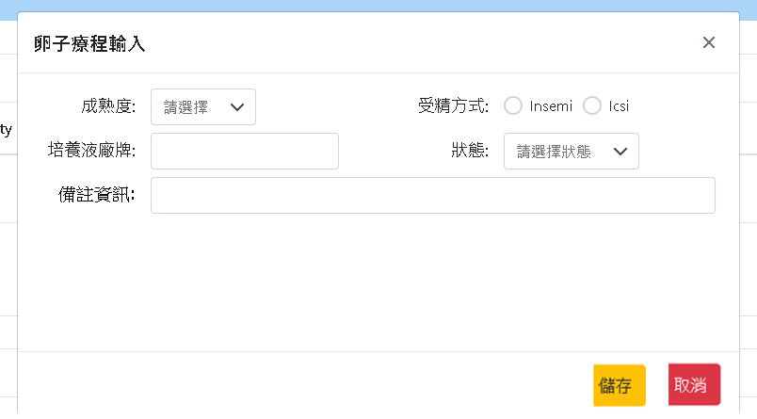
1. UI & Event Binding (8/15)-療程紀錄
序 | 事件名稱
1 | onMaturitySelect($event)
2 | onStatusSelect ($event)
3 | onCancelClick($event)
4 | onSaveClick($event)
1
2
3
4

Slide 11
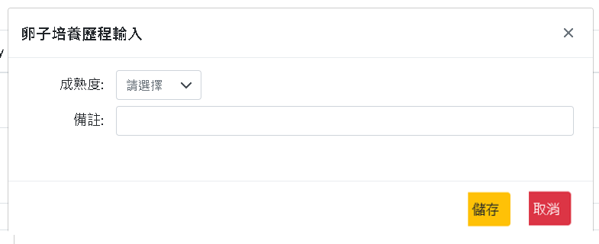
1. UI & Event Binding (9/15)-療程紀錄
序 | 事件名稱
1 | onMaturitySelect($event)
2 | onCancelClick($event)
3 | onSaveClick($event)
1
2
3

Slide 12
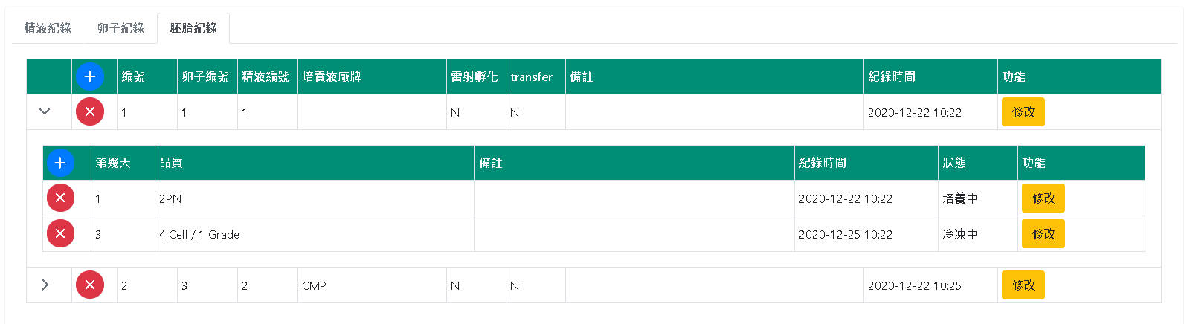
1. UI & Event Binding (10/15)-療程紀錄
序 | 事件名稱
1 | onAddClick($event)
2 | onRowExpand ($event)
3 | onDeleteClick($event)
4 | onModifyClick($event)
5 | onAddHistoryClick($event)
6 | onDeleteHistoryClick($event)
7 | onModifyHistoryClick($event)
1
2
4
3
5
6
7

Slide 13
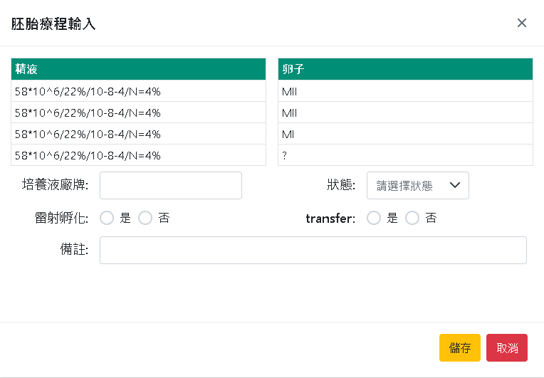
1. UI & Event Binding (11/15)-療程紀錄
序 | 事件名稱
1 | onSpermRowSelect($event)
2 | onOocyteRowSelect($event)
3 | onStatusSelect($event)
4 | onSaveClick($event)
5 | onCancelClick($event)
1
2
3
4
5

Slide 14
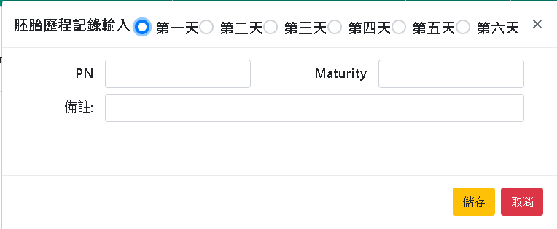
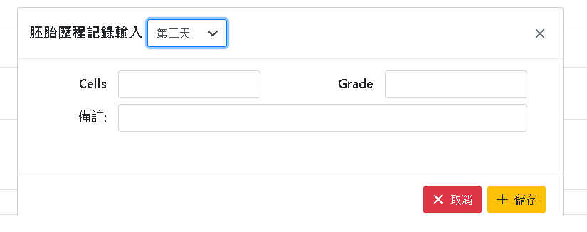
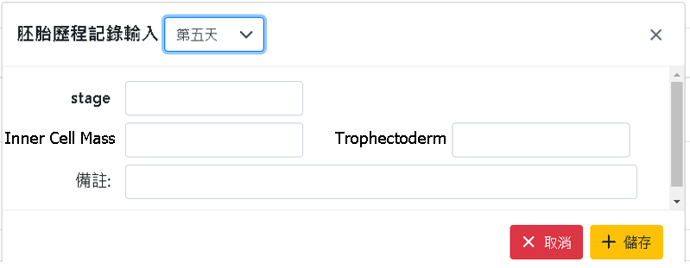

1. UI & Event Binding (12/15)-療程紀錄
1
序 | 事件名稱
1 | onDaySelect($event)
2 | onCancelClick($event)
3 | onSaveClick($event)
2
3
選擇天數不同，
所需填入的資料不同

Slide 15
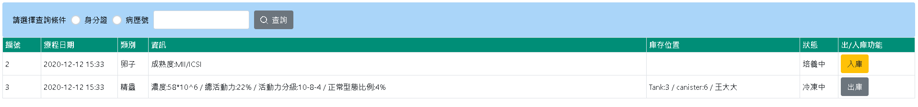
UI & Event Binding (13/15) – 出/入庫
序 | 事件名稱
1 | onSearchClick ($event)
2 | onAddStockClick($event)
3 | onDeliveryClick ($event)
1
2
3

Slide 16
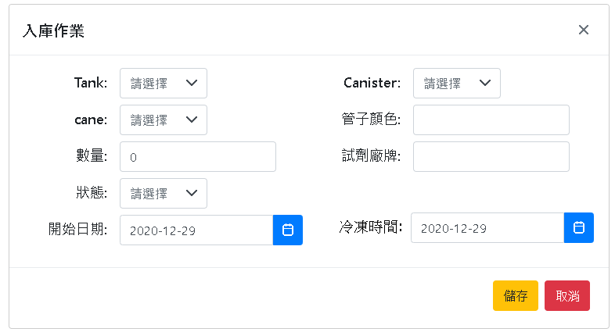
UI & Event Binding (14/15) – 出/入庫
序 | 事件名稱
1 | onTankSelect($event)
2 | onCanisterSelect ($event)
3 | onCaneSelect($event)
4 | onStatusSelect ($event)
5 | onStartDateChange($event)
6 | onCryoTimeChange($event)
7 | onSaveClick($event)
8 | onCancelClick($event)
1
2
3
4
5
6
7
8

Slide 17
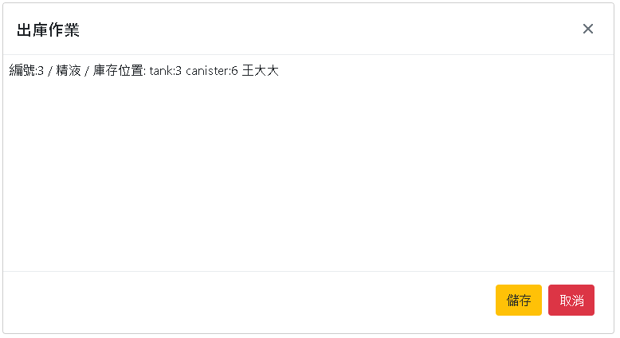
UI & Event Binding (15/15) – 出/入庫
序 | 事件名稱
1 | onSaveClick($event)
2 | onCancelClick($event)
1
2

Slide 18
2. ViewModel(1/4)
ReprodCase(1/2)
Name | DataType
+ treatNo | number
+ hospNo? | String
+ idNo1 | string
+ ptName1 | String
+ ptBirthday1 | Date
+ ptAge1 | Number
+ ptPhone1? | Number
+ ptAddress1? | String
+ ptCharNo1 | string
+ idNo2 | String
+ ptName2 | String
+ ptBirthday2 | Date
+ ptAge2 | Number
ReprodCase(2/2)
Name | DataType
+ ptPhone2? | Number
+ ptAddress2? | String
+ ptCharNo2 | string
+ drNo | Number
+ drName | String
+ drDiv | String
+ drGsm | Number
+ treatDate | Date
+ opuTime? | Date
+ systemUser | Number
+ systemUserName | String
ReprodCaseReq
Name | DataType
+ idNo? | String
+ chartNo? | String
HospInfo
Name | DataType
+ hospNo | String
+ hospName | String
ReprodReq
Name | DataType
+ TreatNo | number
+ reprodType | number
Notes:
MedOrderTemplate
/**組套編號 */
public TempNo: number;
/**醫師/科別代號*/
public OwnerNo: string;
/**組套名稱*/
public TempName: string;
/**組套內容 */
Public Context: string;
/**最後異動人員 */
Public SystemUse: number;
/**最後異動時間*/
Public System time: Date
2

Slide 19
2. ViewModel(2/4)
SpermInfo
Name | DataType
+ treatNo | number
+ spermNo | Number
+ recordTime | Date
+ spermConc | String
+ totalActivity | Number
+ fastActivity | Number
+ mediumActivity | Number
+ slowActivity | Number
+ normalRatio | number
+ totalCapacity | number
+ reprodStatus | number
+ boisyMethod | number
+ remark | string
+ systemUser | number
OocyteInfoMt
Name | DataType
+ treatNo | number
+ oocyteNo | Number
+ recordTime | Date
+ maturity | number
+ isInsemi | boolean
+ isIcsi | boolean
+ nutrientBrand | String
+ remark | String
+ systemUser | Number
+ record? | OocyteInfoDt[]
OocyteInfoDt
Name | DataType
+ oocyteNo | Number
+ recordTime | Date
+ maturity | number
+ reprodStatus | number
+ remark | String
+ systemUser | Number
Notes:
MedOrderTemplate
/**組套編號 */
public TempNo: number;
/**醫師/科別代號*/
public OwnerNo: string;
/**組套名稱*/
public TempName: string;
/**組套內容 */
Public Context: string;
/**最後異動人員 */
Public SystemUse: number;
/**最後異動時間*/
Public System time: Date
2

Slide 20
2. ViewModel(3/4)
EmbryoInfoMt
Name | DataType
+ treatNo | number
+ embryoNo | Number
+ spermNo | Number
+ oocyteNo | number
+ recordTime | Date
+ nutrientBrand | String
+ isAh | Boolean
+ isEt | Boolean
+ remark | string
+ systemUser | Number
+ record? | EmbryoInfoDt[]
EmbryoInfoDt
Name | DataType
+ dayCount | number
+ embryoNo | Number
+ content | string
+ recordTime | Date
+ reprodStatus | number
+ remark | string
+ systemUser | number
StockInfo
Name | DataType
+ reprodNo | Number
+ reprodType | Number
+ tankNo | Number
+ canisterNo | Number
+ container? | String
+ qty | Number
+ reagentBrand | String
+ tranType | number
+ startDate | date
+ endDate | date
+ systemUser | number
Notes:
MedOrderTemplate
/**組套編號 */
public TempNo: number;
/**醫師/科別代號*/
public OwnerNo: string;
/**組套名稱*/
public TempName: string;
/**組套內容 */
Public Context: string;
/**最後異動人員 */
Public SystemUse: number;
/**最後異動時間*/
Public System time: Date
2

Slide 21
2. ViewModel(4/4)
ReprodInfo
Name | DataType
+ reprodNo | number
+ treatDate | Date
+ reprodType | Number
+ reprodInfo | String
+ stockLocation | string
+ reprodStatus | number
+ systemUser | Number
PtInfo
Name | DataType
+ idNo | String
+ chartNo | String
+ ptName | String
+ ptBirthday | Date
+ ptPhone | Number
+ ptAddress | string
DrInfo
Name | DataType
+ drNo | Number
+ drName | String
+ divNo | String
+ divName | String
+ drGsm | Number
Notes:
MedOrderTemplate
/**組套編號 */
public TempNo: number;
/**醫師/科別代號*/
public OwnerNo: string;
/**組套名稱*/
public TempName: string;
/**組套內容 */
Public Context: string;
/**最後異動人員 */
Public SystemUse: number;
/**最後異動時間*/
Public System time: Date
2

Slide 22
3. View Service(1/2)
Page | Description | Property / Event | View Service | Input | Output
收案 | 查詢收案 | onSearchClick ($event) | getReprodCaseList() | ReprodCaseReq | ReprodCase[]
 | 儲存收案 | onSaveClick($event) | setReprodCaseInfo() | ReprodCase | Boolean
 | 查詢病人資訊 | onEnterPtInfoSearch($event) | getReprodPtInfo() | idNo | PtInfo
 | 查詢醫師資訊 | onEnterDrInfoSearch($event) | getReprodDrInfo() | drNo | DrInfo
 | 取得醫療機構清單 | onHospListClick($event) | getHospList() |  | HospInfo[]
療程紀錄 | 查詢收案 | onSearchClick ($event) | getReprodCaseList() | ReprodCaseReq | ReprodCase[]
 | 點擊頁籤 | onTabClick($event) | getSpermInfo() | ReprodReq | SpermInfoMt[]
 |  |  | getOocyteInfo() |  | OocyteInfoMt[]
 |  |  | getEmbryoInfo() |  | EmbryoInfoMt[]
 | 儲存紀錄 | onSaveClick($event) | setSpermBasic() | SpermInfoMt | Boolean
 |  |  | setOocyteBasic() | OocyteInfoMt
 |  |  | setEmbryoBsic() | EmbryoInfoMt
 |  |  | setOocyteTracking() | OocyteInfoDt
 |  |  | setEmbryoTracking() | EmbryoInfoDt

Slide 23
3. View Service(2/2)
Page | Description | Property / Event | View Service | Input | Output
出入庫存 | 查詢病人 | onSearchClick ($event) | getReprodList() | ReprodCaseReq | ReprodInfo[]
 | 入庫/出庫 | onSaveClick($event) | setStockInfo() | StockInfo | Boolean

Slide 24
4. WebAPI Controller
Description | Method | URL(/webApi/reprod-manager/) | Input | Output
查詢收案 | GET | getReprodCaseList | ReprodCaseReq | ReprodCase[]
儲存收案 | PUT | setReprodCaseInfo | ReprodCase | Boolean
取得病人資訊 | GET | getPtInfo | idNo | PtInfo
取得醫師資訊 | GET | getDrInfo | drNo | DrInfo
取得醫療機構清單 | GET | getHospList |  | HospInfo[]
取得精液紀錄 | POST | getSpermInfo | ReprodReq | SpermInfoMt[]
取得卵子紀錄 | POST | getOocyteInfo | ReprodReq | OocyteInfoMt[]
取得胚胎紀錄 | POST | getEmbryoInfo | ReprodReq | EmbryoInfoMt[]
儲存精液紀錄 | PUT | setSpermBasic | SpermInfoMt | Boolean
儲存卵子紀錄 | PUT | setOocyteBasic | OocyteInfoMt | Boolean
儲存胚胎紀錄 | PUT | setEmbryoBasic | EmbryoInfoMt | Boolean
儲存卵子歷程記錄 | PUT | setOocyteTracking | OocyteInfoDt | Boolean
儲存胚胎歷程記錄 | PUT | setEmbryoTracking | EmbryoInfoDt | Boolean
儲存入出庫 | PUT | setStockInfo | StockInfo | Boolean

Slide 25
5. Model Service
Description | Service Function | Input | Output
查詢收案 | getReprodCaseList | ReprodCaseReq | ReprodCase[]
儲存收案 | setReprodCaseInfo | ReprodCase | Boolean
取得病人資訊 | getPtInfo | idNo | PtInfo
取得醫師資訊 | getDrInfo | drNo | DrInfo
取得醫療機構清單 | getHospList |  | HospInfo[]
取得精液紀錄 | getSpermInfo | ReprodReq | SpermInfoMt[]
取得卵子紀錄 | getOocyteInfo | ReprodReq | OocyteInfoMt[]
取得胚胎紀錄 | getEmbryoInfo | ReprodReq | EmbryoInfoMt[]
儲存精液紀錄 | setSpermBasic | SpermInfoMt | Boolean
儲存卵子紀錄 | setOocyteBasic | OocyteInfoMt | Boolean
儲存胚胎紀錄 | setEmbryoBasic | EmbryoInfoMt | Boolean
儲存卵子歷程記錄 | setOocyteTracking | OocyteInfoDt | Boolean
儲存胚胎歷程記錄 | setEmbryoTracking | EmbryoInfoDt | Boolean
儲存入出庫 | setStockInfo | StockInfo | Boolean

Slide 26
6. Stored Procedure
Description | Service Function | Input | Output
查詢收案 | getCaseList | ReprodCaseReq | ReprodCase[]
儲存收案 | setCaseInfo | ReprodCase | Boolean
取得病人資訊 | getPtInfo | idNo | PtInfo
取得醫師資訊 | getDrInfo | drNo | DrInfo
取得醫療機構清單 | getHospList |  | HospInfo[]
取得精液紀錄 | getSpermInfo | ReprodReq | SpermInfoMt[]
取得卵子紀錄 | getOocyteInfo | ReprodReq | OocyteInfoMt[]
取得胚胎紀錄 | getEmbryoInfo | ReprodReq | EmbryoInfoMt[]
儲存精液紀錄 | setSpermInfo | SpermInfoMt | Boolean
儲存卵子紀錄 | setOocyteInfo | OocyteInfoMt | Boolean
儲存胚胎紀錄 | setEmbryoInfo | EmbryoInfoMt | Boolean
儲存卵子歷程記錄 | setOocyteRecord | OocyteInfoDt | Boolean
儲存胚胎歷程記錄 | setEmbryoRecord | EmbryoInfoDt | Boolean
儲存入出庫 | setStockInfo | StockInfo | Boolean

Slide 27
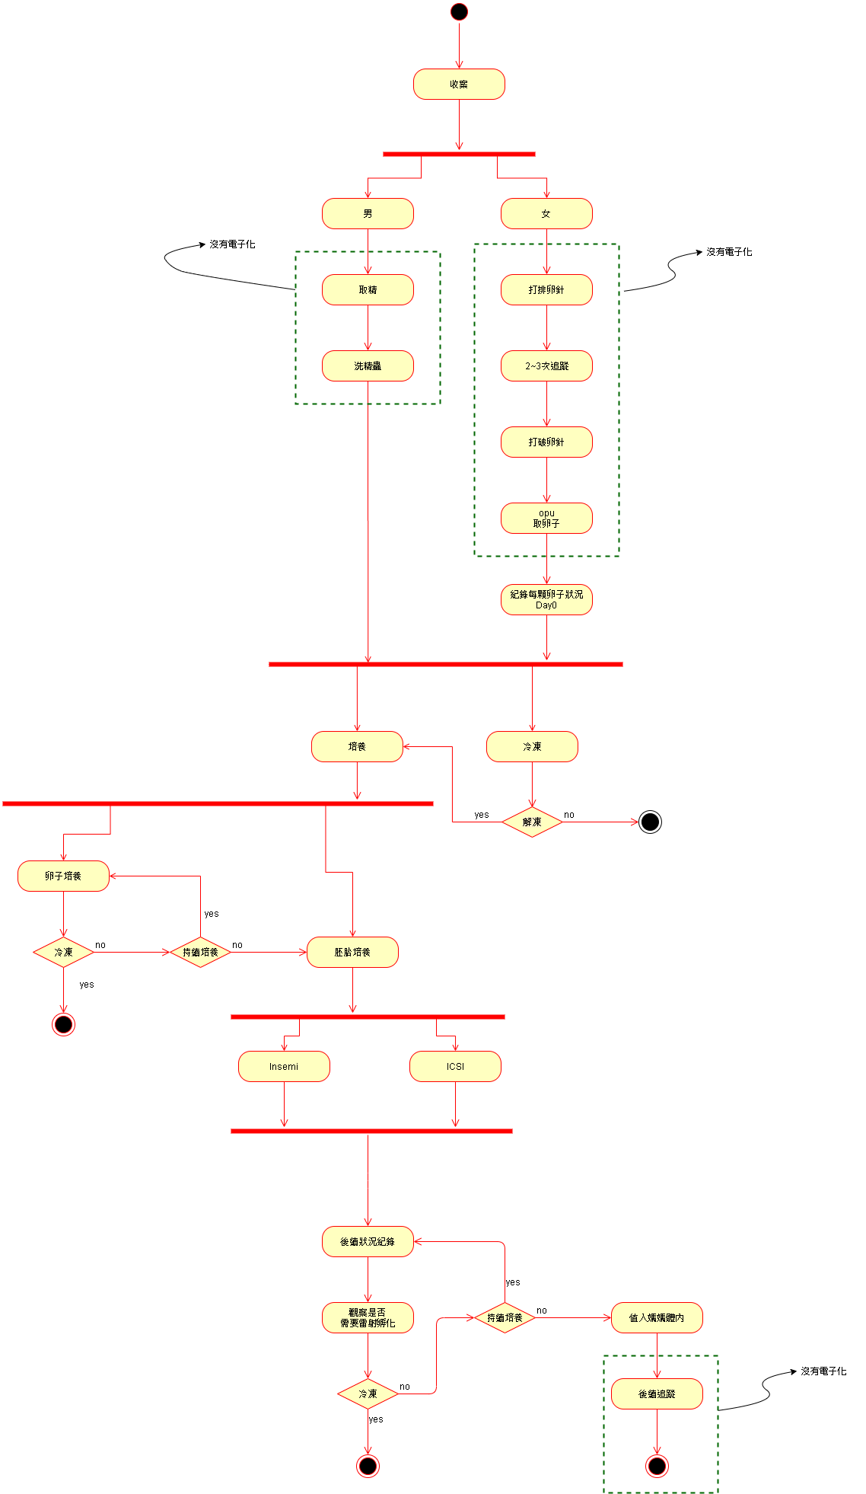
7. 流程圖

Slide 28
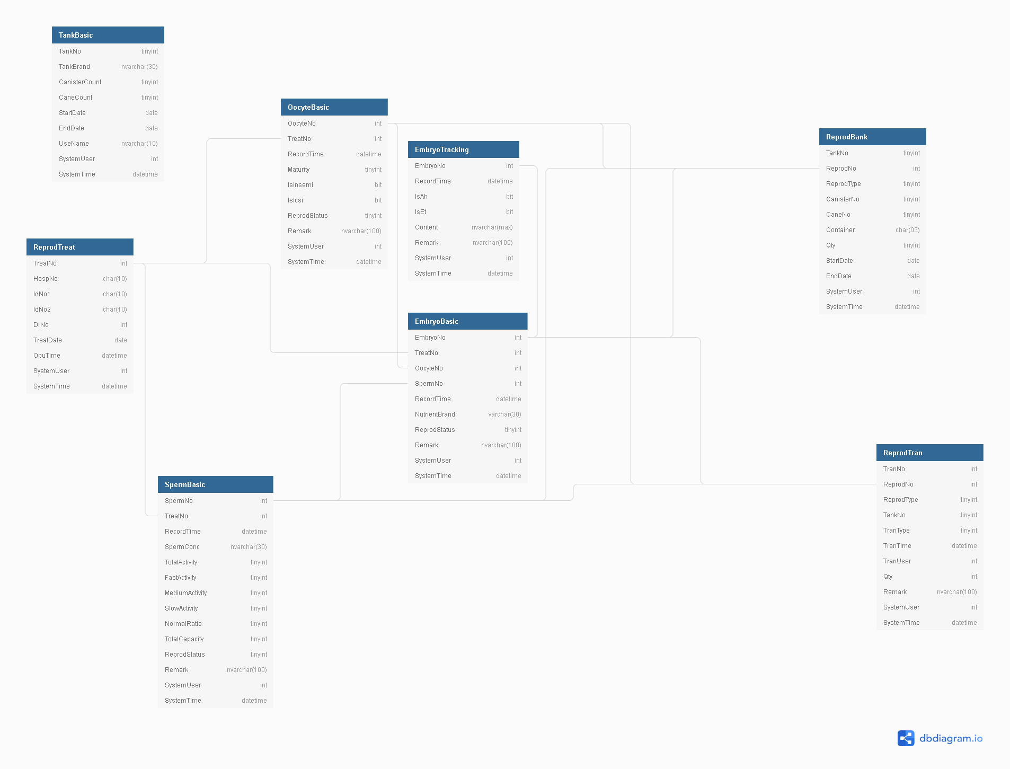
8. 關聯圖

