Slide 1
系統設計書—醫雲中醫用藥
medcloud-tcm-used-view
Product Owner | 孫培然
Scrum Master | 卓曉霜
Scrum Team | 陳睿謙、許家綺
2020.03.16編制

Slide 2
系統設計大綱
UI & Event Binding
ViewModel
View Service
WebAPI Controller
Model Service
Stored Procedure

Slide 3
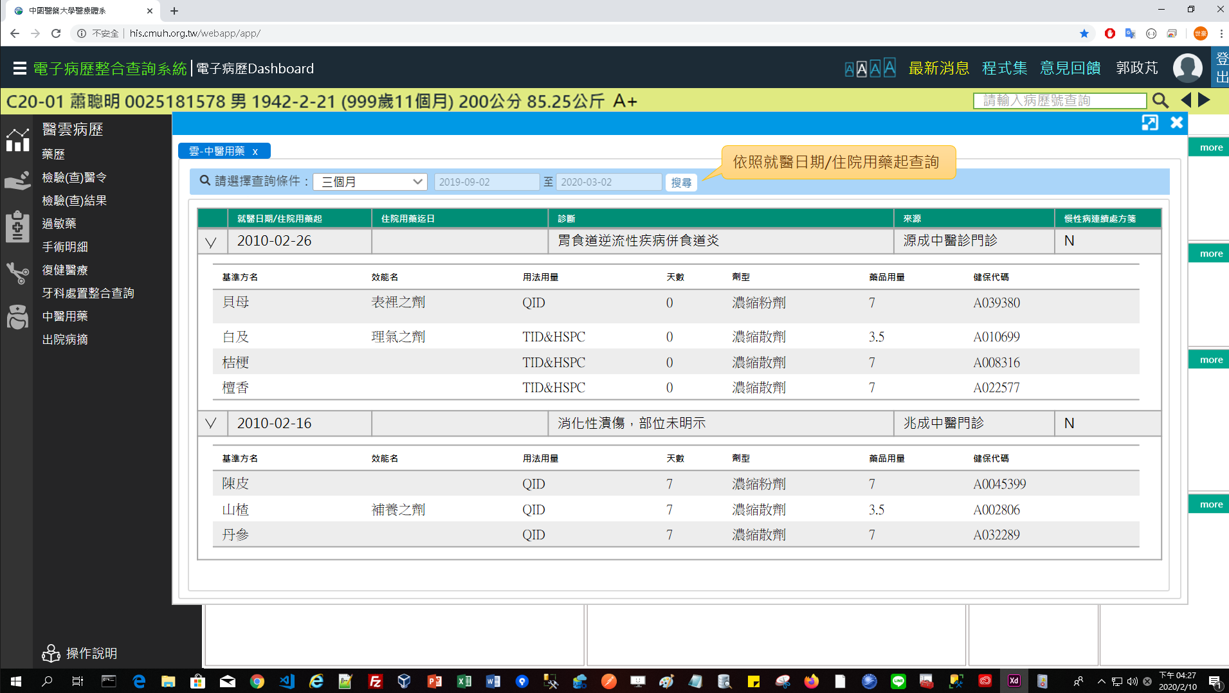
1. UI & Event Binding (1/1)
序 | 事件名稱
1 | onRangeChange($event)
2 | onSearchClick($event)
❶
❷

Slide 4
2. View Model
DateRange
Name |  | DataType
+ name | : | string
+ value | : | number
TcmUsed
Name |  | DataType
+ idNo | : | string
+ startDate | : | date
+ endDate | : | date
+ diagName | : | string
+ hospitalName | : | string
+ isChronic | : | boolean
+ tcmDetails | : | TcmDetail[]
TcmDetail
Name |  | DataType
+ medName | : | string
+ medUtility | : | string
+ usage | : | string
+ usedDays | : | number
+ dosageFrom | : | string
+ totalQty | : | number
+ nhiCode | : | string
SearchReq
Name |  | DataType
+ idNo | : | string
+ startDate | : | date
+ endDate | : | date
Column
Name |  | DataType
+ header | : | string
+ field | : | string
SearchLog
Name |  | DataType
+ type | : | number
+ systemTime | : | datetime
+ systemUser | : | number

Slide 5
3. View Service
Page | Description | Property / Event | View Service | Input | Output
中醫用藥 | 畫面初始設定 | ngOnInit() | getTcmUsedList() | SearchReq | TcmUsed[]
 | 取得中醫用藥 | onSearchClick() | getTcmUsedList() | SearchReq | TcmUsed[]
 | 儲存查詢紀錄 | setSearchLog() | setSearchLog() | SearchLog | Boolean
Notes:
ExamReq = idNo + reportTime

Slide 6
4. WebAPI Controller
Description | Method | URL (/webApi/medcloud/) | Input | Output
取得中醫用藥 | POST | getTcmUsedList | SearchReq | TcmUsed[]
儲存查詢紀錄 | POST | (尚待規劃) | SearchLog | Boolean

Slide 7
5. Model Service
Description | Service Function | Input | Output
取得中醫用藥 | getTcmUsedList() | SearchReq | TcmUsed[]
儲存查詢紀錄 | setSearchLog(尚待規劃) | SearchLog | Boolean

Slide 8
6. Stored Procedure
<註> 副主任指示現階段直接用NodeJs寫Sql抓informix，所以無stored procedure (2020-03-12)

