Slide 1
系統設計書—手術明細
medcloud-operation-view
Product Owner | 孫培然
Scrum Master | 卓曉霜
Scrum Team | 駱彥丞、許家綺
2020.03.06編制

Slide 2
系統設計大綱
UI & Event Binding
ViewModel
View Service
WebAPI Controller
Model Service
Stored Procedure

Slide 3
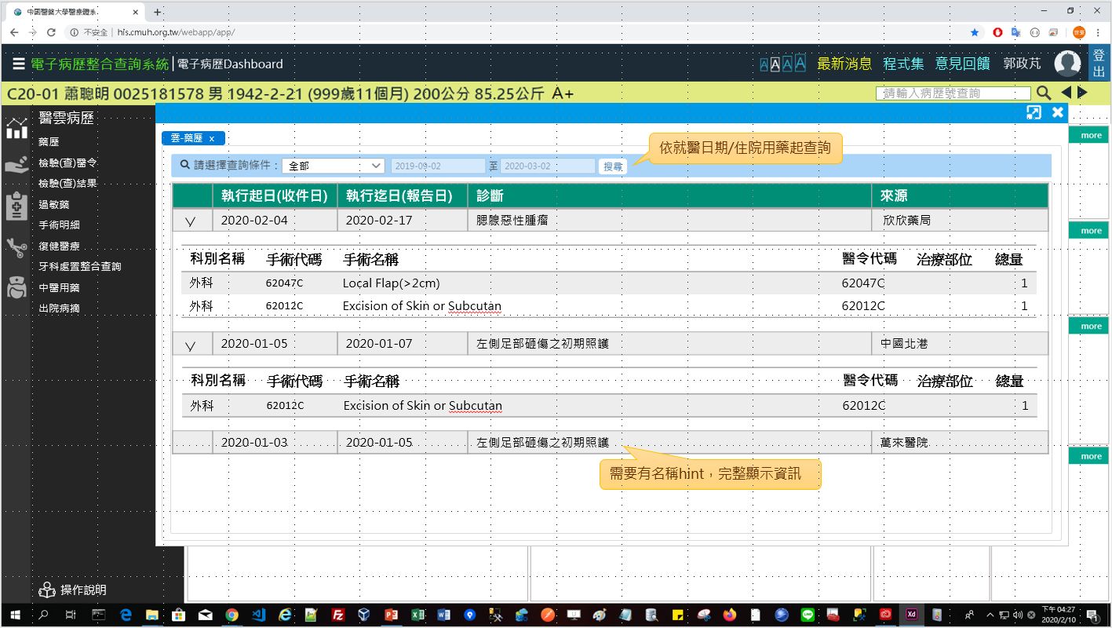
1. UI & Event Binding (1/1)-手術明細
序 | 事件名稱
1 | onRangeChange($event)
2 | onSearchClick($event)
❶
❷

Slide 4
2. View Model
DateRange
Name |  | DataType
+ name | : | string
+ value | : | number
Oper
Name |  | DataType
+ idNo | : | string
+ startDate | : | date
+ endDate | : | date
+ diagName | : | string
+ hospitalName | : | string
+ operDetails | : | OperDetail[]
OperDetail
Name |  | DataType
+ divName | : | string
+ operCode | : | string
+ operName | : | string
+ nhiCode | : | string
+ operSite | : | string
+ orderQty | : | number
SearchReq
Name |  | DataType
+ idNo | : | string
+ startDate | : | date
+ endDate | : | date
Column
Name |  | DataType
+ header | : | string
+ field | : | string
SearchLog
Name |  | DataType
+ type | : | number
+ systemTime | : | datetime
+ systemUser | : | number
Notes:
reportUserTitle必須用
reportUser(員工代碼)到Employee查詢Title 職稱編號
再使用 titleNo到JobTitle查TitleName

Slide 5
3. View Service
Page | Description | Property / Event | View Service | Input | Output
手術明細 | 畫面初始設定 | ngOnInit() | getOperList() | SearchReq | Oper[]
 | 取得手術明細 | onSearchClick($event) | getOperList() | SearchReq | Oper[]
 | 儲存查詢紀錄 | (尚待規劃) |  | SearchLog | Boolean

Slide 6
4. WebAPI Controller
Description | Method | URL (/webApi/medcloud/) | Input | Output
取得手術明細 | POST | getOperList | SearchReq | Oper[]
取得清單欄位 | GET | getColumns (抓取本地端) |  | Column[]
儲存查詢紀錄 | POST | (尚待規劃) | SearchLog | Boolean

Slide 7
5. Model Service
Description | Service Function | Input | Output
取得手術明細 | getOperList() | SearchReq | Oper[]
儲存查詢紀錄 | (尚待規劃) | SearchLog | Boolean

Slide 8
6. Stored Procedure
<註> 副主任指示現階段直接用NodeJs寫Sql抓informix，所以無stored procedure (2020-03-12)

