Slide 1
系統設計書—雲-檢驗(查)結果
medcloud-exam-report-view
Product Owner | 孫培然
Scrum Master | 卓曉霜
Scrum Team | 朱世豪、許家綺
2020.03.10編制

Slide 2
系統設計大綱
UI & Event Binding
ViewModel
View Service
WebAPI Controller
Model Service
Stored Procedure

Slide 3
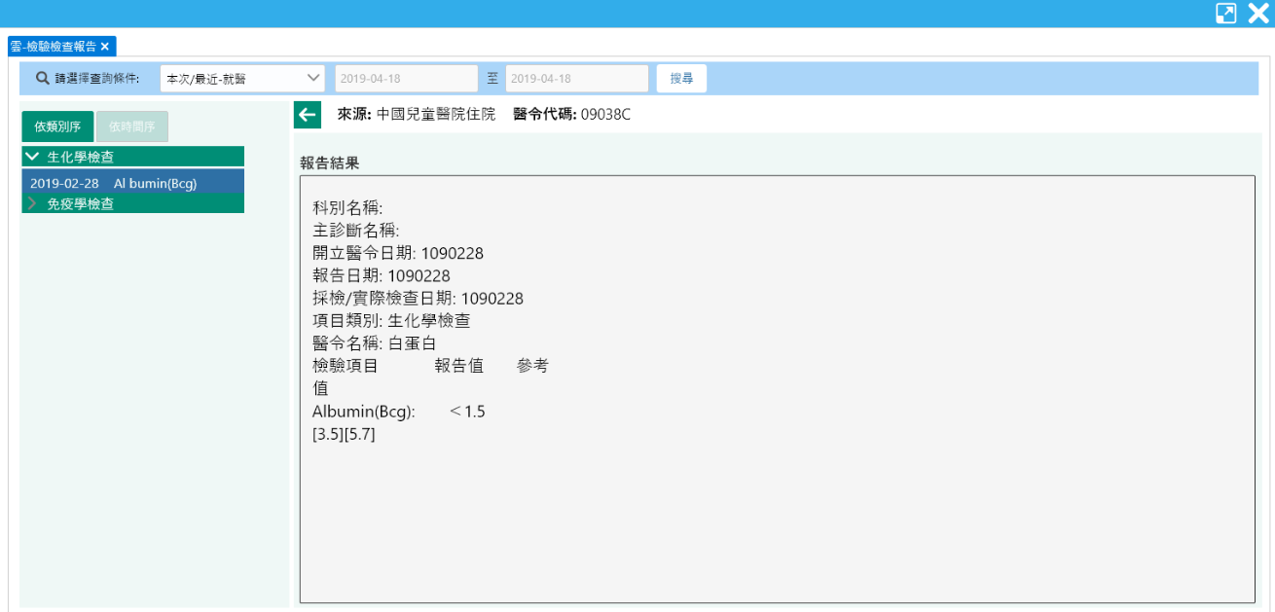
1. UI & Event Binding (1/2)-依類別序
序 | 事件名稱
1 | onRangeChage($event)
2 | onSearchClick($event)
3 | onTabChange($event)
4 | onExpandClick($event)
5 | onRowSelect($event)
❶
❷
❸
❹
❺

Slide 4
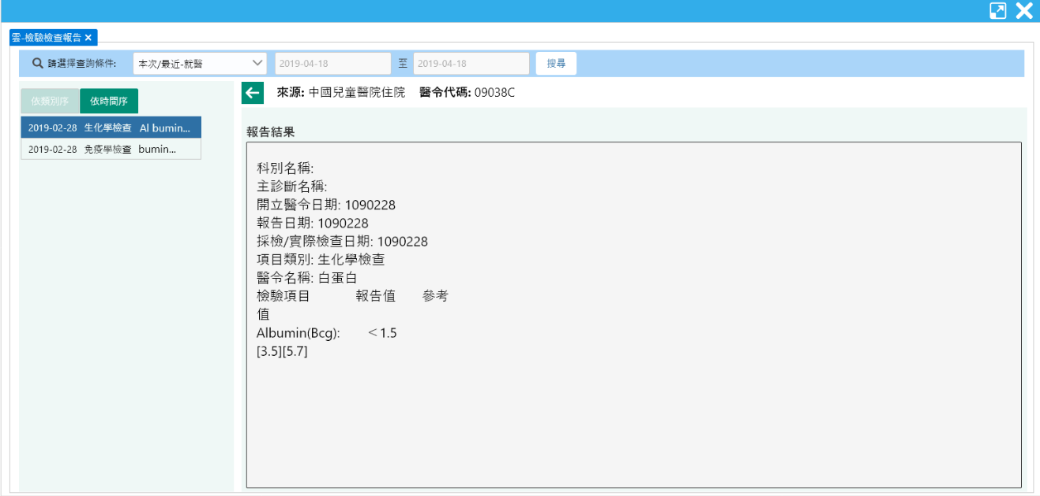
1. UI & Event Binding (2/2)-依報告序
序 | 事件名稱
1 | onRangeChage($event)
2 | onSearchClick($event)
3 | onTabChange($event)
4 | onRowSelect($event)
❶
❷
❸
❹

Slide 5
2. ViewModel(1/2)
DateRange
Name |  | DataType
+ name | : | string
+ value | : | number
ExamDetail
Name |  | DataType
+ idNo | : | string
+ visitType | : | string
+ loadDate | : | date
+ seqNo | : | number
+ reportDate | : | date
+ examTypeName | : | string
+ examItemName | : | string
ColTemplate
Name |  | DataType
+ header | : | string
+ filed | : | string
SearchReq
Name |  | DataType
+ idNo | : | string
+ startDate | : | Date
+ endDate | : | Date
<註> reportDate、 orderDate在資料庫
是存成char(07)以民國年月日顯示
Notes:
primary key(IdNo, ECFromType, LoadDate, ECHisSeq)
ecfromtext AS 來源,
ispname AS 項目類別,
NhiIspName AS 醫令名稱,
ispitems AS 檢驗項目,
ispvalues AS 檢查檢驗結果,
ispreference AS 檢驗參考值,
ReportDate AS 報告日期,
ExmReport AS 報告結果,
ExeDate AS 採檢日期時間,
OrderDate AS 開立醫令日期,
IspWays AS 檢驗方法,
NhiCode AS 醫令代碼,
NhiDeptName AS 科別名稱,
DiagName AS 主診斷名稱

Slide 6
2. ViewModel(2/2)
ExamReq
Name |  | DataType
+ idNo | : | string
+ visitType | : | string
+ loadDate | : | date
+ seqNo | : | number
ExamReport
Name |  | DataType
+ idNo | : | string
+ visitType | : | string
+ loadDate | : | date
+ seqNo | : | number
+ hospitalName | : | string
+ nhiCode | : | string
+ divName | : | string
+ diagName | : | string
+ orderDate | : | date
+ reportDate | : | date
+ execDate | : | date
+ examTypeName | : | string
ExamReport(cont.)
Name |  | DataType
+ nhiName | : | string
+ examItemName | : | string
+ examValue | : | string
+ examRefValue | : | string
+ examWay | : | string
SearchLog
Name |  | DataType
+ type | : | number
+ systemTime | : | datetime
+ systemUser | : | number
<註> reportDate、 orderDate在資料庫
是存成char(07)以民國年月日顯示
Notes:
primary key(IdNo, ECFromType, LoadDate, ECHisSeq)
ecfromtext AS 來源,
ispname AS 項目類別,
NhiIspName AS 醫令名稱,
ispitems AS 檢驗項目,
ispvalues AS 檢查檢驗結果,
ispreference AS 檢驗參考值,
ReportDate AS 報告日期,
ExmReport AS 報告結果,
ExeDate AS 採檢日期時間,
OrderDate AS 開立醫令日期,
IspWays AS 檢驗方法,
NhiCode AS 醫令代碼,
NhiDeptName AS 科別名稱,
DiagName AS 主診斷名稱

Slide 7
3. View Service
Page | Description | Property / Event | View Service | Input | Output
雲-檢驗檢查報告 | 頁面初始預設 | ngOnInit() | getExamDetails() | SearchReq | ExamDetail[]
 | 查詢 檢驗檢查資料 | onSearchClick($event) | getExamDetails() | SearchReq | ExamDetail[]
 | 查詢報告內容 | onRowSelect($event) | getExamReport() | ExamReq | ExamReport
 | 儲存查詢紀錄 | (尚待規劃) |  | SearchLog | Boolean

Slide 8
4. WebAPI Controller
Description | Method | URL (/webApi/medcloud/) | Input | Output
取得檢驗檢查清單 | POST | getExamDetails | SearchReq | ExamDetail[]
取得報告內容 | POST | getExamReport | ExamReq | ExamReport
取得類別序清單欄位 | GET | getExamTypeColumns (抓取本地端) |  | ColTemplate[]
取得報告序清單欄位 | GET | getExamReportColumns (抓取本地端) |  | ColTemplate[]
儲存查詢紀錄 | POST | (尚待規劃) | SearchLog | Boolean

Slide 9
5. Model Service
Description | Service Function | Input | Output
取得檢驗檢查清單 | getExamDetails() | SearchReq | ExamDetail[]
取得報告內容 | getExamReport() | ExamReq | ExamReport
儲存查詢紀錄 | (尚待規劃) | SearchLog | Boolean

Slide 10
6. Stored Procedure
<註> 副主任指示現階段直接用NodeJs寫Sql抓informix，所以無stored procedure (2020-03-12)

