Slide 1
系統設計書—醫雲藥歷
medcloud-drug-used-view
Product Owner | 孫培然
Scrum Master | 卓曉霜
Scrum Team | 陳睿謙、許家綺
2020.03.16編制

Slide 2
系統設計大綱
UI & Event Binding
ViewModel
View Service
WebAPI Controller
Model Service
Stored Procedure

Slide 3
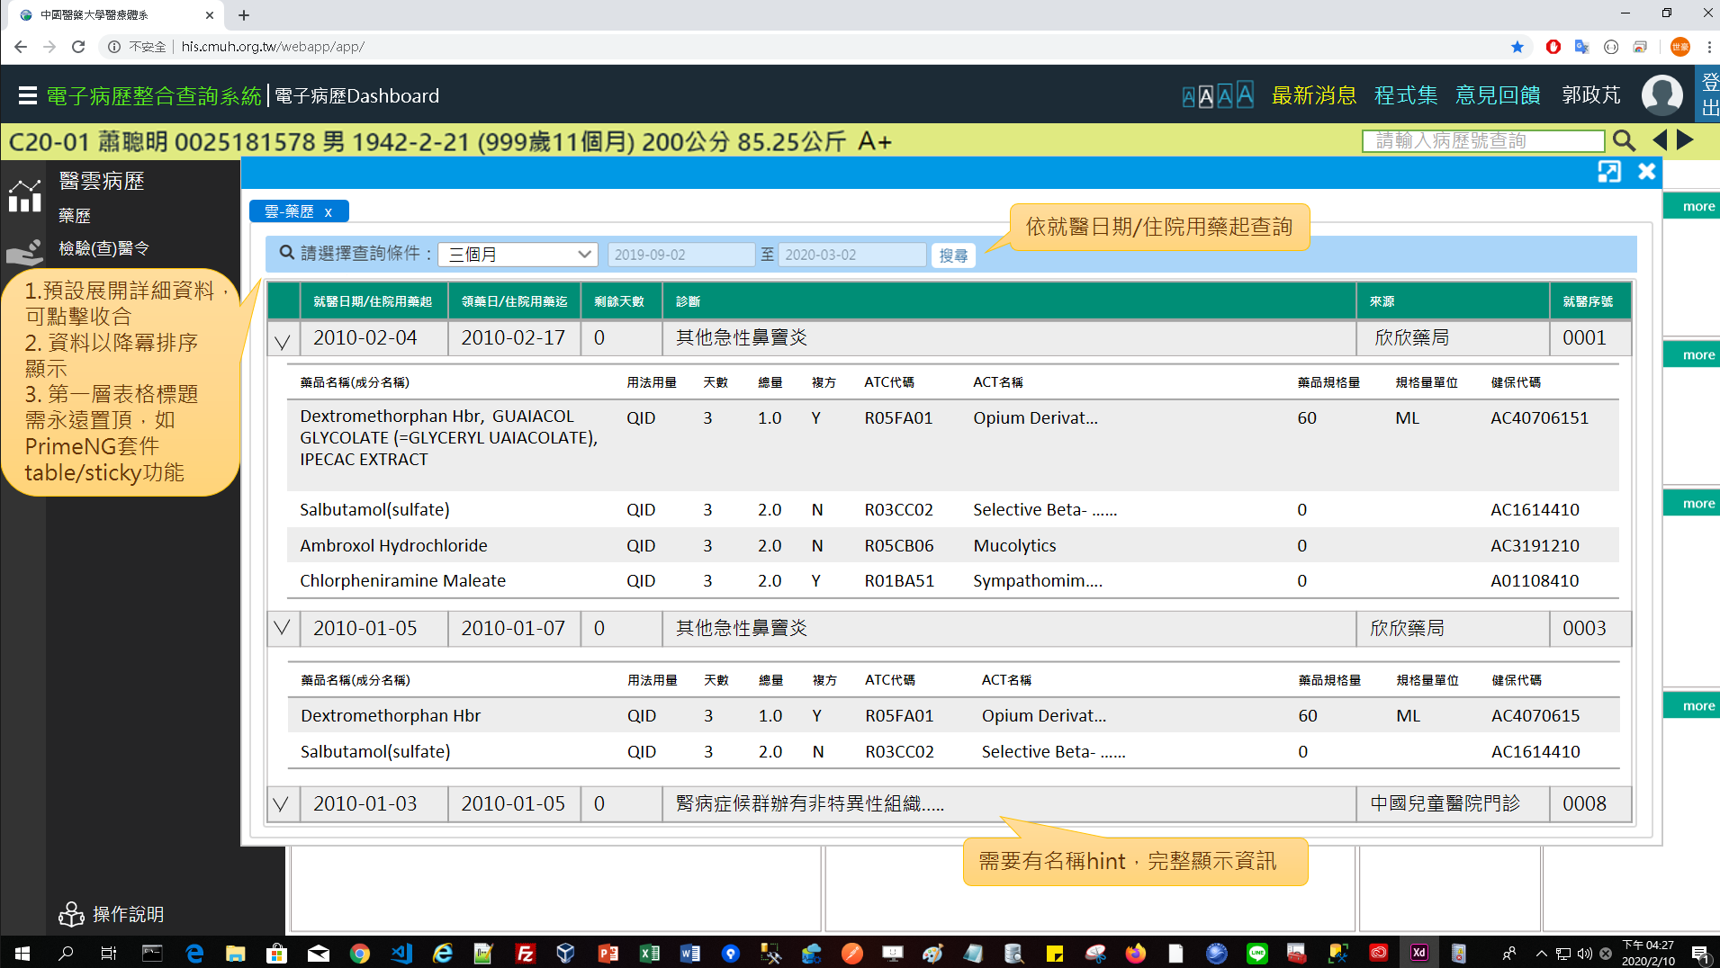
1. UI & Event Binding (1/1)
序 | 事件名稱
1 | onRangeChange($event)
2 | onSearchClick($event)
❶
❷

Slide 4
2. View Model
DateRange
Name |  | DataType
+ name | : | string
+ value | : | number
DrugUsed
Name |  | DataType
+ idNo | : | string
+ startDate | : | date
+ endDate | : | date
+ remainDays | : | number
+ diagName | : | string
+ hospitalName | : | string
+ nhiSeq | : | string
+ drugDetails | : | DrugDetail[]
DrugDetail
Name |  | DataType
+ drugName | : | string
+ usage | : | string
+ usedDays | : | number
+ totalQty | : | number
+ isCompound | : | boolean
+ atcCode | : | string
+ atcName | : | string
+ dosage | : | number
+ dosageUnit | : | string
+ nhiCode | : | string
SearchReq
Name |  | DataType
+ idNo | : | string
+ startDate | : | date
+ endDate | : | date
SearchLog
Name |  | DataType
+ type | : | number
+ systemTime | : | datetime
+ systemUser | : | number
Column
Name |  | DataType
+ header | : | string
+ field | : | string

Slide 5
3. View Service
Page | Description | Property / Event | View Service | Input | Output
藥歷 | 畫面初始設定 | ngOnInit() | getDrugUsedList() | SearchReq | DrugUsed[]
 | 取得藥歷 | onSearchClick() | getDrugUsedList () | SearchReq | DrugUsed[]
 | 儲存查詢紀錄 | (尚待規劃) |  | SearchLog | Boolean

Slide 6
4. WebAPI Controller
Description | Method | URL (/webApi/medcloud/) | Input | Output
取得病人藥歷清單 | POST | getDrugUsedList | SearchReq | DrugUsed[]
儲存查詢紀錄 | POST | (尚待規劃) | SearchLog | Boolean

Slide 7
5. Model Service
Description | Service Function | Input | Output
取得病人藥歷清單 | getDrugUsedList | SearchReq | DrugUsed[]
儲存查詢紀錄 | (尚待規劃) | SearchLog | Boolean

Slide 8
6. Stored Procedure
<註> 副主任指示現階段直接用NodeJs寫Sql抓informix，所以無stored procedure (2020-03-12)

