Slide 1
系統設計書—麻醉排班管理系統
anes-schedule-manager
Product Owner | 孫培然
Scrum Master | 黃浩軒
Scrum Team | 廖健傑、許家綺、栢升偉
2021.09.30 編制

Slide 2
系統設計大綱
UI & Event Binding
ViewModel
View Service
WebAPI Controller
Model Service
Stored Procedure

Slide 3
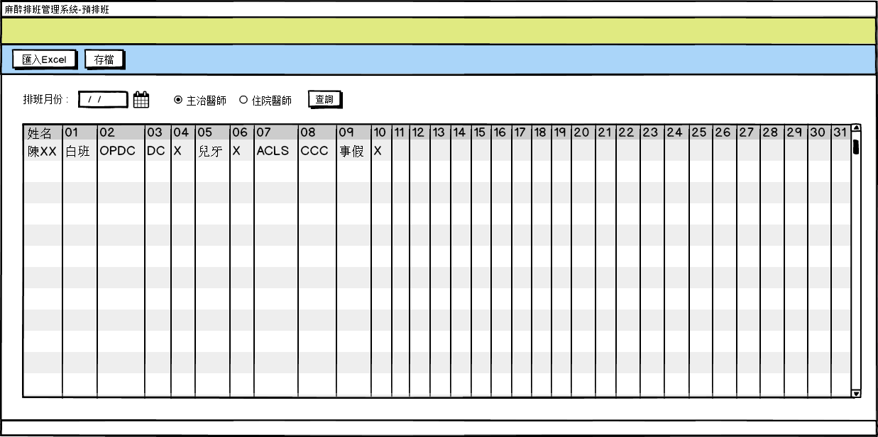
1. UI & Event Binding – 預排班
序 | 事件名稱
1 | onInputClick($event)
2 | onSaveClick($event)
3 | onSearchClick($event)
1
2
3

Slide 4
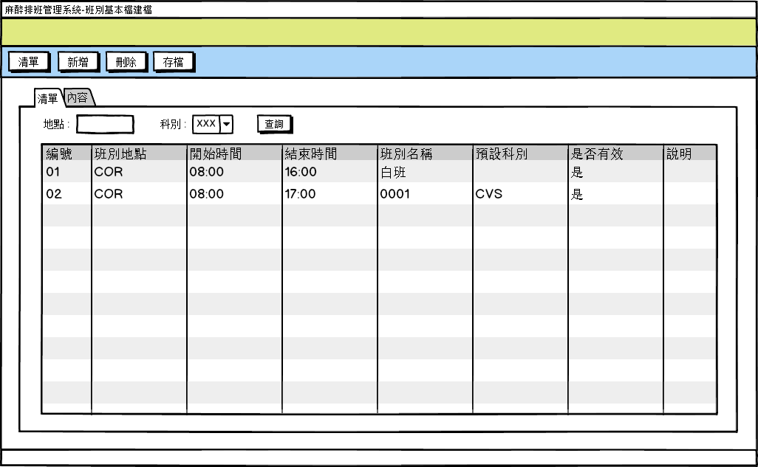
1. UI & Event Binding – 班別基本檔清單
序 | 事件名稱
1 | onListClick($event)
2 | onAddClick($event)
3 | onRemoveClick($event)
4 | onSaveClick($event)
5 | onTabChange($event)
6 | onSearchClick($event)
7 | onRowClick($event)
1
2
3
4
5
6
7

Slide 5
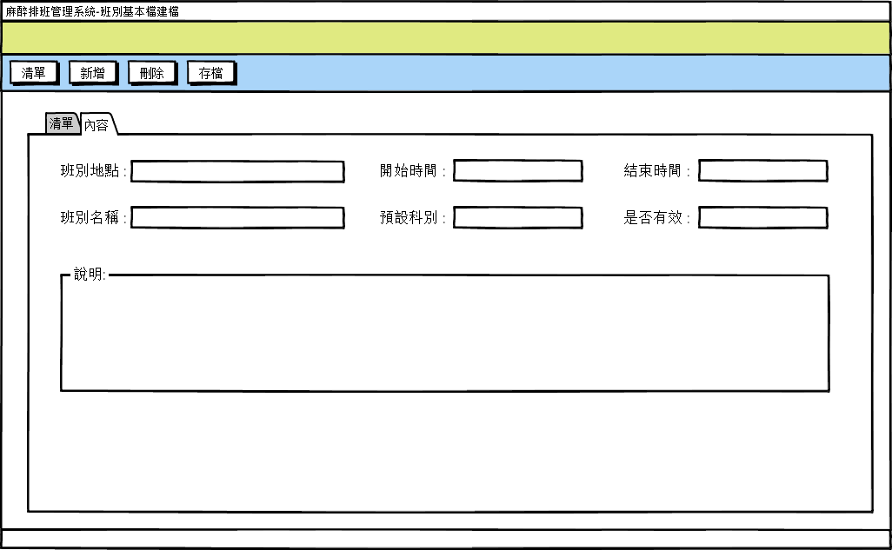
1. UI & Event Binding –班別基本檔內容
序 | 事件名稱
1 | onListClick($event)
2 | onAddClick($event)
3 | onRemoveClick($event)
4 | onSaveClick($event)
5 | onTabChange($event)
1
2
3
4
5

Slide 6
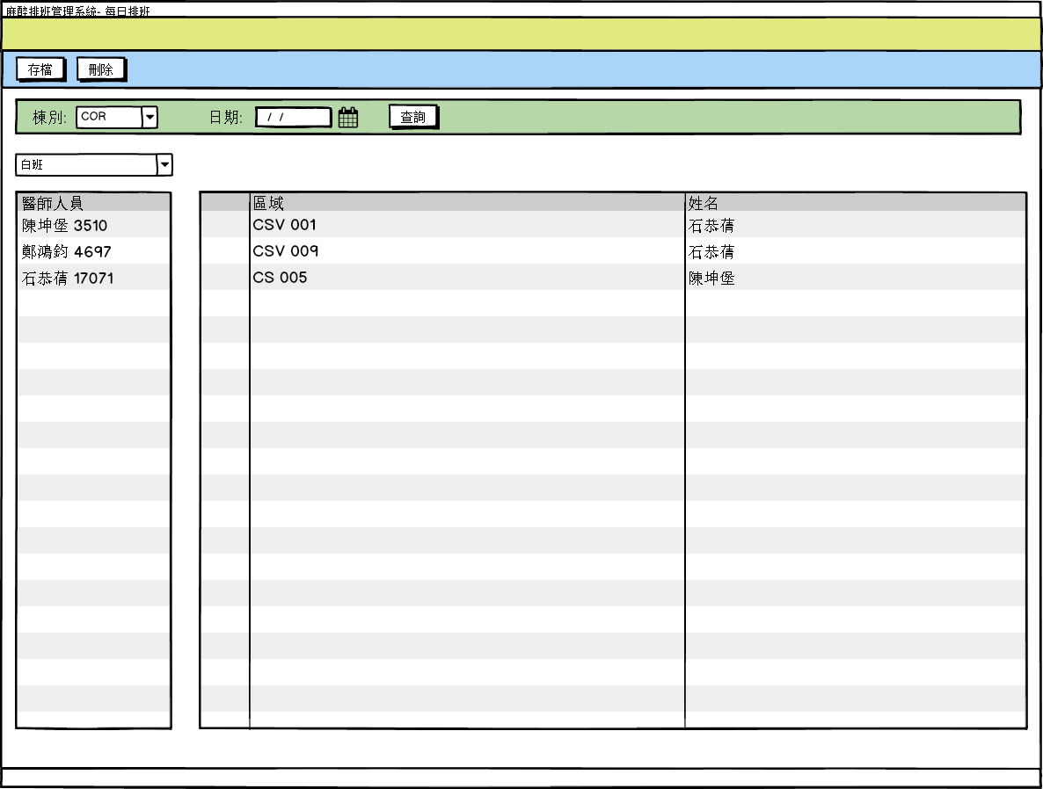
1. UI & Event Binding – 每日排班
序 | 事件名稱
1 | onSaveClick($event)
2 | onRemoveClick($event)
3 | onSearchClick($event)
4 | onShiftChange($event)
1
2
3
4

Slide 7
2. ViewModel
AnesDrSchedule (1/3)
Name |  | DataType
+ dutyMonth | : | Date
+ drNo | : | number
+ teacherNo | : | number
+ day01 | : | number
+ day02 | : | number
+ day03 | : | number
+ day04 | : | number
+ day05 | : | number
+ day06 | : | number
+ day07 | : | number
+ day08 | : | number
+ day09 | : | number
+ day10 | : | number
AnesDrSchedule (2/3)
Name |  | DataType
+ day11 | : | number
+ day12 | : | number
+ day13 | : | number
+ day14 | : | number
+ day15 | : | number
+ day16 | : | number
+ day17 | : | number
+ day18 | : | number
+ day19 | : | number
+ day20 | : | number
+ day21 | : | number
+ day22 | : | number
+ day23 | : | number
AnesDrSchedule (3/3)
Name |  | DataType
+ day24 | : | number
+ day25 | : | number
+ day26 | : | number
+ day27 | : | number
+ day28 | : | number
+ day29 | : | number
+ day30 | : | number
+ day31 | : | number
+ remark | : | string
+ systemUser | : | number

Slide 8
2. ViewModel
ScheduleReq
Name |  | DataType
+ teacherNo | : | number
+ dutyMonth | : | Date
AnesWorkShift
Name |  | DataType
+ shiftNo | : | number
+ locType | : | number
+ startTime | : | string
+ endTime | : | string
+ shiftName | : | string
+ divNo | : | string
+ isActive | : | string
+ remark | : | string
+ systemUser | : | number
AnesDuty
Name |  | DataType
+ dutyDate | : | Date
+ shifNo | : | number
+ drNo | : | number
+ teacherNo | : | number
+ systemUser | : | number
+ anesWorkShit | : | anesWorkShit
AnesShiftReq
Name |  | DataType
+locType | : | number
+ divNo? | : | string
AnesDutyReq
Name |  | DataType
+ locType | : | number
+ dutyDate | : | Date
+ shiftNo? | : | number
EmpInfo
Name |  | DataType
+ empName | : | string
+ empNo | : | number

Slide 9
3. View Service
Page | Description | Property / Event | View Service | Input | Output
預排班 | 匯入EXCEL | onInputClick() | getExcelList() | data | AnesDrSchedule[]
 | 儲存麻醉醫師預排班 | onSaveClick() | setAnesDrSchedules() | AnesDrSchedule[] | True/False
 | 查詢麻醉醫師預排班 | onSearchClick() | getAnesDrSchedules() | ScheduleReq | AnesDrSchedule[]
Page | Description | Property / Event | View Service | Input | Output
班別基本檔 | 儲存班別基本檔 | onSaveClick() | setAnesWorkShift() | AnesWorkShift | True/False
 | 刪除班別基本檔 | onRemoveClick() | removeAnesWorkShift() | shiftNo: number | True/False
 | 查詢班別清單 | onSearchClick() | getAnesWorkShifts() | AnesShiftReq | AnesWorkShift[]
 | 取得班別資訊 | onRowClick() | getAnesWorkShiftInfo() | shiftNo: number | AnesWorkShift
 | 新增空的班別 | onAddClick() | getNewAnesWorkShift() | 無 | AnesWorkShift

Slide 10
3. View Service
Page | Description | Property / Event | View Service | Input | Output
每日排班 | 儲存每日排班資訊 | onSaveClick() | setAnesDutyInfos() | AnesDuty[] | True/False
 | 刪除每日排班 | onRemoveClick() | removeAnesDuty() | shiftNos: number[] | True/False
 | 查詢每日排班 | onSearchClick() | getAnesDutys() | AnesDutyReq | AnesDuty[]
 | 取得班別人員 | onShiftChange() | getShiftEmpInfos() | AnesDutyReq | EmpInfo[]

Slide 11
4. WebAPI Controller
Description | Method | URL(/webapi/anessScheduleManager) | Input | Output
儲存麻醉醫師預排班 | PUT | setAnesDrSchedules() | AnesDrSchedule[] | True/False
查詢麻醉醫師預排班 | POST | getAnesDrSchedules() | ScheduleReq | AnesDrSchedule[]
儲存班別基本檔 | PUT | setAnesWorkShift() | AnesWorkShift | True/False
查詢班別清單 | POST | getAnesWorkShifts() | AnesShiftReq | AnesWorkShift[]
取得班別資訊 | GET | getAnesWorkShiftInfo() | shiftNo | AnesWorkShift
刪除班別基本檔 | POST | removeAnesWorkShift() | shiftNo | True/False
儲存每日排班資訊 | PUT | setAnesDutyInfos() | AnesDuty[] | True/False
刪除每日排班 | POST | removeAnesDuty() | shiftNos | True/False
查詢每日排班 | POST | getAnesDutys() | AnesDutyReq | AnesDuty[]
取得班別人員 | POST | getShiftEmpInfos() | AnesDutyReq | EmpInfo[]

Slide 12
5. Model Service
Description | Service Function | Input | Output
儲存麻醉醫師預排班 | setAnesDrSchedules() | AnesDrSchedule[] | True/False
查詢麻醉醫師預排班 | getAnesDrSchedules() | ScheduleReq | AnesDrSchedule[]
儲存班別基本檔 | setAnesWorkShift() | AnesWorkShift | True/False
查詢班別清單 | getAnesWorkShifts() | AnesShiftReq | AnesWorkShift[]
取得班別資訊 | getAnesWorkShiftInfo() | shiftNo | AnesWorkShift
刪除班別基本檔 | removeAnesWorkShift() | shiftNo | True/False
儲存每日排班資訊 | setAnesDutyInfos() | AnesDuty[] | True/False
刪除每日排班 | removeAnesDuty() | shiftNos | True/False
查詢每日排班 | getAnesDutys() | AnesDutyReq | AnesDuty[]
取得班別人員 | getShiftEmpInfos() | AnesDutyReq | EmpInfo[]

Slide 13
6. Stored Procedure
Description | Service Function
儲存麻醉醫師預排班 | setAnesDrSchedules()
查詢麻醉醫師預排班 | getAnesDrSchedules()
儲存班別基本檔 | setAnesWorkShift()
查詢班別清單 | getAnesWorkShifts()
取得班別資訊 | getAnesWorkShiftInfo()
刪除班別基本檔 | removeAnesWorkShift()
儲存每日排班資訊 | setAnesDutyInfos()
刪除每日排班 | removeAnesDuty()
查詢每日排班 | getAnesDutys()
取得班別人員 | getShiftEmpInfos()

