Slide 1

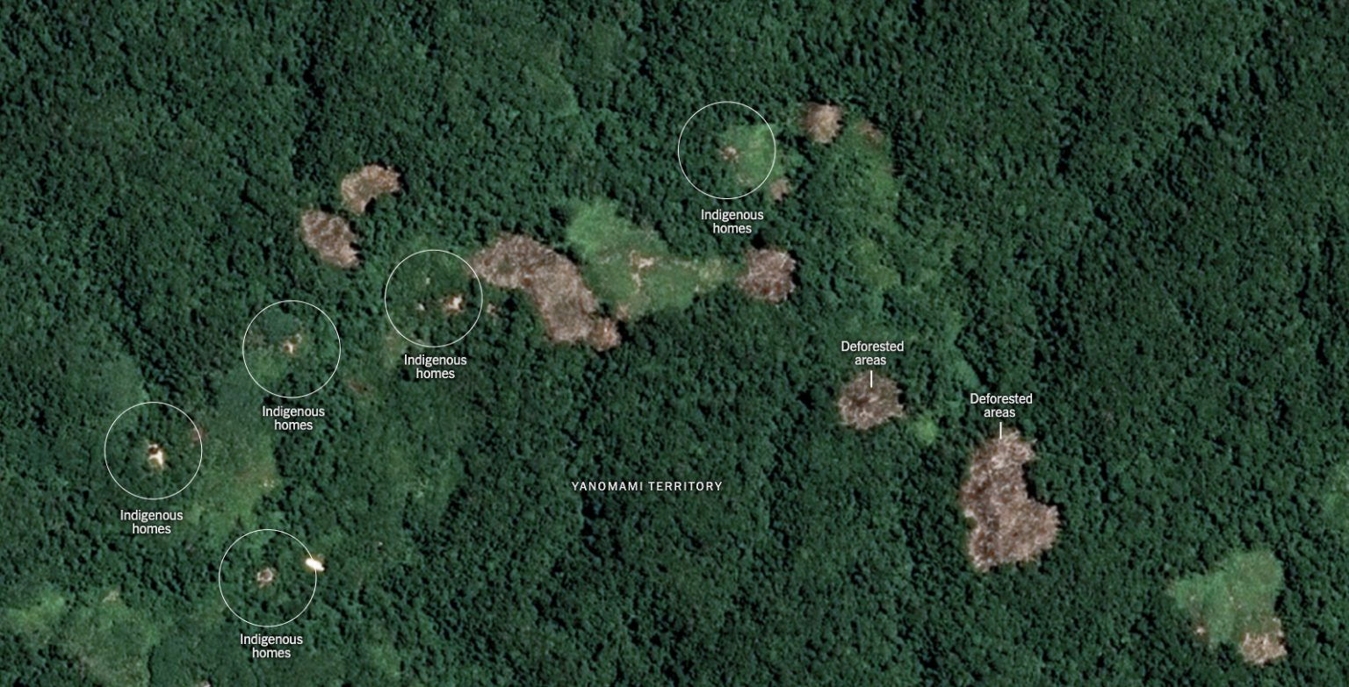
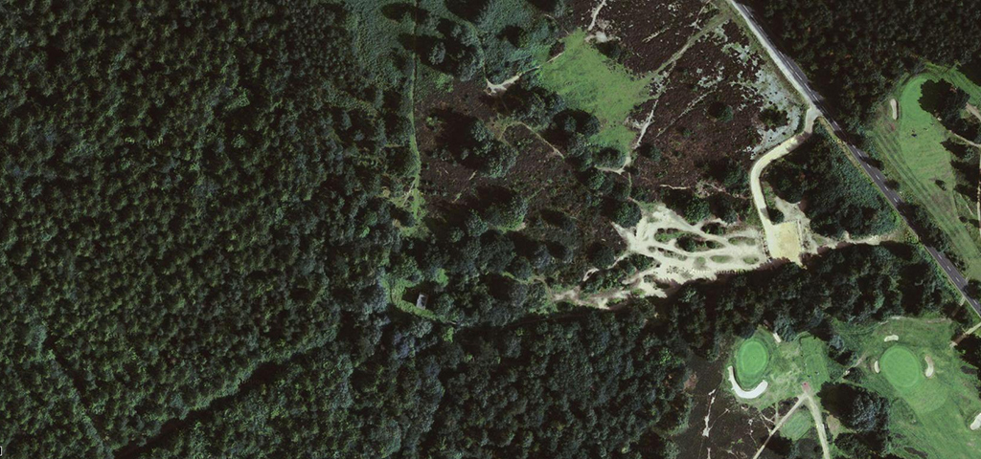
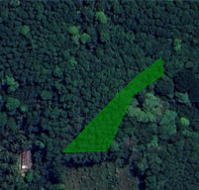


KUDUGALAYAYA, KARAWILA, BADALKUMBURA - TEMPORAL ANALYSIS 2020-2023
2020
2021
2022
2023
Deforestation risk is low (farm unit does not overlap forested areas with tree cover loss)
Encroachment risk is low (Land is not encroaching with a protected area)
Deforestation risk is low (farm unit does not overlap forested areas with tree cover loss)
Encroachment risk is low (Land is not encroaching with a protected area)
Deforestation risk is low (farm unit does not overlap forested areas with tree cover loss)
Encroachment risk is low (Land is not encroaching with a protected area)
Deforestation risk is low (farm unit does not overlap forested areas with tree cover loss)
Encroachment risk is low (Land is not encroaching with a protected area)
Area Information
Legend
Data Source
Technical Data
Risk Level
Total Area | Inters. - Potec. Areas
Inters. - Deforested Area | Eligible Area
No Risk Area
Images: Google Earth
Land use identification: Sentinel Hub and satellite data
Land use classification: Hansen,M.C.,etal.2013.High-Resolution Global Maps of 21st-Century Forest Cover Change.
Protected Area: IUCN and UNEP-WCMC(2023),The World Database on Protected Areas(WDPA),Cambridge,UK:UNEP-WCMC.www.protectedplanet.net.
0.12 ha
0.00 ha
Medium Risk Area
High Risk Area
"Go" : Protected Area where certain regulated economic and agricultural activities are allowed under specific conditions (specified in the applicable law)
Protected Areas
0.00ha
0.12ha
"No Go" : strictly protected high conservation area. Agricultural production is not allowed under applicable law.
20M
Deforested Areas
Areas with tree cover loss
Powered “CarbonEngen” by Engenuity Ai

