Slide 1

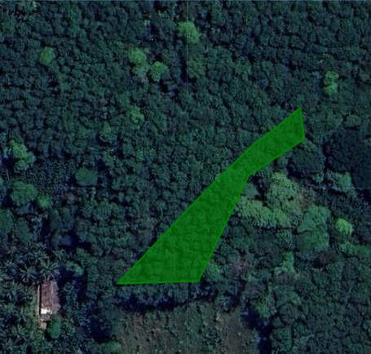

KUDUGALAYAYA, KARAWILA, BADALKUMBURA - TEMPORAL ANALYSIS 2020-2023
2020
2021
2022
2023
deforestation_text
Encroachment risk is low
Deforestation risk is low
Encroachment risk is low
Deforestation risk is low
Encroachment risk is low
Deforestation risk is low
Encroachment risk is low
Area Information
Legend
Data Source
Technical Data
Risk Level
Total Area total_area_val | Inters. - Potec. Areas potec_val
Inters. - Deforested Area def_val | Eligible Area eligible_area_val
No Risk Area
Images: Google Earth
Land use identification: Sentinel Hub and satellite data
Land use classification: Hansen,M.C.,etal.2013.High-Resolution Global Maps of 21st-Century Forest Cover Change.
Protected Area: IUCN and UNEP-WCMC(2023),The World Database on Protected Areas(WDPA),Cambridge,UK:UNEP-WCMC.www.protectedplanet.net.
Medium Risk Area
High Risk Area
"Go" : Protected Area where certain regulated economic and agricultural activities are allowed under specific conditions (specified in the applicable law)
Protected Areas
"No Go" : strictly protected high conservation area. Agricultural production is not allowed under applicable law.
20M
Deforested Areas
Areas with tree cover loss
Powered “CarbonEngen” by Engenuity Ai

