Slide 1

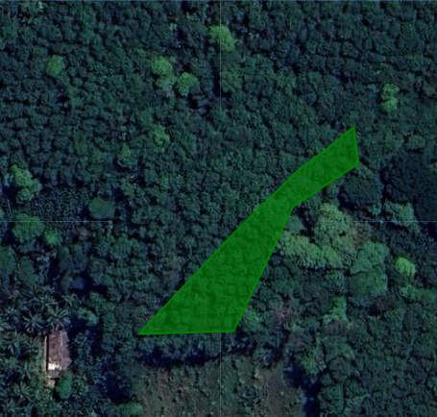

KUDUGALAYAYA, KARAWILA, BADALKUMBURA - TEMPORAL ANALYSIS 2020-2023
2020
2021
2022
2023
{{ deforestation_text }}
{{ encroachment_text1 }}
{{ deforestation_text2 }}
{{ encroachment_text2 }}
{{ deforestation_text3 }}
{{ encroachment_text3 }}
{{ deforestation_text4 }}
{{ encroachment_text4 }}
Area Information
Legend
Data Source
Technical Data
Risk Level
Total Area {{ total_area_val }} | Inters. - Potec. Areas {{ potec_val }}
Inters. - Deforested Area {{ def_val }} | Eligible Area {{ eligible_area_val }}
No Risk Area
Images: Google Earth
Land use identification: Sentinel Hub and satellite data
Land use classification: Hansen,M.C.,etal.2013.High-Resolution Global Maps of 21st-Century Forest Cover Change.
Protected Area: IUCN and UNEP-WCMC(2023),The World Database on Protected Areas(WDPA),Cambridge,UK:UNEP-WCMC.www.protectedplanet.net.
Medium Risk Area
High Risk Area
"Go" : Protected Area where certain regulated economic and agricultural activities are allowed under specific conditions (specified in the applicable law)
Protected Areas
"No Go" : strictly protected high conservation area. Agricultural production is not allowed under applicable law.
{{ tec_val }}
Deforested Areas
Areas with tree cover loss
Powered “CarbonEngen” by Engenuity Ai

