Slide 1
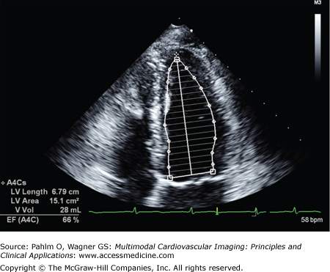
Apex cordis
1
# Automatically recognize Apex from edge points
Step 1: Find the largest triangle from edge points
Step 2: Find Apex with the longest sum of two side lengths
b1
b2
2
# Automatically recognize b1, b2 from edge points
Step 1: Draw the dummy line to divide edge points into two groups
Step 2: b1, b2 are the longest points from Apex in groups, respectively.
Input: edge points of LV
1
Find the point of Apex cordis
2
Find the point of b1, b2
LV volume = f(Apex_cordis, b1, b2, edge points)
f : Modified Simpson’s Method*
* Goerke, R.J. and Carlsson, E., 1967.
Dummy line

