Slide 1


Understanding OpenStack …
Alvin Pei Yan Li
2019.05.20

Slide 2
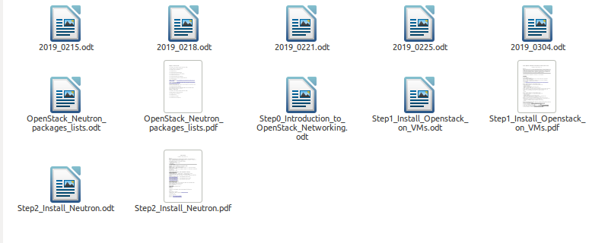
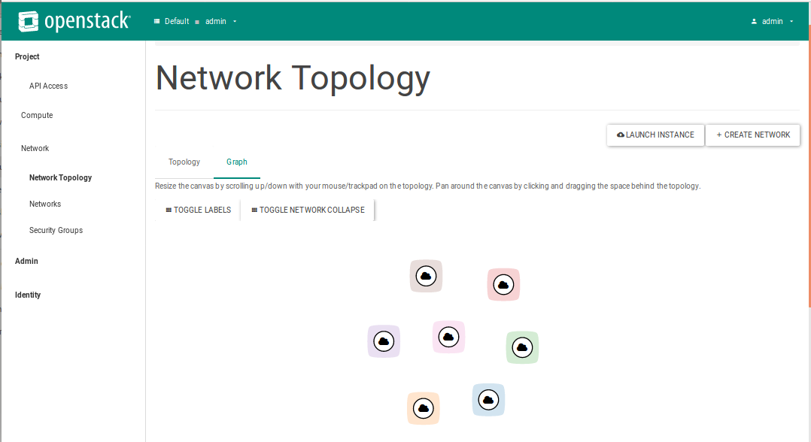
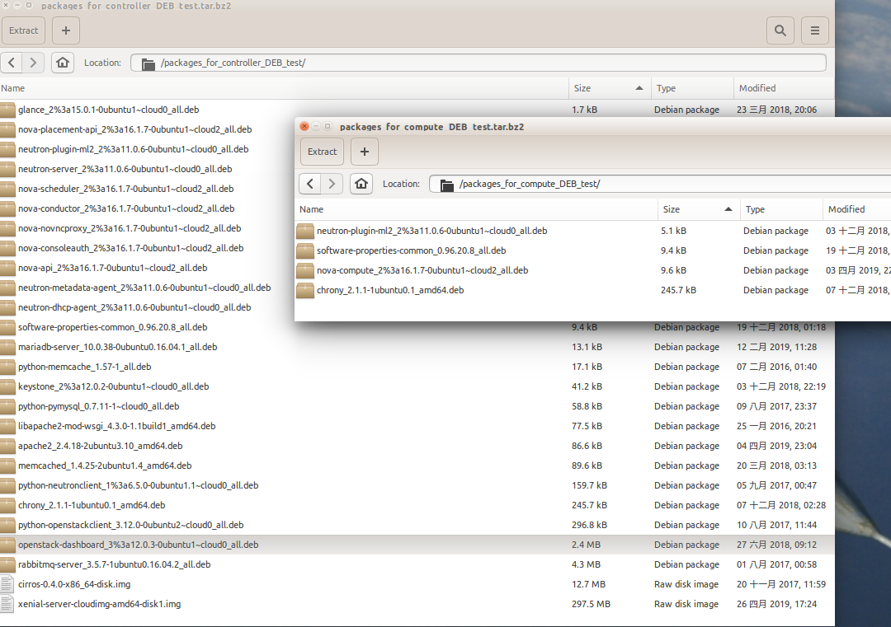
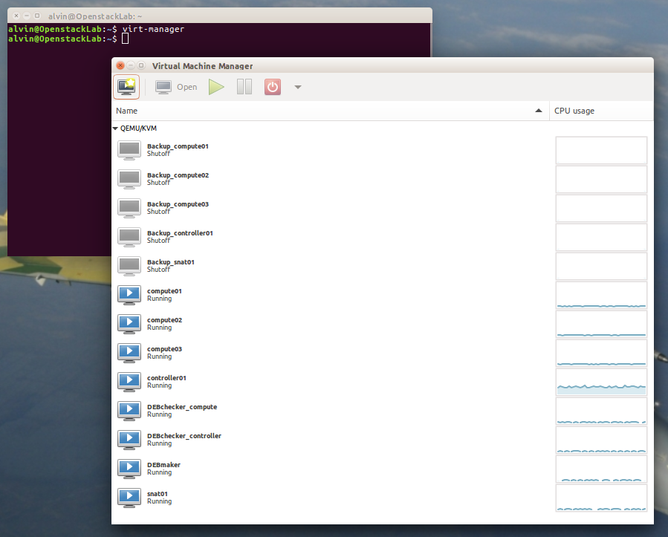

Slide 3
A brief description of OpenStack Networking
OpenStack Networking includes switching, routing, load balancing, firewalling, virtual private networks and network function virtualization.
It provides a framework of the cloud can be enhanced by third party vendors.

Slide 4
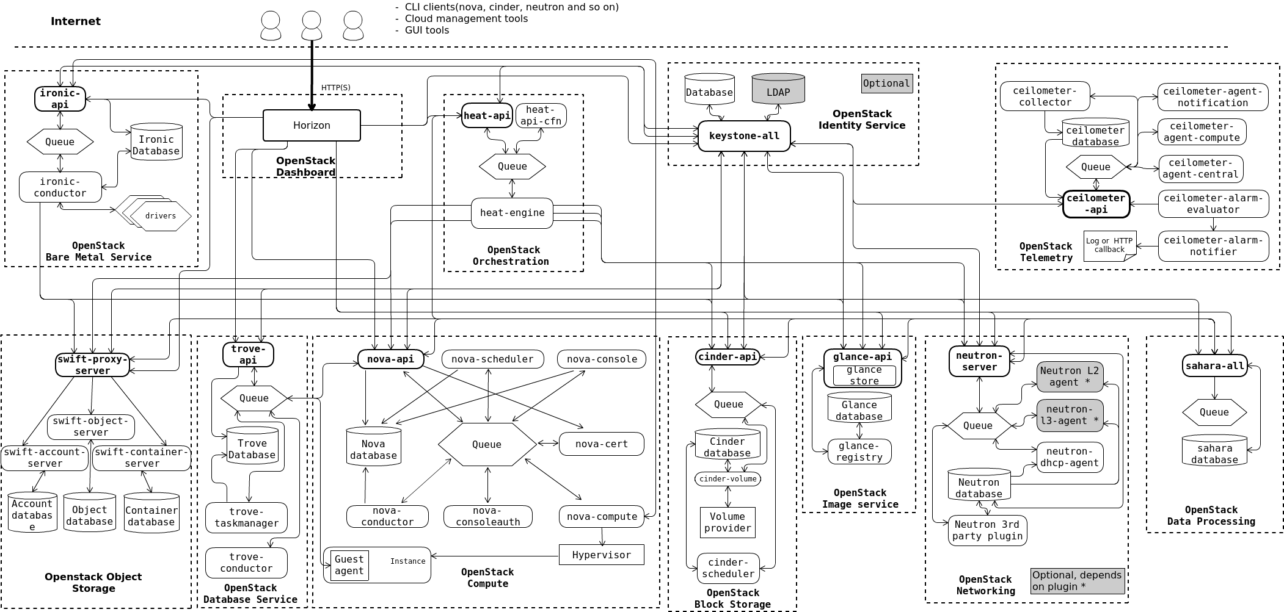

Slide 5




OpenStack began in 2010 as a joint project of Rackspace Hosting and NASA. As of 2016, it is managed by the OpenStack Foundation, a non-profit corporate entity established in September 2012^{[3]} to promote OpenStack software and its community.^{[4]} More than 500 companies have joined the project.[5][6][7][8][9][10][11][12][13][14][15]

Slide 6


Slide 7
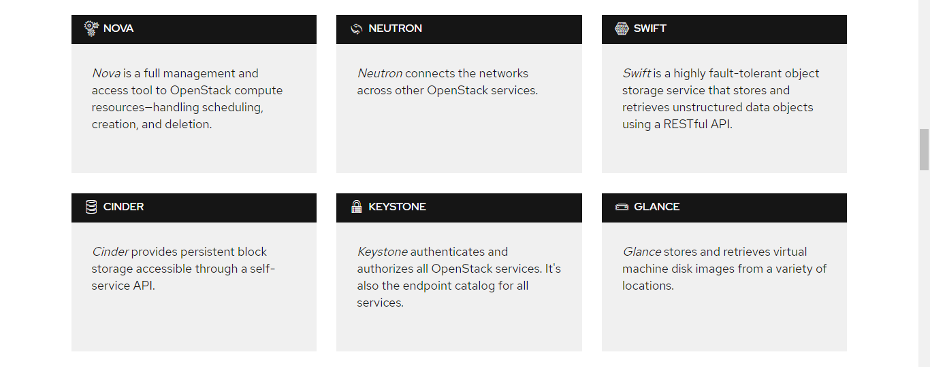

Slide 8
physical NIC
Hypervisor
(QEMU-KVM)
Bridge: br1
controller
compute
virtual NIC: Openstack-net0
VM node
VM node
Others
VM nodes

Slide 9
Hypervisor
(QEMU-KVM)
Controller
virtual NIC: Openstack-net0
virtual NIC: Openstack-net1
virtual NIC: Openstack-net2

Slide 10
How to prepare a good environment ?
Under Ubuntu 16.04 LTS desktop …
# apt update; apt -y upgrade;
# apt -y install qemu-kvm libvirt-bin virtinst bridge-utils cpu-checker
# apt -y install virt-manager
# apt -y install virt-manager ssh-askpass-gnome -no-install-recommends
# apt -y install libguestfs-tools virt-top
# wget http://releases.ubuntu.com/16.04.6/ubuntu-16.04.6-server-amd64.iso
# virt-manager

Slide 11
Setup one bridge network for kvm-based VMs
On the graphic interface of virtual machine manager
Edit > Connection Details > Network Interfaces > select ‘+’
Interface type: Bridge
Name: br1, Start mode: onboot, Activate now: yes
Choose interface(s) to bridge: enp3s0
IPv4 DHCP
Ok

Slide 12
Setup three virtual network for VMs
On the graphic interface of virtual machine manager
Edit > Connection Details > Virtual Networks > select ‘+’
Network Name: openstack-net0 or openstack-net1 …
Network: 192.168.100.0/24 or 192.168.110.0/24 …
Enable DHCPv4: yes
Choose IPv6 address space: no
Connected to a physical network: Isolated virtual network
Ok

Slide 13
Create VMs on host (64-bit x86 processors)
Node 1
controller01:
2 CPU, 1G RAM, 10 GB storage, NIC1: br1, NIC2: openstack-net0, …
Node 2
compute01:
2 CPU, 1G RAM, 10 GB storage, NIC1: br1, NIC2: openstack-net0, …
* Virtual NIC can be added from the detail section of VM located at the upper strip on the window by selecting “add hardware” and “network”.

Slide 14
Installing an OS on a VM
Be aware of
HTTP proxy information (blank for none): ____ (remain blank)
How do you want to manage upgrades? No automatic updates
Only choose [*] standard system utilities while installation

Slide 15
Change NIC names (for each node)
# nano /etc/default/grub
Modify
GRUB_CMDLINE_LINUX=“”
-> GRUB_CMDLINE_LINUX=“net.ifnames=0 biosdevname=0”
# grub-mkconfig -o /boot/grub/grub.cfg
# nano /etc/network/interfaces
ens3 or enp3s0 -> eth0; ens8 or enp5s0 -> eth1; …
# reboot

Slide 16
Interface configuration
For controller01:
# nano /etc/network/interfaces
auto eth0
iface eth0 inet dhcp
auto eth1
iface eth1 inet static
address 192.168.100.10
netmask 255.255.255.0
# ifdown --all; ifup --all
For compute01:
# nano /etc/network/interfaces
auto eth0
iface eth0 inet dhcp
auto eth1
iface eth1 inet static
address 192.168.100.11
netmask 255.255.255.0
# ifdown --all; ifup --all

Slide 17
Update the /etc/hosts file on each node
*Uncomment the line of 127.0.0.1
# sed –i ‘/^127.0.1.1/s/^/#/’ /etc/hosts
# echo “192.168.100.10 controller01.xxx.com controller01” >> /etc/hosts
# echo “192.168.100.11 compute01.xxx.com compute01” >> /etc/hosts
# reboot
# ping -c4 controller01
# ping -c4 compute01
# ping -c4 www.google.com

Slide 18
