Slide 1
Point Cloud Package 2.0 Documentation
2015-10-30

Slide 2
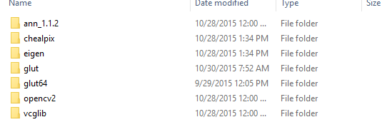
Build the code
The code is build on:
Windows 10 + VS 2013 + QT5_64bit_opengl
The other third party libraries are already included in the project:

Slide 3
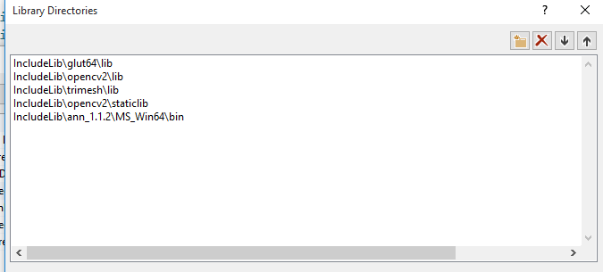
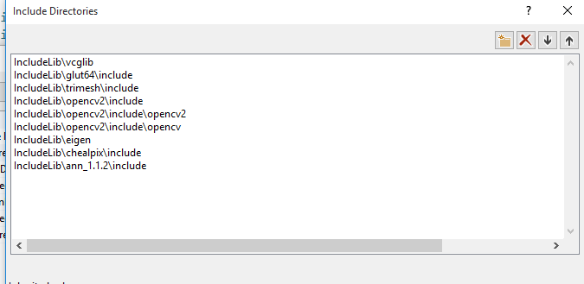
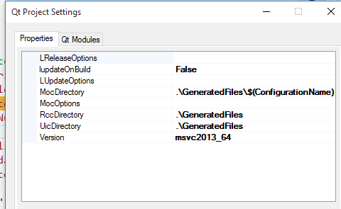
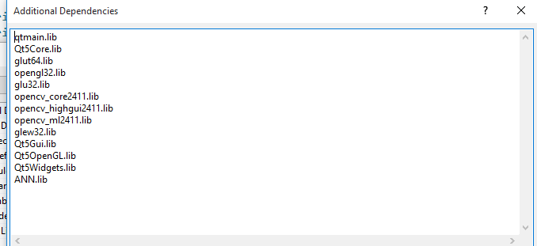
Build the code
Just in case something went wrong…

Slide 4
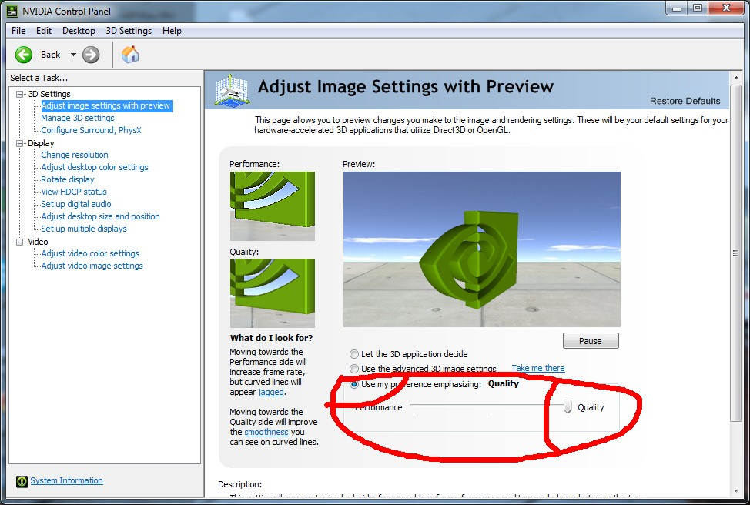
How to get a nice display:
You need to open the optimize quality in the graphics card’s option, for example:

Slide 5
Quick control:
Ctrl + Wheel : Change showing objects size(original points, sample points, skeleton nodes)
Alt + Wheel : Change neighborhood size parameter (the blue ball)
Ctrl + Drag : Pan
Shift + Drag: Zoom
Shift + Wheel: Change the down-sample points number parameter / Change the branch size
Ctrl + Shift + Drag: Chang the light position
Ctrl + Alt + Wheel: Chang the point normal length
Alt + Shift + Wheel: Chang blue neighborhood ball transparency
Ctrl + Shift + Wheel: Change the blue bridge point merge threshold

