Slide 1
COMP90007 Internet Technologies Workshop
Week 5
Ruixi
huor@student.unimelb.edu.au

Slide 2
Slides
https://github.com/SiaHuo/COMP90007Workshops
If there is any error in slides, please point it out.
Please refer to solution on LMS for standard answers

Slide 3
Question 1
What is the minimum overhead in bytes to send an IP packet using PPP?
3
Notes:
3

Slide 4
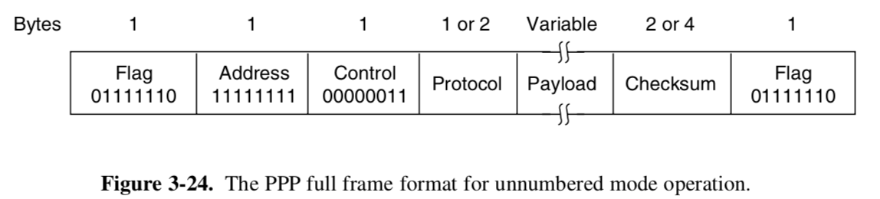
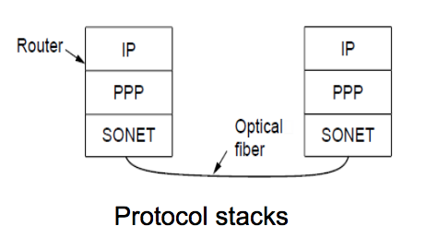
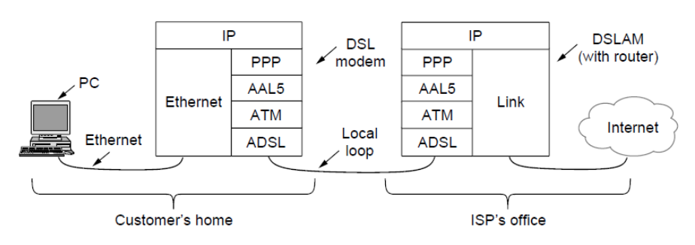
Review
Point to Point Protocol (PPP)
Data-link layer
Controls transmitting data across two nodes(any devices in the network)
Both SONET (Synchronous Optical Networking) and ADSL (Asymmetric Digital Subscriber Loop) use PPP in different ways

Slide 5
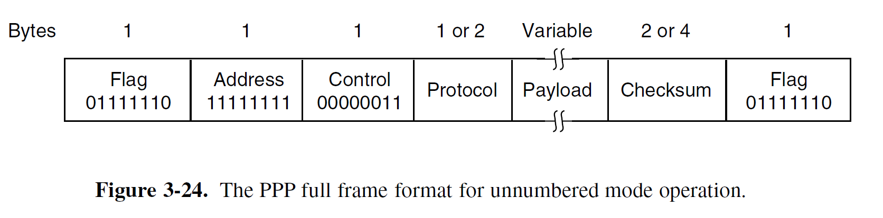
Question 1
What is the minimum overhead in bytes to send an IP packet using PPP?
Answer:
Note that you do not need to consider the length of the IP packet or its header.
Minimum bytes in PPP frame: 1 byte for leading flag, 0 bytes for address and control,
1 byte for protocol, 2 bytes for checksum, 1 byte for trailing flag, giving a total of 5 bytes.
The address and control fields can be omitted via LCP negotiation when the connection begins. (See Ch 3.5.1 Tanenbaum)
5
Notes:
5

Slide 6
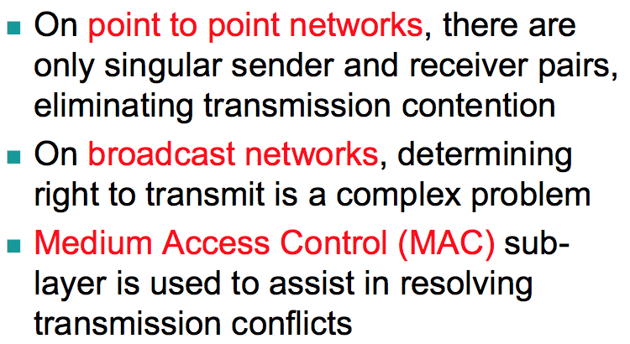
Application
Presentation
Session
Transport
Network
Data Link
Physical
MAC
Logical Link Control
Medium Access Control

Slide 7
Sub-Layer: MAC
Application
Presentation
Session
Transport
Network
Data Link
Physical
Lives near the bottom of the data link layer
Controls how we can allocate multiple users over a single shared channel in a broadcast network.
Logical Link Control
Medium Access Control

Slide 8
Multiple Access Protocols
ALOHA
Pure
slotted
CSMA
1-persistent
non-persistent
p-persistent
CSMA/CD
Bit-map
Binary Countdown
4. Limited Contention Protocol
The Adaptive Tree Walk Protocol

Slide 9
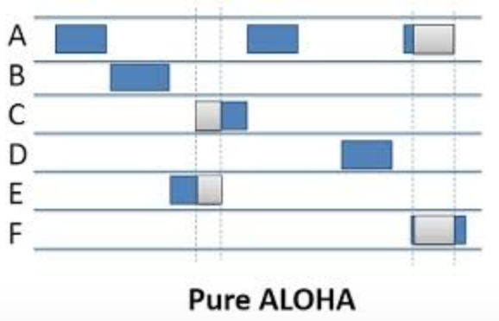
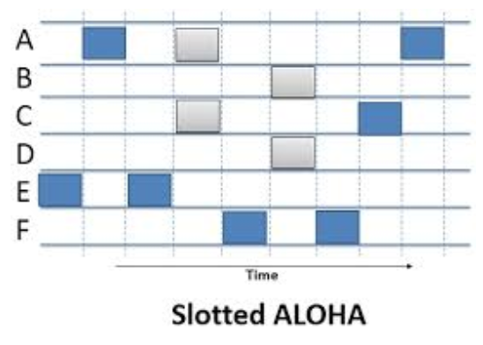
1.ALOHA
The basic idea of an ALOHA system is simple: let users transmit whenever they have data to be sent.
2 versions: pure and slotted.

Slide 10
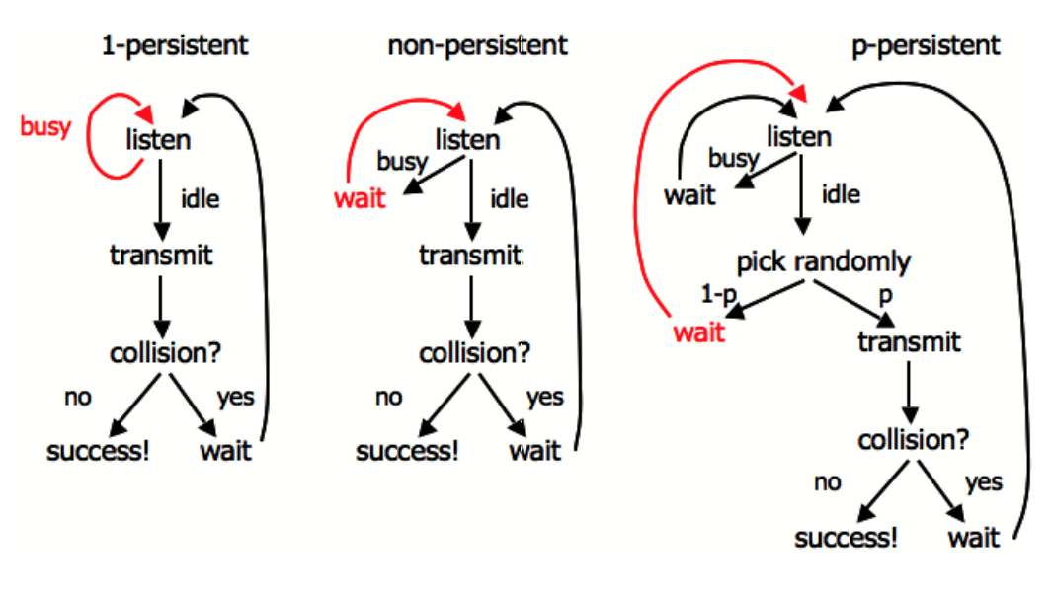
2.CSMA(Carrier Sense Multiple Access)
Stations listen for a carrier and act accordingly are called carrier sense protocol.

Slide 11
However, if two stations sense the channel to be idle and begin transmitting simultaneously, their signals will still collide.
Another improvement is for the stations to quickly detect the collision and abruptly stop transmitting, (rather than finishing them) since they are irretrievably garbled anyway. This strategy saves time and bandwidth.
CSMA/CD
CSMA with Collision Detection
Bit-Map Protocol
Binary Countdown

Slide 12
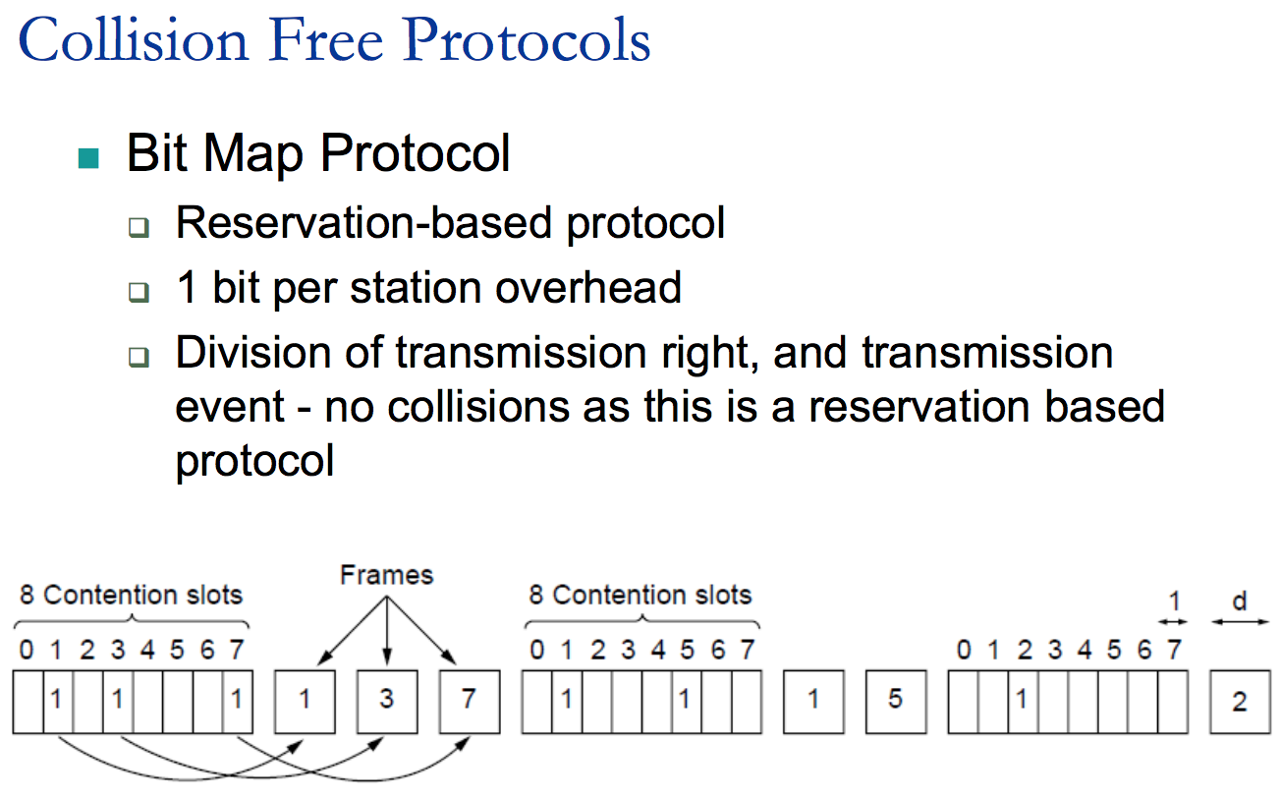
3.

Slide 13
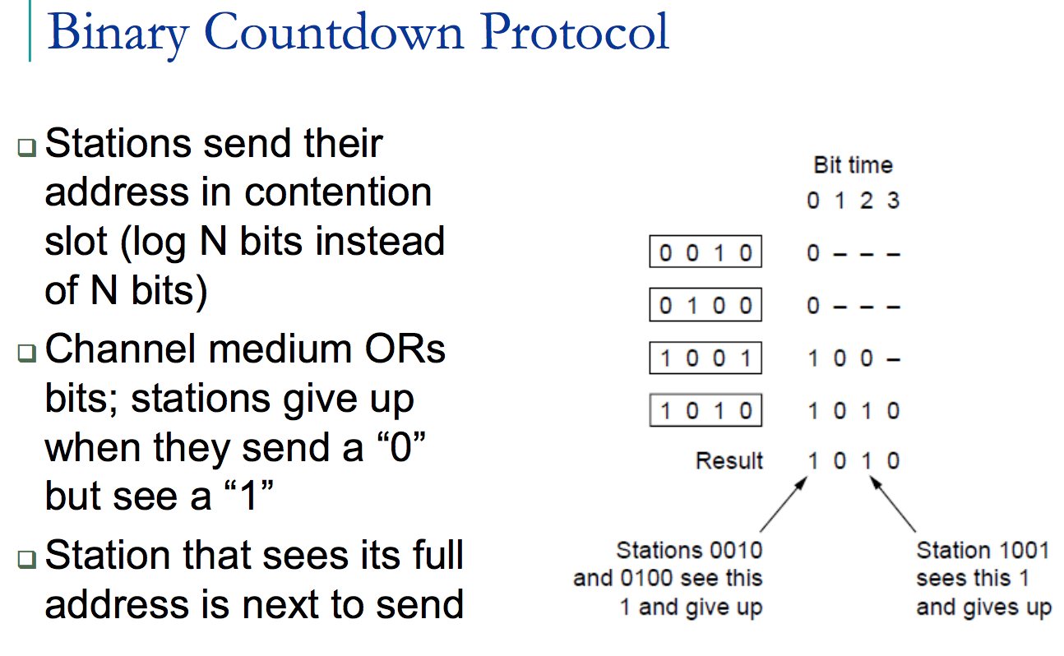

Slide 14
Comparison
ALOHA, CSMA protocols – potential collisions
No need to reserve, send once the conditions are satisfied.
CSMA/CD – collision free (bit map and binary countdown)
Need to reserve
With a low load, the reservation-based protocols may incur unnecessary overhead.
With the load increases, they become more and more attractive.

Slide 15
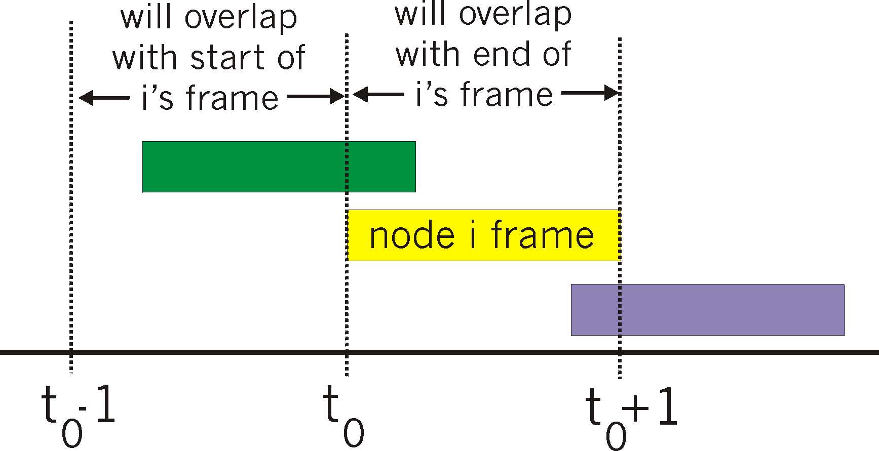
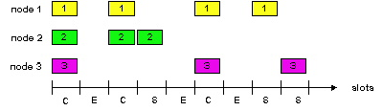
Question 2
Consider the delay of pure ALOHA versus slotted ALOHA at low load. Which one is less? Explain your answer.
Slotted ALOHA
Unslotted ALOHA
Answer:
With slotted ALOHA, it has to wait for the next slot. This introduces half a slot time of delay. With pure ALOHA, transmission can start instantly.
At low load with minimal collisions, pure ALOHA will have less delay.
However, at higher loads, there is more probability for collisions in pure ALOHA compared to slotted ALOHA. This is because frames can collide in midway. By enforcing synchronisation, slotted ALOHA is able to achieve much greater efficiency.
Notes:
15

Slide 16
Question 4
Eight stations, numbered 1 through 8, are contending for the use of a shared channel by using the adaptive tree walk protocol. If all the stations whose addresses are prime numbers suddenly became ready at once, how many bit slots are needed to resolve the contention?
Notes:
Assigning groups to who can transmit
“One particularly simple way of performing the necessary assignment is to use
the algorithm devised by the U.S. Army for testing soldiers for syphilis during
World War II (Dorfman, 1943). In short, the Army took a blood sample from N
soldiers. A portion of each sample was poured into a single test tube. This mixed
sample was then tested for antibodies. If none were found, all the soldiers in the
group were declared healthy. If antibodies were present, two new mixed samples
were prepared, one from soldiers 1 through N/2 and one from the rest. The process
was repeated recursively until the infected soldiers were determined.“
16

Slide 17
4.Limited-contention protocols
Adaptive tree walk protocol
Evenly distribute the resource (depth first search)
We combine the best properties of the contention and collision-free protocols, arriving at a new protocol that used contention at low load to provide low delay, but used a collision-free technique at high load to provide good channel efficiency.

Slide 18
A
Slot1: 2,3,5,7
B
C
D
E
F
G
1
2
3
4
5
6
7
8

Slide 19
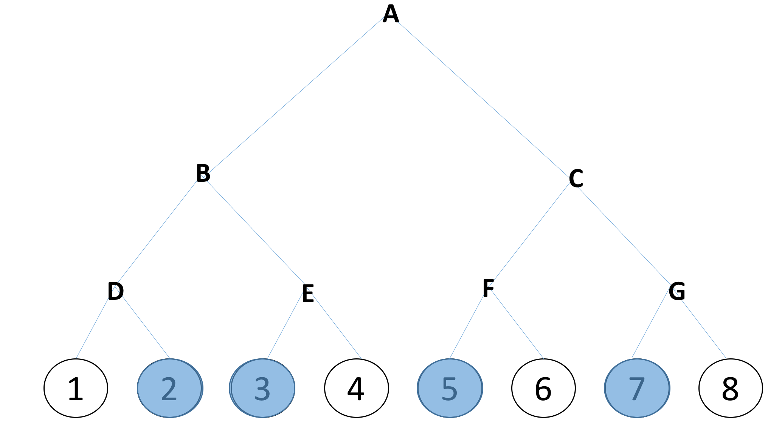
Slot1: 2, 3, 5, 7
Slot2: 2, 3

Slide 20
Slot1: 2, 3, 5, 7
Slot2: 2, 3
Slot3: 2

Slide 21
Slot1: 2, 3, 5, 7
Slot2: 2, 3
Slot3: 2
Slot4: 3

Slide 22
Slot1: 2, 3, 5, 7
Slot2: 2, 3
Slot3: 2
Slot4: 3
Slot5: 5, 7

Slide 23
Slot1: 2, 3, 5, 7
Slot2: 2, 3
Slot3: 2
Slot4: 3
Slot5: 5, 7
Slot6: 5

Slide 24
Slot1: 2, 3, 5, 7
Slot2: 2, 3
Slot3: 2
Slot4: 3
Slot5: 5, 7
Slot6: 5
Slot7: 7

Slide 25
Question 4
Eight stations, numbered 1 through 8, are contending for the use of a shared channel by using the adaptive tree walk protocol. If all the stations whose addresses are prime numbers suddenly became ready at once, how many bit slots are needed to resolve the contention?
Answer:
Stations 2,3,5,7 want to send. 7 slots are needed, with the contents of each slot being as follows:
slot 1: 2, 3, 5, 7 (collision)
slot 2: 2, 3 (collision)
slot 3: 2 (success)
slot 4: 3 (success)
slot 5: 5, 7 (collision)
slot 6: 5 (success)
slot 7: 7 (success)
8/23/18
25
Notes:
Assigning groups to who can transmit
“One particularly simple way of performing the necessary assignment is to use
the algorithm devised by the U.S. Army for testing soldiers for syphilis during
World War II (Dorfman, 1943). In short, the Army took a blood sample from N
soldiers. A portion of each sample was poured into a single test tube. This mixed
sample was then tested for antibodies. If none were found, all the soldiers in the
group were declared healthy. If antibodies were present, two new mixed samples
were prepared, one from soldiers 1 through N/2 and one from the rest. The process
was repeated recursively until the infected soldiers were determined.“
25

Slide 26
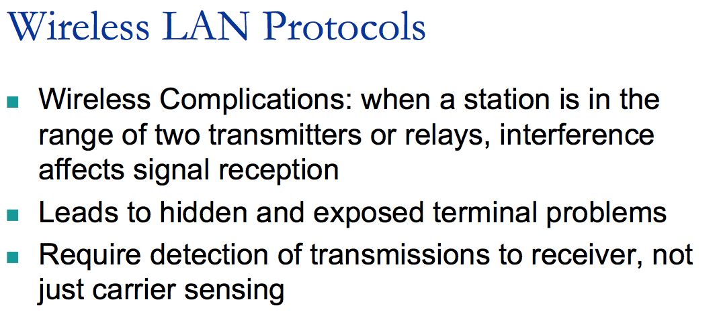

Slide 27
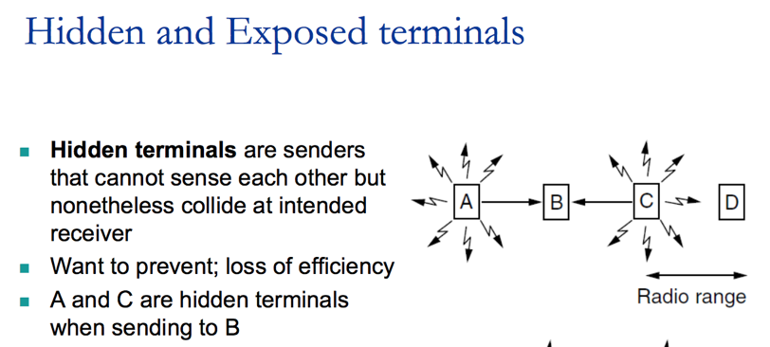
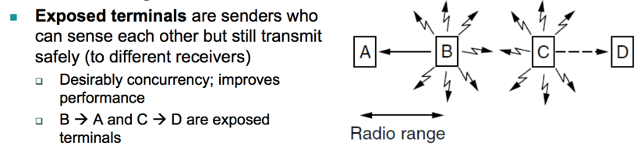

Slide 28
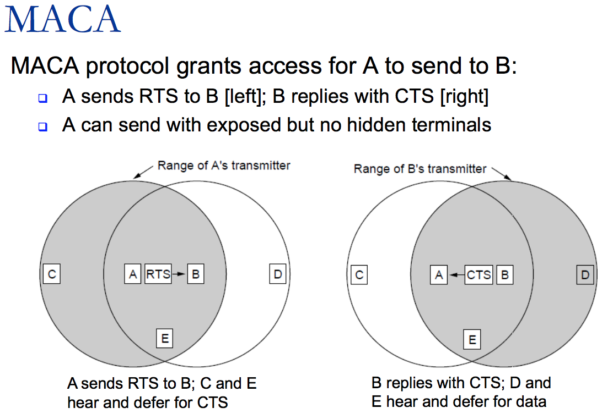

Slide 29
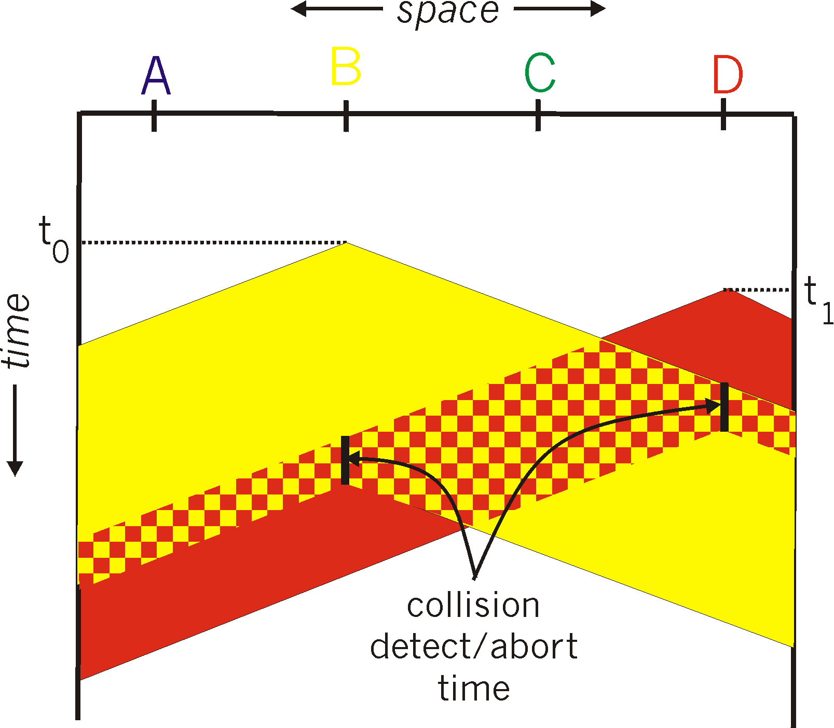
Question 3
The wireless LANs that we studied used protocols such as MACA instead of using CSMA/CD. Under what conditions, if any, would it be possible to use CSMA/CD instead?
Answer:
Radios cannot receive and transmit on the same frequency at the same time. In wireless systems, the received signal can be 1,000,000 smaller than the transmitting signal. Therefore detecting the received signal superimposed on the transmitted signal is near impossible.
There is also the problem of not all stations being within radio range of each other, and therefore will not detect the collision.
8/23/18
29
Notes:
“It is important to realize that collision detection is an analog process.
The station’s hardware must listen to the channel while it is transmitting. If
the signal it reads back is different from the signal it is putting out, it knows that a
collision is occurring. The implications are that a received signal must not be tiny
compared to the transmitted signal (which is difficult for wireless, as received signals
may be 1,000,000 times weaker than transmitted signals)”
29

Slide 30
Question 5
Six stations, A through F, communicate using the MACA protocol. Is it possible that two transmissions take place simultaneously? Explain your answer.
Answer:
Yes. Imagine that they are in a straight line and that each station can reach only its nearest neighbours. Then A can send to B while E is sending to F.
A
B
C
D
E
F
Notes:
30

Slide 31
Question 6
Give two reasons why networks might use an error-correcting code instead of error detection and retransmission.
Answer:
One reason is the need for real-time quality of service. If an error is discovered, there is no time to get a retransmission. The show must go on. Forward error correction can be used here. Another reason is that on very low quality lines (e.g. wireless channels), the error rate can be so high that practically all frames would have to be retransmitted, and the retransmissions would probably be damaged as well. To avoid this, forward error correction is used to increase the fraction of frames that arrive correctly.
8/23/18
31
Notes:
31

Slide 32
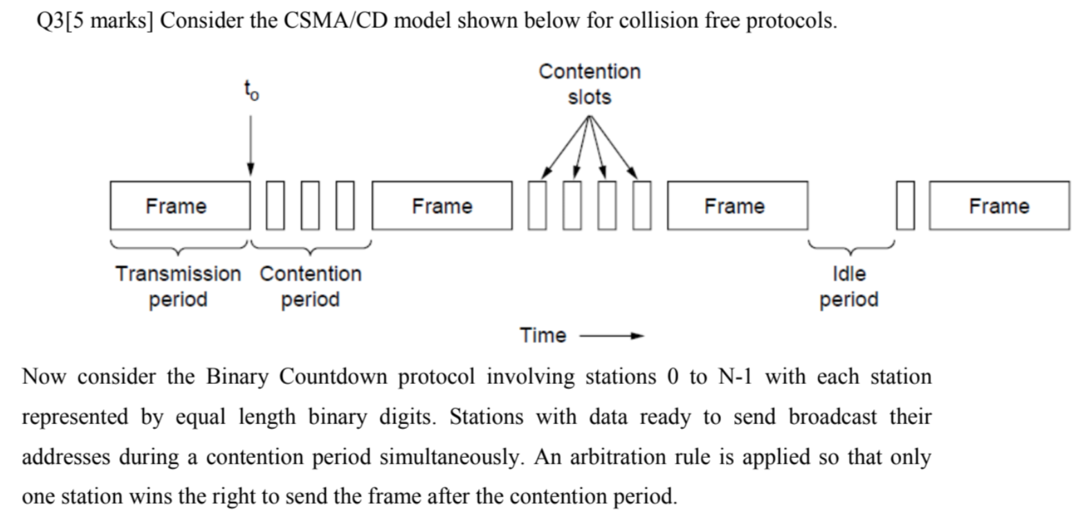

Slide 33
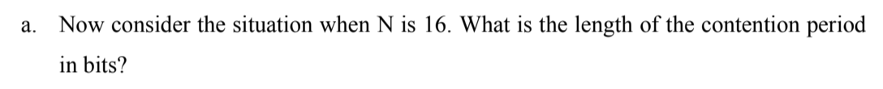

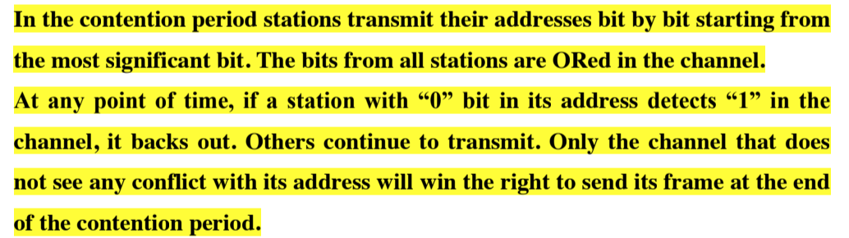



Notes:
Bit-map version?

