Slide 1

Software Processes and Management
GitHub
GitHub is a code hosting platform for version control and collaboration. It lets you and others work together on projects from anywhere.
This tutorial teaches you GitHub essentials like repositories, branches, commits, and Pull Requests. You’ll create your own Hello World repository and learn GitHub’s Pull Request workflow, a popular way to create and review code.

Slide 2
Software Processes and Management
No Coding Necessary
To complete this tutorial, you need a GitHub.com account and Internet access. You don’t need to know how to code, use the command line, or install Git (the version control software GitHub is built on).
Tip: Open this guide in a separate browser window (or tab) so you can see it while you complete the steps in the tutorial.

Slide 3
Software Processes and Management
Step 1. Create a Repository
A repository is usually used to organise a single project. Repositories can contain folders and files, images, videos, spreadsheets, and data sets – anything your project needs.
GitHub makes it easy to add one at the same time you create your new repository. It also offers other common options such as a license file.
Your hello-world repository can be a place where you store ideas, resources, or even share and discuss things with others.

Slide 4
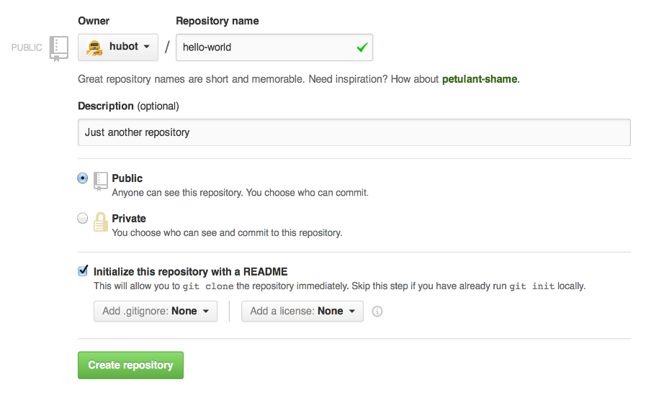
Software Processes and Management
To Create a New Repository
In the upper right corner, next to your avatar or identicon, click + and then select New repository.
Name your repository hello-world.
Write a short description.
Select Initialize this repository with a README.
Click Create Repository

Slide 5
Software Processes and Management
Step 2. Create a Branch
Branching is the way to work on different versions of a repository at one time.
By default, your repository has one branch named master which is considered to be the definitive branch. We use branches to experiment and make edits before committing them to master.
When you create a branch off the master branch, you’re making a copy, or snapshot, of master as it was at that point in time. If someone else made changes to the master branch while you were working on your branch, you could pull in those updates.

Slide 6
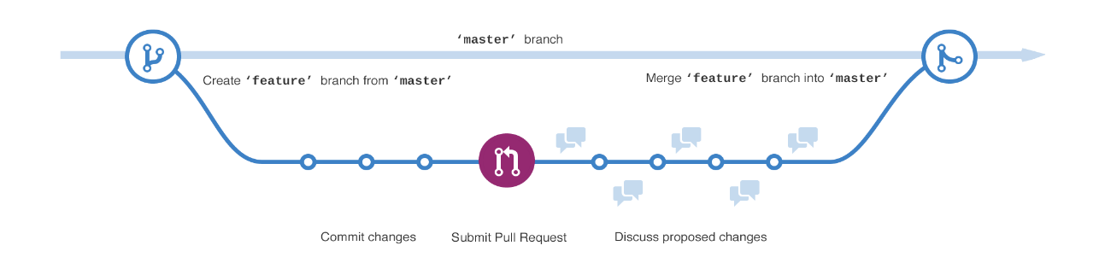
Software Processes and Management
Step 2. Create a Branch
This diagram shows:
The master branch
A new branch called feature (because we’re doing ‘feature work’ on this branch)
The journey that feature takes before it’s merged into master
Have you ever saved different versions of a file? Something like:
story.txt
story-joe-edit.txt
story-joe-edit-reviewed.txt

Slide 7
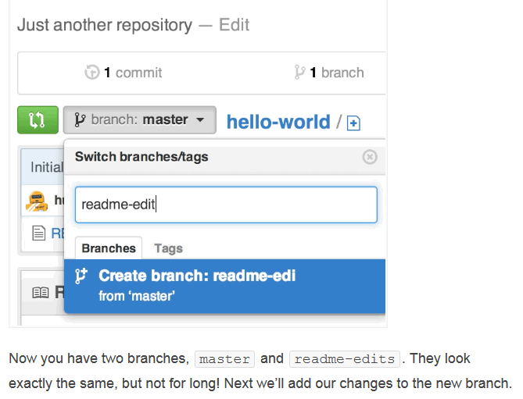
Software Processes and Management
To Create a New Branch
Go to your new repository hello-world.
Click the drop down at the top of the file list that says branch: master.
Type a branch name, readme-edits, into the new branch text box.
Select the blue Create branch box or hit “Enter” on your keyboard.
Now you have two branches, master and readme-edits. They look exactly the same, but not for long! Next, we’ll add our changes to the new branch.

Slide 8
Software Processes and Management
Step 3. Make and Commit Changes
Bravo! Now, you’re on the code view for your readme-edits branch, which is a copy of master. Let’s make some edits.
On GitHub, saved changes are called commits. Each commit has an associated commit message, which is a description explaining why a particular change was made. Commit messages capture the history of your changes, so other contributors can understand what you’ve done and why.

Slide 9
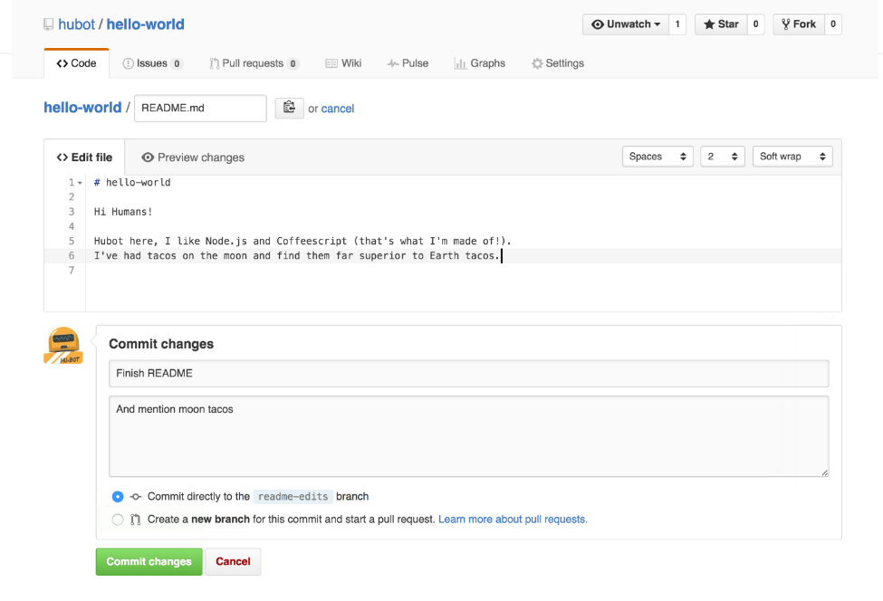
Software Processes and Management
Step 3. Make and Commit Changes
Click the README.md file.
Click the pencil icon in the upper right corner of the file view to edit.
In the editor, write a bit about yourself.
Write a commit message that describes your changes.
Click Commit changes button.
These changes will be made to just the README file
on your readme-edits branch,
so now this branch contains content that’s different from master.

Slide 10
Software Processes and Management
Step 4. Open a Pull Request
Pull Requests are the heart of collaboration on GitHub. When you open a pull request, you’re proposing your changes and requesting that someone review and pull in your contribution and merge them into their branch. Pull requests show diffs, or differences, of the content from both branches. The changes, additions, and subtractions are shown in green and red.
As soon as you make a commit, you can open a pull request and start a discussion, even before the code is finished.
By using GitHub’s @mention system in your pull request message, you can ask for feedback from specific people or teams, whether they’re down the hall or 10 time zones away.
You can even open pull requests in your own repository and merge them yourself. It’s a great way to learn the GitHub flow before working on larger projects.

Slide 11
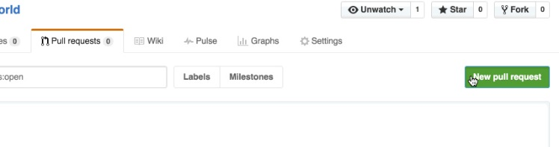
Software Processes and Management
Open a Pull Request for Changes to the README
Click the Pull Request tab, then from the Pull Request page, click the green New pull request button.

Slide 12
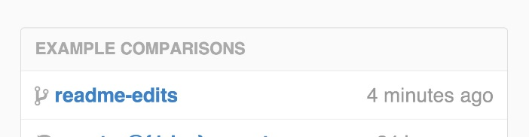
Software Processes and Management
Open a Pull Request for Changes to the README
In the Example Comparisons box, select the branch you made, readme-edits, to compare with master (the original).

Slide 13
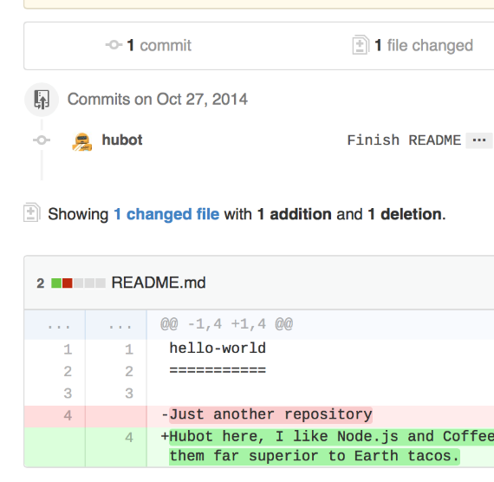
Software Processes and Management
Open a Pull Request for Changes to the README
Look over your changes in the diffs on the Compare page, make sure they’re what you want to submit.

Slide 14
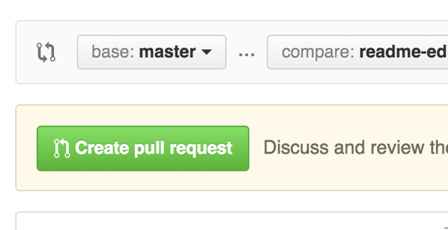
Software Processes and Management
Open a Pull Request for Changes to the README
When you’re satisfied that these are the changes you want to submit, click the big green Create Pull Request button.

Slide 15
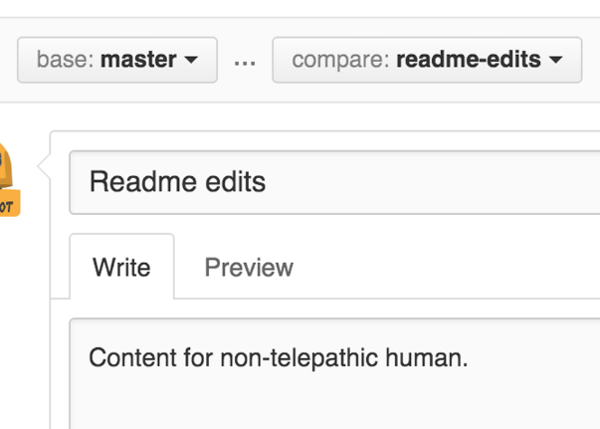
Software Processes and Management
Open a Pull Request for Changes to the README
Give your pull request a title and write a brief description of your changes
When you’re done with your message, click Create pull request!

Slide 16
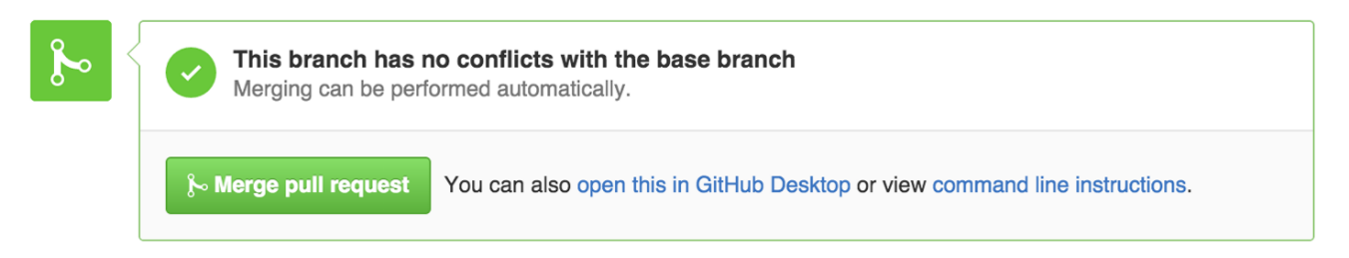
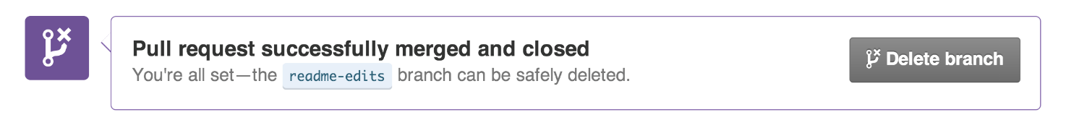
Software Processes and Management
Step 5. Merge Your Pull Request
In this final step, it’s time to bring your changes together – merging your readme-edits branch into the master branch.
Click the green Merge pull request button to merge the changes into master.
Click Confirm merge.
Go ahead and delete the branch, since its changes have been incorporated, with the Delete branch button in the purple box.

Slide 17
Software Processes and Management
Celebrate!
By completing this tutorial, you’ve learned to create a project and make a pull request on GitHub!
Here’s what you accomplished in this tutorial:
Created an open source repository
Started and managed a new branch
Changed a file and committed those changes to GitHub
Opened and merged a Pull Request

