Slide 1


COMP90049 Knowledge Technologies
Introduction to basic probability
(Lecture Set2)
Rao Kotagiri
Department of Computing and Information Systems
The Melbourne School of Engineering
Some of slides are derived from Prof Vipin Kumar and modified, http://www-users.cs.umn.edu/~kumar/

Slide 2
Probability
Discrete Random Variables
• A is a Boolean-valued random variable if A
denotes an event, and there is some degree
of uncertainty as to whether A occurs. This uncertinity is stated in terms of probability
Examples:
A = The next toss of coin is Head
A = The next toss of a coin is Tail
A = The flights will resume next day

Slide 3
Probability
Discrete Random Variables
• P(A) = “the fraction of worlds in which A is true” or
the fraction of times the event is true in independent trails
P(A) = Proportion of area of
reddish oval.
A is false
A is true

Slide 4
The Axioms of Probability
0 <= P(A) <= 1, Head and Tail are mutually exclusive.
P(True) = 1 e.g., p(A = Head or A = Tail) = 1 (we also write P(Head or Tail))
P(False) = 0 e.g. P(A = Head and A = Tail) = 0 (we also write P(Head and Tail))
If A and B are not mutually exclusive
P(A or B) = P(A) + P(B) - P(A and B)
A
B
A-B AB
B-A
A OR B

Slide 5
The Axioms of Probability
P(A) = P(A and B) + P(A and Not B)
A
B
A-B AB
B-A

Slide 6
Conditional Probability
P(A|B) = Fraction of time A is true knowing B is true
= P(A and B)/P(B)
P(A|B) = P(A and B)/P(B)
P(A and B) = P(A|B)*P(B) -- product rule
A
B
AB

Slide 7

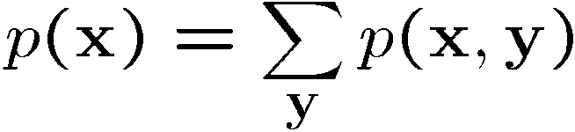
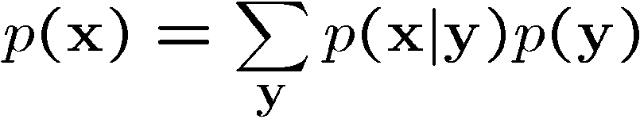
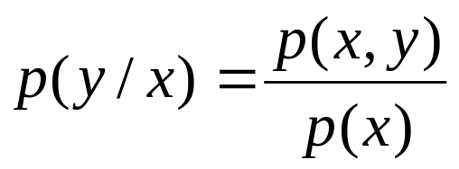
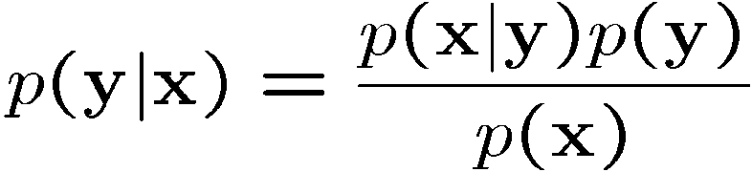
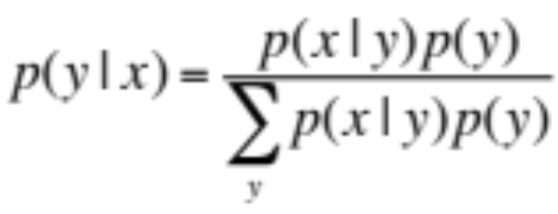
Probability
A-B AB
B-A
Product rule
Sum rule
From these we have Bayes theorem

Slide 8
We use “~” to represent “not”, E.g., Not B is represented by ~B
P(A) +P(~A) = 1; P(A) = P(A,B) + P(A, ~B)
P(x|y) +P(~x|y) = 1; But P(x|y) + P(x|~y) ~= 1;
Example:
B = restaurant is bad; S = menu is smudged;
~B = restaurant is good;
p(B) = ½ = 0.5 % Prior probability
p(S|B) = ¾; p(S| ~B) = 1/3 % Likelihood
We are interested to know p(B|S) % Posterior probability
p(B|S ) = p(B,S)/p(S) = p(B, S)/[(p(S, B) + p(S,~B)]
= p(S|B)P(B)/[p(S|B)P(B) + p(S|~B)P(~B)] % Bayes theorem
= (3/4)*(1/2)/[(3/4)*(1/2) + (1/3)*(1/2)]
= 9/13 =0.69

Slide 9

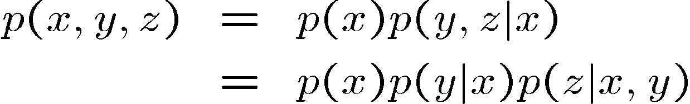
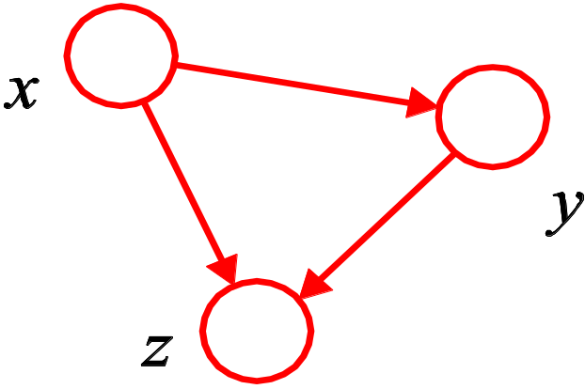
Probabilistic Graphical Models (PGM)
PGM provides new insights into existing models
Consider an arbitrary joint distribution
By successive application of the product rule
P(X)
P(y|x))
P(z|x,y))

Slide 10
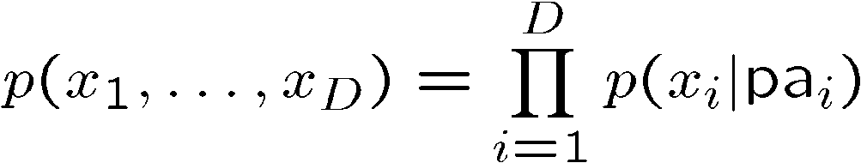
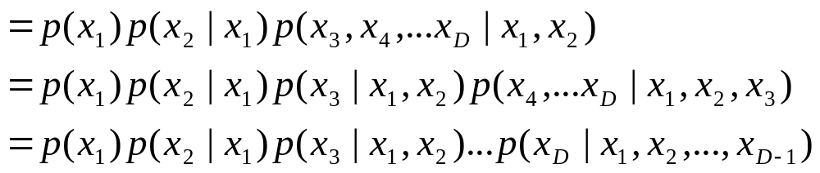
Directed Acyclic Graphs
Joint distribution
where pa_{i} denotes the parents of i
x₁
x₂
x₃
x_{D-1}
x_{D}

Slide 11
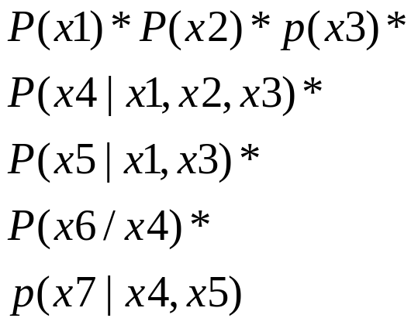

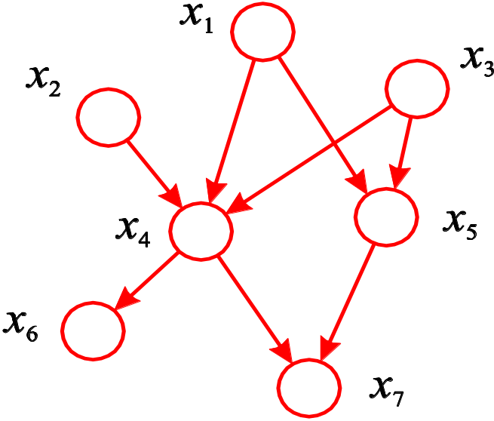
Directed Acyclic Graphs
Joint distribution
where pa_{i} denotes the parents of i

Slide 12
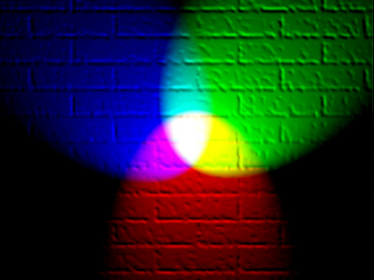




“Explaining Away”
Conditional independence for directed graphs is similar, but with one subtlety
Illustration: pixel colour in an image
p(I,L,S) = p(L,S)p(I|L,S)
p(I,L,S) = p(L)p(S)p(I|L,S)
lighting
colour of the room
surface
colour of the painting
image colour
p(I,L,S) ≠ p(I)*p(L|I)*p(S|I)

