Slide 1
Quantum Twitter Sentiment Analysis
Group Member: Pei-Yong Wang, Rong-Xin Zhu and Rui Xing

Slide 2
Data Preprocessing
Remove punctuations;
Remove emojis;
From here, we can have three different types of data sets:
Doing nothing, no lemmatization (services->service, is->be, …), no stemming (service->servic)
Just lemmatization
The full suite, stemming after lemmatization

Slide 3
Data Preprocessing
First we chose 2578 tweets of the whole data set which contains more than 40k tweets, with equal number of positive and negative tweets;
Due to limited time and computational resources, we randomly selected 206 tweets for training and 26 tweets for validation. The length of each tweet is generally no more than 10;

Slide 4
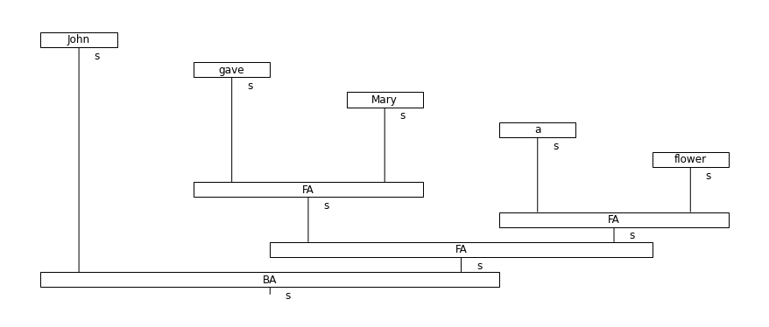
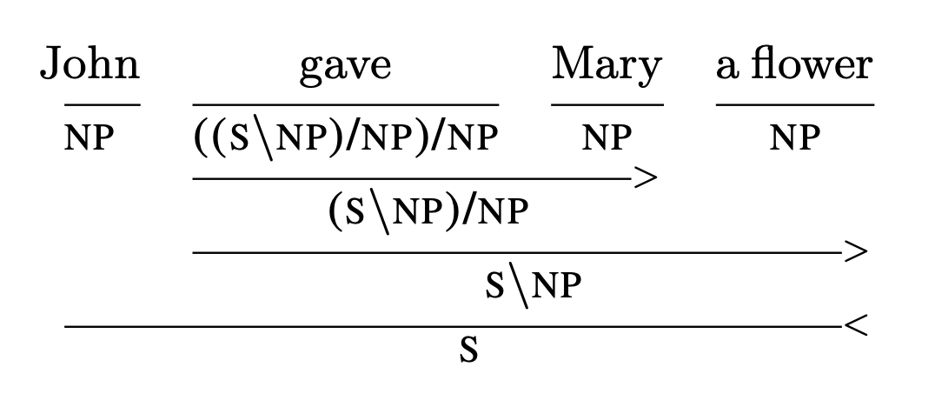
From Sentences to Diagrams
We apply TreeParser(), a CCG (combinatorial categorical grammar)based parser from the lambeq package for parsing sentences and convert sentences to diagrams, instead of the BobcatParser(), which explicitly apply the pregroup grammar, since BobcatParser() is not good at handling sentences without object.

Slide 5
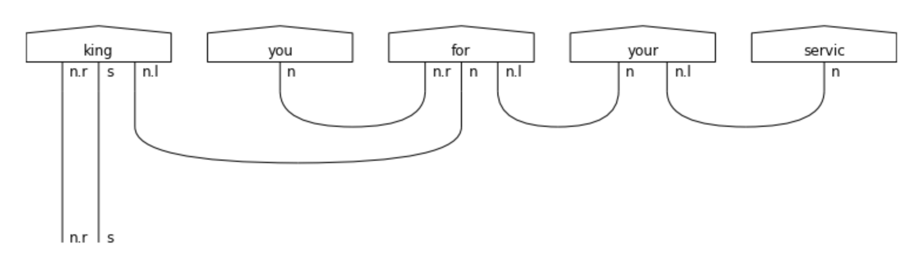
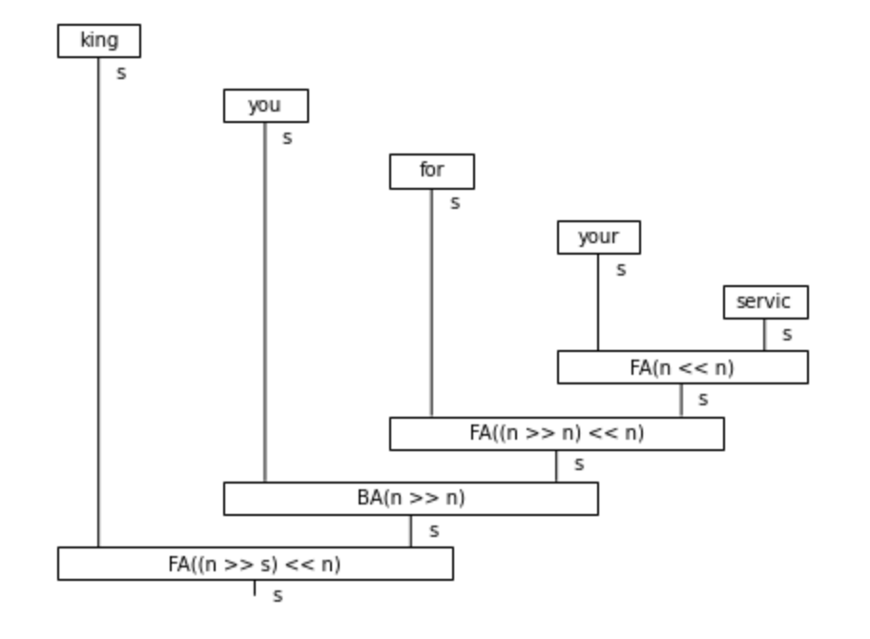

Slide 6
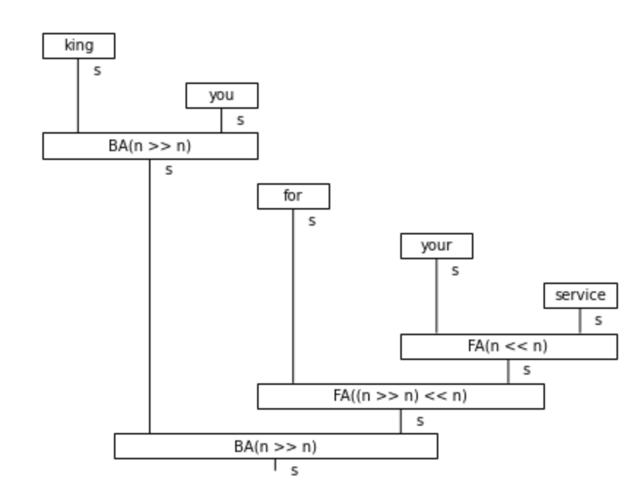
Stemming Can Change Parsing

Slide 7
Diagrams to Circuits
We assign one qubit for each of these following types in lambeq. AtomicType, and then apply the IQP ansatz
NOUN, SENTENCE, PREPOSITIONAL_PHRASE, NOUN_PHRASE, CONJUNCTION

Slide 8
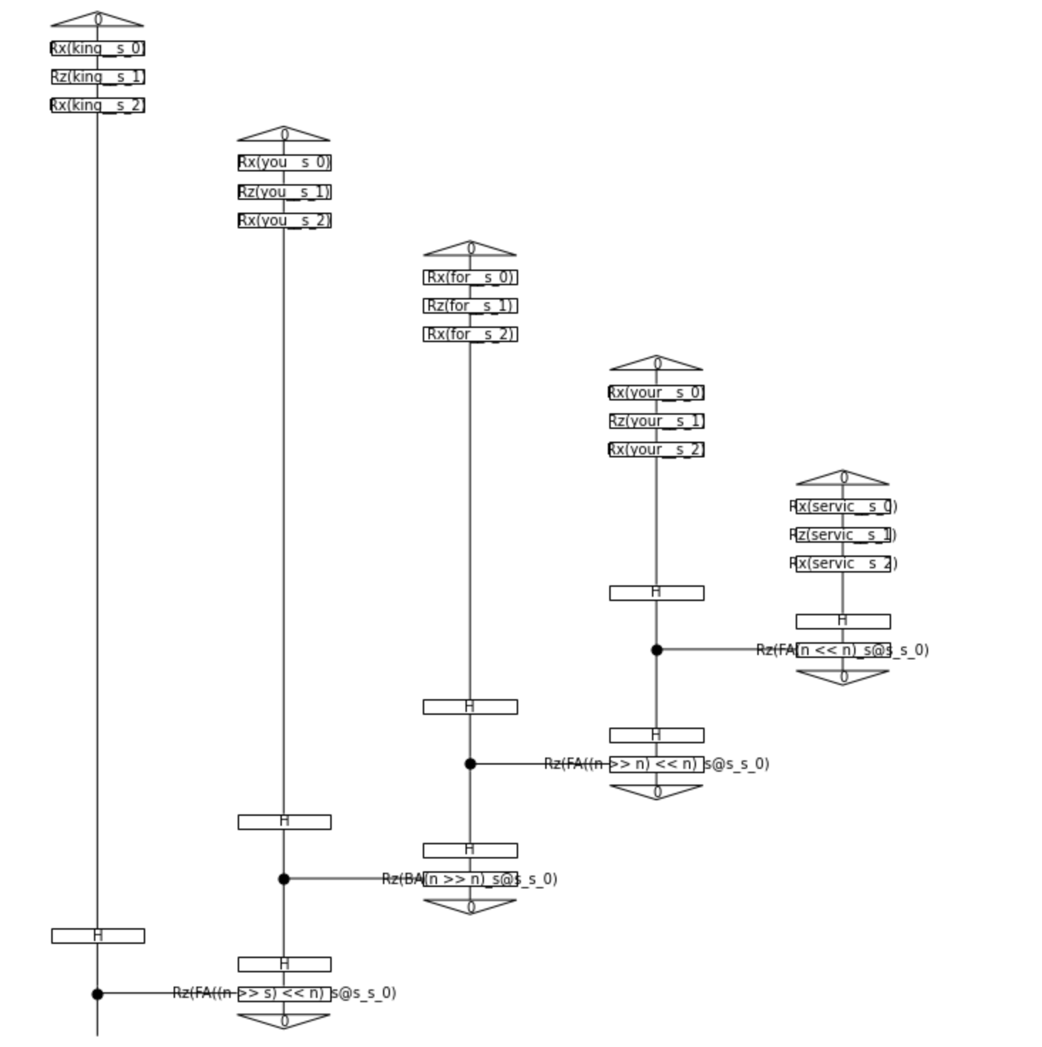
In the circuit, each word is represented with a single-qubit unitary RxRzRx, which has three (trainable) parameters. In NLP jargon, these three rotation angles can be viewed as “word embeddings”. The type of composed phrases, like “your servic”, are represented by parameterized two-qubit unitaries.

Slide 9
To retrieve classifications, we’ll need the probability from the only dangling qubit (the left most one)

Slide 10
Training the Model
Loss function: binary cross entropy;
Parameters for words and types are updated with SPSA;
Circuit simulated with Jax/tensornetworks (inside lambeq).

Slide 11
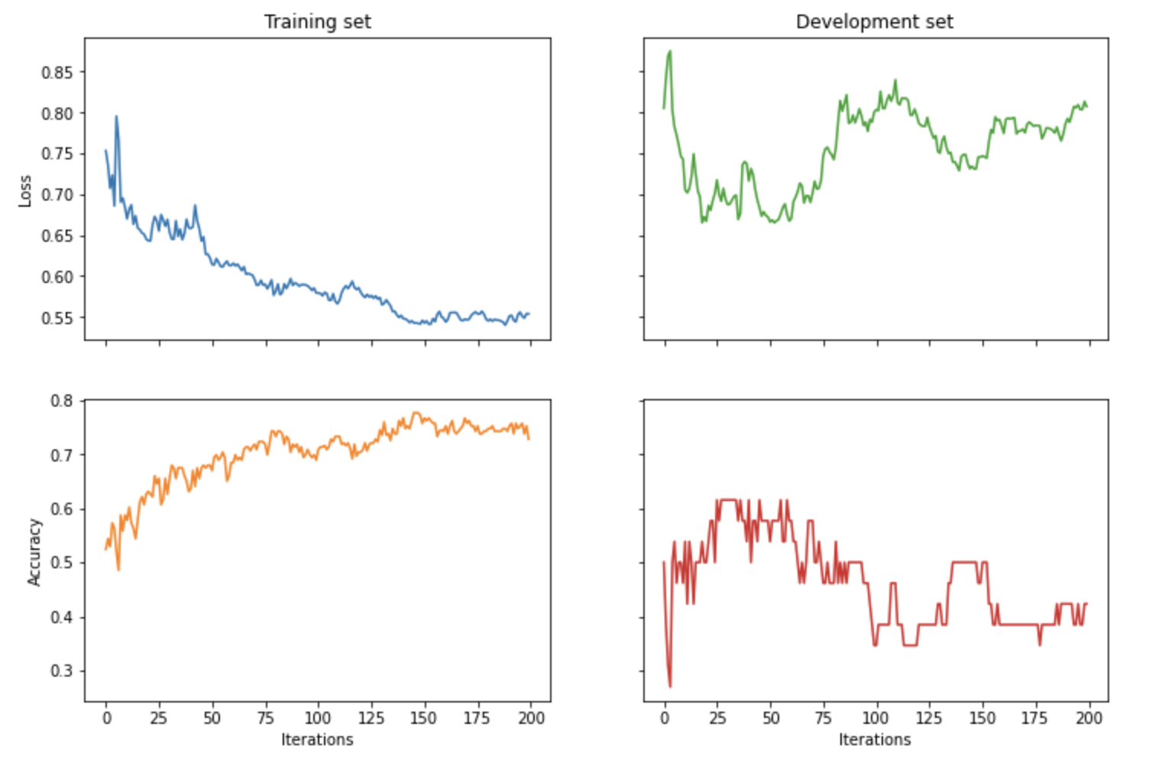
Results: Full-Suite Preprocessed Data

Slide 12
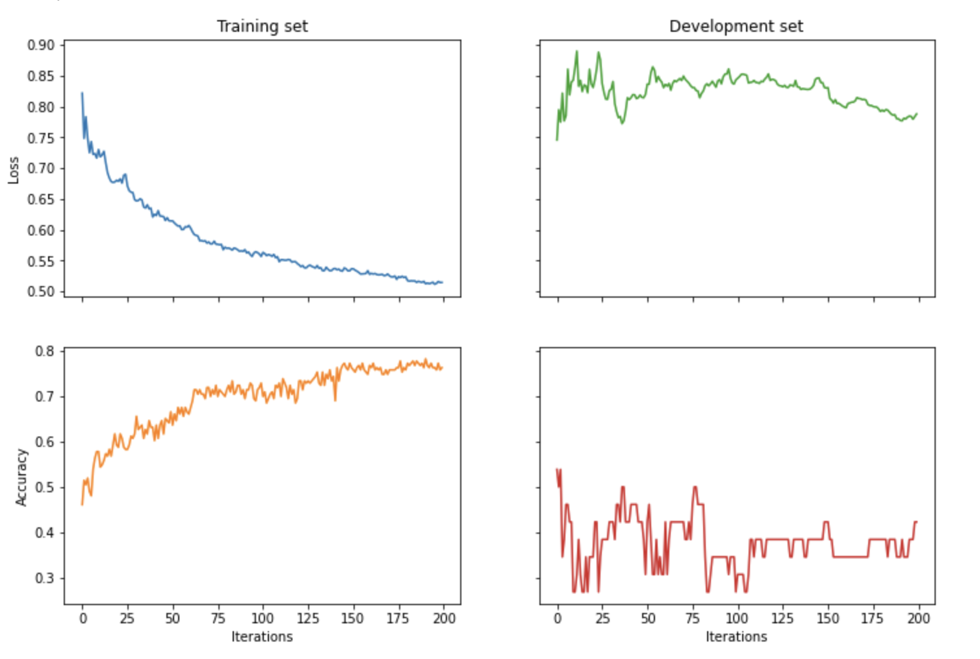
Results: Only Lemmatized Data

Slide 13
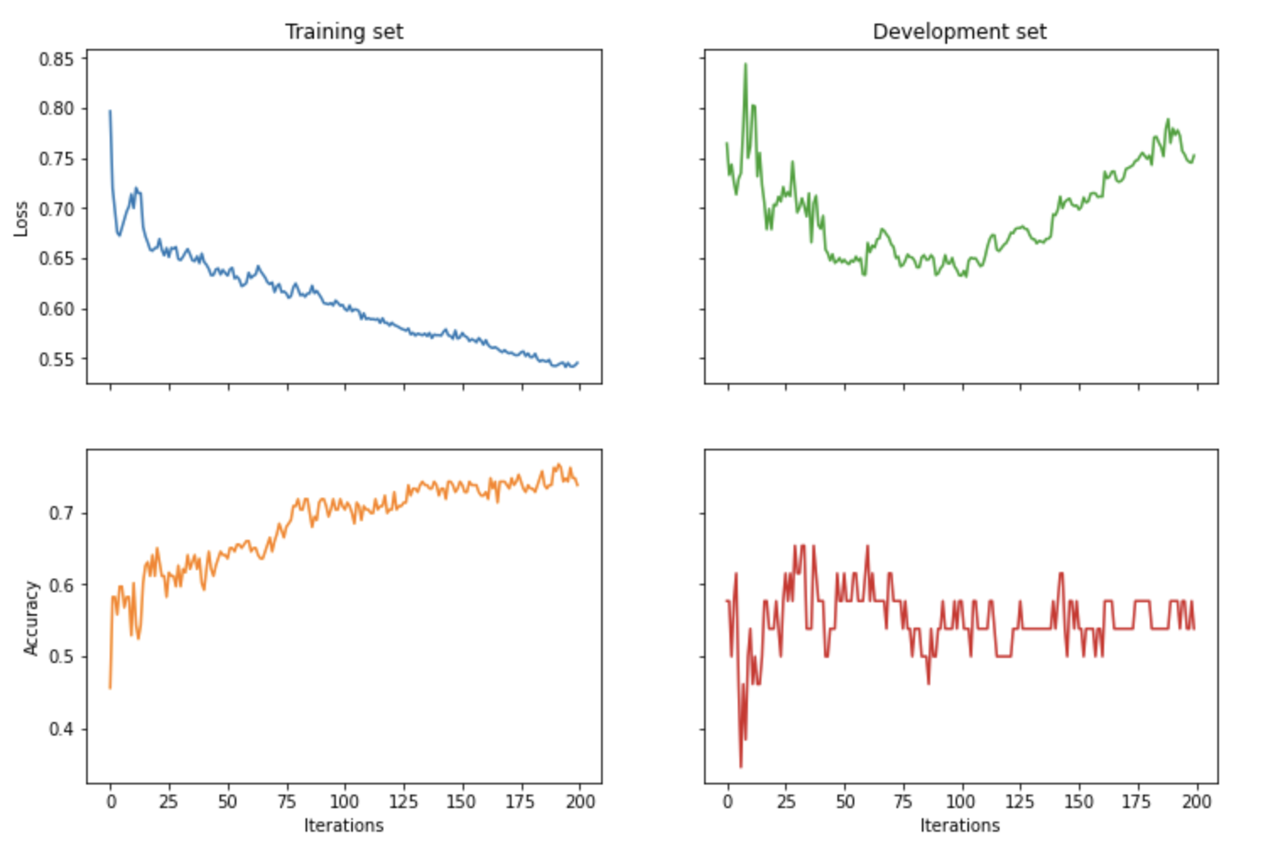
Results: No Stemming or Lemmatization

Slide 14
Results
Size of training data severely impacted on our model performances on the validation set due to limited vocabulary in the training data -> some (maybe most) word embeddings in the validation set are not trained;
Need to increase training data size;
Need to increase the speed of applying parameters to circuit in lambeq;
Another future direction could be combining parsers (and types) from industry-grade NLP software, like SpaCy, with lambeq, to provide more accurate results.

