Slide 1

Sequential simulation drawing structures from training images
Sebastien Strebelle
Stanford Center for Reservoir Forecasting
Stanford University

Slide 2
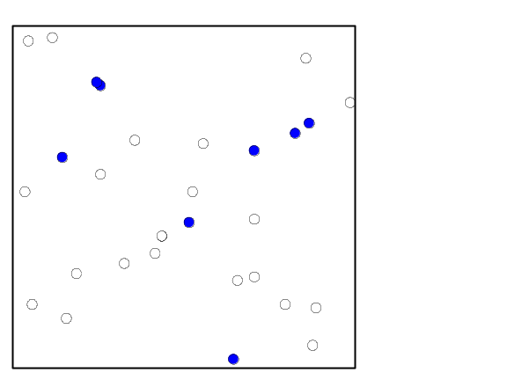
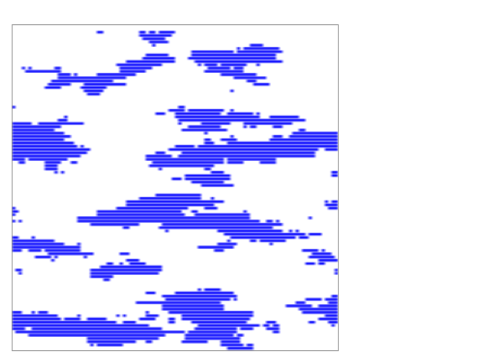
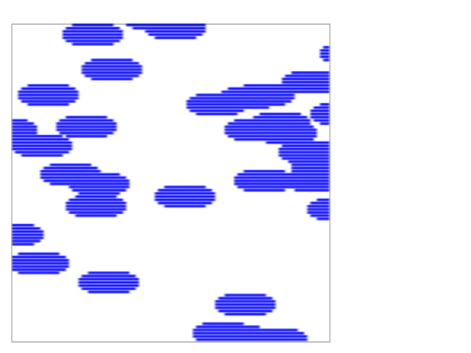
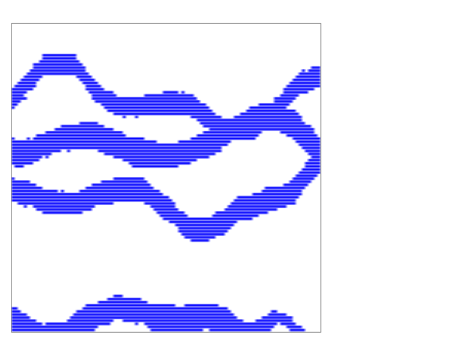
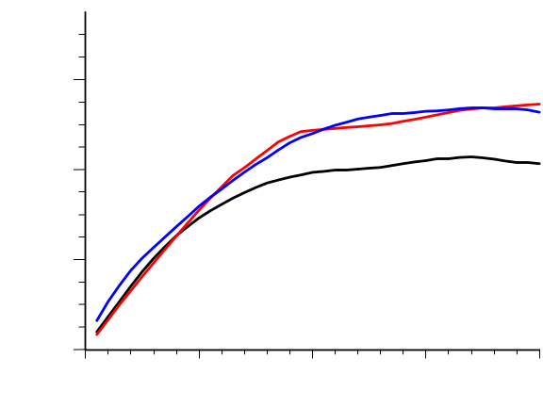
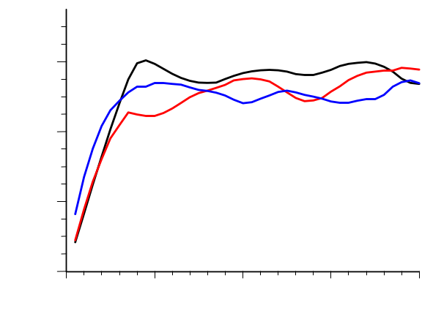
Preliminary remark
30 sample data
3 different numerical models conditioned by the same data
1
2
3
Variograms EW
Variograms NS
1.2
1
1.2
2
0.8
3
0.8
0.4
0.4
0
10
20
30
40
0
10
20
30
40
2-point correlation is not enough to characterize connectivity
A prior geological interpretation is required

Slide 3
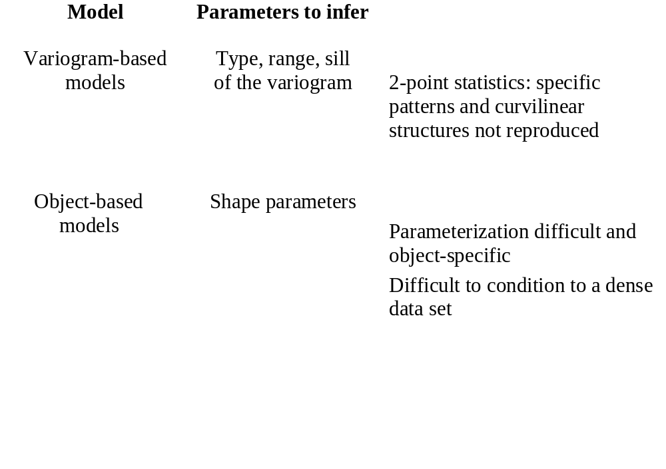
Traditional Geostatistics
Geological information is critical for flow performance prediction…
but must be quantified to be integrated into the reservoir model.
γ(h)
+
+
+
+
+
+
h
s
w

Slide 4
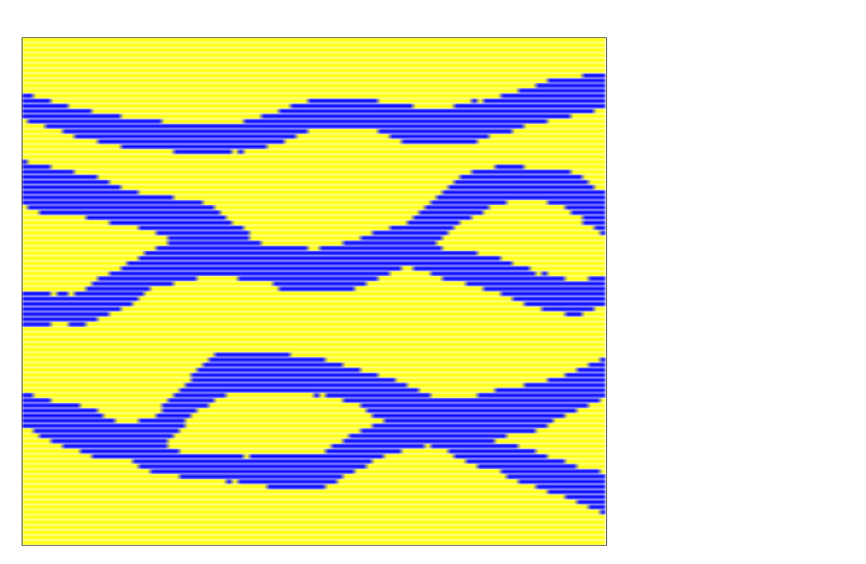
Training images
Reflect prior geological/structural concept:
- unconditional realization generated by
object-based algorithm
- simulated realization of reservoir analogue
- photograph of outcrop
- sketch hand drawn by geologist
- …
Geologists are more likely to provide a training image than a variogram range or an object parameter.
As ‘objective’ as any other model decisions
Training image

Slide 5
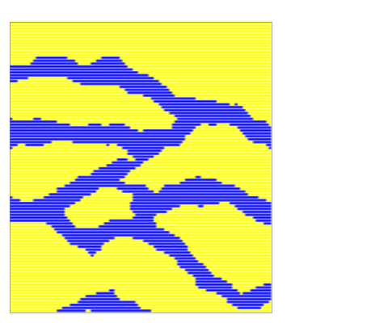
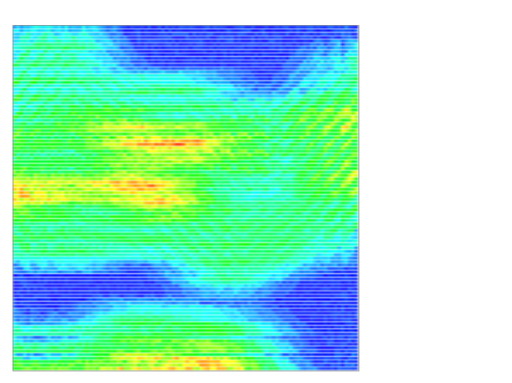
Recasting Petroleum Geostatistics
Generate a set of stochastic reservoir realizations:
consistent with prior
geological/structural vision:
Image analysis problem
Recognize exportable geological
structures from training image(s).
consistent with all data:
Image construction problem
Anchor geological structures
to subsurface data:
- hard data frozen at their location
- soft data reproduced through
proper calibration
Training image
Set of simulated realizations
Seismic and well data

Slide 6
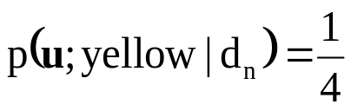
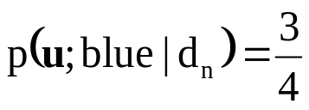
From 2-point to multiple-point statistics
2-point statistics: joint variability at 2 locations
Data analysis phase: model variogram γ(h)
Construction phase: kriging provides conditional
probability estimate reflecting only 2-point correlation
multiple-point statistics: joint variability at many locations
One global conditioning data event (geometry + data values) :
d_{n}={z(u₁),z(u₂),z(u₃),z(u₄)}
u₂
u₄
u?
u₃
u₁
Training image
Retrieve training replicates of d_{n}
u₂
u?
u₃
cpdf
u₄
u₁

Slide 7
Inference of multiple-point statistics
The training image does not contain all possible cpdf’s!
12 fixed data locations
Training image (100x100)
100
Variable taking 4 possible categorical values
4¹²=17,000,000 possible data events
Less than 10,000 can be found in the training image!
?
0
100
Two solutions:
Fit to the training cpdf’s a parametric function F_{θ}(u|d_{n})
Possible only for a fixed geometric configuration (J. Caers)
Use only the cpdf’s actually present in the training image
(no constraint on the geometric data configuration)

Slide 8
Pioneering work in multiple-point geostatistics
Guardiano and Srivastava , Geostatistics-Troia 1992: Multivariate geostatistics: Beyond bivariate moments.
First direct sequential simulation algorithm reproducing multiple-point statistics
Inference of each cpdf requires scanning full training image anew
too slow to simulate large 3D grids

Slide 9
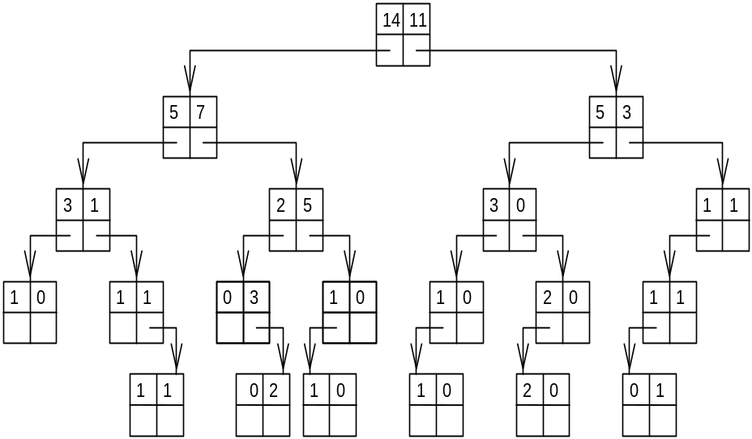
Image analysis
Use a dynamic data structure (search tree) to store the training data events prior to the image simulation.
Training image
Data template
(data search neighborhood)
Search tree
Construction requires scanning training image one single time
Minimizes memory demand
Allows retrieving all training cpdf’s
for the template adopted!

Slide 10
Image construction
snesim: direct (non-iterative) sequential simulation algorithm:
Each node of the simulation grid is visited one single time
At each unsampled node,
retain nearby conditioning data
and retrieve cpdf from search tree
If number of training replicates is too small,
drop the furthest away datum and retrieve new cpdf
Very fast algorithm
Simulation grid
u₂
u₄
u?
u₃
u₁
Simulated realization

Slide 11
Multiple-grid simulation approach
Use large template for coarse grid simulation
Use coarse grid nodes as conditioning data to simulate finer grid nodes
Training image
Finer simulation grid
Coarse simulation grid

Slide 12
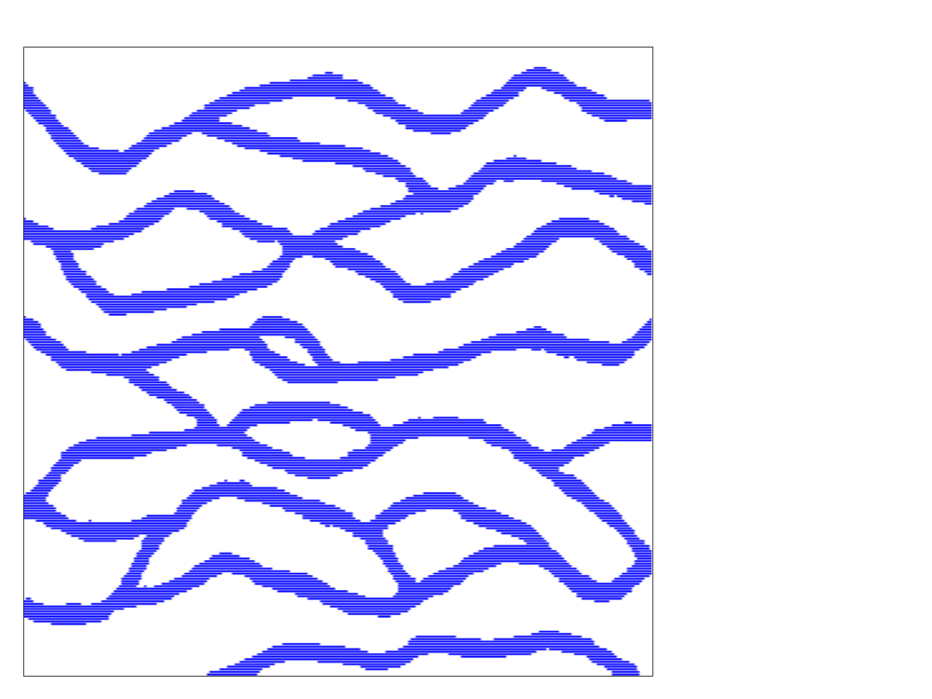
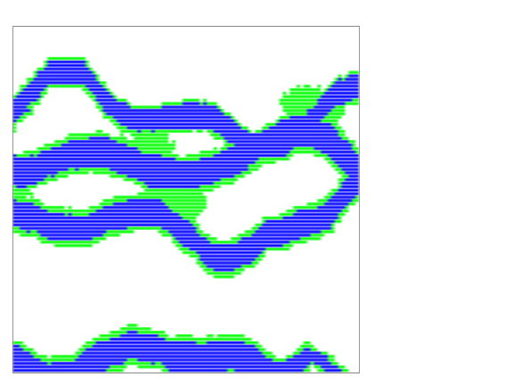
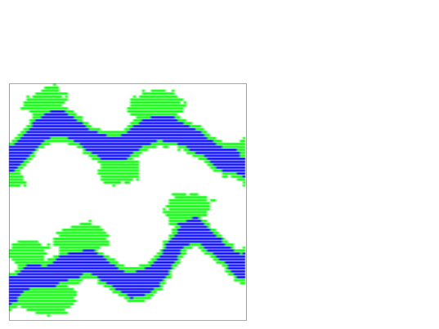
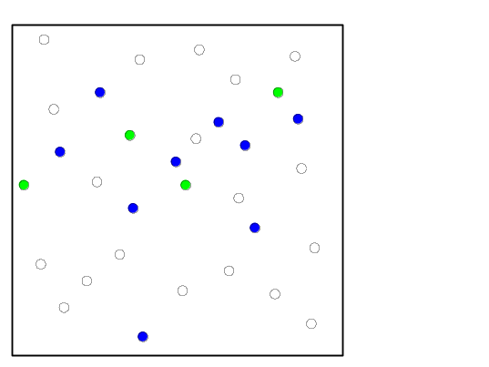
Horizontal section of a fluvial reservoir
True image
Large scale training image
100
250
Small scale
training image
0
100
80
32 sample data
100
0
80
0
100
0
250

Slide 13
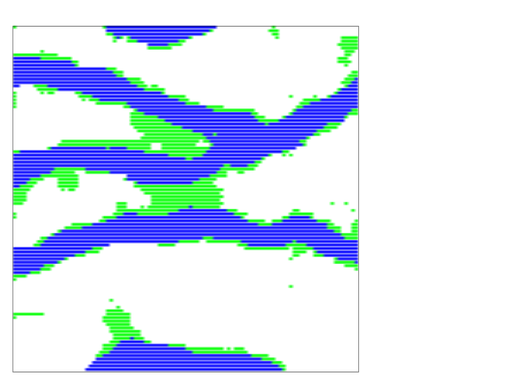
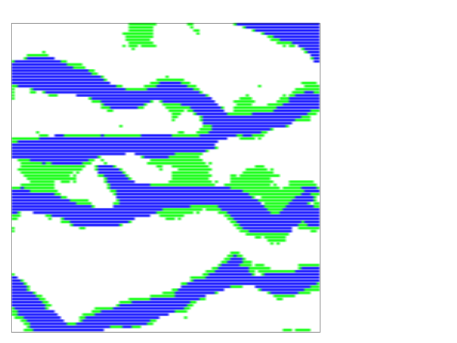
Horizontal section of a fluvial reservoir: simulation
True image
First realization
Second realization
100
0
100
One realization
10,000 grid nodes
5.8 s
4.5 s
Number of
multiple-grids
4
2
Memory
required
2.8 Mb
0.7 Mb
Search trees
construction
4.1 s
0.9 s
First step
(channels)
Second step
(crevasses and levies)
DEC 600MHz

Slide 14
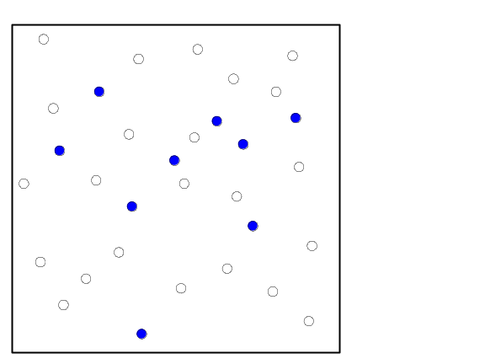
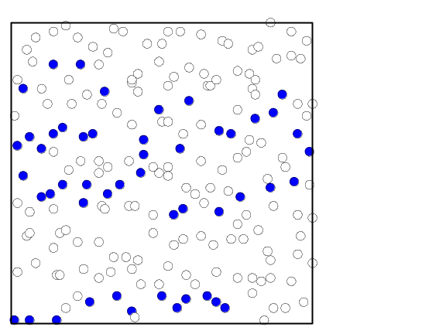
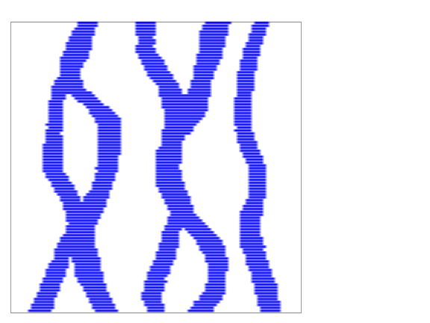
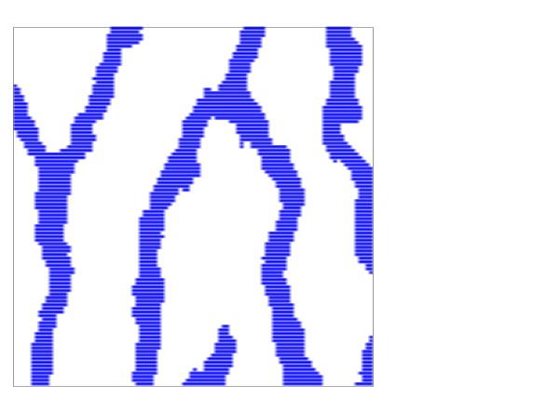
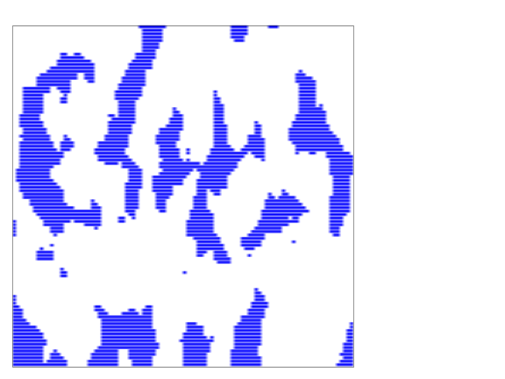
Sensitivity analysis
True image
32 sample data
200 sample data
Alternative training image
Conditional realizations

Slide 15
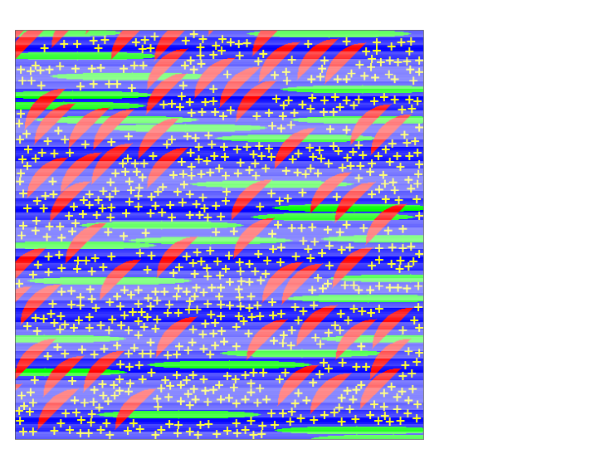
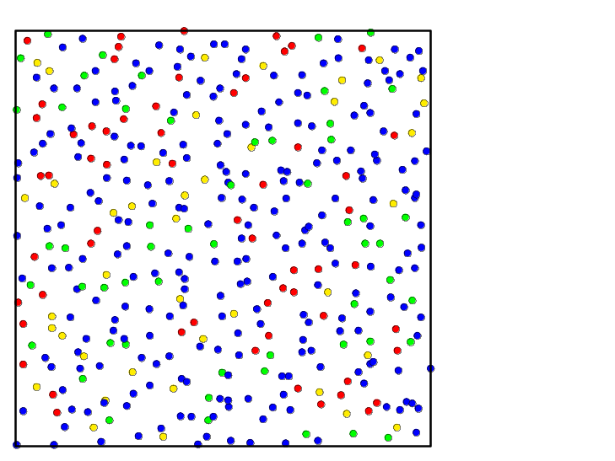
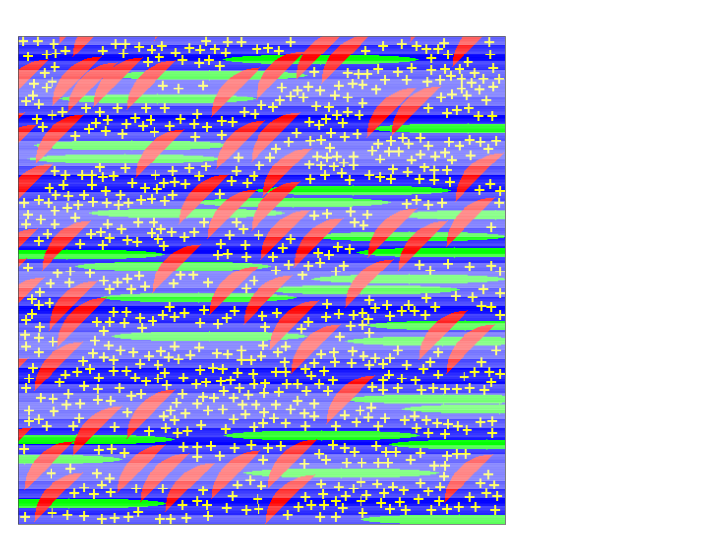
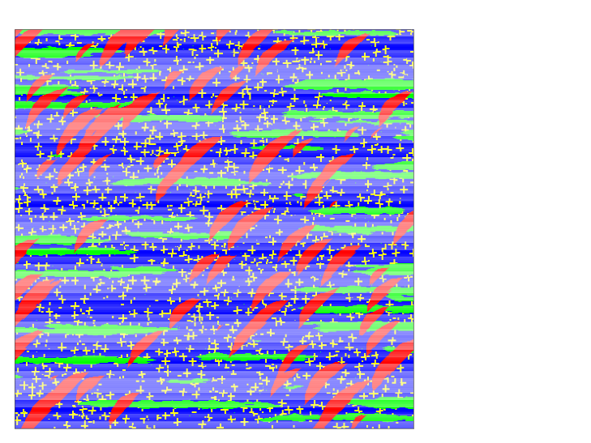
Simulation of multiple complex patterns
True image
400 sample data
500
0
500
Training image
Realization
500
Sample data values
exactly honored!
1/4 million nodes
5 cpu minutes
(DEC 600 MHz)
0
500

Slide 16
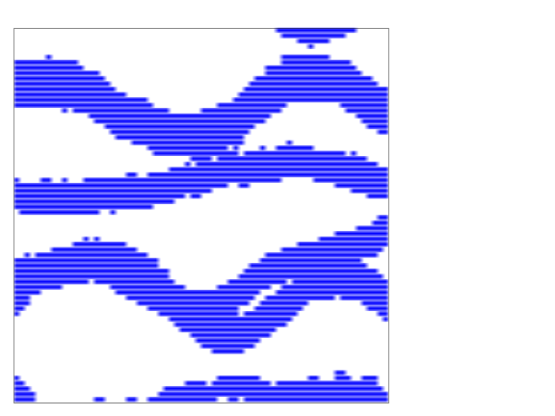
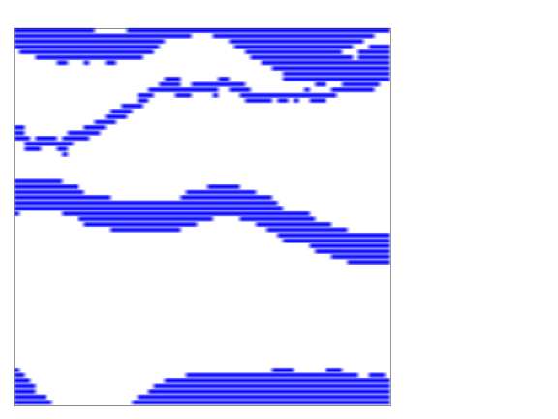
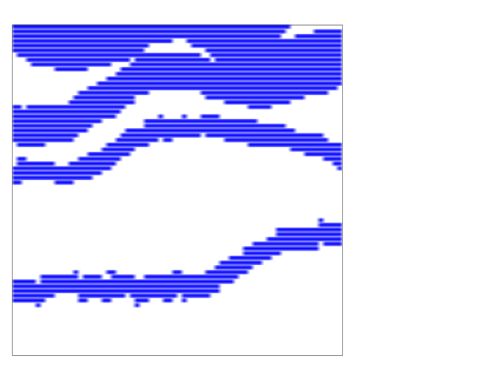
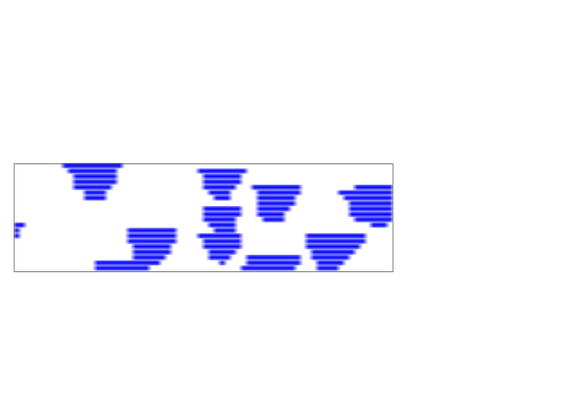
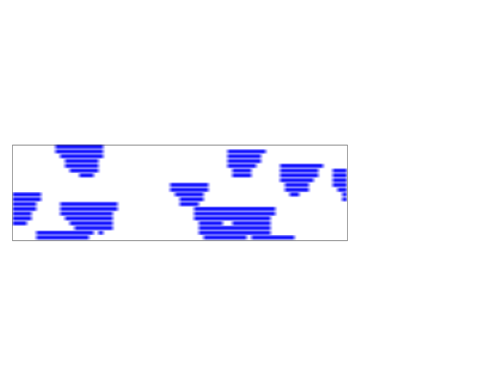
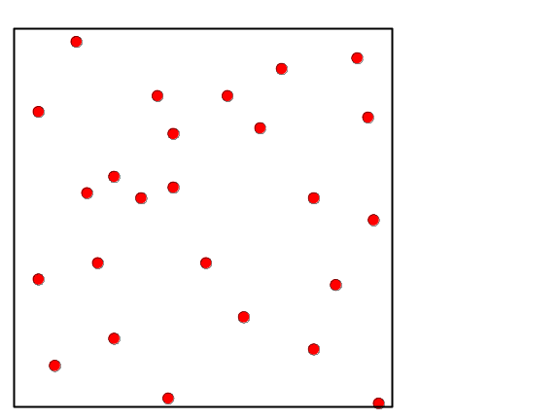
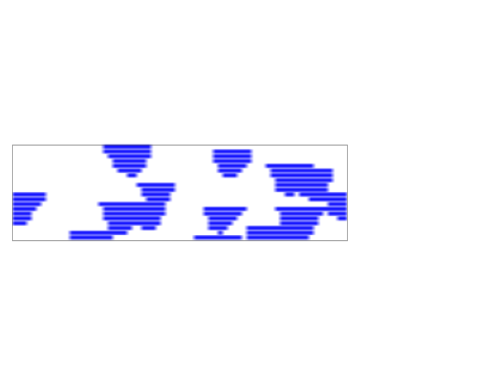
3D fluvial reservoir: true image (70x70x20)
Horizontal sections:
Z=5
Z=10
Z=15
70
0
70
X=10
Locations of the
20 vertical wells
20
Cross sections:
70
0
70
X=35
X=60
0
70

Slide 17
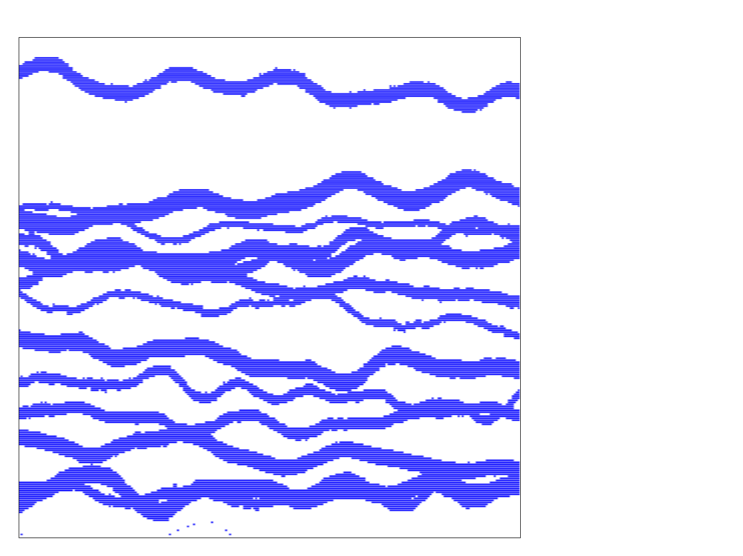
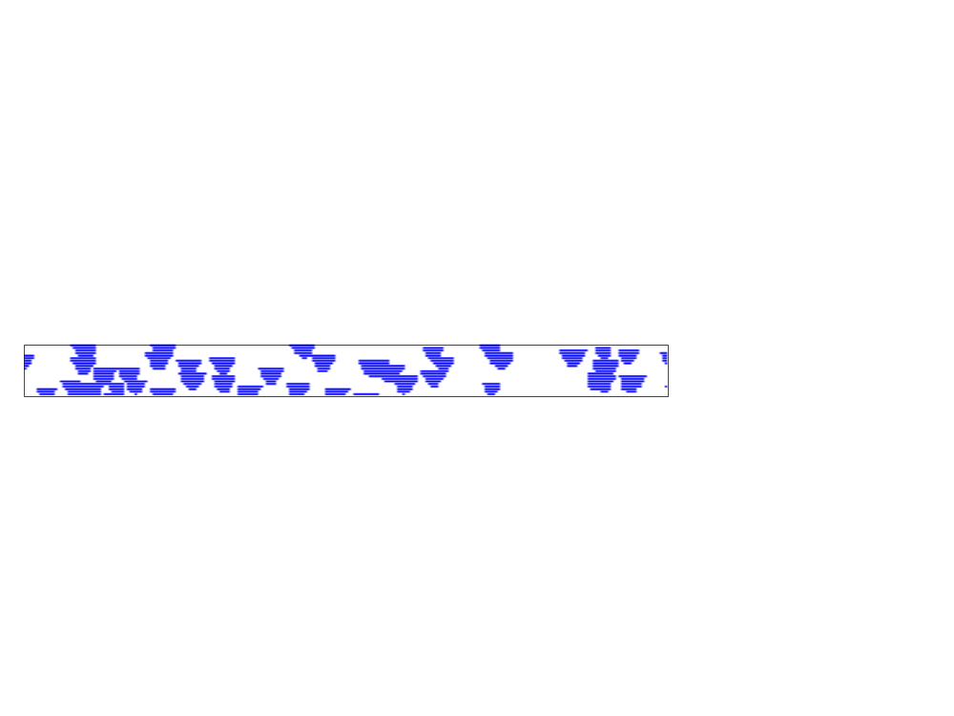
3D fluvial reservoir: training image (250x250x20)
Horizontal section
250
0
250
Cross section
20
0
250

Slide 18
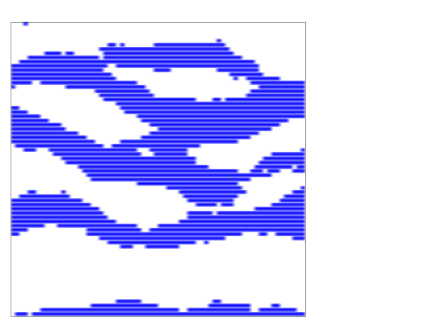
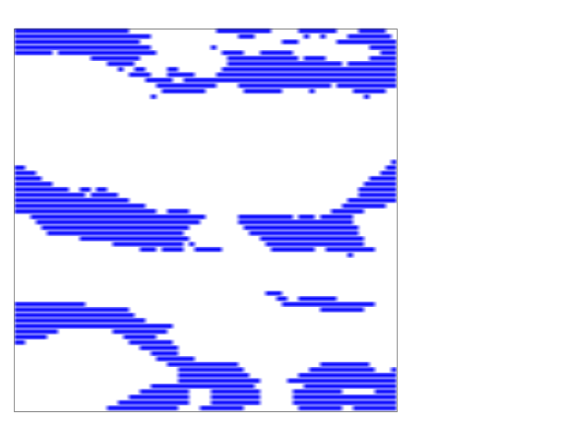
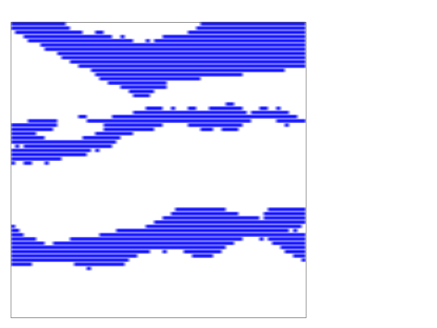
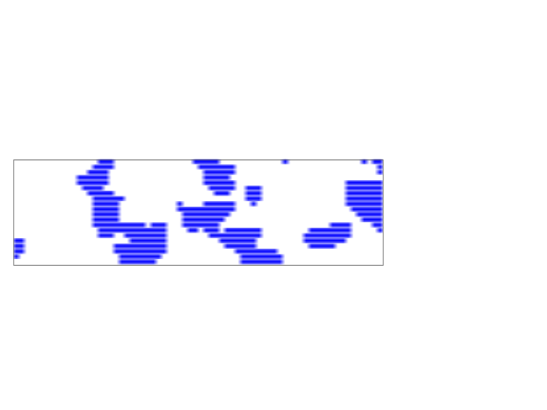
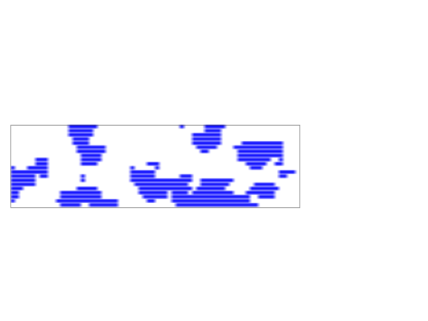
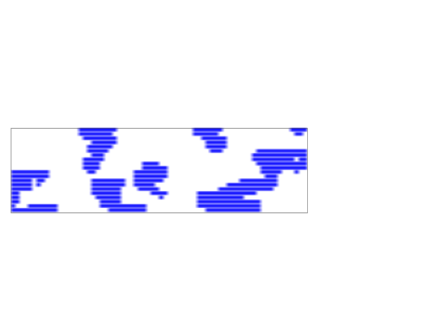
3D fluvial reservoir: Conditional realization
Horizontal sections:
Z=5
Z=10
Z=15
70
0
70
20
X=10
Cross sections:
12 minutes per realization
98,000 grid nodes
(DEC 600MHz)
0
70
X=35
X=60

Slide 19
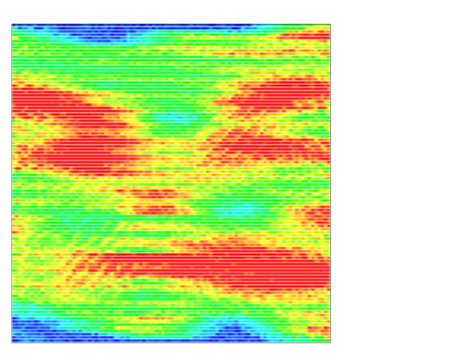
Integration of secondary data
Simulation grid
Soft data
W(u)
u₂
A=occurrence of state s_{k}
at location u
u₄
u?
u₃
u
u₁
B: hard data event
C: soft data event
(B,C)=much larger data event than B Problem of inference of P(A|B,C)
First method: Infer the full probability P(A|B,C)
small number of soft data
Second method: Decompose P(A|B,C) into a function of P(A|B) and P(A|C)
larger number of soft data, but requires additional hypothesis.

Slide 20
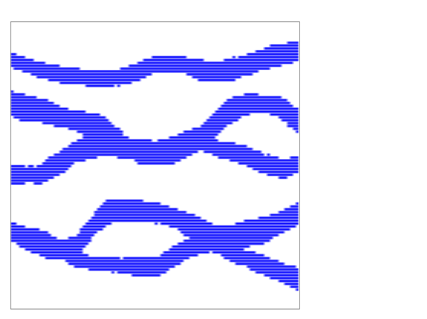
Integration of secondary data - First method
Generate training image of the soft data variable
Map of facies
Seismic signature
Forward simulation of physical process
Training image
Soft data training image
Vectorial training image

Slide 21


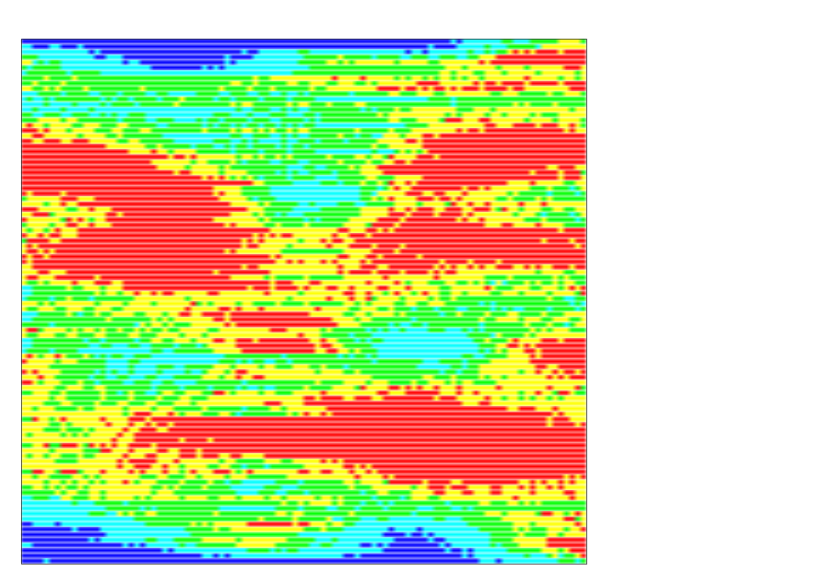
Inference of conditional probabilities
Extended conditioning data event :
d_{n}={z(u₁),z(u₂),z(u₃),z(u₄), y(u)}
Hard data
Soft data
u₂
+
u
u?
u₃
u₄
u₁
Training image
Soft data training image

Slide 22
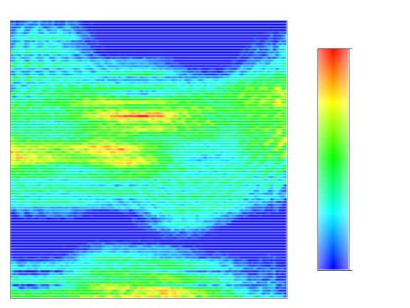
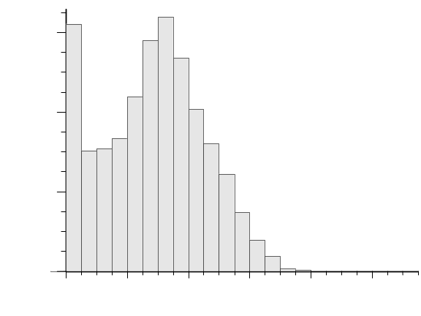
Horizontal section of a fluvial reservoir
True image
32 sample data
Actual seismic data
Seismic data histogram
Template of facies values
used to construct
seismic datum at u
100
1.2
0.8
0.8
u
0.4
0.1
0
0.2
0.4
0.6
0.8
0
100

Slide 23
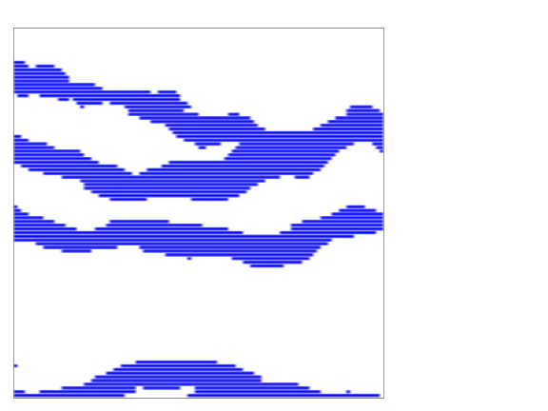
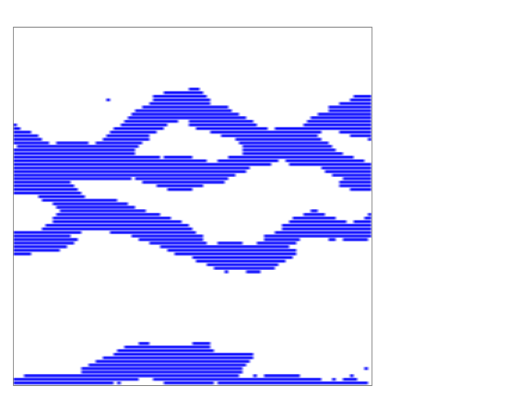






Simulation conditional to both well data and seismic data (1st method)
True image
Realization 1
Realization 2
Seismic signature
Actual seismic data

Slide 24

Integration of secondary data - Second method
(decomposition method)
P(A|B) inferred from
(hard data) training image
P(A|C) modeled using a neural net (Caers),
or from scattergram of sample hard data
versus collocated soft data
Training image
Soft data
W(u)
u
P(A|B)
P(A|C)
A=occurrence of state s_{k}
at location u

Slide 25







Integration of secondary data - Second method
Relative conditional independence (Journel, 2000):
a : relative distance to A occurring
= 0 if P(A)=1
= if P(A)=0
Simulation grid
Soft data
u₂
W(u)
u₄
u?
u₃
u
u₁
P(A|B)
P(A|C)

Slide 26





Simulation conditional to both well data and seismic data (2nd method)
True image
Realization 1
Realization 2
Seismic signature
Actual seismic data

Slide 27
Conclusions...
Pros:
snesim = interface to quantify and integrate critical geological information (in the form of training images)
Better prediction of reservoir characteristics
and flow performance
Simple, general and fast
Several training images can be used:
different scales of heterogeneities
/ alternative geological scenarios
Conditioning to both hard and soft data

Slide 28
...Conclusions
Cons:
snesim requires training images,
but training images should be available if structured heterogeneities are expected
All cpdf’s inferred directly from the training image,
no filtering, no modeling.
Training images must have a repetitive/stationary character.

