Slide 1

Welcome
Ford C Programming Academy 2022
Notes:
Mandatory
ACTION: Adjust title to fit your course.

Slide 2
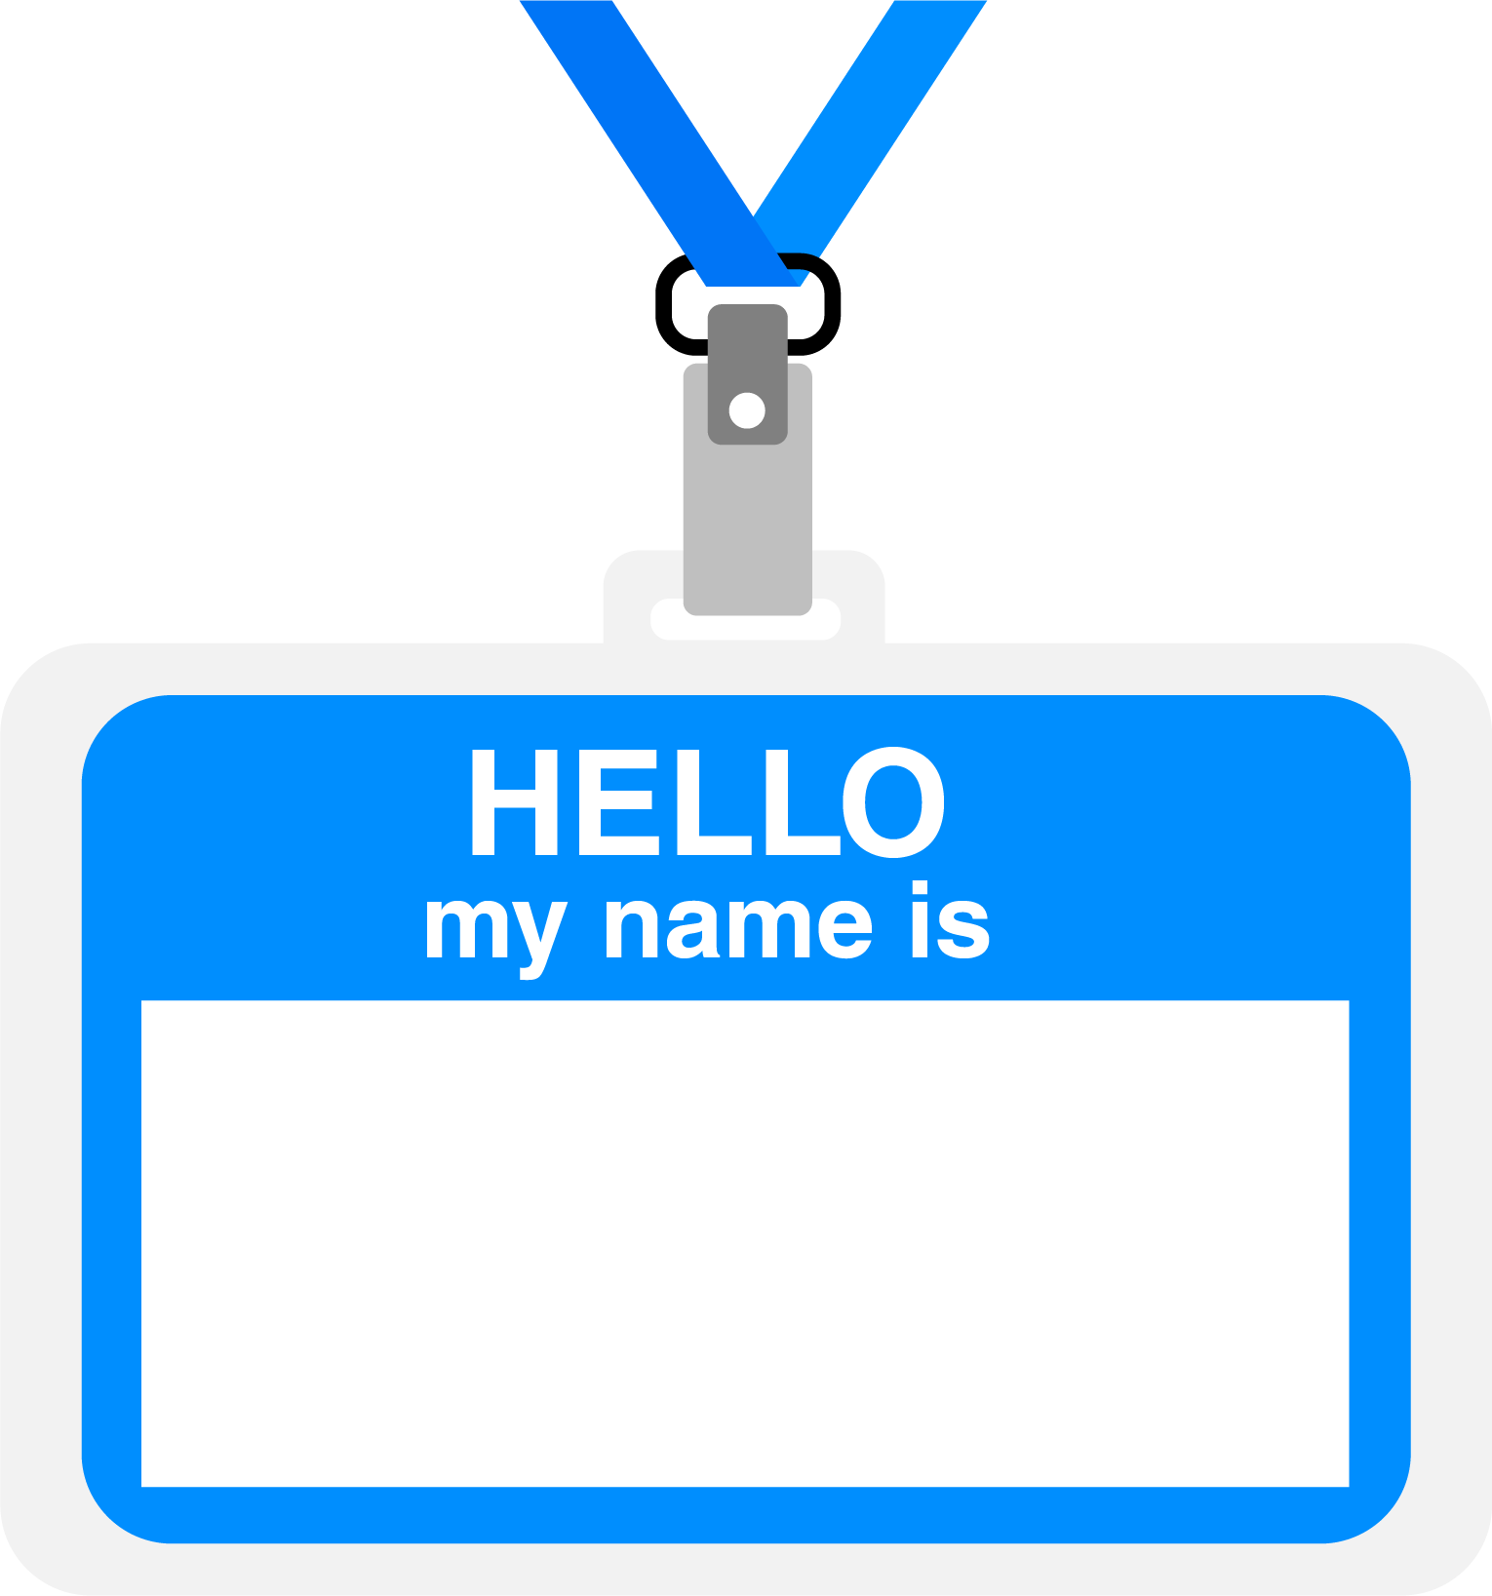
Hello!
About me...
Cat Dad / Anime Fan
Engineer (ME / CE)
Programmer (C/C++, Java, FORTRAN)
Values: curiosity, honesty, kindness, sense of humor
Interests: language, music, space, people
Paul Kimball
Interface Associates with DevelopIntelligence, a Pluralsight company
Notes:
Mandatory
ACTION: Adjust objectives to fit your course.
Script: I am [insert name] with DevelopIntelligence. We’re the training partner for [insert client name]. [Provide brief info on your background.]
Wing it!!! Keep it short!!! (Under 2 minutes; less than 1 is even better). Your goal is to establish rapport. You’re just trying to connect with the students. For example...
Here’s a little about my background in case you want this for reference later. Fun fact: [insert a piece of trivia about your personal life…”When I’m not teaching or coding, I am a skydiver”…whatever cool hobby you are engaged in]
Avoid putting your resume here. Say only a sentence or two about your professional credentials and invite them to ask questions about your background or experiences at any point during the training.

Slide 3
Prerequisites
This course assumes you:
Have some experience in engineering disciplines
Have never taken a formal course in C or C++, and know little or nothing about the language or development environment
Will be working on embedded systems and want to appreciate their interesting features and limitations
Please Note:
If you have no background in science or engineering this is not the right class for you.
Please message me in Chat so we can get you to the right resource.
Notes:
Mandatory
ACTION: Adjust prerequisites to fit your course. Keep it brief.
Script: Before we start, I want to make sure everyone is in the correct class. Take a look at these prerequisites and message me in Chat if you have questions or aren’t sure you’re in the right spot.

Slide 4
Why study C Programming?
One of the top programming languages for Embedded Systems
All the power of bit-twiddling, but you can build anything
The gateway to C++, Java, C# and other Object-Oriented languages
Notes:
Mandatory
ACTION: Adjust benefits to fit your course.
Examples...
Learning Python will let you….
You’ll be learning Python so that you can work on XYZ project…
Your organization will be using Python in its upcoming digital transformation project...

Slide 5






































We teach over 400 technology topics
Notes:
Mandatory
Script: DevelopIntelligence teaches a lot of different tech. If there’s a technology you want to learn and you don’t see it in your company’s learning catalog, let your manager know. We’d be glad to help.”

Slide 6



You experience our impact on a daily basis!
Notes:
Mandatory
Script: In your everyday life, you come across tech many times a day. When you shop online. When you pay for your morning coffee. When you watch a movie or travel. We train software developers and IT professionals who work on many of the products and services you use daily.
In fact, when you talk on the phone, watch a movie, connect with friends on social media, drive a car, fly on a plane, shop online, and order a latte with your mobile app, you are experiencing the impact of our solutions.

Slide 7
My pledge to you
I will...
Make this interactive; we will program and explore together
Ask you questions
Ensure everyone can speak
Work hard every day to help you find the answers that you are looking for
Introduce you to a Ton of references, books, guides and helpers
... also snack foods, and my cat
Notes:
Mandatory
Script: This is my pledge to you. I’d like to talk in particular about the third bullet. Sometimes in a class, an enthusiastic participant will want to speak out in every discussion, answer every question and so forth. I want to make sure all of you have the opportunity to be heard. So, if I haven’t heard from you in awhile, I may call on you or check in via chat, because I want to make sure everyone gets their questions answered. Also, I want to demonstrate the timer and confirm that everyone can see it. EggTimer is a good timer - https://e.ggtimer.com/

Slide 8
Objectives
At the end of this course you will be able to:
Write C Programs with correct syntax and semantics
Use the C standard libraries effectively
Use Visual Studio to compile, link, test and debug your code
Use Git and GitHub to manage your code and collaborate
Understand and describe the challenges of writing for embedded systems, including compliance with safety specifications (e.g., MISRA, AUTOSAR)
Notes:
Mandatory
ACTION: Adjust objectives to fit your course.
Use measurable objectives that start with action verbs such as: describe, define, identify, assess, demonstrate, use, utilize. https://elearningindustry.com/writing-learning-objectives-for-elearning-what-elearning-professionals-should-know

Slide 9
Agenda (by week)
Prework – exposing you to a variety of subjects related to our study
C Language Programming
The C Toolchain, data types, algorithms and memory
Testing, Code metrics and Safety Compilance with MISRA
Notes:
Mandatory
ACTION: Adjust agenda as per your course.
The agenda provides students a roadmap of where the class is going and what is coming up. Keep it high level, as there is no need to include “Gazornin” in the agenda if that’s something they don’t understand. Refer to the agenda at the beginning of the class, at the end of every day and at the beginning of every morning. In the mornings, the Agenda is a great way to facilitate a Q&A session about what was covered on the previous day.

Slide 10
How we’re going to work together before class
Pre-work in your Pluralsight Channel to get you thinking about embedded C
Assigned readings – MCU data sheets
On-line video content covering C and some related topics
C Skills IQ evaluation
Setting up your workstation
Zoom meeting scheduled for Thursday Jan 6th, 12:00 PM
If you have questions, contact me
Student survey to help me get to know you
Notes:
Mandatory
ACTION: Adjust bullets as per your course.
In this section, discuss the structure of the course—exercises, labs, etc.
Also, discuss any resources students will be using.

Slide 11
How we’re going to work together during class
Every day:
Standing meeting
Accomplishments, struggles, + something fun
Recap, answer questions, and set course for the day
New material
Instructor-led team programming (with Popsicle Sticks!)
Individual and group programming projects in breakout rooms
Every week:
Guest speakers from functional groups
Review, quiz and evaluation
Notes:
Mandatory
ACTION: Adjust bullets as per your course.
In this section, discuss the structure of the course—exercises, labs, etc.
Also, discuss any resources students will be using.

Slide 12




Thank you!
If you have additional questions, please reach out to me at:
pekimball@interfaceassociates.net

