Slide 1
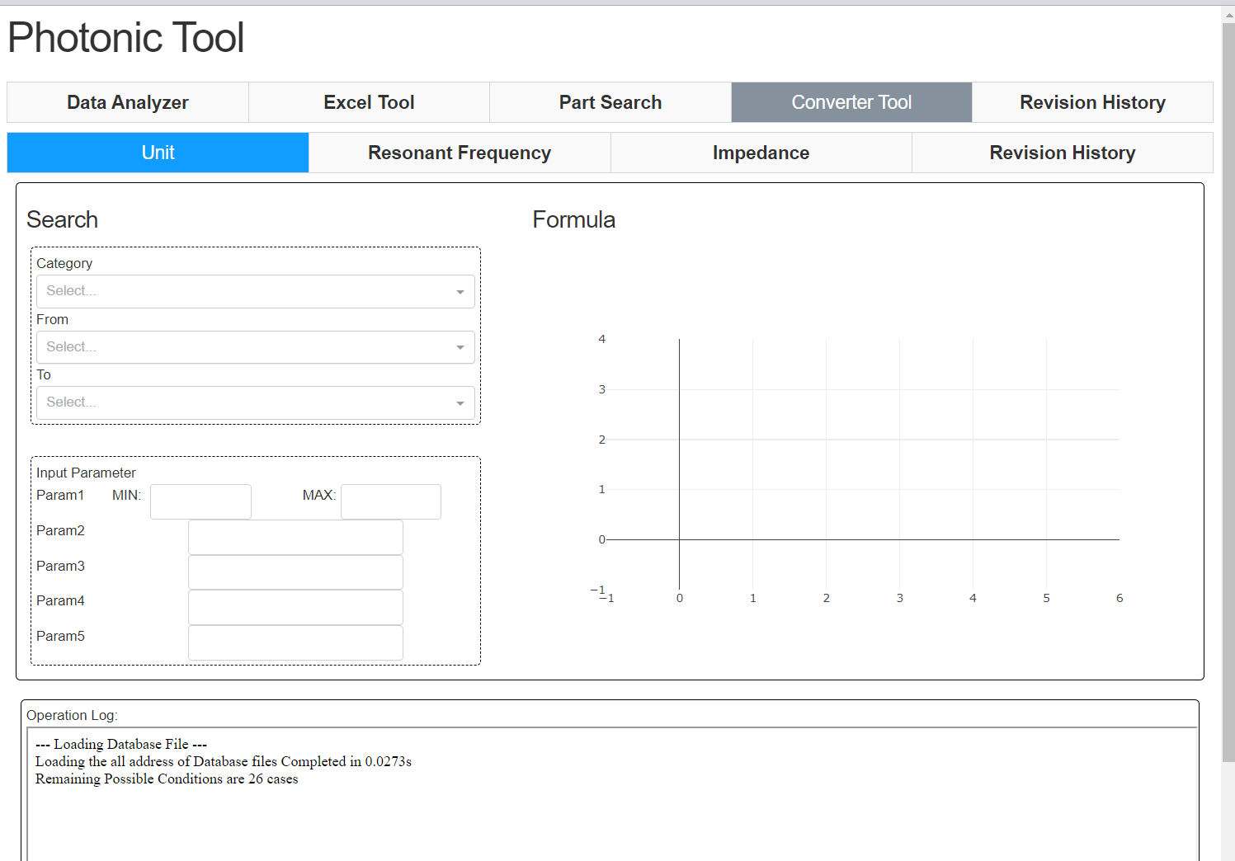
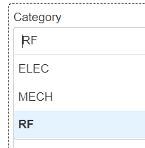
Added new tab, “Unit”
Function:
Showing relationship between From select to To select
Covering formula and relationships are 26 so far.
I have added ELEC, Mechanical and RF genres.
Symbolic formula for calculation
Adding new formula takes < 1 minute.
Latex syntax for the title

Slide 2
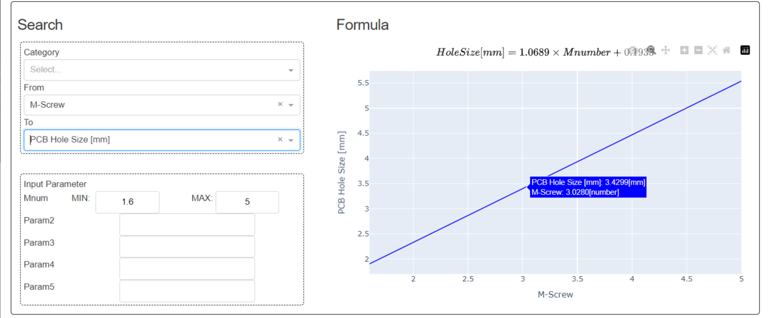
Sample #1:
Input: M-Screw #
Output: PCB Hole Size [mm]
Ex) M3 screw needs 3.43mm hole size

Slide 3
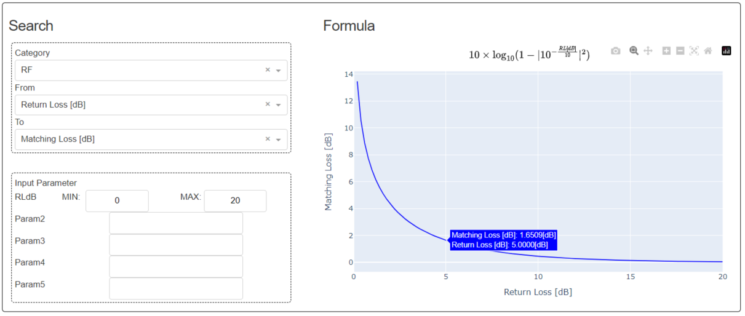
Sample #2:
Input: Return Loss S11 [dB]
Output: Matching Loss [dB]
Ex) S11 5dB will make 1.65dB matching loss

