Slide 1
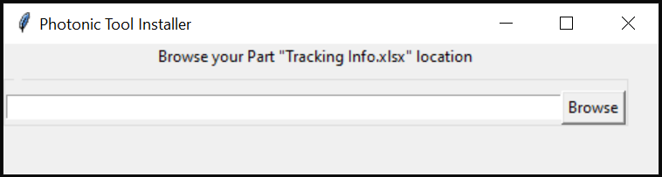
■Installation Step
Execute “AnalysisTool_Install.bat”
The below window will pop up
To Activate BOM Check function
■API key
Get API key from Mouser web site https://www.mouser.com/api-search
Activate your key for search function.
Then, save it into your computer as an environmental parameter.
Then, enter or browse your
referenceTechLibDepot\Part Information
folder location

Slide 2
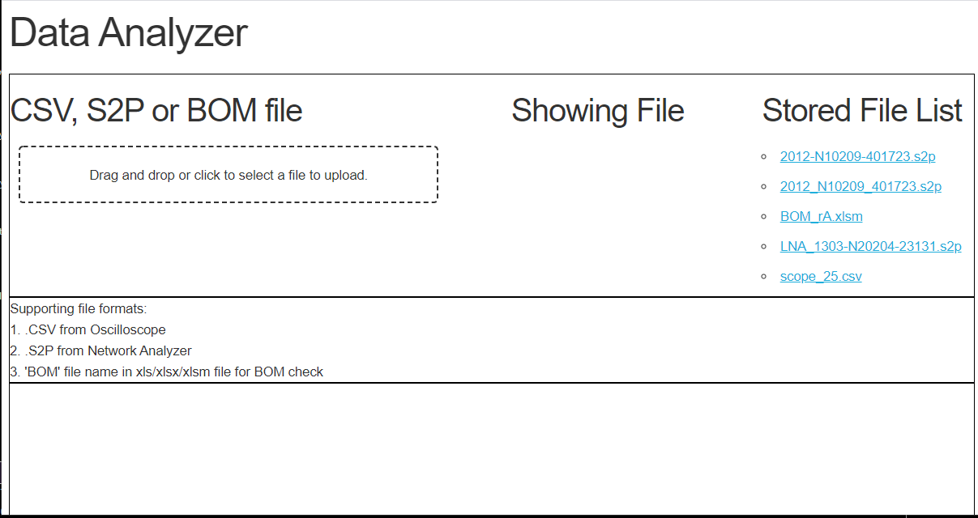
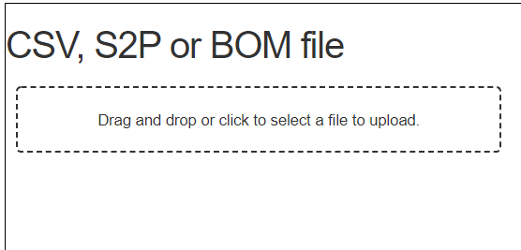
■How to use Data Analyzer
A local flask server will show up with your default web browser at 127.0.0.1:8888
Calculation result will show up as another web page.
■ Time Domain and Frequency Domain analyzer
If you select .csv file, this app will detect as Oscilloscope data.
■ RF parameter analyzer
If you select .s2p file, this app will switch to RF parameter calculation.
■ BOM Checker
If your file has ”BOM” characters in your file name, Mouser API will be activated
■ Promira Serial Batch File Creator
If your file has “Promira” characters in your file name, Waveform viewer and XML file will be generated
Do Drag and drop or click here

Slide 3
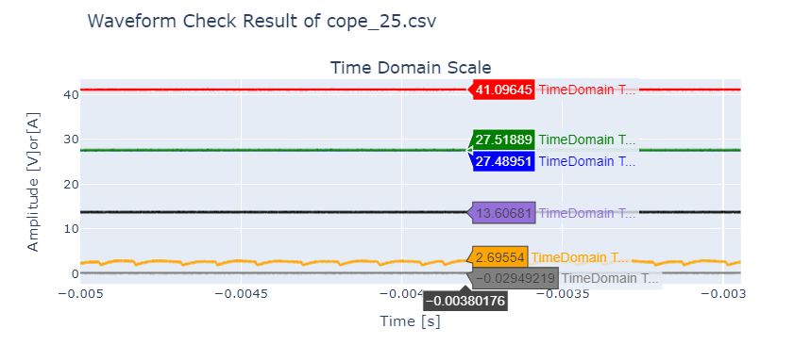
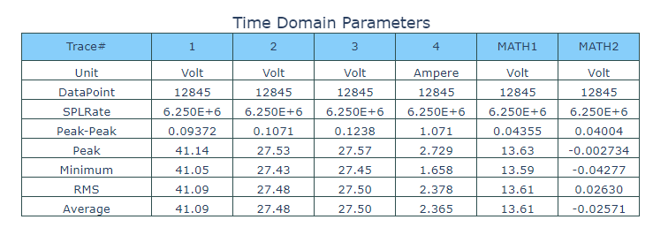
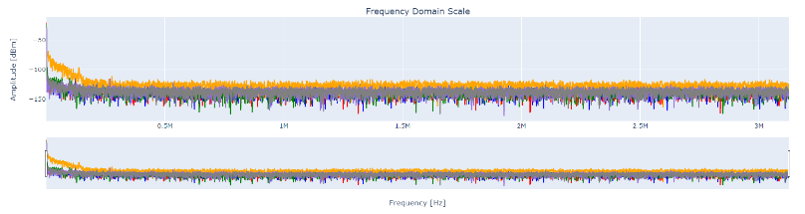
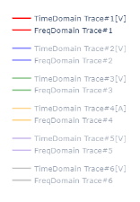
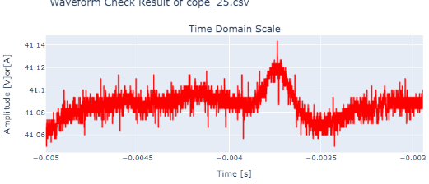
Case #1 Time Domain and Frequency Domain analyzer
■Time Domain part
■Time Domain Parameters
When you hover your mouse over the trace,
It shows raw data accordingly.
The measured parameters per traces will show up.
This data might be equal to oscilloscope result.
■Frequency Domain part
■View data select
If you make some traces gray out, you can select visible traces.
Ex) only trace#1 is active, graph data will switch to show only trace#1
FFT calculation result shows up per traces.
Bottom slider will also support you to zoom in

Slide 4
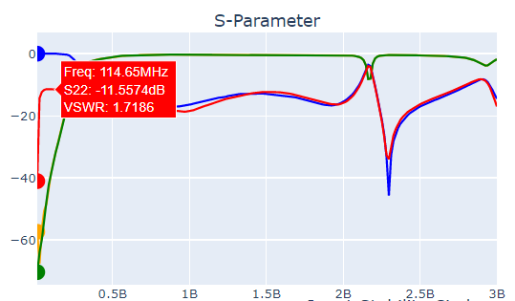

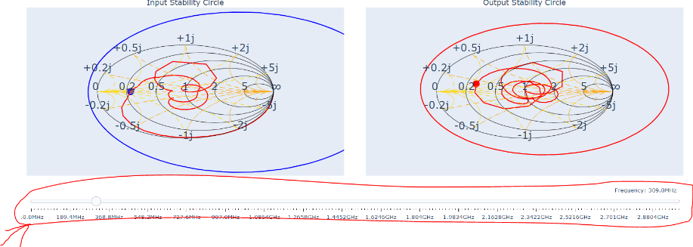
Case #2 RF parameter analyzer
■ S-parameter
■ Ideal Gain
Based on the dropped s2p file, calculated below 3 gain will show up. You can see how much space your tuning can improve.
■ Stability Circle
Based on the dropped s2p file, both input and output stability circle will be displayed.
The checking frequency is determined with blow slider.
S-parameters from s2p file will show up.
On S11 or S22, I also added VSWR data as hover data.
■ Stability Factor
Based on the dropped s2p file, calculated K and Mu factors show up.
As far as both factor shows higher than 1, the RF device must be stable.

Slide 5
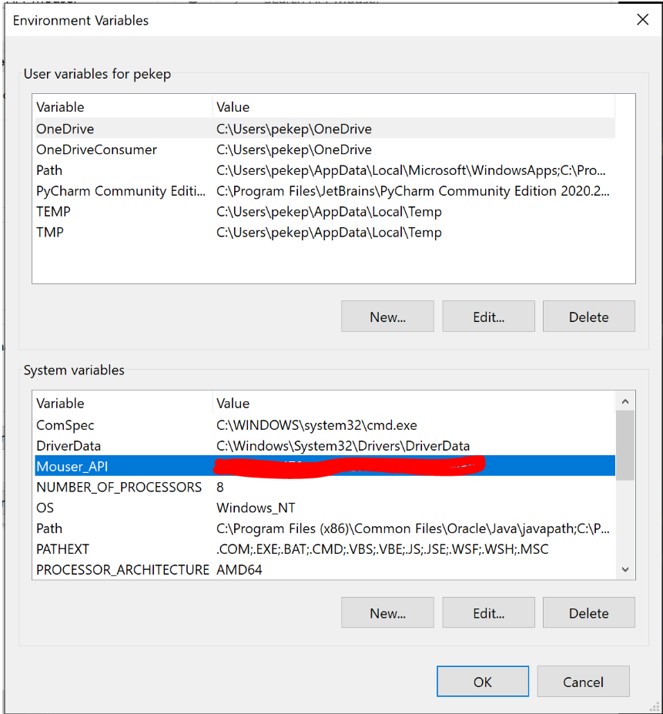
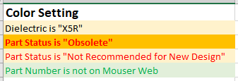
Case #3 Mouser API
■Derived Result Data
“DerivedExcel.xlsx” will be created at your desktop.
It will contain below data.
Mfr part numbers per Norsat#
Part definition
Part Type
Parts parameters if part description of Mouser database has
<- Type, Value, Tolerance, Size, Wattage, Dielectic
Manufacturer name
Lifecycle Status
Lead Time
Compliance Info: RoHS, Export Control and so on…
Price [CAD]
Datasheet link
Part Image (jpg or pdf)
■API Key from Mouser web page
At below link, get an API key for you.
We cannot share API password key.
https://www.mouser.com/api-search/
■API Key store location in your computer
Store your ID into your environmental setting.
This program will access your key from this location.
■Excel format

Slide 6
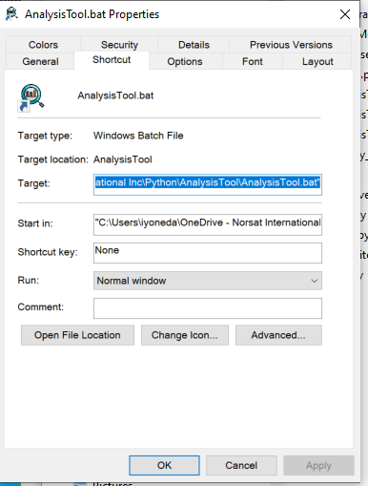

Creating bat file
Create a shortcut file of “AnalysisTool.bat” file.
The shortcut allows you to activate this program
2. Change icon style to whatever you want.
-> Analysis.ico is saved in [Top_Assets] folder.
AnalysisTool.ico

