Slide 1

计算机图形学
曹卫群
Weiqun.cao@126.com
第八/九讲 OpenGL简介

Slide 2
OpenGL
什么是OpenGL?
Open Graphics Library, Software interface for graphics hardware.
Defined by Silicon Graphics, Inc.

Slide 3
OpenGL
OpenGL做什么?
支持点、线段、多边形和图像这些基本图形元素的绘制，变换、光照计算、纹理映射、反走样
Notes:
OpenGL is designed as a streamlined, hardware-independent interface to be implemented on many different hardware platforms. To achieve these qualities, no commands for performing windowing tasks or obtaining user input are included in OpenGL; instead, you must work through whatever windowing system controls the particular hardware you're using. Similarly, OpenGL doesn't provide high-level commands for describing models of three-dimensional objects. Such commands might allow you to specify relatively complicated shapes such as automobiles, parts of the body, airplanes, or molecules. With OpenGL, you must build up your desired model from a small set of geometric primitives—points, lines, and polygons.

Slide 4
OpenGL
OpenGL不做什么?
窗口管理、用户输入的 获取、绘制复杂几何模型

Slide 5
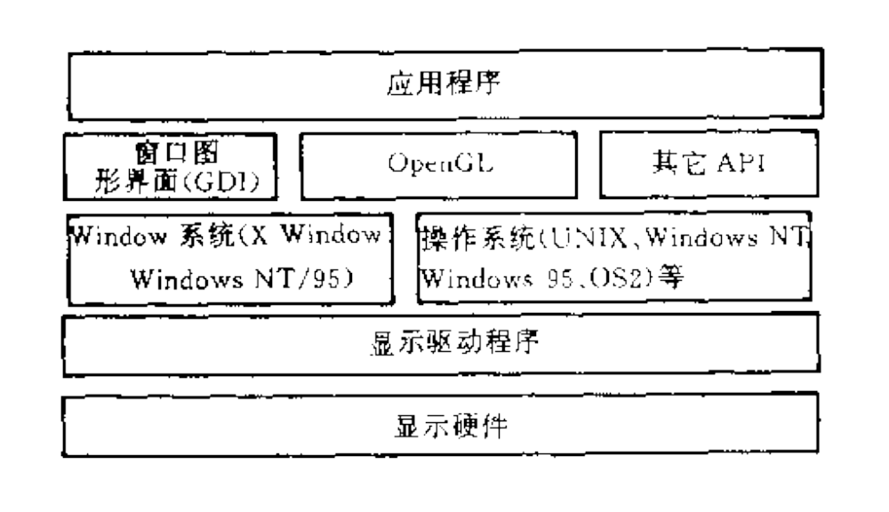
OpenGL在显示环境中的地位
Notes:
OpenGL只提供绘制操作访问而没有提供用来建立窗口、接受用户输入等机制．它要求所运行环境中的窗口系统提供这些机制。

Slide 6
OpenGL
几个基本概念
几个相关库
OpenGL编程

Slide 7
OpenGL几个基本概念
顶点（Vertex）
像素（Pixel）
帧缓冲区（Framebuffer）
图像缓冲区、辅助缓冲区
RGBA
Notes:
Pixel:
OpenGL最后绘制的图像是屏幕上的一系列像素值,此像素(图像元素的简称)是 显示设备能够显示到屏幕上的最小可见单位。有关像素的信息，如它们支持什么颜色 等，是由系统显示存储器的位面数来决定的。位是内存中的一个区域，它保留每个像素 点在屏幕上的一位信息，位可以决定某一像素点应该显示什么颜色。位的总和构成了 帧缓冲区。其中保存了图形显示所消要的屏幕上的所有像素值
Framebuffer
OpenGL的帧缓冲区既可以是运行环境中宙口系统构造的一个窗口，也可以是存储 器中的一个数据结构。OpenGL的帧缓冲区逻辑上是一组缓冲区组成的、每个缓冲区逻 辑上就是一个二维数组。OpenGL的帧缓冲区从功能上可以分为两种；图像缓冲区和辅助 缓冲区。图像缓冲区是OpenGL最重要的缓冲区，它包含实际的颜色信息和Alpha分量, 辅助缓冲区包括深度缓冲区(Depth Buffer)、模板缓冲区(Stencil Buffer)、累积缓冲区 (Accumulation buffer)、双缓冲区和立体缓冲区等。

Slide 8
辅助缓冲区
Depth Buffer
Stencil Buffer
Accumulation Buffer
Double Buffer
Notes:
深度缓冲区也称为z缓冲区，它存储每 个像素的深度值。模板缓冲区用来限制绘制到屏幕某个区域中的内容，这确点像用—个有 图案的纸模板精确地绘制一·幅图画一样。累积缓冲区存储RGBA颜色数据，用来累积一 系列图像，形成一个最终的合成图像。双缓冲区指前端可视缓冲区与后台可绘制缓冲 区的组合．它可以使得在显示一幅图像的同时绘制另一幅图像，这是通过后台将可绘制缓 冲区绘制到内存中，然后将缓冲区内容快速拷贝到屏幕缓冲区来实现的。立体缓冲区类似 于双缓冲区，它组合了多个缓冲区，包括前端、后端以及左右缓冲区，大多数OPcn(儿的实 现都支持双缓冲区，而立体缓冲区要求待殊的硬件支持，而当前大多数OpengGL的实现 还不支持立体缓冲区．

Slide 9
隐藏面剔除
glutInitDisplayMode (GLUT_DEPTH | .... );
glEnable(GL_DEPTH_TEST);
...
while (1)
{
glClear(GL_COLOR_BUFFER_BIT |
GL_DEPTH_BUFFER_BIT);
get_viewing_point_from_mouse_position();
draw_3d_object_A();
draw_3d_object_B(); }

Slide 10
OpenGL几个基本概念
颜色模式
RGBA
glColor3d(1.0, 0.14, 0.6667) ;
Index
glIndexs(37) ;
显示列表（Display List）
Notes:
RGBA is the preferred mode for most OpenGL applications. In RGBA color mode you specify colors as red + green + blue + alpha quadruplets.
In color index mode you specify an index into a color lookup table.
RGBA mode and color index mode are mutually exclusive: You can use either mode, but not simultaneously.
Display Lists are about performance. It is a simple way of enhancing your OpenGL application making it run faster.
At a first glance a display list can be seen just as a function in a computer program. You define it once and can use it as many times as you want. A display list stores a group of OpenGL commands so that they can be used repeatedly just by calling the display list.
Consider for instance that you're modeling a car. You can define a wheel in a display list and then call it four times with the appropriate translations.

Slide 11
OpenGL
几个基本概念
几个相关库
OpenGL编程

Slide 12
OpenGL几个相关库
核心库
以“gl”为前缀
实用程序库
（OpenGL utility library）
以“glu”为前缀
Notes:
OpenGL的核心库包含OpenGL最基本的命令函数，它们可以在任何OpenGL的实 现平台上应用。这些函数用来建文各种各样的几何模型、进行坐标变换、产生光照效果、进 行纹理映射、执行各种缓冲区操作、大气现象模拟、曲线曲面计算等几乎所有的三维图形 操作。基本函数由于不同的参数而可能导致格式的变形，从而可以派生出数百个命令函 数。 OpenGL核心库中的命令均以。”gl”关键字为前缀。
OpenGL实用程序库是比OpenGL核心库更高一层的实用函数组合，也可以看作是 对核心库的扩充。该程序库主要用来进行纹理映射、坐标变换、多边形区域分割、一些简单多边形实体(如圆柱、球体等)的绘制等。任何OpenGL的实现都必须包台这个库，该库中 的函数名约定以“glu”关键字为前缀。

Slide 13
OpenGL几个相关库
窗口系统扩展库
以“glx”、”wgl”、”pgl”为前缀
编程辅助库
（OpenGL auxilery library）
以“glaux”为前缀
Notes:
For every window system, there is a library that extends the functionality of that window system to support OpenGL rendering. For machines that use the X Window System, the OpenGL Extension to the X Window System (GLX) is provided as an adjunct to OpenGL. GLX routines use the prefix glX. For Microsoft Windows, the WGL routines provide the Windows to OpenGL interface. All WGL routines use the prefix wgl. For IBM OS/2, the PGL is the Presentation Manager to OpenGL interface, and its routines use the prefix pgl
OpenGL编程辅助库是窗口系统和操作系统无关的，用户可以像使用OpenGL其它 库命令函数一样使用编程辅助库程序(在#include语句中头文件名的写法可能会有点区 别)。OpenGL编程辅助库不仅提供了窗口管理、鼠标／键盘事件处理函数，而且还提供了 一些基本的三维几何对象(如球体、立方体、圆柱体等)的创建函数。

Slide 14
OpenGL几个相关库
OpenGL Utility Toolkit
以“glut”为前缀
Notes:
As you know, OpenGL contains rendering commands but is designed to be independent of any window system or operating system. Consequently, it contains no commands for opening windows or reading events from the keyboard or mouse. Unfortunately, it's impossible to write a complete graphics program without at least opening a window, and most interesting programs require a bit of user input or other services from the operating system or window system. In many cases, complete programs make the most interesting examples, so this book uses GLUT to simplify opening windows, detecting input, and so on. If you have an implementation of OpenGL and GLUT on your system, the examples in this book should run without change when linked with them.
In addition, since OpenGL drawing commands are limited to those that generate simple geometric primitives (points, lines, and polygons), GLUT includes several routines that create more complicated three-dimensional objects such as a sphere, a torus, and a teapot. This way, snapshots of program output can be interesting to look at. (Note that the OpenGL Utility Library, GLU, also has quadrics routines that create some of the same three-dimensional objects as GLUT, such as a sphere, cylinder, or cone.)
GLUT may not be satisfactory for full-featured OpenGL applications, but you may find it a useful starting point for learning OpenGL.

Slide 15
OpenGL
几个基本概念
几个相关库
OpenGL编程

Slide 16
OpenGL编程
头文件
简单的OpenGL程序: hello
GLUT
用OpenGL绘制图形

Slide 17
头文件
所有的OpenGL应用程序
#include <GL/gl.h>
#include <GL/glu.h>
Notes:
For all OpenGL applications, you want to include the gl.h header file in every file. Almost all OpenGL applications use GLU, the aforementioned OpenGL Utility Library, which requires inclusion of the glu.h header file.

Slide 18
头文件
若使用窗口系统扩展库GLX
#include <X11/xlib.h>
#include <GL/glx.h>
Notes:
If you are directly accessing a window interface library to support OpenGL, such as GLX, AGL, PGL, or WGL, you must include additional header files. For example, if you are calling GLX, you may need to add these lines to your code

Slide 19
头文件
若使用glut
#include <GL/glut.h>
Notes:
Note that glut.h includes gl.h, glu.h, and glx.h automatically, so including all three files is redundant. GLUT for Microsoft Windows includes the appropriate header file to access WGL.

Slide 20
OpenGL编程
头文件
简单的OpenGL程序: hello
GLUT
用OpenGL绘制图形

Slide 21
OpenGL编程
头文件
简单的OpenGL程序: hello
GLUT
用OpenGL绘制图形

Slide 22
GLUT
窗口管理
Display callback
处理输入事件
开始事件处理

Slide 23
GLUT的窗口管理
初始化GLUT并处理命令行参数
glutInit(int *argc, char **argv)
置于所有其他GLUT函数之前
Notes:
glutInit(int *argc, char **argv) initializes GLUT and processes any command line arguments (for X, this would be options like -display and -geometry). glutInit() should be called before any other GLUT routine.

Slide 24
GLUT的窗口管理
定义显示模式：
glutInitDisplayMode(unsigned int mode)
glutInitDisplayMode (GLUT_DOUBLE
| GLUT_RGB| GLUT_DEPTH);
Notes:
glutInitDisplayMode(unsigned int mode) specifies whether to use an RGBA or color-index color model. You can also specify whether you want a single- or double-buffered window. (If you're working in color-index mode, you'll want to load certain colors into the color map; use glutSetColor() to do this.) Finally, you can use this routine to indicate that you want the window to have an associated depth, stencil, and/or accumulation buffer. For example, if you want a window with double buffering, the RGBA color model, and a depth buffer, you might call glutInitDisplayMode(GLUT_DOUBLE | GLUT_RGB | GLUT_DEPTH).

Slide 25
GLUT的窗口管理
定义窗口位置、大小
glutInitWindowPosition(int x, int y)
glutInitWindowSize(int width, int height)
创建窗口
int glutCreateWindow(char *string)
Notes:
glutInitWindowPosition(int x, int y) specifies the screen location for the upper-left corner of your window.
glutInitWindowSize(int width, int size) specifies the size, in pixels, of your window.
int glutCreateWindow(char *string) creates a window with an OpenGL context. It returns a unique identifier for the new window. Be warned: Until glutMainLoop() is called (see next section), the window is not yet displayed.

Slide 26
GLUT
窗口管理
Display callback
处理输入事件
开始事件处理

Slide 27
Display callback
glutDisplayFunc(void (*func)(void))
int main(int argc, char** argv) {
…
glutDisplayFunc(display);
…}
void display(void) {
…
}
Notes:
glutDisplayFunc(void (*func)(void)) is the first and most important event callback function you will see. Whenever GLUT determines the contents of the window need to be redisplayed, the callback function registered by glutDisplayFunc() is executed. Therefore, you should put all the routines you need to redraw the scene in the display callback function.

Slide 28
GLUT
窗口管理
Display callback
处理输入事件
开始事件处理

Slide 29
处理输入事件
当改变窗口大小时
glutReshapeFunc
(void (*func)(int w, int h))

Slide 30
处理输入事件
当按下或松开键盘/鼠标键时
glutKeyboardFunc
(void (*func)(unsigned char key, int x, int y))
glutMouseFunc(void (*func)
(int button, int state, int x, int y))

Slide 31
处理输入事件
当鼠标键被按下并同时被移动
glutMotionFunc
(void (*func)(int x, int y))

Slide 32
管理后台进程
当其他进程闲置时：
glutIdleFunc
(void (*func)(void))
Notes:
glutIdleFunc sets the global idle callback to be func so a GLUT program can perform background processing tasks or continuous animation when window system events are not being received. If enabled, the idle callback is continuously called when events are not being received. The callback routine has no parameters.

Slide 33
GLUT
窗口管理
Display callback
处理输入事件
开始事件处理

Slide 34

开始事件处理
glutMainLoop()
Notes:
After a GLUT program has done initial setup such as creating windows and menus, GLUT programs enter the GLUT event processing loop by calling glutMainLoop.
glutMainLoop enters the GLUT event processing loop. This routine should be called at most once in a GLUT program. Once called, this routine will never return. It will call as necessary any callbacks that have been registered.

Slide 35
OpenGL编程
头文件
简单的OpenGL程序: hello
GLUT
用OpenGL绘制图形

Slide 36
OpenGL绘制图形
OpenGL语法
清屏
定义图形元素的绘制颜色
定义投影变换矩阵

Slide 37
OpenGL绘制图形
OpenGL图形元素
显示点、线、多边形
坐标变换及矩阵堆栈
基本状态管理
光照

Slide 38
OpenGL绘制图形
OpenGL语法
清屏
定义图形元素的绘制颜色
定义投影变换矩阵

Slide 39
Table 2-1. Command Suffixes and Argument Data Types
Suffix | Data Type | Typical Corresponding C-Language Type | OpenGL Type Definition
b | 8-bit integer | signed char | GLbyte
s | 16-bit integer | short | GLshort
i | 32-bit integer | int or long | GLint, GLsizei
f | 32-bit floating-point | float | GLfloat, GLclampf
d | 64-bit floating-point | double | GLdouble, GLclampd
ub | 8-bit unsigned integer | unsigned char | GLubyte, GLboolean
us | 16-bit unsigned integer | unsigned short | GLushort
ui | 32-bit unsigned integer | unsigned int or unsigned long | GLuint, GLenum, GLbitfield
Notes:
As you might have observed from the simple program in the previous section, OpenGL commands use the prefix gl and initial capital letters for each word making up the command name (recall glClearColor(), for example). Similarly, OpenGL defined constants begin with GL_, use all capital letters, and use underscores to separate words (like GL_COLOR_BUFFER_BIT).
You might also have noticed some seemingly extraneous letters appended to some command names (for example, the 3f in glColor3f() and glVertex3f()). It's true that the Color part of the command name glColor3f() is enough to define the command as one that sets the current color. However, more than one such command has been defined so that you can use different types of arguments. In particular, the 3 part of the suffix indicates that three arguments are given; another version of the Color command takes four arguments. The f part of the suffix indicates that the arguments are floating-point numbers. Having different formats allows OpenGL to accept the user's data in his or her own data format

Slide 40
OpenGL语法
glColor3f(0.5, 0.5,0.5)
glVertex3f(0.2, 0.4, 0.6)

Slide 41
OpenGL绘制图形
OpenGL语法
清屏
定义图形元素的绘制颜色
定义投影变换矩阵

Slide 42
清屏
设置color buffer 初值
glClearColor(0.0, 0.0, 0.0, 0.0);
glClear(GL_COLOR_BUFFER_BIT);

Slide 43
清屏
设置depth buffer 初值
glClearDepth(1.0);
glClear(GL_DEPTH_BUFFER_BIT);

Slide 44
清屏
设置color & depth buffer 初值
glClearColor(0.0, 0.0, 0.0, 0.0);
glClearDepth(1.0);
glClear(GL_COLOR_BUFFER_BIT|
GL_DEPTH_BUFFER_BIT);

Slide 45
OpenGL绘制图形
OpenGL语法
清屏
定义图形元素的绘制颜色
定义投影变换矩阵

Slide 46
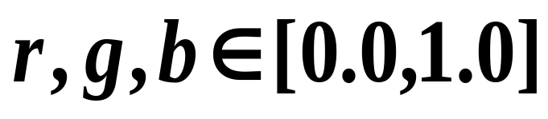
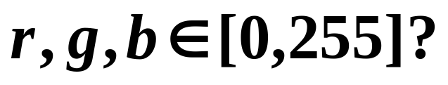
图形元素的颜色
glColor3f(GLfloat r,
GLfloat g, GLfloat b);

Slide 47
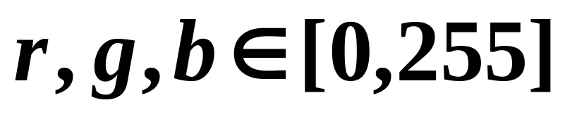
图形元素的颜色
r,g,b,a?
glColor3ub(GLubyte r,
GLubyte g, GLubyte b);

Slide 48
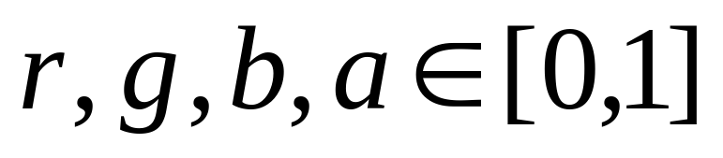
图形元素的颜色
glColor4f(GLfloat r,
GLfloat g, GLfloat b,GLfloat a);
a为透明度

Slide 49
OpenGL绘制图形
OpenGL语法
清屏
定义图形元素的绘制颜色
定义投影变换矩阵

Slide 50
定义投影变换矩阵
glMatrixMode(GL_PROJECTION); glLoadIdentity();

Slide 51
定义投影变换矩阵
平行投影
void glOrtho(GLdouble left, GLdouble right, GLdouble bottom,
GLdouble top, GLdouble near, GLdouble far);
Notes:
.

Slide 52
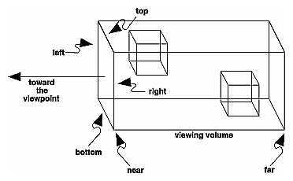
定义投影变换矩阵
Notes:
.

Slide 53
定义投影变换矩阵
透视投影
void glFrustum(GLdouble left, GLdouble right, GLdouble bottom, GLdouble top, GLdouble near, GLdouble far);
Notes:
.

Slide 54
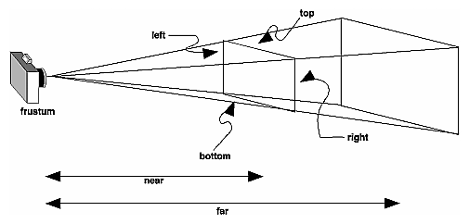
定义投影变换矩阵
Notes:
.

Slide 55
定义投影变换矩阵
透视投影
void glFrustum(GLdouble fovy, GLdouble aspect,
GLdouble near, GLdouble far );
Notes:
.

Slide 56
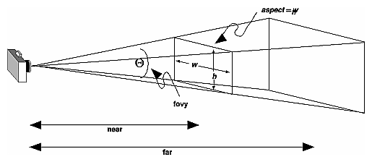
定义投影变换矩阵
Notes:
.

Slide 57
OpenGL编程
头文件
简单的OpenGL程序: hello
GLUT
用OpenGL绘制图形

Slide 58
OpenGL绘制图形
OpenGL语法
清屏
定义图形元素的绘制颜色
定义投影变换矩阵

Slide 59
OpenGL绘制图形
OpenGL图形元素
显示点、线、多边形
坐标变换及矩阵堆栈
基本状态管理
光照

Slide 60
OpenGL图形元素
画点
glBegin(GL_POINTS);
glVertex2f(0.0, 0.0);
glVertex2f(0.0, 3.0);
glVertex2f(4.0, 3.0);
glVertex2f(6.0, 1.5);
glEnd();
Notes:
.

Slide 61
OpenGL图形元素
画线
glBegin(GL_LINES);
glVertex2f(0.0, 0.0);
glVertex2f(0.0, 3.0);
glVertex2f(4.0, 3.0);
glVertex2f(6.0, 1.5);
glEnd();
Notes:
.

Slide 62
OpenGL图形元素
画多边形
glBegin(GL_POLYGON);
glVertex2f(0.0, 0.0);
glVertex2f(0.0, 3.0);
glVertex2f(4.0, 3.0);
glVertex2f(6.0, 1.5);
glEnd();
要求
简单凸多边形
Notes:
. OpenGL makes some strong restrictions on what constitutes a primitive polygon. First, the edges of OpenGL polygons can't intersect (a mathematician would call a polygon satisfying this condition a simple polygon). Second, OpenGL polygons must be convex, meaning that they cannot have indentations.
The reason for the OpenGL restrictions on valid polygon types is that it's simpler to provide fast polygon-rendering hardware for that restricted class of polygons.
Many real-world surfaces consist of nonsimple polygons, nonconvex polygons, or polygons with holes. All such polygons can be formed from unions of simple convex polygons .

Slide 63
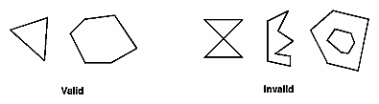
有效及无效多边形
Notes:
. OpenGL makes some strong restrictions on what constitutes a primitive polygon. First, the edges of OpenGL polygons can't intersect (a mathematician would call a polygon satisfying this condition a simple polygon). Second, OpenGL polygons must be convex, meaning that they cannot have indentations.

Slide 64
OpenGL图形元素
画矩形
void glRect{sifd}
(TYPE x1, TYPE y1, TYPE x2, TYPE y2);
void glRect{sifd}v
(TYPE *v1, TYPE *v2);
Notes:
Draws the rectangle defined by the corner points (x1, y1) and (x2, y2). The rectangle lies in the plane z=0 and has sides parallel to the x- and y-axes. If the vector form of the function is used, the corners are given by two pointers to arrays, each of which contains an (x, y) pair .

Slide 65

OpenGL图形元素
Commands between
glBegin(), glEnd()
E:Primitives
Notes:
.glVertex*()set vertex
glColor*()set current
glIndex*()set current color index
glNormal*()set normal vector coordinates
glTexCoord*()set texture coordinates
glEdgeFlag*()control drawing of edges
glMaterial*()set material properties
glArrayElement()extract vertex array data
glEvalCoord*(), glEvalPoint*()generate coordinates
glCallList(), glCallLists()

Slide 66
OpenGL图形元素
glBegin (GL_POLYGON);
glNormal3fv(n0);
glVertex3fv(v0);
glNormal3fv(n1);
glVertex3fv(v1);
glNormal3fv(n2);
glVertex3fv(v2);
glNormal3fv(n3);
glVertex3fv(v3);
glEnd();
Notes:
.

Slide 67
OpenGL图形元素
glBegin (GL_POLYGON);
glColor3fv(c0);
glVertex3fv(v0);
glColor3fv(c1);
glVertex3fv(v1);
glColor3fv(c2);
glVertex3fv(v2);
glColor3fv(c3);
glVertex3fv(v3);
glEnd();
Notes:
.

Slide 68
OpenGL图形元素
glShadeModel
(GL_FLAT )
GL_SMOOTH
E:Primitives
Notes:
.

Slide 69
OpenGL绘制图形
OpenGL图形元素
显示点、线、多边形
坐标变换及矩阵堆栈
基本状态管理
光照

Slide 70
显示点、线、多边形
缺省值：1
Antialiasing
点
void glPointSize(GLfloat size);
缺省值：1
线
void glLineWidth(GLfloat width);
多边形
Notes:
如果激活OpenGL的反走样特性，显示像素块的尺寸将按平滑边界的要求进行修改，点的默认大小是1.0

Slide 71
线
点画线
void glLineStipple(GLint factor, GLushort pattern);
glEnable(GL_LINE_STIPPLE);
Notes:
. To make stippled (dotted or dashed) lines, you use the command glLineStipple() to define the stipple pattern, and then you enable line stippling with glEnable().
参数factor说明模式中，每一位重复应用多少次才轮到下一位。默认的重复是1

Slide 72
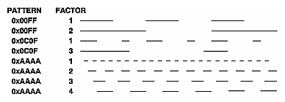
点画线
E:Lines
Notes:
. To make stippled (dotted or dashed) lines, you use the command glLineStipple() to define the stipple pattern, and then you enable line stippling with glEnable().

Slide 73
多边形
E:Primitives
多边形的显示模式
void glPolygonMode(GLenum face, GLenum mode);
GL_FRONT_AND_BACK, GL_FRONT, or GL_BACK
GL_POINT, GL_LINE, or GL_FILL
Notes:
face
The polygons that mode applies to. Must be GL_FRONT for front-facing polygons, GL_BACK for back-facing polygons, or GL_FRONT_AND_BACK for front- and back-facing polygons.
mode
The way polygons will be rasterized. The following modes are defined and can be specified in mode. The default is GL_FILL for both front- and back-facing polygons.

Slide 74
OpenGL绘制图形
OpenGL图形元素
显示点、线、多边形
坐标变换及矩阵堆栈
基本状态管理
光照

Slide 75
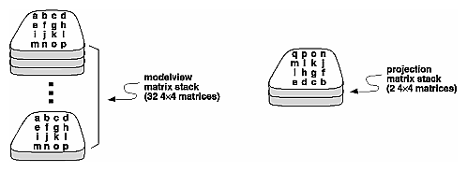
矩阵堆栈
Notes:
. The modelview and projection matrices you've been creating, loading, and multiplying have only been the visible tips of their respective icebergs. Each of these matrices is actually the topmost member of a stack of matrices

Slide 76
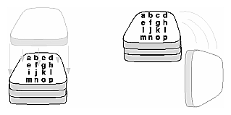
出入矩阵堆栈
Notes:
Pushes all matrices in the current stack down one level. The current stack is determined by glMatrixMode(). The topmost matrix is copied, so its contents are duplicated in both the top and second-from-the-top matrix. If too many matrices are pushed, an error is generated.
Pops the top matrix off the stack, destroying the contents of the popped matrix. What was the second-from-the-top matrix becomes the top matrix. The current stack is determined by glMatrixMode(). If the stack contains a single matrix, calling glPopMatrix() generates an error.

Slide 77
出入矩阵堆栈
void glPushMatrix(void);
void glPopMatrix(void);
E:robot

Slide 78
glPushMatrix();
glTranslatef ( -1.0, 0.0, 0.0);
glRotatef ((GLfloat) shoulder, 0.0, 0.0, 1.0);
glTranslatef (1.0, 0.0, 0.0);
glPushMatrix();
glScalef (2.0, 0.4, 1.0);
glutWireCube (1.0);
glPopMatrix();
glPushMatrix();
glTranslatef (1.0, 0.0, 0.0);
glRotatef ((GLfloat) elbow, 0.0, 0.0, 1.0);
glTranslatef (1.0, 0.0, 0.0);
glScalef (2.0, 0.4, 1.0);
glutWireCube (1.0);
glPopMatrix();
glPopMatrix();

Slide 79
OpenGL绘制图形
OpenGL图形元素
显示点、线、多边形
坐标变换及矩阵堆栈
基本状态管理
光照

Slide 80
基本状态管理
void glEnable(GLenum cap);
void glDisable(GLenum cap);
GL_BLEND ，GL_DEPTH_TEST ，GL_FOG ，
GL_LINE_STIPPLE ，GL_LIGHTING
Notes:
. OpenGL maintains many states and state variables. An object may be rendered with lighting, texturing, hidden surface removal, fog, or some other states affecting its appearance.
By default, most of these states are initially inactive. These states may be costly to activate; for example, turning on texture mapping will almost certainly slow down the speed of rendering a primitive. However, the quality of the image will improve and look more realistic, due to the enhanced graphics capabilities.
To turn on and off many of these states, use these two simple commands:

Slide 81
基本状态管理
GLboolean glIsEnabled(GLenum capability)
void glGetIntegerv(GLenum pname, GLint *params);
void glGetFloatv(GLenum pname, GLfloat *params);
Notes:
. glGetBooleanv, glGetDoublev, glGetFloatv, glGetIntegerv
These functions return the value or values of a selected parameter.

Slide 82
OpenGL绘制图形
OpenGL图形元素
显示点、线、多边形
坐标变换及矩阵堆栈
基本状态管理
光照

Slide 83
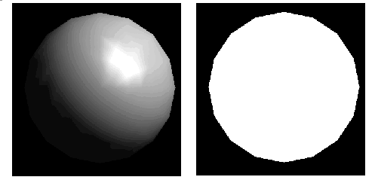
光照
Notes:
OpenGL computes the color of each pixel in a final, displayed scene that's held in the framebuffer. Part of this computation depends on what lighting is used in the scene and on how objects in the scene reflect or absorb that light. As an example of this, recall that the ocean has a different color on a bright, sunny day than it does on a gray, cloudy day. The presence of sunlight or clouds determines whether you see the ocean as bright turquoise or murky gray-green. In fact, most objects don't even look three-dimensional until they're lit. The figure shows two versions of the exact same scene (a single sphere), one with lighting and one without.

Slide 84
基本步骤
定义顶点矢量
生成、选择、定位一个或多个光源
生成、选择光照模式
定义材料属性
Notes:
Define normal vectors for each vertex of all the objects. These normals determine the orientation of the object relative to the light sources.
Create, select, and position one or more light sources.
Create and select a lighting model, which defines the level of global ambient light and the effective location of the viewpoint (for the purposes of lighting calculations).
Define material properties for the objects in the scene.

Slide 85
定义材料属性
发光材料
void glMaterial{if}(GLenum face,
GLenum pname, TYPE param);
void glMaterial{if}v(GLenum face,
GLenum pname, TYPE *param);
Notes:
These functions specify material parameters for the lighting model.
glMaterial{if}
The face or faces that are being updated. Must be one of GL_FRONT, GL_BACK, or GL_FRONT_AND_BACK.
pname
The single-valued material parameter of the face or faces being updated. Must be GL_SHININESS.
param
The value that parameter GL_SHININESS will be set to
glMaterial{if}v
face
The face or faces that are being updated. Must be one of GL_FRONT, GL_BACK, or GL_FRONT_AND_BACK.
pname
The material parameter of the face or faces being updated. The parameters that can be specified using glMaterial, and their interpretations by the lighting equation, are as follows: GL_AMBIENT
, GL_DIFFUSE, GL_SPECULAR,GL_EMISSION, GL_AMBIENT_AND_DIFFUSE ……
params
A pointer to the value or values to which pname will be set.

Slide 86
定义材料属性:
发光材料
GLfloat mat_emission[] = {0.3, 0.2, 0.2, 0.0};
glMaterialfv(GL_FRONT,
GL_EMISSION, mat_emission);

Slide 87
定义材料属性
定义材料
glMaterialfv(GL_FRONT, GL_SPECULAR, mat_specular);
MR,MG,MB,MA
Notes:
These functions specify material parameters for the lighting model.

Slide 88
定义光源
void glLight{if}(GLenum face,
GLenum pname, TYPE param);
void glLight{if}v(GLenum face,
GLenum pname, TYPE *param);
Notes:
light
A light. The number of lights depends on the implementation, but at least eight lights are supported. They are identified by symbolic names of the form GL_LIGHTi where 0 ≤ i < GL_MAX_LIGHTS.
pname
A light source parameter for light. The following values are accepted:

Slide 89
光源类型
环境光
GL_AMBIENT
漫射光
GL_DIFFUSE
定向光
GL_SPECULAR
Notes:
Ambient illumination is light that's been scattered so much by the environment that its direction is impossible to determine—it seems to come from all directions. Backlighting in a room has a large ambient component, since most of the light that reaches your eye has first bounced off many surfaces. A spotlight outdoors has a tiny ambient component; most of the light travels in the same direction, and since you're outdoors, very little of the light reaches your eye after bouncing off other objects. When ambient light strikes a surface, it's scattered equally in all directions.
The diffuse component is the light that comes from one direction, so it's brighter if it comes squarely down on a surface than if it barely glances off the surface. Once it hits a surface, however, it's scattered equally in all directions, so it appears equally bright, no matter where the eye is located. Any light coming from a particular position or direction probably has a diffuse component.
Finally, specular light comes from a particular direction, and it tends to bounce off the surface in a preferred direction. A well-collimated laser beam bouncing off a high-quality mirror produces almost 100 percent specular reflection. Shiny metal or plastic has a high specular component, and chalk or carpet has almost none. You can think of specularity as shininess.

Slide 90
OpenGL光照模型
LR,LG,LB,LA
定义光照
glLightfv(GL_LIGHT0, GL_SPECULAR, light_specular);
定义材料
glMaterialfv(GL_FRONT, GL_SPECULAR, mat_specular);
LR*MR, LG*MG, LB*MB
MR,MG,MB,MA
Notes:
These functions specify material parameters for the lighting model.

Slide 91
光源定位
glLightfv(GL_LIGHT0,
GL_POSITION, light_position);

Slide 92
光源启用
glEnable(GL_LIGHTING);
glEnable(GL_LIGHT0);

Slide 93
定义光照模式
void glLightModel{if}
(GLenum pname, TYPE param);
void glLightModel{if}v
(GLenum pname, TYPE * param);
GL_LIGHT_MODEL_AMBIENT，
GL_LIGHT_MODEL_LOCAL_VIEWER，
GL_LIGHT_MODEL_TWO_SIDE
Notes:
Sets properties of the lighting model. The characteristic of the lighting model being set is defined by pname, which specifies a named parameter 。 param indicates the values to which the pname characteristic is set; it's a pointer to a group of values if the vector version is used, or the value itself if the nonvector version is used. The nonvector version can be used to set only single-valued lighting model characteristics, not for GL_LIGHT_MODEL_AMBIENT.
GL_LIGHT_MODEL_AMBIENT (0.2, 0.2, 0.2, 1.0) ambient RGBA intensity of the entire scene
GL_LIGHT_MODEL_LOCAL_VIEWER 0.0 or GL_FALSE how specular reflection angles are computed
GL_LIGHT_MODEL_TWO_SIDE 0.0 or GL_FALSE choose between one-sided or two-sided lighting
在全局级定义OpenGL 光照参数

Slide 94
定义光照模式
全局环境光强
GL_LIGHT_MODEL_AMBIENT
视点位置
GL_LIGHT_MODEL_LOCAL_VIEWER
几何对象前后表面的计算方式
GL_LIGHT_MODEL_TWO_SIDE
Notes:
The global ambient light intensity
Whether the viewpoint position is local to the scene or whether it should be considered to be an infinite distance away
Whether lighting calculations should be performed differently for both the front and back faces of objects

Slide 95
定义全局环境光
GLfloat lmodel_ambient[] = { 0.2, 0.2, 0.2, 1.0 };
glLightModelfv(GL_LIGHT_MODEL_AMBIENT,
lmodel_ambient);

Slide 96
视点定位
glLightModeli
(GL_LIGHT_MODEL_LOCAL_VIEWER,
GL_TRUE);
Notes:
The location of the viewpoint affects the calculations for highlights produced by specular reflectance.

Slide 97
双面光照
glLightModeli
(GL_LIGHT_MODEL_TWO_SIDE,
GL_TRUE);

Slide 98
OpenGL参考网站
http://www.SGI.com/
http://www.opengl.org/
http://www.sgi.com/products/software/opengl/

Slide 99
OpenGL参考网站
http://www.parallab.uib.no/SGI_bookshelves/SGI_Developer/ index.html
http://rush3d.com/reference/

