Slide 1
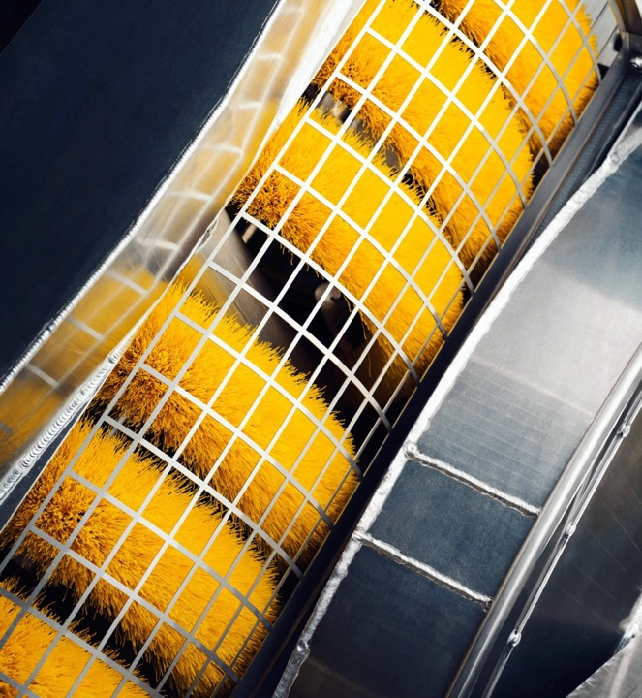
Recovery Devices
Notes:
Welcome to Module 5. This session covers recovery devices used during oil spill response and how to select the most effective option for different scenarios.

Slide 2
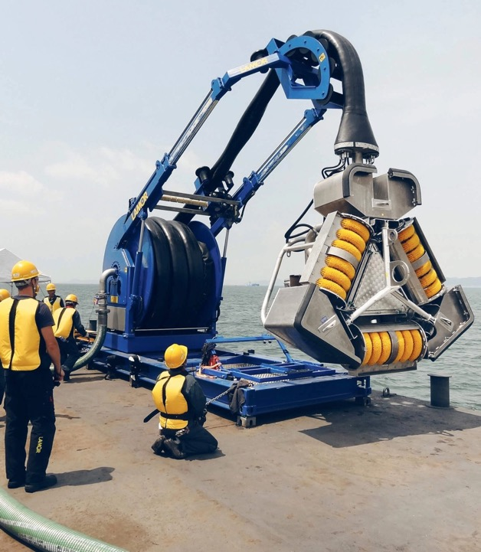

Recovery Devices
Objectives
1
Explain what a skimmer is
2
Understand the various types of skimmers and how they work
3
Understand the advantages and disadvantages of the different skimmer types
Notes:
Learning objectives: define a skimmer, understand major skimmer types, explain how they work, and compare their strengths and limitations.

Slide 3
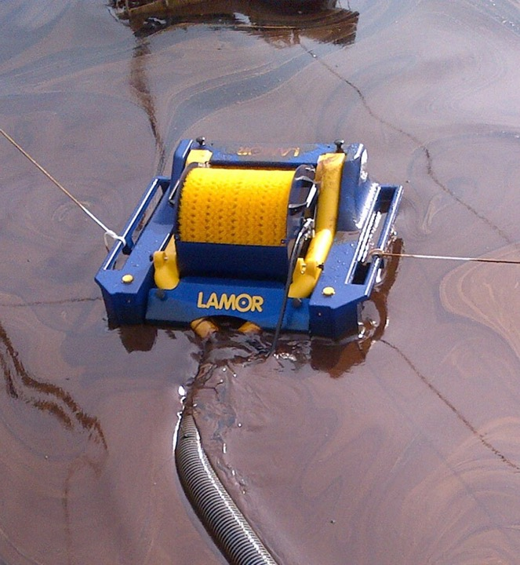
What do you know about skimmers?
Do these words mean anything to you?
Oleophillic / Weir / Vacuum / Mechanical / Manual / Sorbents
Notes:
Use this discussion slide to assess existing knowledge. Ask participants what they know about oleophilic, weir, vacuum, mechanical, manual recovery and sorbents.

Slide 4

Sell me your skimmer
Oleophilic
Weir
Mechanical / Manual
Vacuum
Sorbents
Exercise!
How does it work?
What oil product does it work on? Light, medium, heavy
List 3 positives / 1 negative
Why should I buy your skimmer
Notes:
Facilitate the group exercise. Each group researches one recovery method and prepares a short sales pitch explaining operation, oil suitability, advantages and disadvantages.

Slide 5
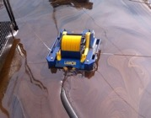

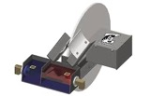
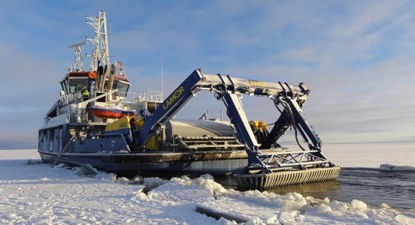
Oleophilic Skimmers
Selective Recovery: Utilizes materials that adhere to oil
Best on light to medium viscosity oil (100 – 2000 centisoktes)
Operational Versatility: Functions effectively in varying water conditions,
Recovery efficiency – can be 90% oil / 10% water
High Oil Recovery Rates: Features high efficiency due to oleophilic materials like brushes, disks, or drums.
Question
Will they work on emulsified oils?
Will they work on oil treated with dispersant?
Notes:
Oleophilic skimmers attract oil to brushes, drums or discs. They are highly selective with low water uptake and generally perform best on light to medium oils.

Slide 6
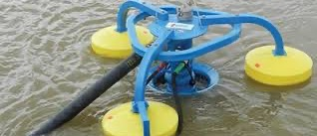
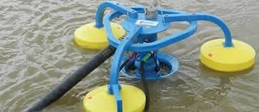
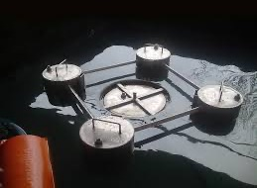
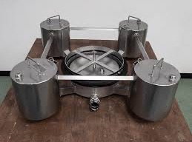


Weir Skimmer
Selective Skimming: Weir skimmers can adjust to varying oil thicknesses, typically skimming layers from 1 mm up to 10cm
Recovery Rates: Capable of processing large volumes,
Operational Range: Effective in both calm and moderately rough waters
Oil Type Flexibility: Efficient across a broad spectrum of oil types, from light gasoline to heavy crude oils.
Water Content: Typically collects between 40 - 60% water in the recovered oil,
Question
Will they work on emulsified oils?
Will they work on oil treated with dispersant?
Notes:
Weir skimmers recover oil by allowing the surface layer to flow over an adjustable weir. They can achieve high throughput but often recover significant amounts of water.

Slide 7
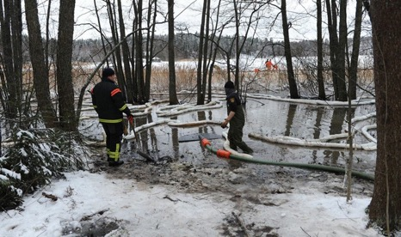
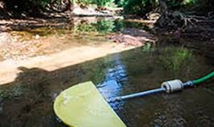
Vacuum Skimmer
Operational Depth: Can operate in water depths as shallow as a few inches to several feet,
Versatility in Viscosity: Vacuum skimmers can handle any viscosity of oil
Labour Intensity: Operating these skimmers is labor-intensive, requiring constant supervision and manual adjustments by operators.
Water Content: High water content in recovered material, averaging around 70%, which varies based on the operator’s skill
Explosion Risk: There is an increased risk of explosion when recovering lighter, more volatile oil products
Question
Will they work on emulsified oils?
Will they work on oil treated with dispersant?
Notes:
Vacuum skimmers remove oil through suction. They are versatile and can handle many oil viscosities, but operations are labour intensive and often recover large volumes of water.

Slide 8
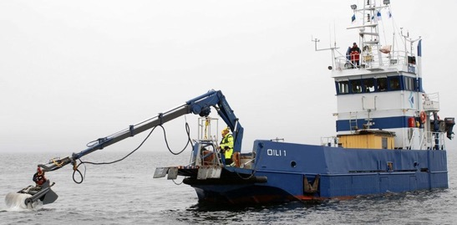
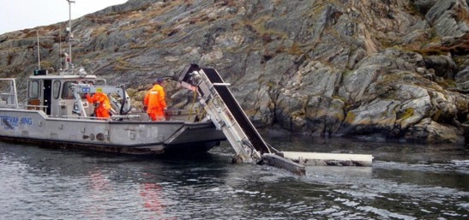
Mechanical Skimmer
Recovery Rate: Mechanical skimmers can recover large volumnes quickly
Viscosity Suitability: Best suited for medium to heavy oils, with operational effectiveness decreasing as oil viscosity decreases.
Deployment Flexibility: Can be deployed in a variety of settings calm inland to icy environments
Versatility: Needs thick layers of product to recover
Debris: Can recover oil with debris in it
Question
Will they work on emulsified oils?
Will they work on oil treated with dispersant?
Notes:
Mechanical skimmers physically collect thicker layers of oil and can cope with debris. They are commonly used for medium to heavy oils and situations requiring high recovery rates.

Slide 9
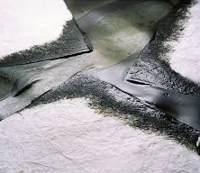
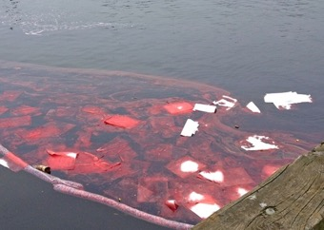
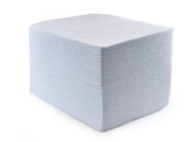
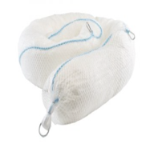
Sorbents
High Absorbency: Sorbents are materials designed to absorb oils rapidly
Types: Common types include natural organic (e.g., peat moss, straw), inorganic (e.g., clay, volcanic ash), and synthetic (e.g., polypropylene)
Application: Typically used for final polishing of affected areas or small spills,
Disposal: Used sorbents require careful handling as they become hazardous waste,
Cost-Effectiveness: Generally cost-effective for small spills
Notes:
Sorbents absorb or adsorb oil and are most useful for small spills and final cleanup. Discuss disposal requirements and waste management considerations.

Slide 10
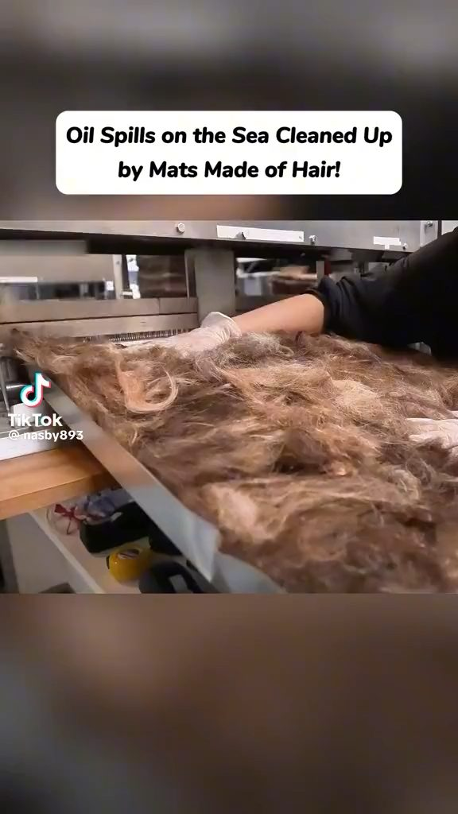
Notes:
Transition slide. Use this point to answer questions and move to the next section.

Slide 11
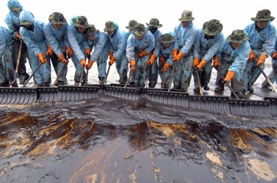
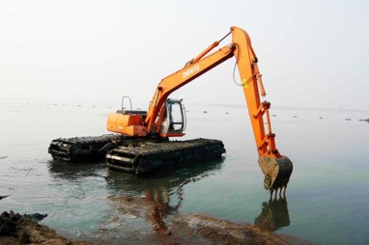
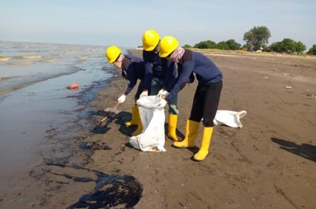
Mechanical + Manual Recovery
As people fatigue recovery of oil : sediment can increase
Needs to be monitored so that over sterilisation does not occur
Used on shoreline areas with good accessibility
Notes:
Manual recovery is often used on shorelines where access is good. Emphasise workforce management, fatigue, and avoiding unnecessary disturbance of shoreline habitats.

Slide 12
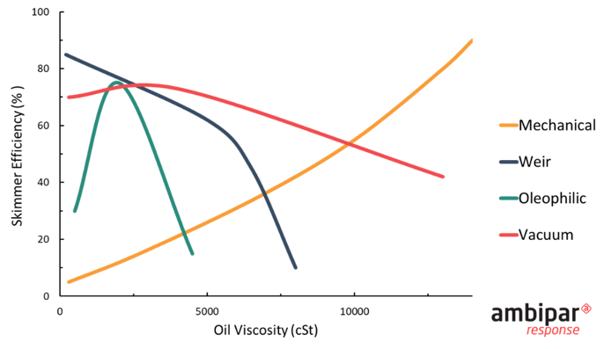
Oil Thickness Vs Skimmer functionality
Notes:
Explain the relationship between oil layer thickness and skimmer effectiveness. Different technologies perform better under different conditions.

Slide 13
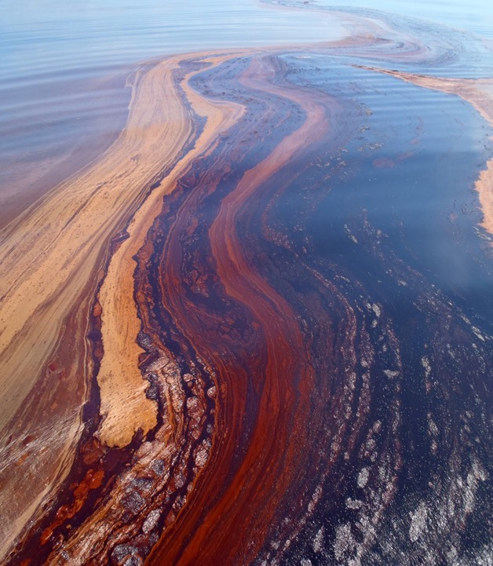
Which is the best skimmer?
It depends on your scenario . . .
Notes:
There is no single best skimmer. Selection depends on oil type, sea state, debris levels, accessibility, available resources and response objectives.

