Slide 1
Introduction of ReportGenerator

Slide 2
outline
Input files
Output files
How to execute
How to get the tool

Slide 3
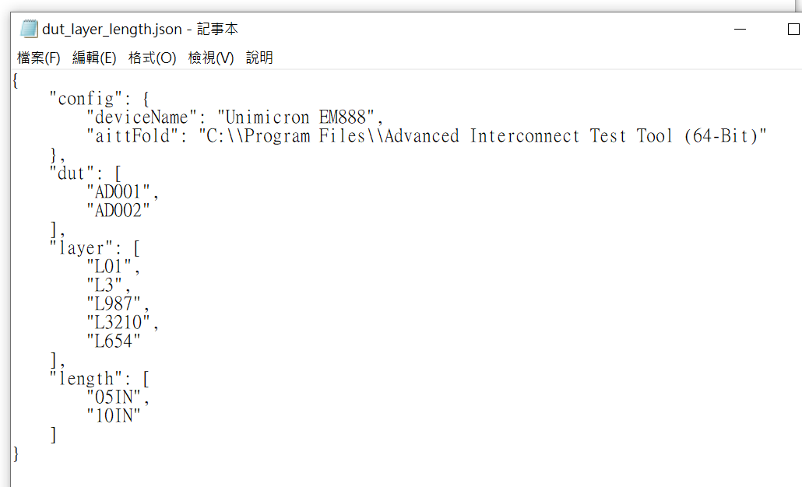
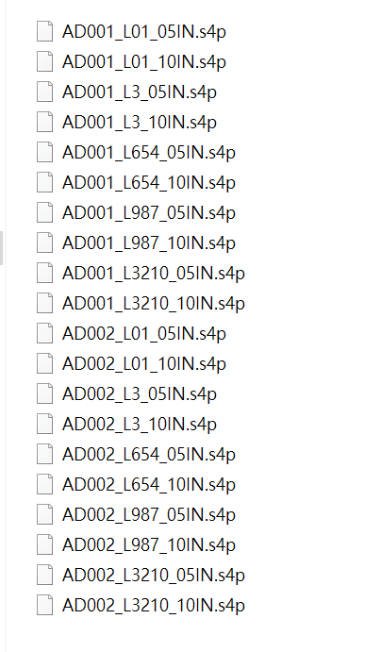
Input files
dut_layer_length.json
Format in json
Reference: https://en.wikipedia.org/wiki/JSON
Input_s4p
This the folder which is used to put .s4p raw data
.s4p raw data must be the combination of
{dut, layer, length} in dut_layer_length.json

Slide 4
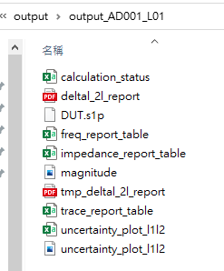
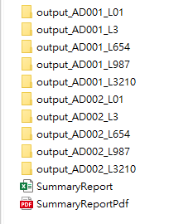
Output folder
The result would be generated to output folder including
Per dut_layer folder
summaryReport.xls
SummaryReportPdf

Slide 5
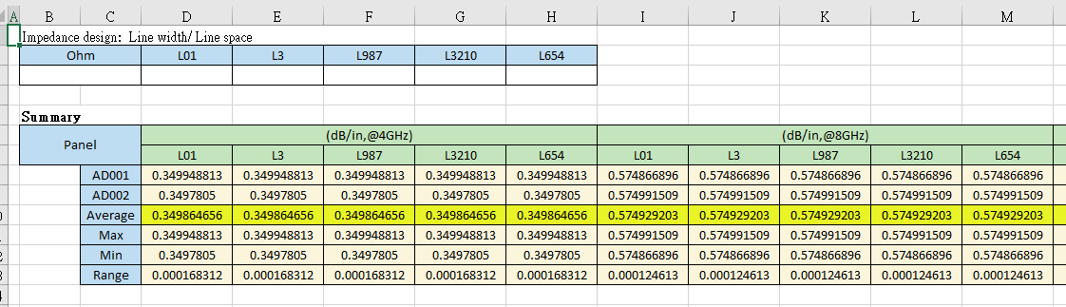
Summary.xls
Include many sheets
Summary, Data, Picture, and Layers
Fig. Summary for different freq. and layers

Slide 6
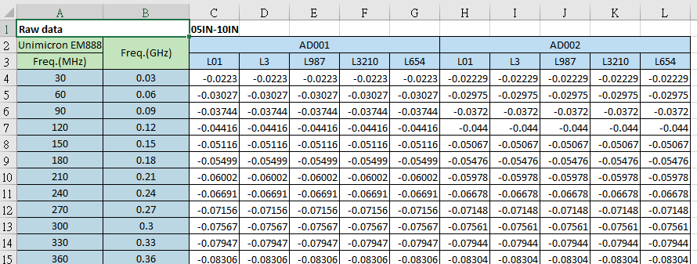
Summary.xls
Include many sheets
Summary, Data, Picture, and Layers
Fig. freq table

Slide 7
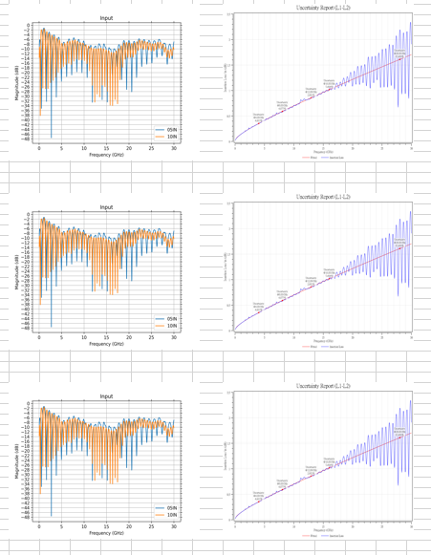
Summary.xls
Include many sheets
Summary, Data, Picture, and Layers
Fig. pictures collection

Slide 8
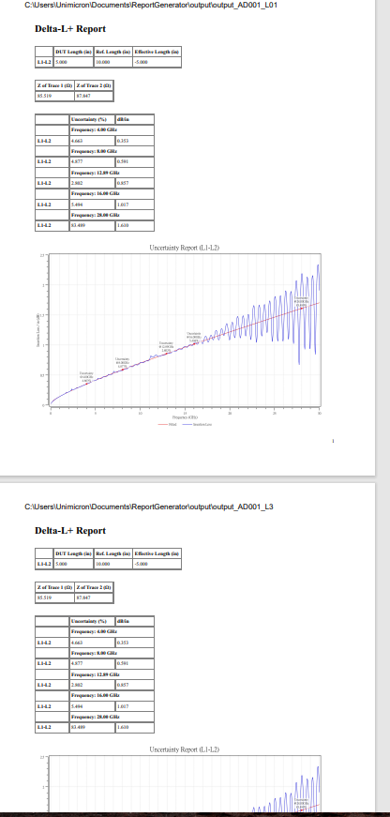
SummaryReportPdf

Slide 9
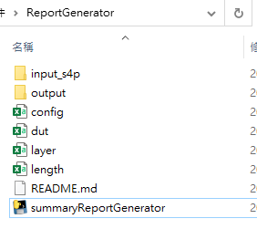
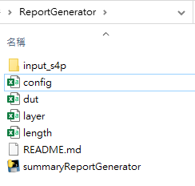
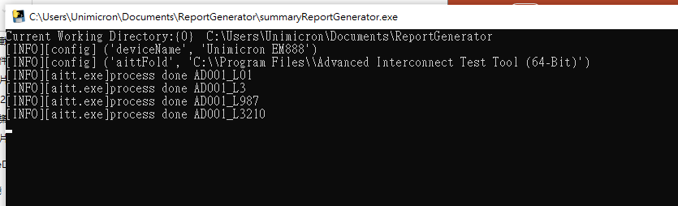
How to execute
Directly double click on “summaryReportGenerator.exe”
Fig.1 before execute
Fig.2 after execute

Slide 10
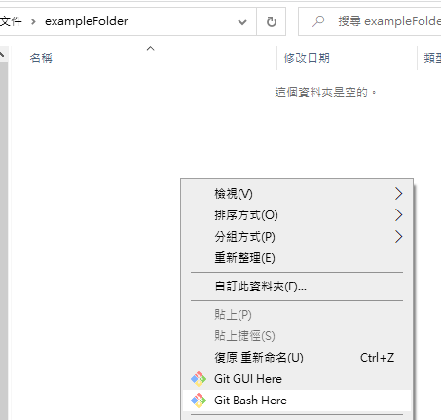
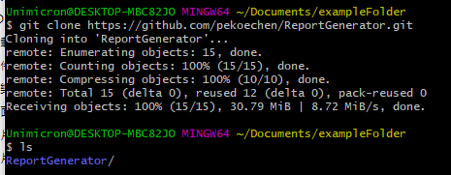
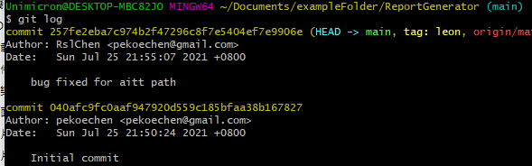
How to get the tool
1. down load and install git
2. open git bash in the target folder
3. execute “git clone https://github.com/pekoechen/ReportGenerator.git”
4. cd to ReportGenerator and execute” git log” to check version
Fig.1 git clone
Fig.2 git clone

