Slide 1


— SDC 2026 · HANDS OFF OUR RIGHTS
Future Skills
Find your place in IT

Slide 2
— MEET DANIEL
Daniel, fresh IT graduate
“Which part of IT is for me?”
He has the degree. He doesn't have the answer.
Future Skills
2
Notes:
Daniel is a fictional fresh IT graduate who has all three problems on the next slide.

Slide 3
— PROBLEM
Problem
1
2
3
Doesn't know which IT field suits him
School can't guide every student 1‑to‑1
Career apps are boring
Future Skills
3
Notes:
1. IT students don't know which field fits them.
2. Schools lack the people to get to know each student from zero; it takes time.
3. Apps on the market have boring UI.

Slide 4
— PROBLEM
The numbers
30%
[R3] RESEARCH NEEDED
66%
1 : ___
of university students switch major within 3 years
of graduates aged 24 and under work below their skills
school counsellors to students
Source: NCES (US), 2017
Source: DOSM Graduates Statistics 2024
Future Skills
4
Notes:
30%: NCES Data Point 2018-434 (Dec 2017), US first-time undergraduates who declared a major (2012/14 BPS study). STEM majors: 35%.
66%: DOSM Graduates Statistics 2024 (released 31 Oct 2025): skill-related underemployment of graduates aged 24 and below is 66.0%. All employed graduates: 32.2% (about 1.6 million).
Note: 66% means jobs below their skills, not 'unsure of their field'.
RESEARCH NEEDED
[R3] Counsellor-to-student ratio in Malaysian schools or universities. Source + year.

Slide 5
— HOW IT WORKS
How it works
1
2
3
→
→
Interest
Skill Check
Learn
Find what you enjoy
Prove what you can do
Close the gaps
Future Skills
5

Slide 6
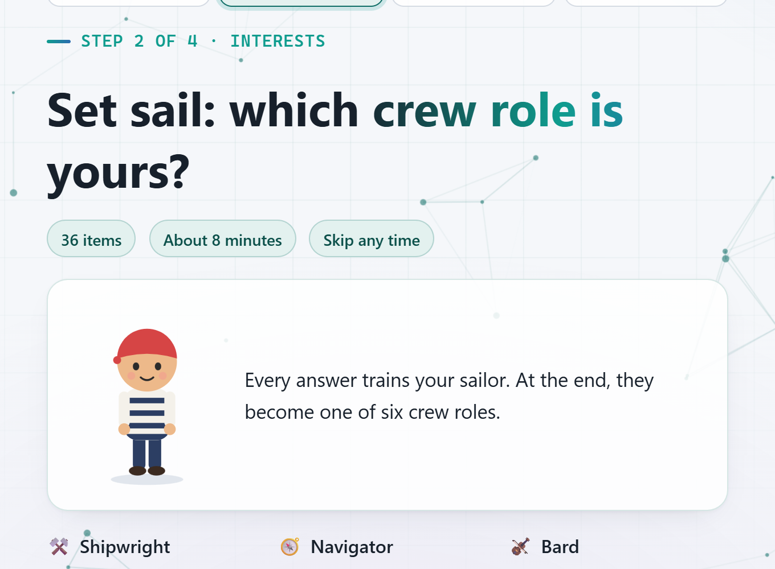
— 1 · INTEREST
Interest
36 questions. Your sailor grows with every answer.
Future Skills
6

Slide 7






— 1 · INTEREST
RIASEC
R
I
A
S
E
C
Realistic
Investigative
Artistic
Social
Enterprising
Conventional
Shipwright
Navigator
Bard
Ship's Doctor
Captain
Quartermaster
Future Skills
7
Notes:
Holland's six interest types; in the app each type is a crew role.

Slide 8
Why?
Future Skills
8
Notes:
RESEARCH NEEDED
[R5] Why RIASEC: who uses it (e.g. O*NET, US Department of Labor) and evidence that it predicts career fit or satisfaction. Source + year.

Slide 9
— 1 · INTEREST
6 types → 5 IT areas
R
Realistic
Software Engineering
I
Investigative
Data & AI
A
Artistic
→
Cybersecurity
S
Social
Cloud & Networking
E
Enterprising
C
Conventional
Web & Interface Design
Future Skills
9

Slide 10
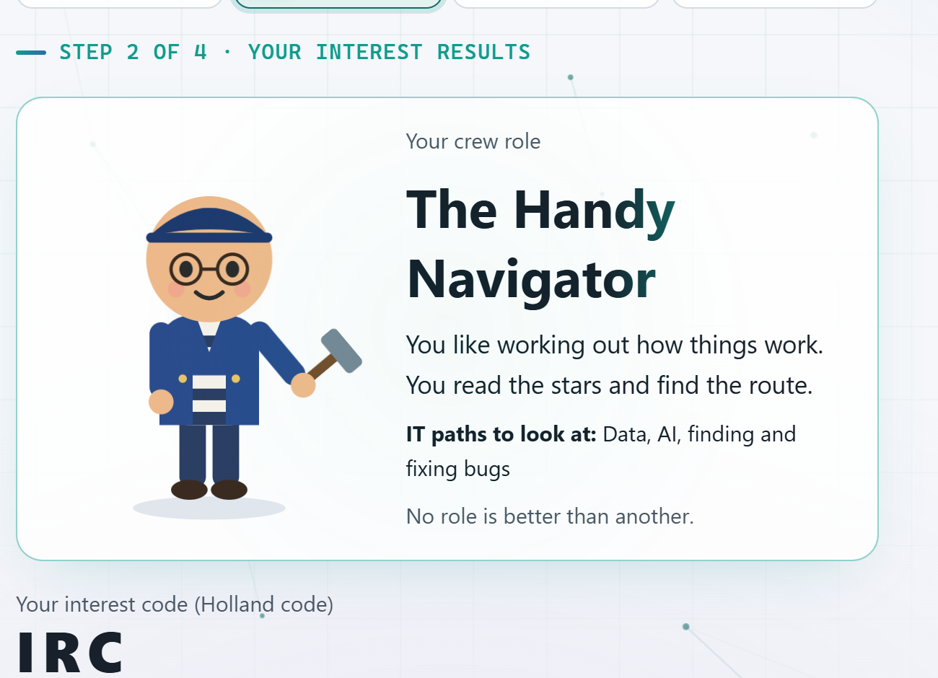
— 1 · INTEREST
Find what thrills you
Daniel is a Navigator: data, AI, fixing bugs.
Future Skills
10

Slide 11
— 2 · SKILL CHECK
Nobody wants 100 questions
Other tests
Future Skills
Every area,
every question
15–21
questions, only on the 3–5 areas you like
Future Skills
11
Notes:
RESEARCH NEEDED (optional)
[R6] Drop-off rate for long questionnaires or tests (e.g. completion falls after N questions). Source + year.

Slide 12
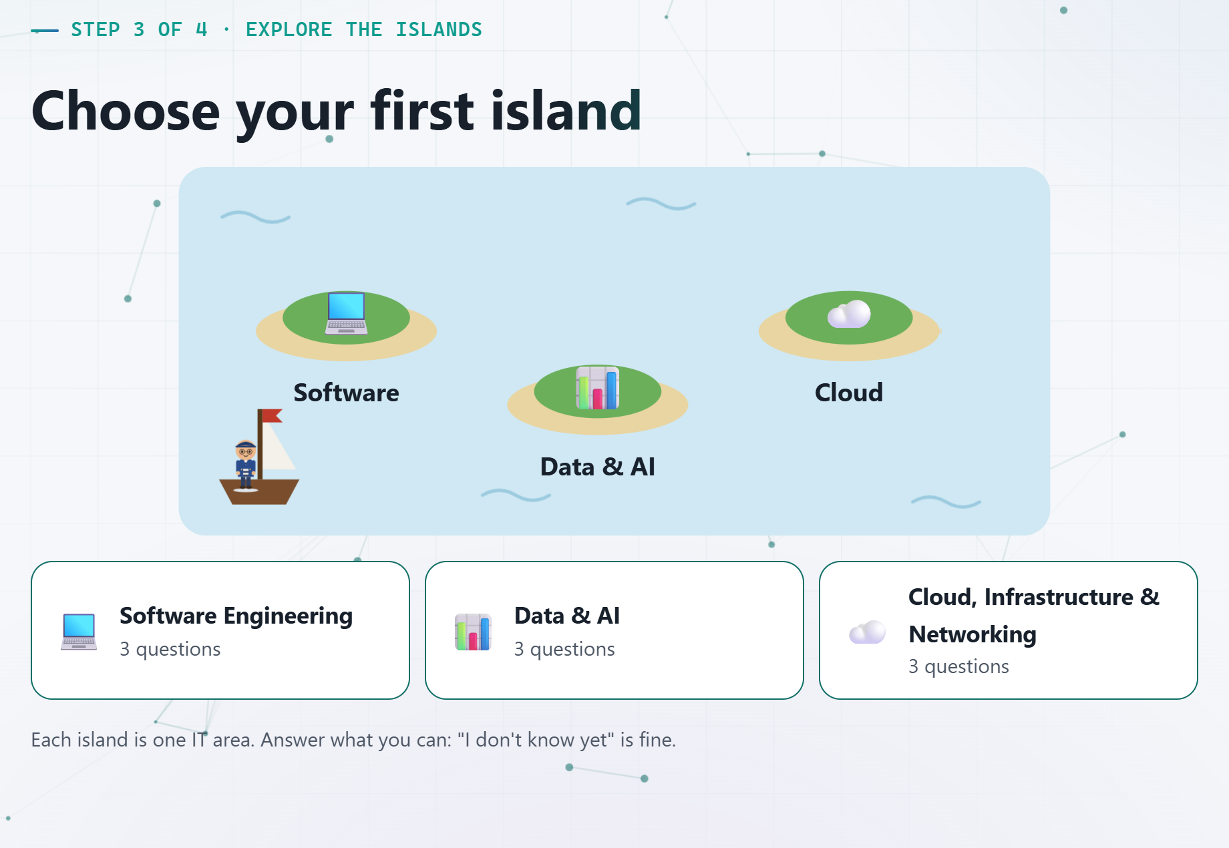
— 2 · SKILL CHECK
Skill Check
Liking it is not the same as being good at it.
Future Skills
12

Slide 13
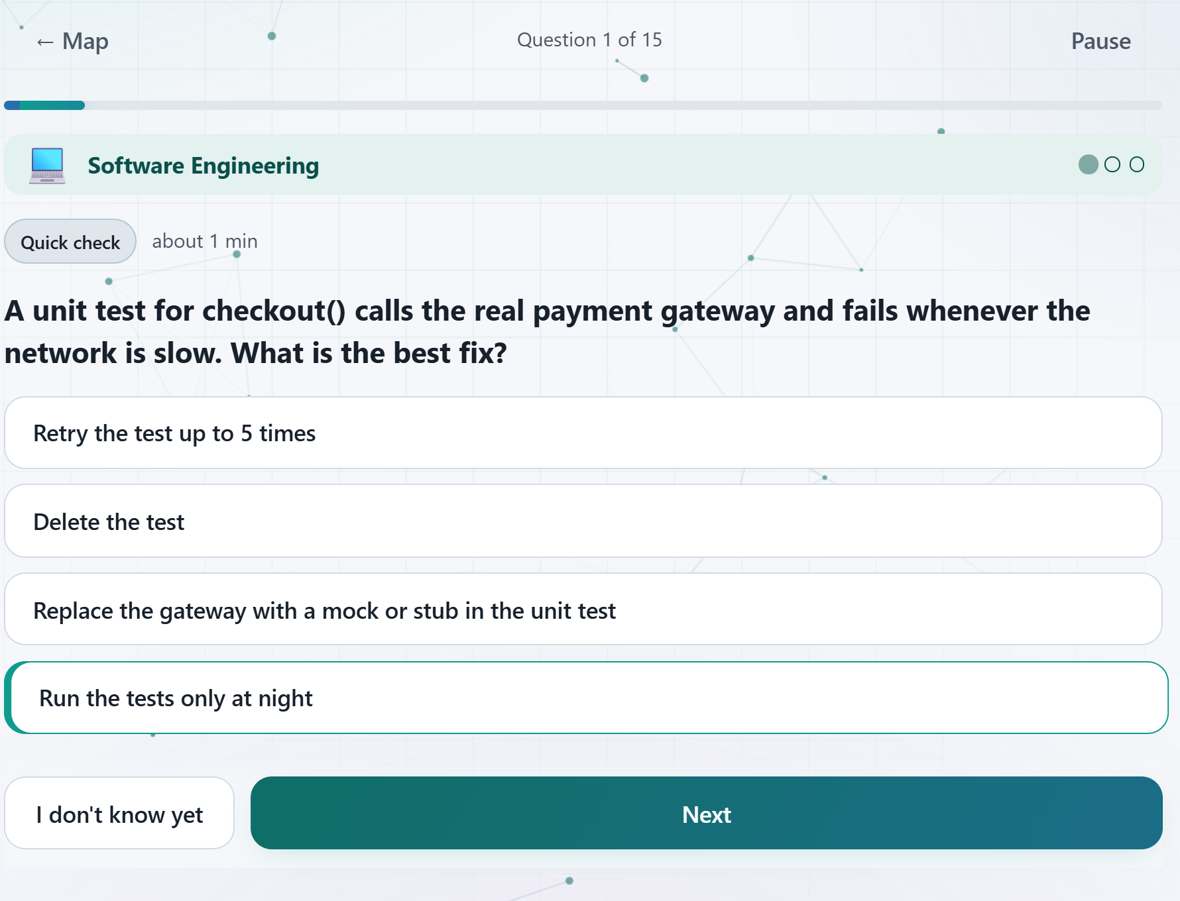
— 2 · SKILL CHECK
Test real skill in the field you love
Future Skills
13

Slide 14
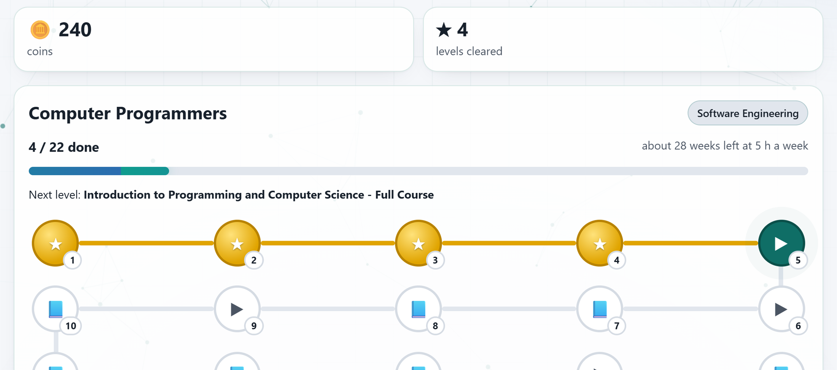
— GAMIFY
Gamify
Interest
Skill Check
Learn
Your sailor
Islands
Coins and levels
Future Skills
14

Slide 15
— GAMIFY
Games keep people going
85%
of teens play video games
Source: Pew Research Center, 2024
Gamified learning improves results and motivation. Source: Sailer & Homner, 2020 (meta-analysis)
Future Skills
15
Notes:
85%: Pew Research Center, 'Teens and Video Games Today' (May 2024), US teens 13-17, survey fielded Sep-Oct 2023; 41% play daily.
Sailer & Homner (2020), Educational Psychology Review 32: gamification has small positive effects on learning (g = .49), motivation (g = .36) and behaviour (g = .25).

Slide 16
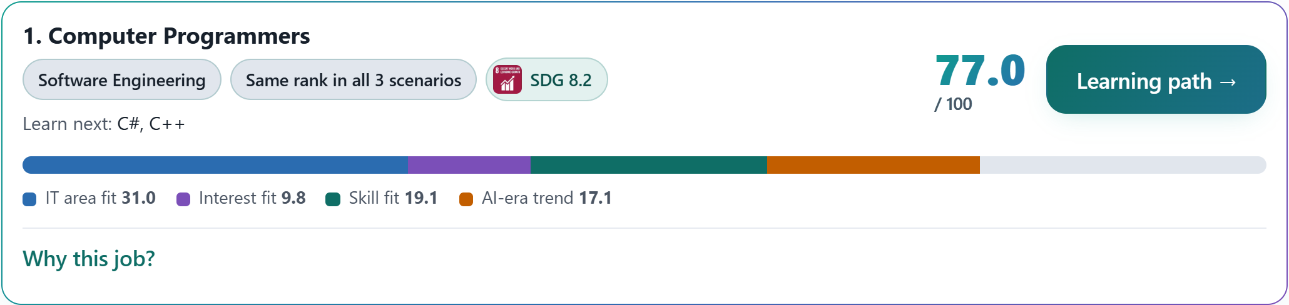
— RESULT
Then: your best-fit job
Every score explained: IT area, interest, skill, AI-era trend.
Future Skills
16

Slide 17
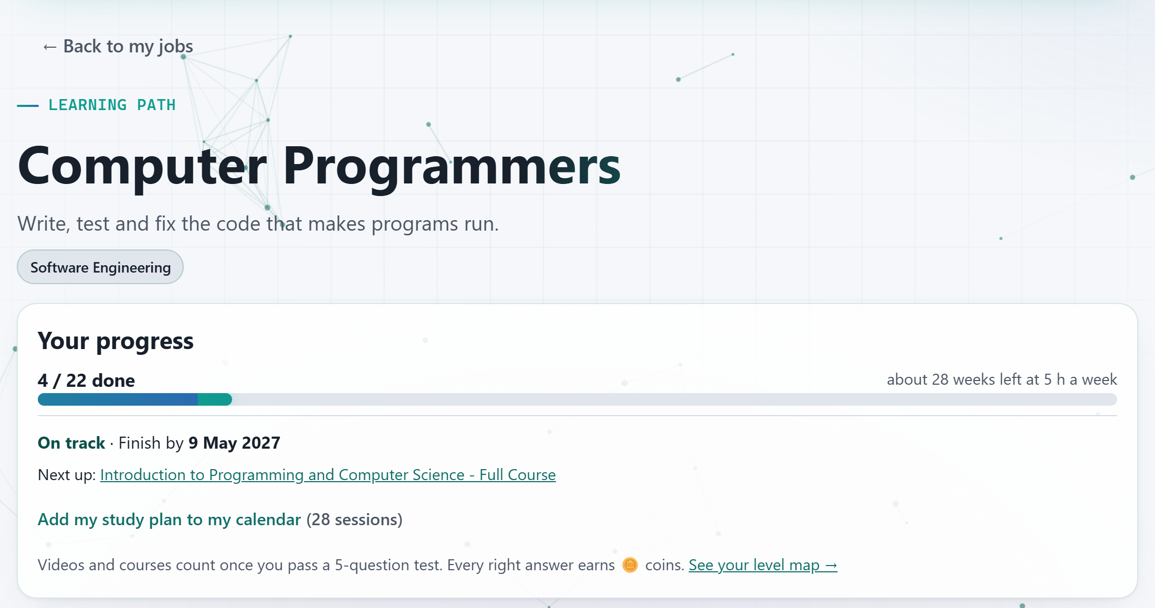
— 3 · LEARN
Keep studying
Your learning path: free courses, in order, with a finish date.
Future Skills
17

Slide 18
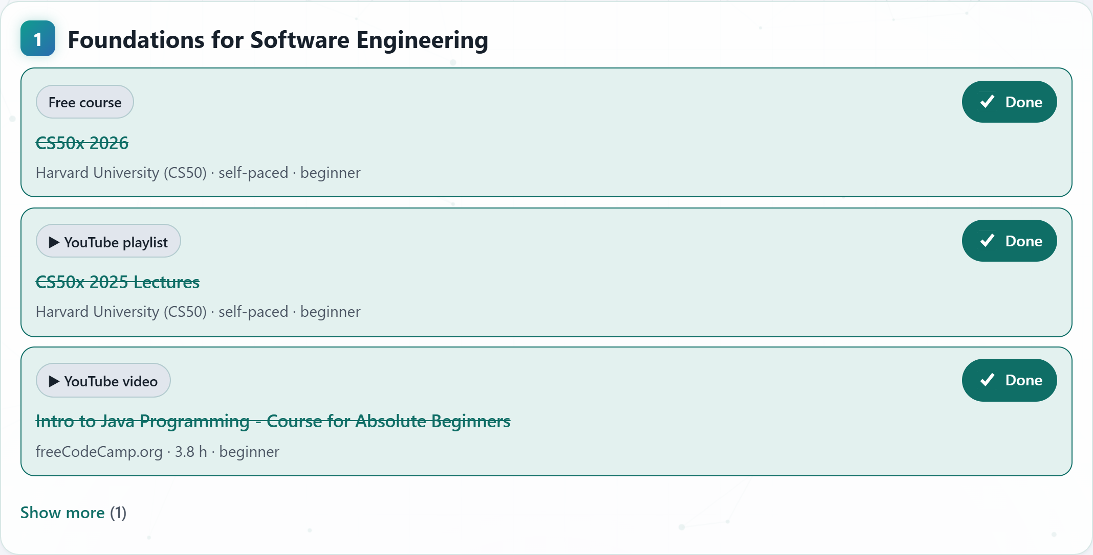
— 3 · LEARN
Future Skills
18

Slide 19
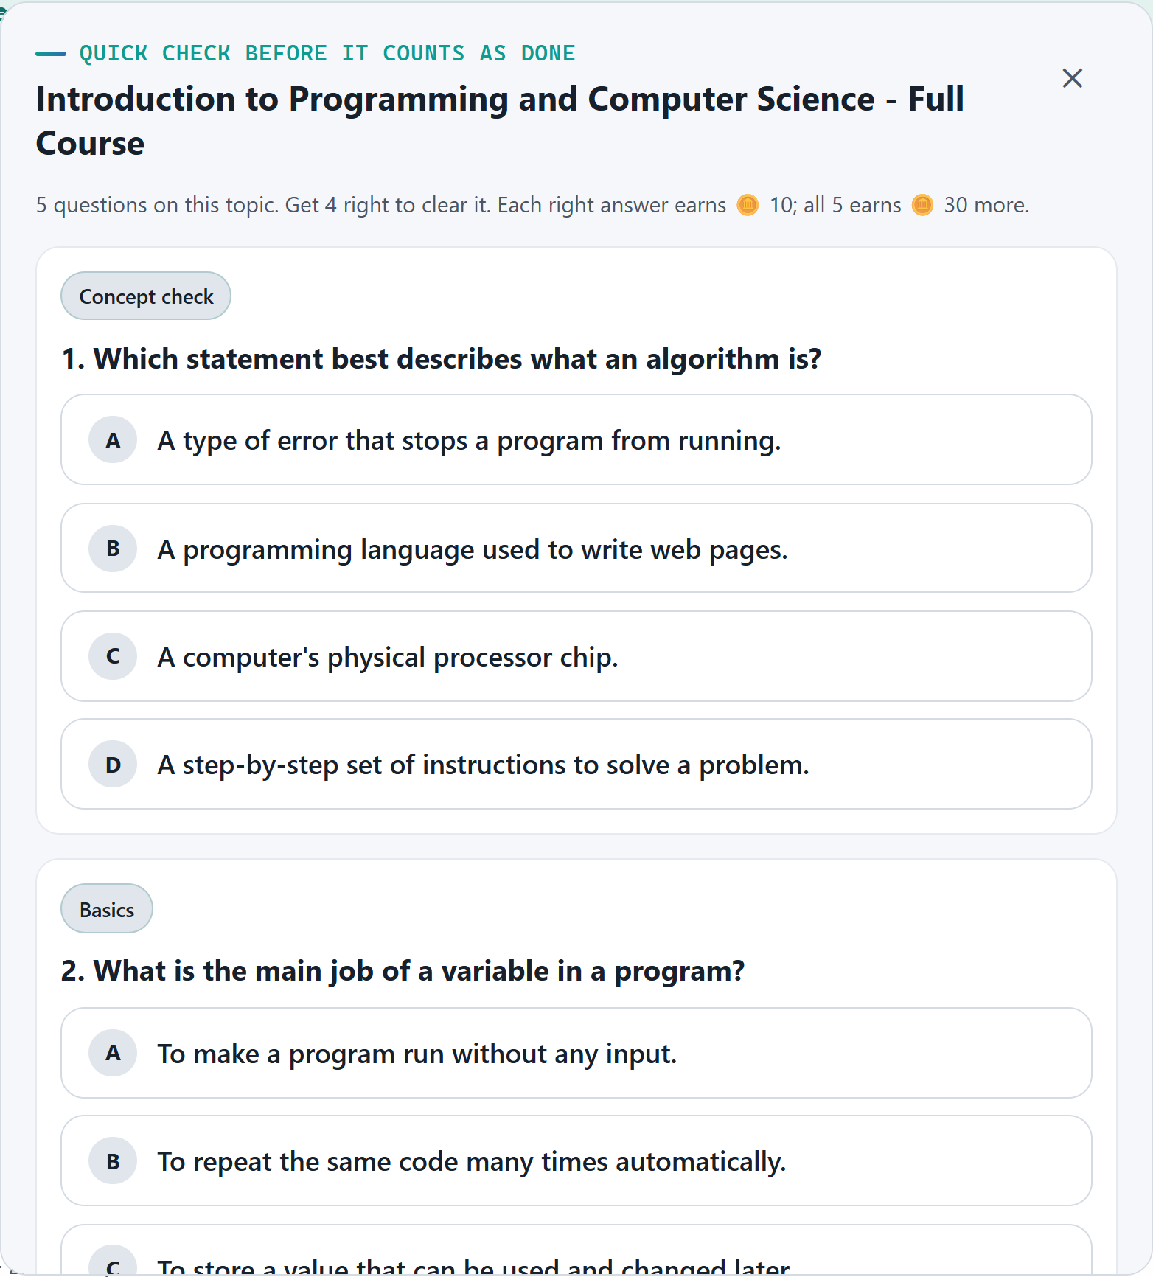
— 3 · LEARN
Future Skills
19

Slide 20
— 3 · LEARN
Validation
4 / 5
right answers to clear each course
Future Skills
20

Slide 21
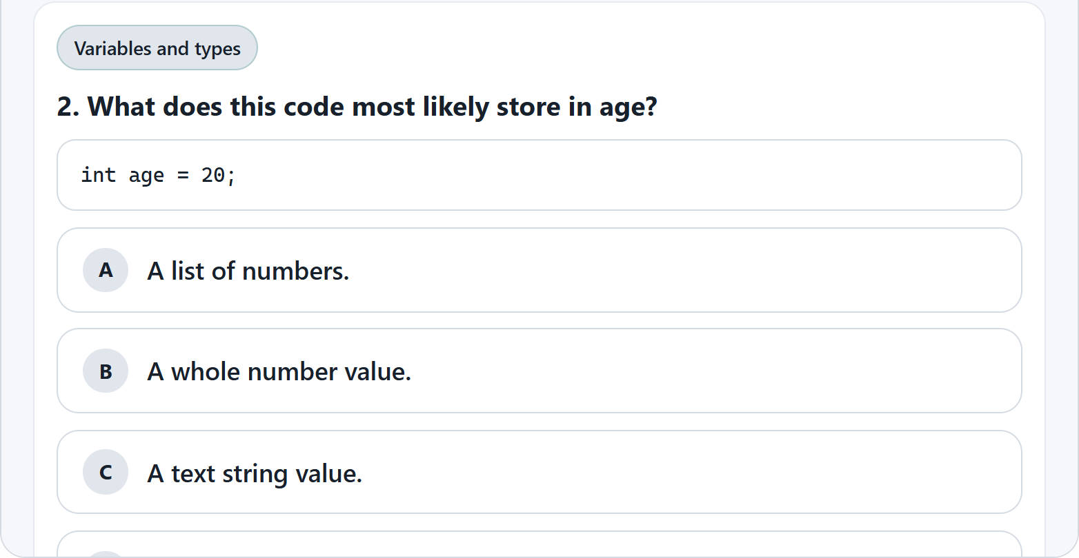
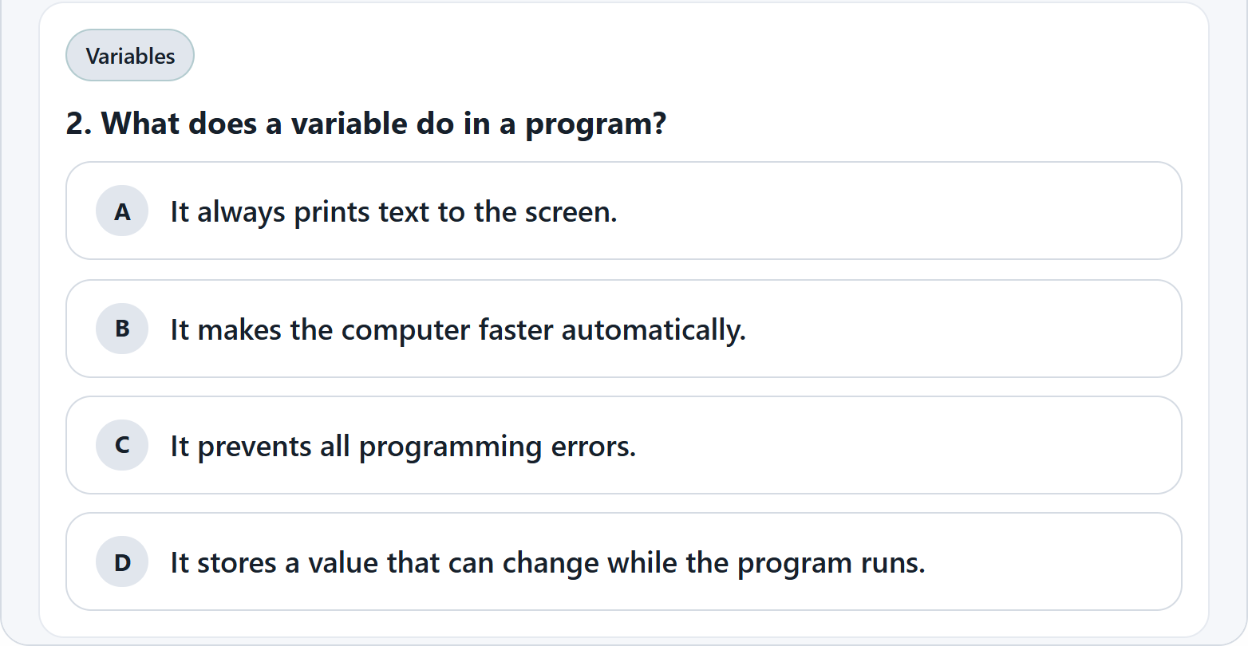
— 3 · LEARN
AI writes fresh questions
Try 1
Try 2
Future Skills
21
Notes:
Same course (CS50x 2026), opened twice: question 2 of each try. Each try asks the AI for a new set of 5. If the AI call fails, the app falls back to a fixed question set, which can repeat.

Slide 22
— BUSINESS MODEL
Schools pay us
SaaS → B2B
PRICE (OUR ESTIMATE)
RM 15 / student / year
High schools and universities
[R8] RESEARCH NEEDED
Connect 1 uni → reach all its students
1 uni × ____ IT students × RM 15 = RM ____ / year
Future Skills
22
Notes:
Price is our estimate: Xello, a US school career platform, charged about USD 3.60-4.95 per high-school student per year (2019-20 Pennsylvania consortium flyer). RM 15 is set lower for Malaysia. Confirm before pitching.
RESEARCH NEEDED
[R8] Number of IT / computing students in one typical Malaysian university, and number of universities. Source + year. Then fill in the yearly revenue per university.

Slide 23
— COMPETITORS
Why us
 | Finds your IT field | Checks real skill | Learning path | Game-like | EN · BM · 中文
Future Skills | ✓ | ✓ | ✓ | ✓ | ✓
MyNext (TalentCorp) | General careers | ✗ | [check] | ✗ | EN · BM
EduAdvisor | Course, not IT field | ✗ | ✗ | ✗ | [check]
roadmap.sh | ✗ | Quizzes | ✓ | ✗ | [check]
Sololearn | ✗ | ✓ | ✓ | ✓ | [check]
Future Skills
23
Notes:
Sources: mynext.my (RIASEC + OCEAN profiling, university dashboards); eduadvisor.my career planning workbook; roadmap.sh; Sololearn.
RESEARCH NEEDED
[R10] Check each [check] cell: MyNext learning paths; languages of EduAdvisor, roadmap.sh and Sololearn. Confirm Sololearn's skill checks and game features from its own site.

