Slide 1
Bioinformatics for biomedicine
Protein domains and 3D structure
Lecture 4, 2006-10-10
Per Kraulis
http://biomedicum.ut.ee/~kraulis

Slide 2
Course design
What is bioinformatics? Basic databases and tools
Sequence searches: BLAST, FASTA
Multiple alignments, phylogenetic trees
Protein domains and 3D structure
Seminar: Sequence analysis of a favourite gene
Gene expression data, methods of analysis
Gene and protein annotation, Gene Ontology, pathways
Seminar: Further analysis of a favourite gene

Slide 3
Multiple alignment
Example: ras proteins
FASTA input file available at course site
http://www.ebi.ac.uk/Tools/sequence.html
  ClustalW, MUSCLE
http://msa.cgb.ki.se/cgi-bin/msa.cgi
  Kalign

Slide 4
Proteins and drug action
Most drugs act via proteins
  Binds to the protein
  Inhibits or activates it
“Drug targets”
  Small subset of all proteins
  Certain protein families
  3D structural basis

Slide 5
3D structure and protein function
‘Native’ state
  Functional state
  Well-defined 3D structure (usually)
  Folded state
Denaturing a protein inactivates it
  Heat, salt, solvents… (boiling an egg)
  Undefined 3D structure; a mess
  Unfolded state

Slide 6
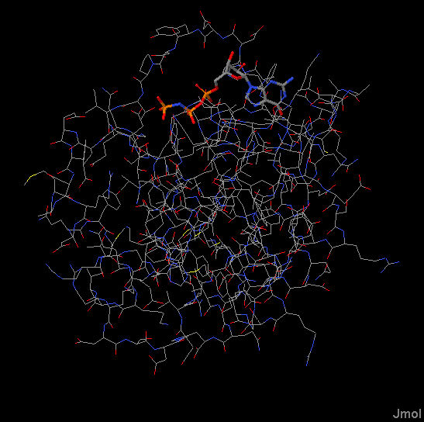
3D structures are complicated
1000’s of atoms
Hard to see anything
But: details essential for understanding

Slide 7
Levels of 3D structure
Primary
  Protein sequence
Secondary
  Alfa helix, beta sheet; hydrogen bonds
Tertiary
  Overall 3D structure; “fold”
Quaternary
  Complex between biomolecules

Slide 8
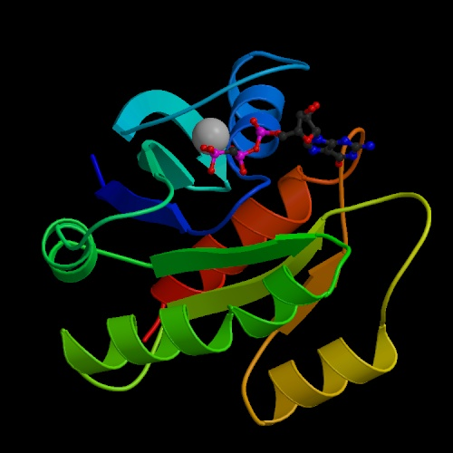
Simplified view of 3D structure
Schematic view
Peptide chain
Secondary structure
  Alfa helix
  Beta strands
Ligands
  Metal ions
  Cofactors
  Drugs

Slide 9
Structure database
PDB database
  3D coordinates for structures
    Protein, DNA, RNA, complexes
  Experimentally determined structures
At RCSB: http://www.rcsb.org/pdb/
Via UniProt: http://www.ebi.uniprot.org/
Many different 3D viewers…

Slide 10
Experimental determination
X-ray crystallography
  Atomic resolution
  Small and large molecules (ribosome)
NMR
  Small, soluble proteins
Electron microscopy
  Not atomic resolution
  Very large molecules/particles

Slide 11
X-ray crystallography 1
Requires protein crystal
  Size 0.1-1.0 mm
  Possibly with ligands, other proteins
  Optimize conditions (salt, solvents,…)
Recent technological advances
Structural Genomics Initiatives

Slide 12
X-ray crystallography 2
Quality?
Resolution
  How much data was available?
  Given in Ångström
    Good: 2.0 Å or less
    Bad: 3 Å or higher
Refinement
  How well do atomic coordinates agree with data?
  R-value
    Should be 20% or less

Slide 13
X-ray crystallography 3
Is crystal state relevant?
Short answer: Yes
  High solvent content; similar to cell plasma
  Comparisons indicate OK
But: occasional relevant differences
  Surface differences; loops
  Details of ligand binding

Slide 14
Protein structure and prediction
Secondary structure prediction
  Typically 70-80% accurate
  Not as good as it sounds
  Always use experimentally derived data, when available
3D structure modelling
  Based on known structure: predict similar
  OK when sequence >90 % similar
  Depends, when 50-90% similar
  Problematic, when <50% similar

Slide 15
The folding problem 1
3D structure encoded in protein sequence
  Anfinsen 1960s
  Small proteins refold spontaneously
  Synthetic peptides fold
    Activity as for ‘natural’ protein
Assisted folding does not change this
  Chaperones: catalysts for folding
  Needed in cell environment (thick soup)

Slide 16
The folding problem 2
Physics
Denatured protein
Native protein
Prediction
Protein sequence
3D structure
Protein sequence determines 3D structure
3D structure should be predictable
But: notoriously hard (unsolved) problem

Slide 17
Protein domains 1
Proteins appear to be modular
3D structure: pearls on a string
Sequence: partial sequence similarity

Slide 18
Protein domains 2
Proteins are modular
  Particularly in eukaryotes
A part of sequence as a unit
The units are called domains
  Partial gene duplication
Domain families
  Proteins containing a particular domain

Slide 19
Protein domains 3
Sequence-based domain definitions
Pfam http://www.sanger.ac.uk/Software/Pfam/
  Based on Hidden Markov Models (HMMs)
    Statistical method to detect patterns
    Sensitive
Other domain databases
  Structural: CATH http://www.cathdb.info/

Slide 20
Protein domains 4
Domains from structure or sequence?
  Usually very similar results
  But some differences
    Sequence region inserted
    Structure formed from different parts of sequence

Slide 21
Protein families in medicine
“Druggable” proteins
Contains domains known to bind drugs
  Small subset of proteins
Usually: binds small molecules naturally
  Enzymes
  Receptors
Protein-protein interactions very difficult
  Much work, few results

Slide 22
Example: Nuclear receptors
Transcription factors
  3D structures available for several
Small-molecule ligands
  Estrogen, progesteron,…
Androgen receptor
  ANDR_HUMAN, P10275
Several drugs
  Tamoxifen

Slide 23
Example: 7TM receptors
7TM = Seven transmembrane helices
Receptors
  CNS, other systems
Maybe 50% of drugs act on these
Integral membrane protein
  Very hard for X-ray crystallography
  No good 3D structure!

Slide 24
7TM: rhodopsin
Light detector protein in eye
3D structure determined!
Serves as model for other 7TM proteins
  Known to be very approximate
UniProt: OPSD_BOVIN, P02699
  Retinal ligand shows binding pocket
  In some 7TM proteins: different binding site

Slide 25
Example: protein kinases
Regulatory proteins, signalling
  Cancer
Much recent work
  Few drugs on market, yet
Drug design strategy
  Compete with ATP in its pocket
  Specificity?
UniProt: ABL1_HUMAN,P00519
  PDB: 2F4J

