Slide 1
The bioinformatics of biological processes
The challenge of temporal data
Per J. Kraulis
CMCM, Tartu University

Slide 2
What is bioinformatics?
“Information technology applied to the management and analysis of biological data”
  Attwood & Parry-Smith 1999
“Collection, archiving, organization and interpretation of biological data”
  Thornton 2003

Slide 3
“Classical” bioinformatics
Sequences
  Nucleotide
  Protein
3D structure
  Protein

Slide 4
Classical bioinformatics
Handling, storage
  SwissProt, Ensembl, PDB, etc
Analysis
  BLAST, FASTA
  Patterns, HMMs…
  Many other methods…

Slide 5
Thus far: Static structures
Structural: sequence, 3D coordinates
Static: time is not involved
Easier to work with?
  Experimentally
  Conceptually?

Slide 6
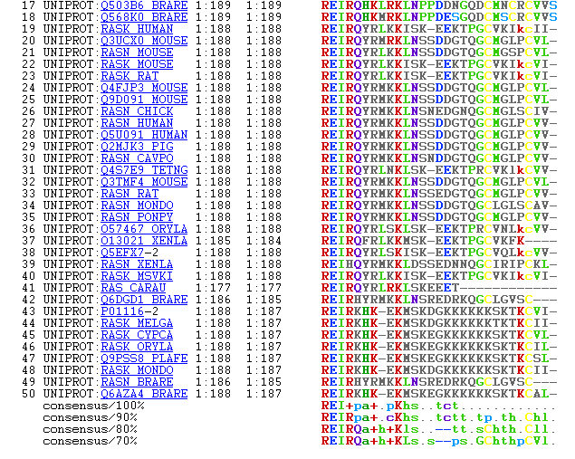
Sequence analysis

Slide 7
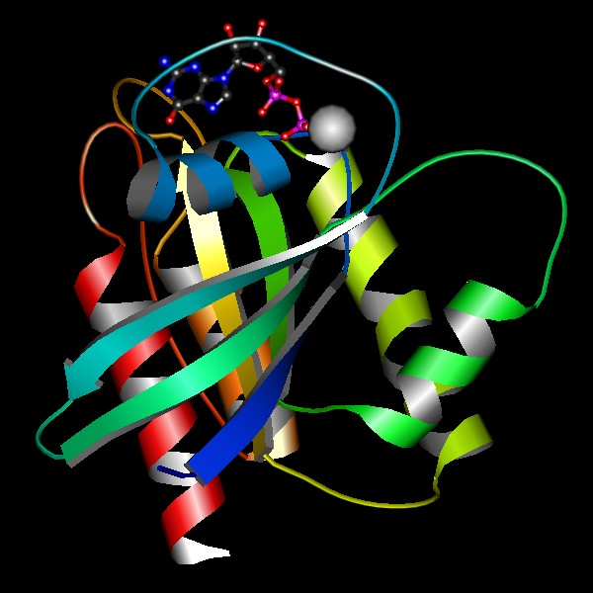
MolScript: Per Kraulis 1991, 1997

Slide 8
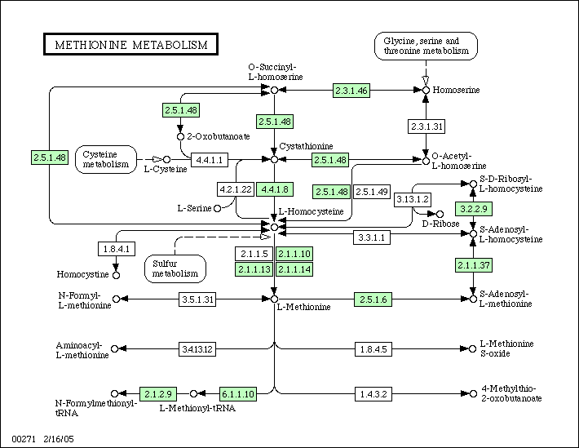
KEGG: Kanehisa 2004

Slide 9
Functional genomics
The function of genes
  Catalytic activity
  Biological function
  Biological process
Links between genes/proteins
  Pathways (metabolic, signaling)
  Genetic relationships

Slide 10
Gene Ontology
Annotation
  Statement of properties
  Keyword/phrases, controlled vocabulary
  Comparison, analysis
Ontology
  Activity; chemical
  Localization; spatial
  Process; functional

Slide 11
Biology is temporal
Processes are inherently temporal
  Narrative descriptions in lit
  Gene expression time series
  Embryonal development (FunGenes!)
The goals of biological processes
  Cell cycle: produce another cell

Slide 12
But: No temporal databases?!
't' viewed as an essential parameter
Temporal relationships
Searches
  During
  Before
  After

Slide 13
Computable temporal data
Database needed
Appropriate data model
  Events during a process
  Context, preconditions
  Temporal relationships
  Duration
  Property = f(t)

Slide 14
"Can computers help to explain biology?"
Like information in Geographical Information Systems, which also have a limited vocabulary, biological narratives of cause and effect are readily systematizable by computers.
Happily, there is considerable interest in wanting to build one element of biological semantics — the passage of time — into information theory.
[This] might help biologists to go beyond quantifying reaction rates and molecular species of biological systems to understand their dynamic behaviour.
R. Brent & J. Bruck, Nature (440) 23 March 2006, 416-417

Slide 15
Work in other fields
Geographical Information Science, GIS
Artificial Intelligence
  Knowledge Representation
  Temporal Logic
  Automated planning, scheduling
Temporal databases
Project management

Slide 16
Knowledge representation I
Logic: Formal rules of inference
Ontology: The types of entities
Computation: Automated analysis
Sowa 2000

Slide 17
Knowledge representation II
Artificial Intelligence, AI
  Reasoning
  Planning, scheduling
Philosophy: Aristotle, Kant, Peirce, Whitehead…
Holy grail: Well-structured and natural
Fundamental for data model
  EcoCyc
  Gene Ontology (GO)

Slide 18
Knowledge Representation
Philosophy
  Ontology: what exists
  Logic
Artificial Intelligence, AI
  Database design
  Reasoning systems
  Planning, scheduling

Slide 19
Allen's temporal relationships
before
meets
overlaps
starts
during
finishes
equals

Slide 20
Temporal data in GIS
Galton’s distinctions

Slide 21
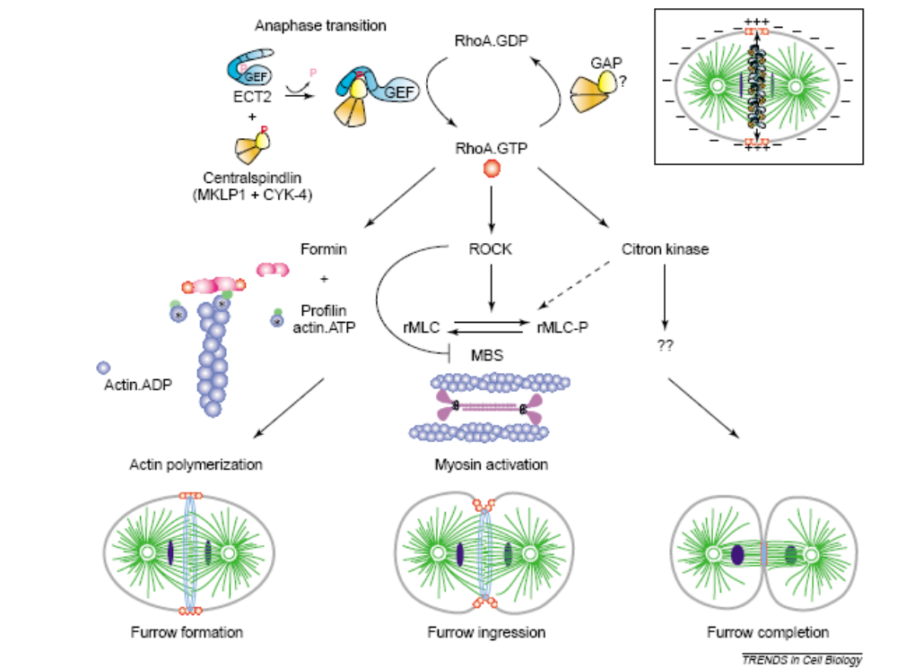
Cytokinesis: Rho regulation
Piekny, Werner, Glotzer 2005

Slide 22
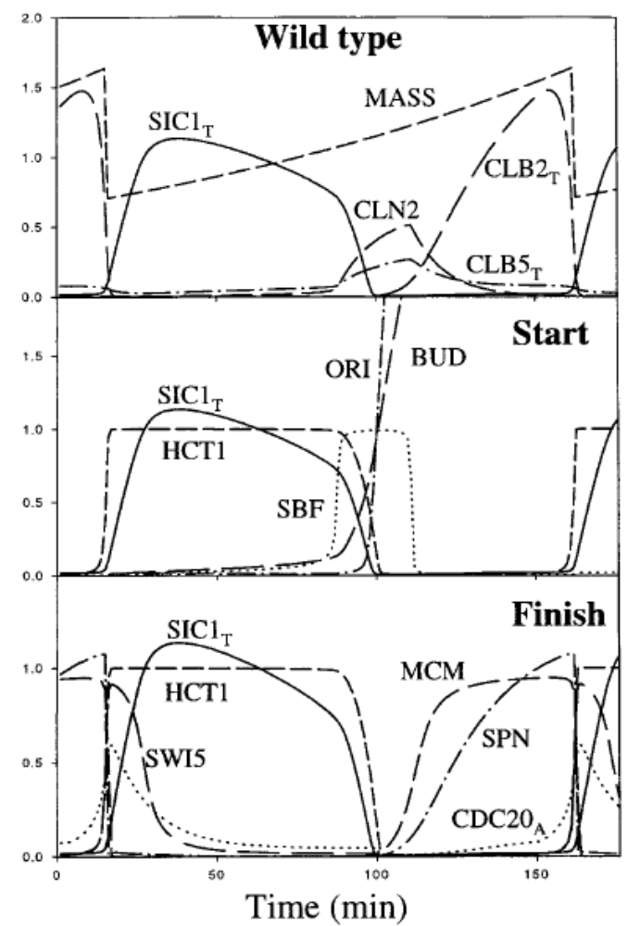
Kinetic analysis of budding yeast cell cycle: Chen et al 2000

Slide 23
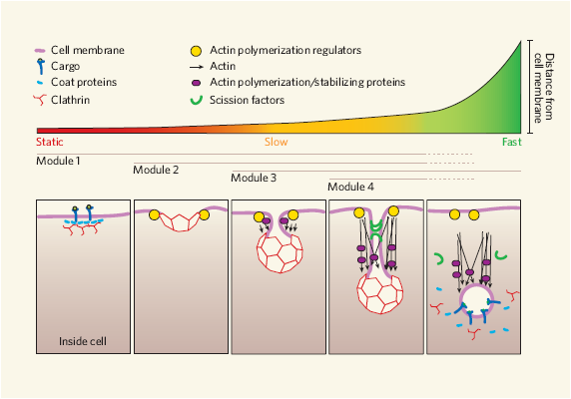
Endocytic vesicle formation
Duncan & Payne 2005

Slide 24
Computable information
Free text
Unwritten
Keyword/value data
Annotated text
Ontology
Relational DB
Petri Net, logic
Statecharts, UML
Simulation
Diff equ model
Notes:
Systems biology can't be puritanical if it is to be useful. Currently, there is a feeling that one must have a full-blown simulation model (diff equ, or maybe even stochastic) to be serious about Systems biology. My point is that systems biology absolutely requires computable information as a basis. This basis can be useful before we reach the simulation stage. And it is a continuum. GeneCV and my suggestion about viewing macroscopic biology as a project aim to become one part of this continuum.

Slide 25
Design issues
Main entities:
  Continuant (thing, object)
  Occurrent (event, process, happening)

Slide 26
BioChronicle
Handle temporal biological information
  Events, subevents
  Relationships
  Duration
  Property values
  Preconditions, context
Database
Test case: Cell cycle

