Slide 1
Bioinformatics beyond sequences
Knowledge representation and analysis of biological data
Per J. Kraulis

Slide 2
What is bioinformatics?
“Information technology applied to the management and analysis of biological data”
  Attwood & Parry-Smith 1999
“Collection, archiving, organization and interpretation of biological data”
  Thornton 2003

Slide 3
Sequence databases
ID RASH_HUMAN STANDARD; PRT; 189 AA.
AC P01112; Q14080; Q6FHV9;
DT 21-JUL-1986, integrated into UniProtKB/Swiss-Prot.
DT 21-JUL-1986, sequence version 1.
DT 07-MAR-2006, entry version 77.
DE GTPase HRas precursor (Transforming protein p21) (p21ras) (H-Ras-1)
DE (c-H-ras).
GN Name=HRAS; Synonyms=HRAS1;
OS Homo sapiens (Human).
CC -!- FUNCTION: Ras proteins bind GDP/GTP and possess intrinsic GTPase
CC activity.
CC -!- ENZYME REGULATION: Alternate between an inactive form bound to GDP
CC and an active form bound to GTP. Activated by a guanine
CC nucleotide-exchange factor (GEF) and inactivated by a GTPase-
CC activating protein (GAP).
SQ SEQUENCE 189 AA; 21298 MW; EE6DC2D933E2856A CRC64;
MTEYKLVVVG AGGVGKSALT IQLIQNHFVD EYDPTIEDSY RKQVVIDGET CLLDILDTAG
QEEYSAMRDQ YMRTGEGFLC VFAINNTKSF EDIHQYREQI KRVKDSDDVP MVLVGNKCDL
AARTVESRQA QDLARSYGIP YIETSAKTRQ GVEDAFYTLV REIRQHKLRK LNPPDESGPG
CMSCKCVLS
//

Slide 4
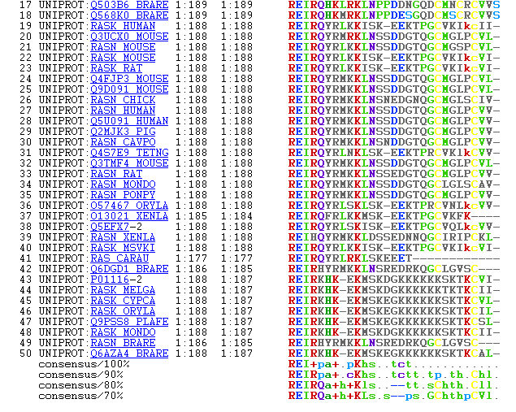
Sequence analysis

Slide 5
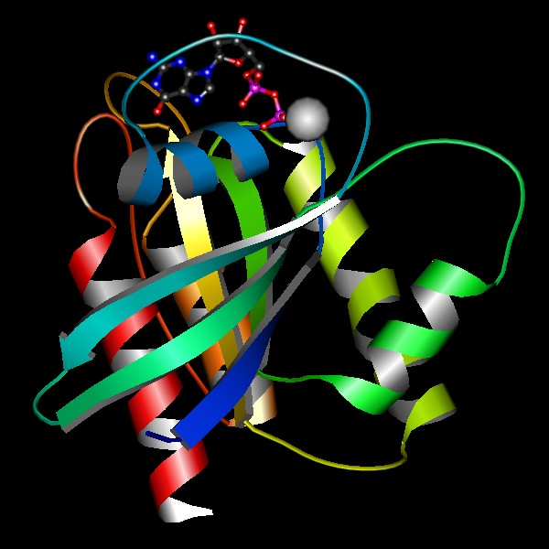
MolScript: Per Kraulis 1991, 1997

Slide 6
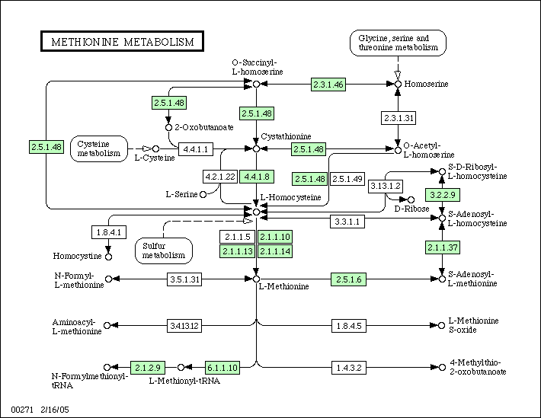
KEGG: Kanehisa 2004

Slide 7
Knowledge Representation (KR)
Biomedicine: "Difficult" data
  Different scales (molecules … organisms)
  Complexity: objects, relations
Usage should govern representation
  Searching: find relevant info
  Analysis: e.g. comparison
  Computation: simulation

Slide 8
Project 1:
Improved data model for pathways
Molecular states
Complexes
Locations
Events
Hierarchy; levels of detail

Slide 9
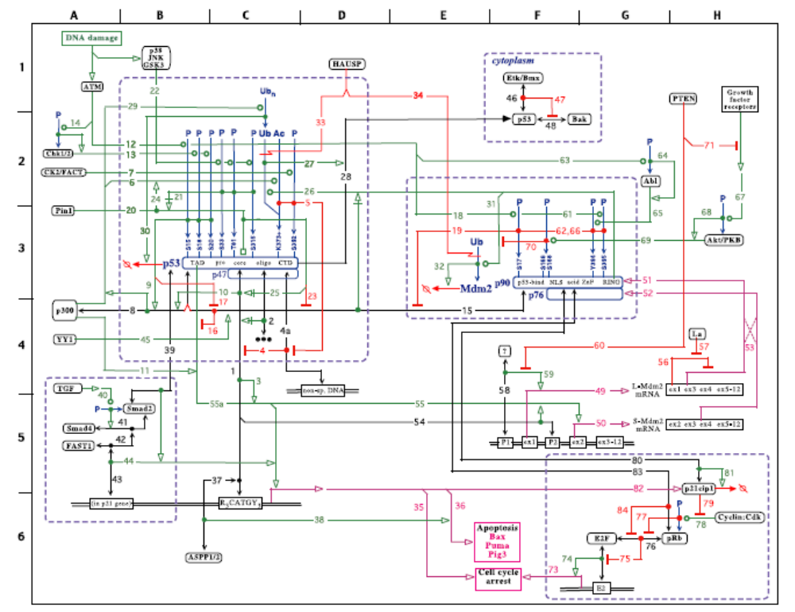
p53 and Mdm2 interactions: Kohn & Pommier 2005

Slide 10
Statecharts
David Harel, 1987
State-transition diagrams, extended with
  Hierarchy
  Orthogonality
  Communication
For reactive systems
  Event-driven
  Stimuli; external and internal

Slide 11
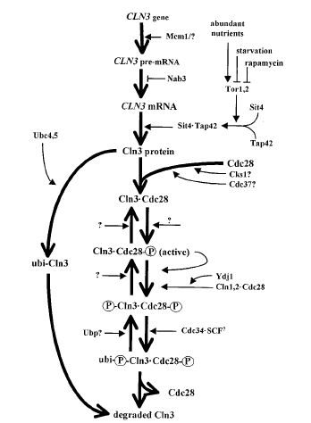
GeneCV
The life of a biomolecule
Objects
  Gene
  Protein
  Complexes
  Locations
Events
  Creation
  Destruction
  Regulation
  Transport
  Interaction
Statecharts
Mendenhall & Hodge 1998

Slide 12
Project 2:
Data model for biological processes
Temporal data
Events
Activities
Trajectories of parameters (levels)
Temporal relationships (before, after…)
General; allow different scales

Slide 13
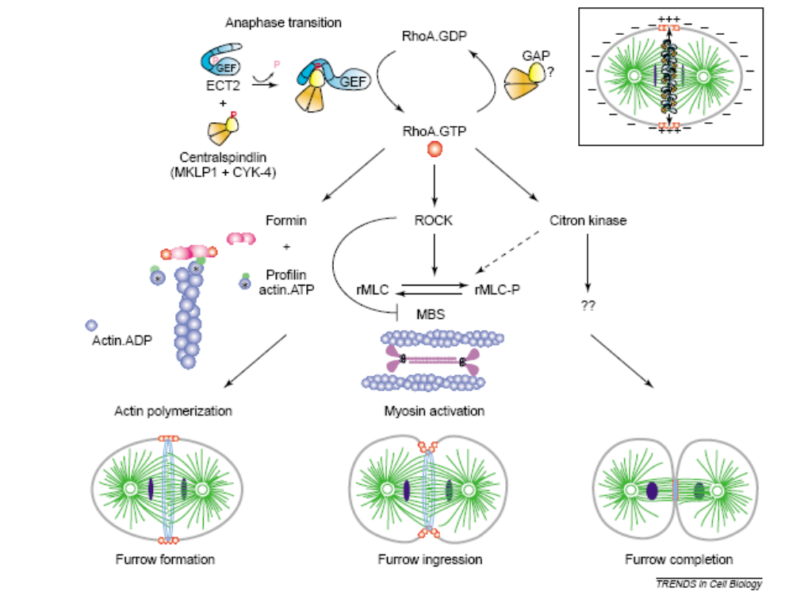
Cytokinesis: Rho regulation
Piekny, Werner, Glotzer 2005

Slide 14
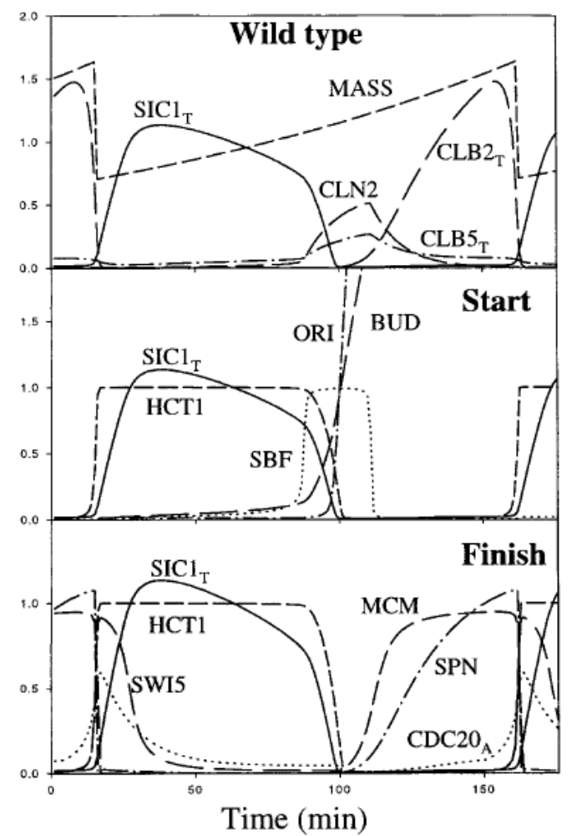
Kinetic analysis of budding yeast cell cycle: Chen et al 2000

Slide 15
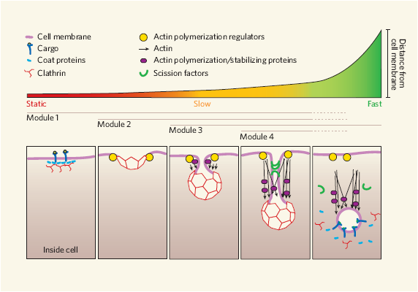
Endocytic vesicle formation
Duncan & Payne 2005

Slide 16
The Chronicle system
Temporal database
Macroscopic systems
  Cells
  Signaling cascades
  In vivo studies
Inspired by Geographical Information Systems (GIS) research
Prototype: Sara Eriksson, Biovitrum

