Slide 1
GeneCV
  Knowledge Representation of Molecular Events in Cellular Pathways
Per Kraulis

Slide 2
Biological processes
Examples:
  Pathways
  Signaling
  Cell cycle
  Growth of an organism
  Response of a system to perturbations
Currently, no standard DB design
Several new ideas, initiatives…

Slide 3
Biological complexity
Biological data are inherently complex
More complex than physics, astronomy
Several different sources of complexity
Data handling: difficult, serious problem

Slide 4
Levels of abstraction
Molecular structures
Polymers (DNA, protein)
Features: genes, domains,…
Complexes
Cells, compartments
Tissues, and so on…
→ Makes data modelling hard

Slide 5
No law without an exception
There are very few biological natural laws
Most proper laws from physics, chemistry
Many common mechanisms and structures
But, always an exception somewhere
→ Makes data modelling hard

Slide 6
Knowledge Representation
Ontology
  What exists: entities, objects, items
  What relationships: associations, relations
Important tools:
  Is-a relationships: classes, inheritance
    JNK1 is a kinase, is an enzyme, is a protein
  Part-of relationship: composition
    Nucleosome: DNA + histone octamer

Slide 7
Criteria for Knowledge Representation systems
Match the scientist’s view of the universe
  Use domain-specific terms, concepts
  Avoid novel or alien concepts
Focused: clear domain definition
Formalize information
  Allow computation
  Allow database, publication
  Implement uncertainty, updates, deletions

Slide 8
What data is represented, and how
Explicit data model should be required
Self-evident? No.
  Many DBs have unclear semantics
  Implicit assumptions are dangerous
  Important additional data overlooked

Slide 9
Choice of data model has consequences
Directly
  Missing data
    Some compounds are considered implicit
  Conflated entities
    Is ”Fe” in KEGG Fe²⁺or Fe³⁺ ?
Indirectly
  Some analysis becomes harder
  Constrains future extensions

Slide 10
Metabolic pathway DBs
Missing data (typically):
  Species
  Cellular location
  During what processes?
  Kinetic parameters
  Literature refs
AMP + ATP
Adenylate kinase
2 ADP

Slide 11
Metabolic pathway DBs: problems
More chemical than biological
  Enzymes, proteins do not have states
  Ill-defined connection to life processes
No notion of classes or inheritance
  Compounds, enzymes, reactions: that’s it
Weak description of relationships
  Homology?
  Arbitrary pathway demarcations

Slide 12
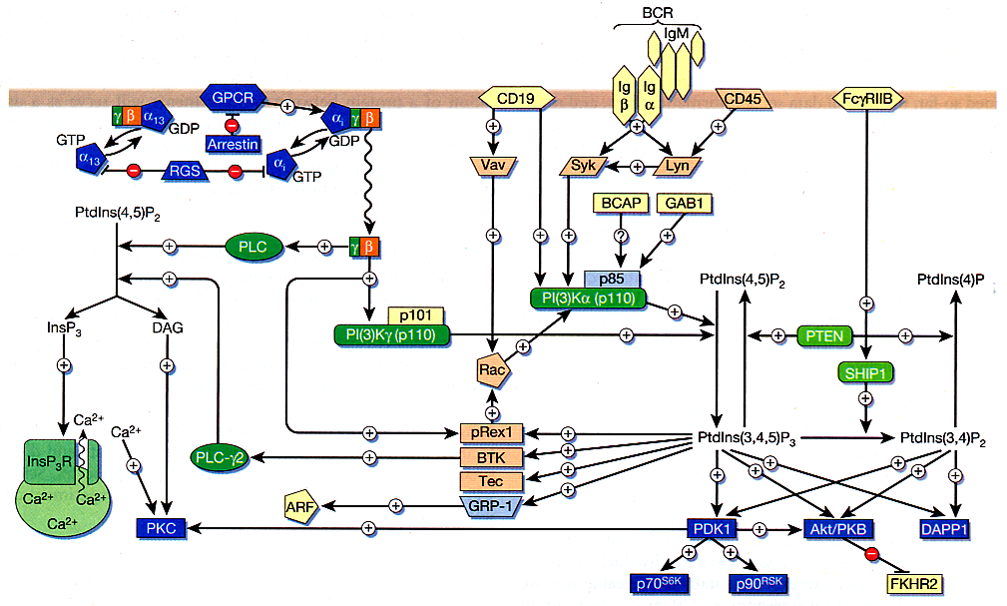
Signaling pathway description
Sambrano et al, Nature (2002) 420, 708

Slide 13
Proteomics DBs
Interactions between proteins
  Literature; review-like (BIND)
Oriented towards omics data
  Experimental values (DIP)
Weak connection to metabolic DBs
Proteins only, usually

Slide 14
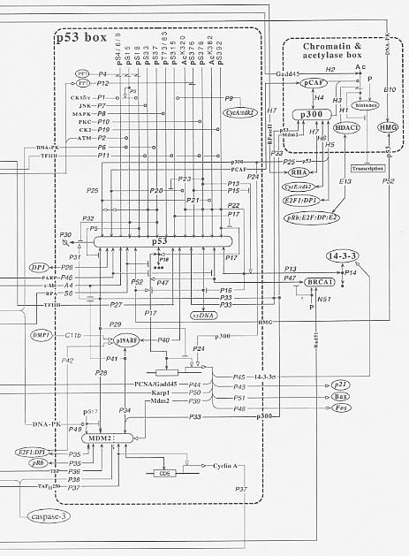
Kohn interaction maps
Kohn, Mol Biol Cell (1999) 10, 2703-2734
Representation of networks
Proteins, complexes, modifications
No dynamics
Map only, no DB
Failure, but interesting

Slide 15
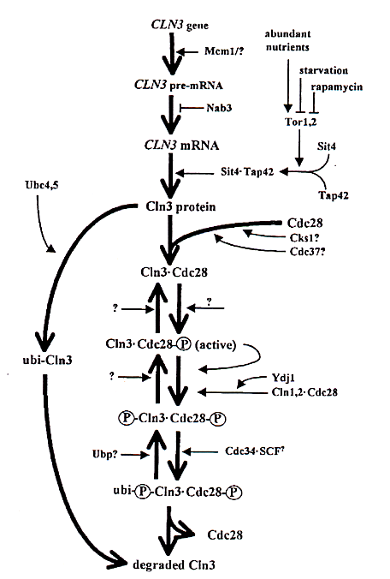
What’s missing?
Proteins are changed during processes: states
Not only proteins: RNA, molecules, complexes
Why separate signaling and metabolism?
The life and times of a gene, protein, molecule…
Mendenhall & Hodge, Microbiol Mol Biol Rev (1997) 62, 1191-1243

Slide 16
GeneCV
Model genes, proteins, complexes
Follow the life of a gene product
Molecular events
Refer to cellular process; do not model explicitly (for now)
Based on Statecharts
Consider: class relationships

Slide 17
Statecharts
David Harel 1987
State-transition diagrams, extended with
  Hierarchy
  Orthogonality
  Communication
Designed for large reactive systems: event-driven, reacting to external and internal stimuli
Now part of UML

Slide 18
Statecharts literature
David Harel & Michal Politi, Modeling Reactive Systems with Statecharts, McGraw-Hill (1998).
David Harel, Statecharts: A visual formalism for complex systems, Sci Comp Prog (1987) 8, 231-274.
Naaman Kam, David Harel, Irun R Cohen, Modeling Biological Reactivity: Statecharts vs Boolean Logic, Proc 2nd Conf Systems Biology (Nov 2001) Pasadena, CA, USA

Slide 19
Statecharts: states and events
On
Inactive
Active
Reset
Off
Fault
Error

Slide 20
Statecharts: state hierarchy
On
Active
Inactive
Measure
Reset
Off
Write
Fault
Error

Slide 21
Statecharts: state orthogonality
Active
On
Mode
Debug mode
Inactive
Measure
Normal
Reset
Off
Write
Debug
Fault
Error

Slide 22
Statecharts: conditions
Debug_command
[User_is_admin]
Normal
Debug

Slide 23
Statecharts: actions
Debug_command
/Debugger_in_use
Normal
Debug

Slide 24
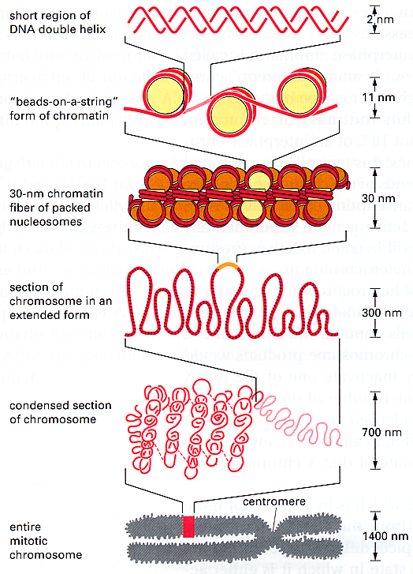
Nucleosomes: from DNA to chromosome
Alberts et al, Essential Cell Biology (1998) Garland

Slide 25
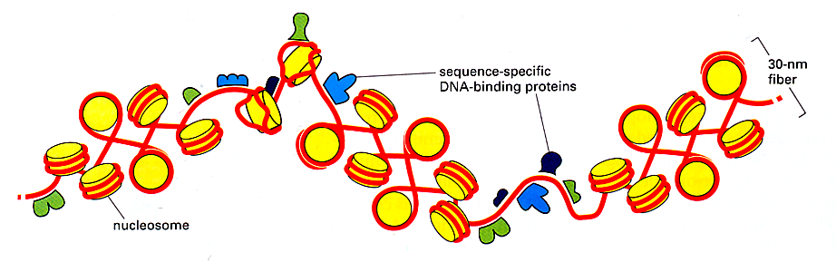
Dynamic nucleosomes
Alberts et al, Molecular Biology of the Cell (2002) Garland

Slide 26
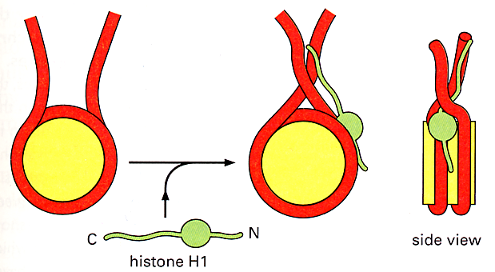
Nucleosome structure
Alberts et al, Molecular Biology of the Cell (2002) Garland

Slide 27
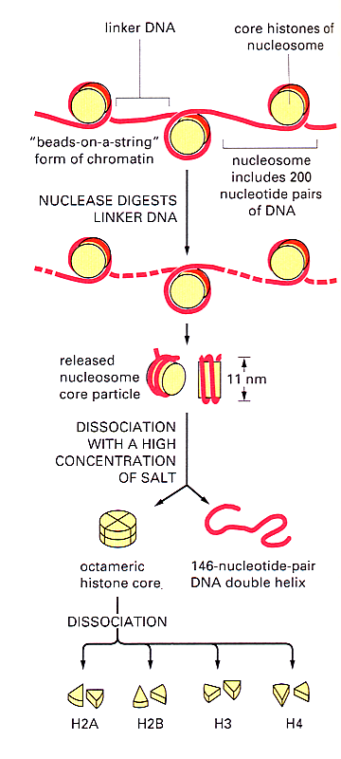
Nucleosome components
Alberts et al, Essential Cell
Biology (1998) Garland

Slide 28
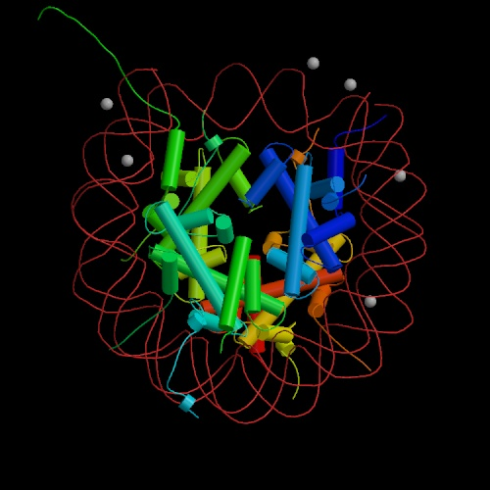
Nucleosome X-ray structure
Luger et al, Nature (1997) 389, 251

Slide 29
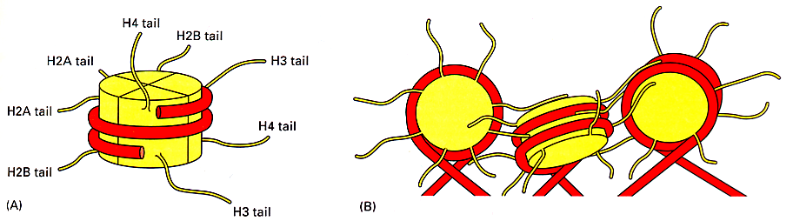
Histone tails
Alberts et al, Molecular Biology of the Cell (2002) Garland

Slide 30
Covalent modifications
= Posttranslational modifications (PTMs)
Chemical structure is modified
Done by enzymes
Some reversible, others irreversible
Binding properties change: protein complex formation
Phosphate
-OPO₃
Ser, Thr
Tyr
His
Kinase
Phosphatase
Acetyl
-Ac
-COCH₃
Lys
Acetylase
Deacetylase
Methyl
-Me
-CH₃
Lys
Arg
Methylase
Demethylase
Ubiquitin
-Ubq
Lys
Ubiquitin ligase

Slide 31
Example PTM Statechart: Lys
Methylase
Lys-Me
Lys-NH₃⁺
Lys-NH₂⁺-CH₃
Demethylase
Deacetylase
Acetylase
Lys-NH⁺(CH₃)₂
Lys-NH-COCH₃
Lys-N⁺(CH₃)₃

Slide 32
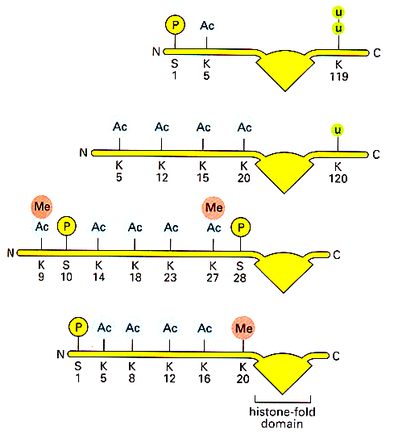
Histone tail modifications
Alberts et al, Molecular Biology of the Cell (2002) Garland

Slide 33
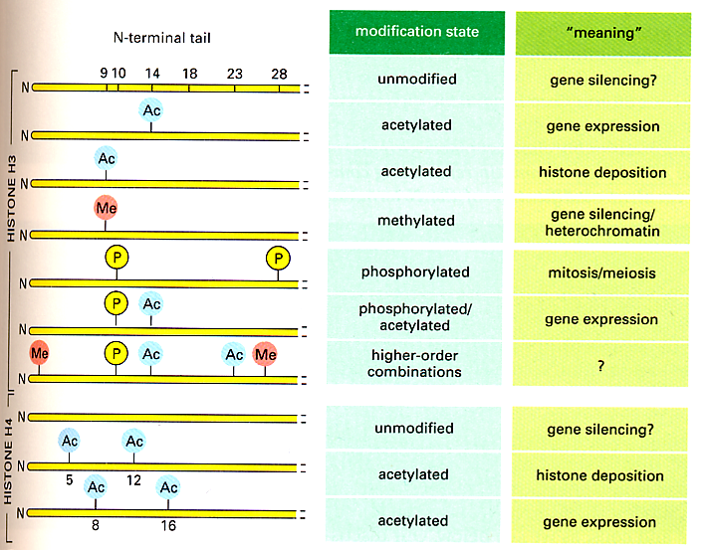
Functions of histone tail marks
Alberts et al, Molecular Biology of the Cell (2002) Garland

Slide 34
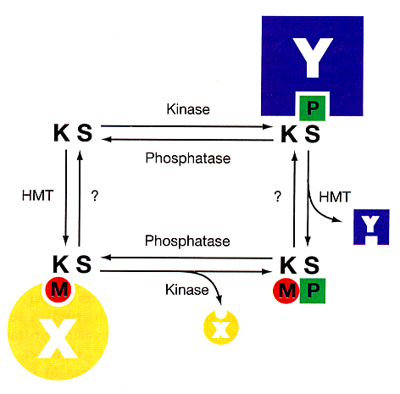
Local binary switch: methyl/phos
Fischle, Wang & Allis, Nature (2003) 425, 475

Slide 35
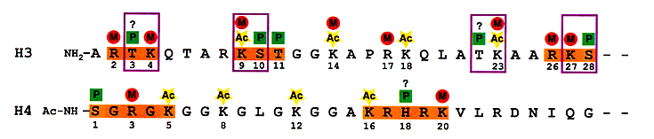
Clusters of histone marks
Fischle, Wang & Allis, Nature (2003) 425, 475

Slide 36
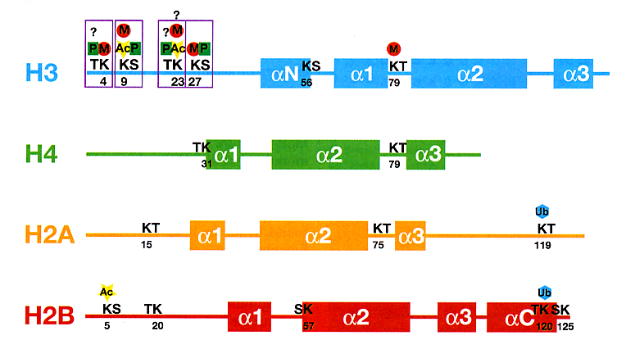
Putative methyl/phos switches
Fischle, Wang & Allis, Nature (2003) 425, 475

Slide 37
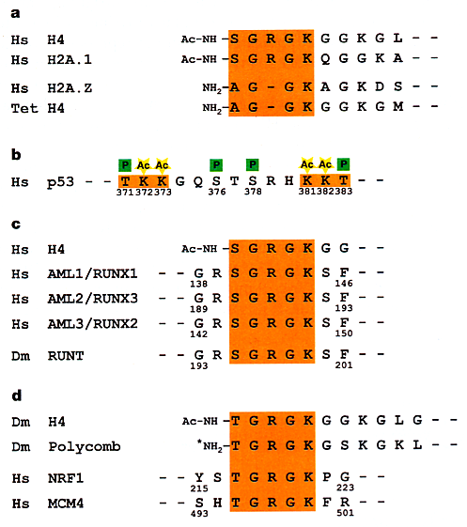
Putative switches in other proteins
Fischle, Wang & Allis, Nature (2003) 425, 475

Slide 38
Local binary switch: states
KS(P)
Y
KS
KS(P)
K(Me)S
K(Me)S(P)
K(Me)S
X
Fischle, Wang & Allis,
Nature (2003) 425, 475

Slide 39
Local binary switch: orthogonality?
[in S(P),
not in K(Me)]
+Y
K
S(P)
K(Me)
S(P)
+X
[not in S(P),
in K(Me)]
Fischle, Wang & Allis,
Nature (2003) 425, 475

Slide 40
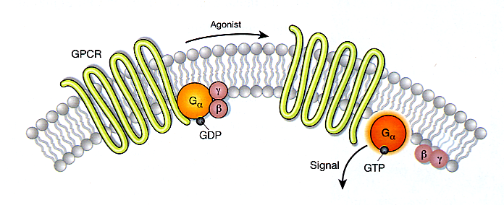
Typical state change(s) in signaling
Li et al, Nature (2002) 420, 716

Slide 41
GeneCV issues: terms and concepts must be adapted
Creation and destruction of proteins, complexes:
  Central to biology
  Not a primitive in Statecharts
Hardwire some states?
  Location
Events (broadcast) irrelevant?

Slide 42
GeneCV issues: phenomenon vs mechanism
States describing phenomena:
  Active vs inactive
  Binding vs non-binding
States describing mechanism:
  Phosphorylated or not
  Folded vs unfolded
How relate?
  Combine to one state?
  Relate two separate states?

Slide 43
GeneCV issues: object classes and inheritance
Objects should belong to classes
Should all objects be classes?
Inherit properties from parent classes:
  JNK1 is a tyrosine kinase
  A tyrosine kinase is an ATP-dependent kinase
  A kinase is an enzyme
  An enzyme is a protein
Classes for states and transitions?

Slide 44
GeneCV issues: state classes and inheritance?
Classes for states (and transitions?)
More powerful than generic states
Ramifications?

Slide 45
GeneCV issues: implementation
Graphics: same level as objects?
Update and modification policies?
Consistency checks
Computational tools

Slide 46
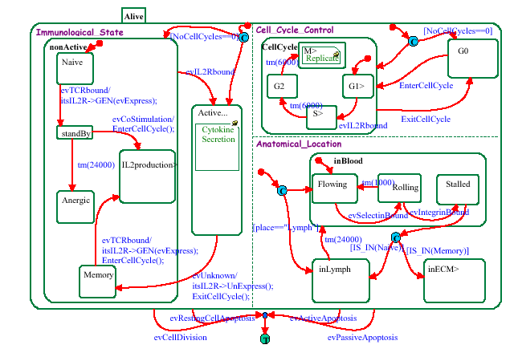
GeneCV issues: extensions to higher levels
How to extend to language of signaling: activation, inactivation…
Biological life processes, scenarios
Kam, Cohen & Harel, VLFM’01 (2001)

