Slide 1

Utmaningar för bioinformatiken inom industri och akademi
Per Kraulis
Biovitrum AB
Industriakademin, 27 okt 2005

Slide 2
Landskapet 1
Homo sapiens genomet klart (nåja)
Flera mammalie-genom, i användbart skick
1000 bakterie-genom (snart)
Genidentifiering, annotering
  Proteinkodande gener identifierade
  Sköts av stora centra: inget för mindre grupper
  RNA-gener och reglering: mycket att göra

Slide 3
Landskapet 2
Expressionsanalys
  Mognande teknik och analysmetoder
  Nya applikationer/analyser?
Proteomik
  Stora dataset, nya typer av data
  Ex: HPR www.proteinatlas.org
  Mycket att göra

Slide 4
Landskapet 3
Nätverksanalys
  Signalering
  Metabola nätverk
  Databaser, litteratur (text mining)
Systembiologi
  Modeller av mekanismer, simulering
  Förklaring av förlopp
  Men: Prediktion! Varför så skralt?

Slide 5
Förändring av fokus
Struktur
genom
gener
proteinsekvenser
proteindomäner
Processer
förlopp
nätverk
signallering
metabolism

Slide 6
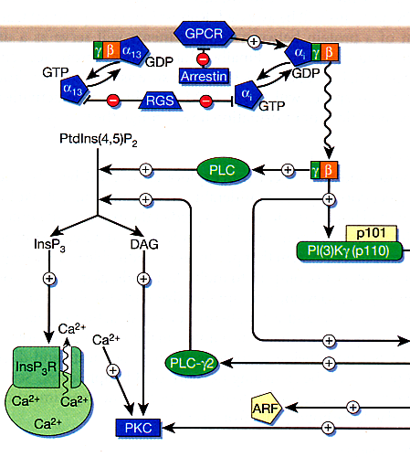
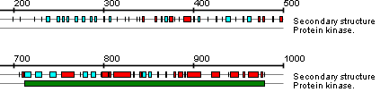
Bioinformatics
Integrated Pharmacology, Biovitrum
Sequence analysis
Homologs
Orthologs
Splice variants
Expression patterns
Pathway analysis
System effects
Study design
Readouts
Biomarkers
Target
Lead
In vitro
Animal models
In vivo studies
CD
Clinical
Drug discovery pipeline

Slide 7
Tes 1: Sekvensorienterad bioinformatik är rutin
Annotering finns i publika DB
Verktyg finns tillgängliga
Få uppenbara möjligheter till “lyft”
Undantag
  RNA
  Fylogenetiska jämförelser

Slide 8
Tes 2: Vissa behov ej uppfyllda
Saknas: Annoteringssystem för små grupper med intresse för specifika gener/system
Existerande produkter är “imperialistiska”
Idéer:
  Modell: Dossier eller ‘best current view’
  Editera: web eller specialverktyg
  Läs: web eller PDF

Slide 9
Tes 3: Nya ‘drug targets’ från biologi, funktion (inte sekvens)
‘Drug target hunting’ är passerat kapitel
Tillbaka till cellbiologi, farmakologi, mm
Hur kan bioinfo hjälpa experimentalisten?
  Ordna, systematisera litteraturen
  Designa experiment
  Välja ‘read-outs’
  Handskas med data (DB motsv)

Slide 10
Tes 4: (Bio)informatik krävs för systembiologi
Mekanistiska modeller standard (nåja)
  SBML, Reactome, KEGG, etc
Men förloppen som ska simuleras?
  Datamodeller/databaser saknas!
    Initialvärden, randvillkor
    Kontext
    Dynamiska förändringar

Slide 11
Tes 5: Bioinformatiken måste ta sig an biologiska förlopp
Förlopp (processer) är biologins hjärta
Den temporala aspekten är central
  Ex: Vad händer när en cell stimuleras?
  Ex: Cell-cykeln: vilka komponenter, processer?
Få databaser/datamodeller!
Jmf: Geographical Information Systems (GIS), temporala aspekter forskas kring sedan 15 år

Slide 12
Proto-Systems biology?
If sufficient regularity can be found between molecular entities and logical and informational outcomes to allow appropriate databases to be built, then genomic and post-genomic data could be interrogated more effectively.
…
If successful, this approach would not require detailed kinetic analyses of all processes within cells, but rather rely on more cursory calculations to study phenomena of interest.
Paul Nurse, ”Understanding cells”, Nature (424) 2003, 883.
Notes:
Point: we can gain understanding already at the qualitative level if we can sort out the informatics issues.

Slide 13
Computable information
Free text
Unwritten
Keyword/value data
Annotated text
Ontology
Relational DB
Petri Net, logic
Statecharts, UML
Simulation
Diff equ model
Notes:
Systems biology can't be puritanical if it is to be useful. Currently, there is a feeling that one must have a full-blown simulation model (diff equ, or maybe even stochastic) to be serious about Systems biology. My point is that systems biology absolutely requires computable information as a basis. This basis can be useful before we reach the simulation stage. And it is a continuum. GeneCV and my suggestion about viewing macroscopic biology as a project aim to become one part of this continuum.

Slide 14
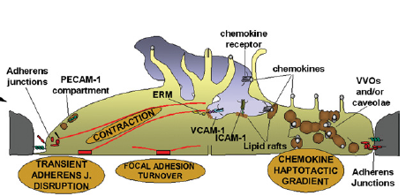
Multiple levels and types in biology
Objects
  Molecules
  Complexes
  Compartments
  Cells
Events
  Reactions
  Transport
  Signals
  Processes
Millán & Ridley (2005)
Notes:
The basic challenge in systems biology is to handle the many levels of abstraction, and the extreme degree of complexity. Virtually every review paper in cell biology contains illustrations that mix and match molecular, mesoscopic and macroscopic structures and dynamics. Basically, it's a mess that needs to be straightened out. But, should be done in a way that a biologist will still be able to understand.

Slide 15
Theory
Explanation
Prediction
Macroscopic structure, dynamics
Molecular properties
(Computable) information
Notes:
Systems biology is about connecting the molecular aspect of biological systems with the macroscopic aspect. Theory (including simulation) must be applied to make the connection. But in order to make this possible, there must be information (data) that describes both sides of the equation adequately. The info has to be computable, that is, possible to use in a computational analysis, qualitatively or quantitatively.

Slide 16
The predictions…
Roles of uncharacterized components
Behavior after perturbation
Suggest points of intervention; drug targets
Notes:
The utility of systems biology lies in the predictions it may help us to make. Obviously, good hints about points of intervention is what we in the engineering business would like to obtain.

Slide 17
Part 1: Molecular data
Molecular components
  Genomics, transcriptomics, proteomics, etc
Molecular events
  Interactions
  Modifications
  Localisation
Explicit data model required for DB!
Notes:
The left-hand side of the equation: molecular data. The formalization must be done to allow databases to be built.
What follows is exploratory work I have done to do this.

Slide 18
Part 2: Macroscopic processes
Describe macroscopic processes
  Simulations must be compared with something
  Goal-oriented description?
    What is required to achieve a specific state?
Life processes as projects
  Goals, milestones
  Resource usage; scheduling
  Subprojects, tasks
Notes:
GeneCV is strictly molecular. The second required part in an information platform for systems biology must therefore be the macroscopic aspects.
One possible attempt is to view a cell as a project with some well-defined goal (teleology!) defined by its evolutionary basis. Then view the system as an attempt at optimizing resource usage and milestones to achieve this goal. Perturbations are misalignments or resource problems.

Slide 19
GeneCV concepts
Entities
  Genes
  Proteins
  Molecules
  Complexes
States
  Complexes, member of
  Modifications
  Location
Transitions
  Creation
  Destruction
  Interactions
  Regulation
  Transport
Ras p21
Expression
Cell: fibroblast
TF: xxx
Ras p21
Chem: unmodified
Location: cytosol
Modification
Enzyme: FT
Ras p21
Chem: farnesylated
Location: membrane

Slide 20
Statecharts
David Harel, 1987
Describe reactive computer systems
  Event-driven
  Responding to external and internal stimuli
State-transition diagrams extended with:
  Hierarchy
  Orthogonality
  Communication
Now part of UML

Slide 21
Statecharts: states and events
On
Inactive
Active
Reset
Off
Fault
Error

Slide 22
Statecharts: state hierarchy
On
Active
Inactive
Measure
Reset
Off
Write
Fault
Error

Slide 23
Statecharts: state orthogonality
Active
On
Mode
Debug
Inactive
Measure
Normal
Reset
Off
Write
Debug
Fault
Error

Slide 24
Statecharts: conditions
Debug_command
[User_is_admin]
Normal
Debug

Slide 25
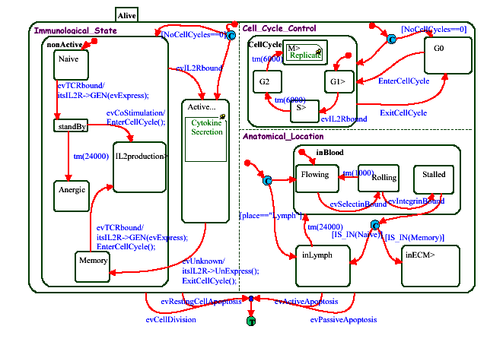
Modeling T-cell transformations
Kam, Cohen, Harel 2001

Slide 26
Example: Lysine post-transl mod's
Methylase
Lys-Me
Lys-NH₃⁺
Lys-NH₂⁺-CH₃
Demethylase
Deacetylase
Acetylase
Lys-NH⁺(CH₃)₂
Lys-NH-COCH₃
Lys-N⁺(CH₃)₃
Notes:
This statechart contains much implicit information:
Methylases cannot act on acetylated lysines.
Both acetylation and methylation are reversible.
Methylation is a stepwise affair, where Me1, Me2 and Me3 variants should be possible to isolate.

Slide 27
www.reactome.org
CSHL, EBI, GO collaboration
Entities
  Generic/concrete
  No explicit state; no hierarchy of states
Events
  Hierarchy
  Molecular as well as macroscopic (processes)
Notes:
Entities and events are central. Not strictly molecular. Also attempts to model higher-level processes. No explicit state model, as far as I can tell.

Slide 28
www.signaling-gateway.org
Alliance for Cell Signaling, AfCS
Molecules
  Proteins
States
  No hierarchy
  Molecular only; complexes are states
  Location is not state
Transitions
  Conditions?
Notes:
Entities and states are central. Flat state model, no hierarchy. Therefore has problems with scalability, already. Does not model upper-level events or structures.

Slide 29
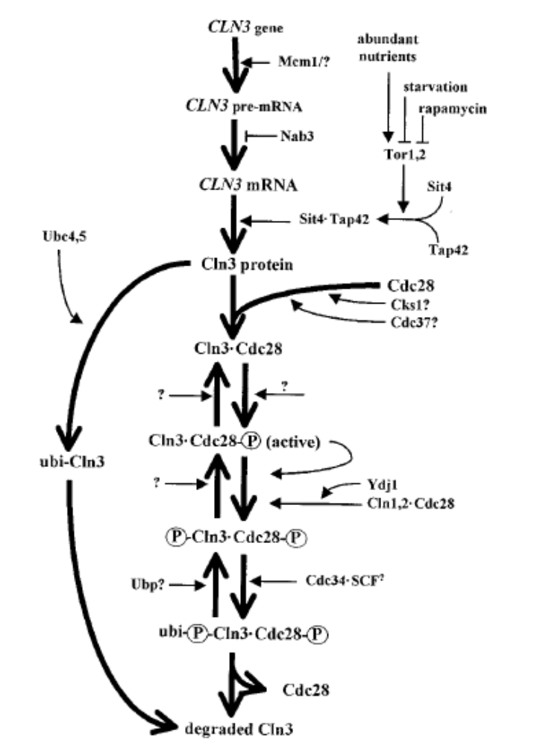
GeneCV
The life of a biomolecule
Molecular data only!
Creation
Maturation
Transport
Interactions
Destruction
Mendenhall & Hodge 1998
Notes:
The inspiration for GeneCV: describe the life and times of a single biomolecule.
This should be viewed as one specific layer of information about biological processes.
The explicit limitation is important: all-encompassing systems are notoriously difficult to implement.

