Slide 1
The bioinformatics of biological processes
The challenge of temporal data
  Per Kraulis
  Avatar Software AB

Slide 2
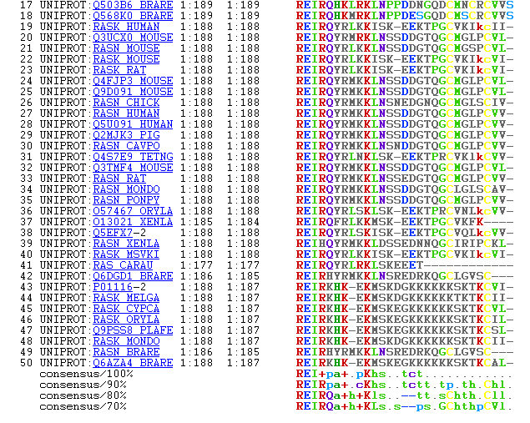

Slide 3
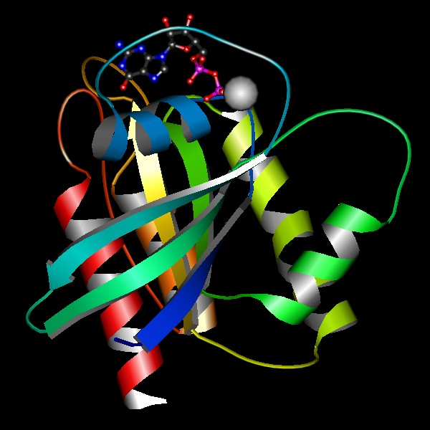
MolScript: Per Kraulis 1991, 1997

Slide 4
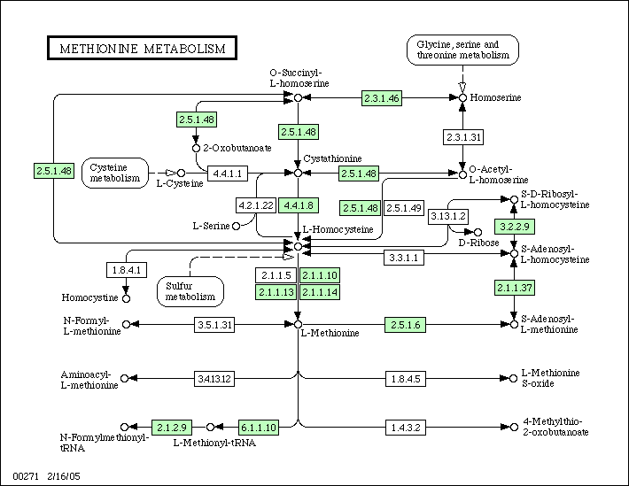
KEGG: Kanehisa 2004

Slide 5
“Classical” Bioinformatics:
Static structures
Structural: Sequence, 3D coordinates
Time is not involved
Why? Easier to work with...
  Experimentally
  Conceptually?

Slide 6
Biology is temporal
Processes are inherently temporal
  Narrative descriptions in literature
  Gene expression time series
  Embryonal development
Biological processes are goal-oriented
  Cell cycle: produce another cell

Slide 7
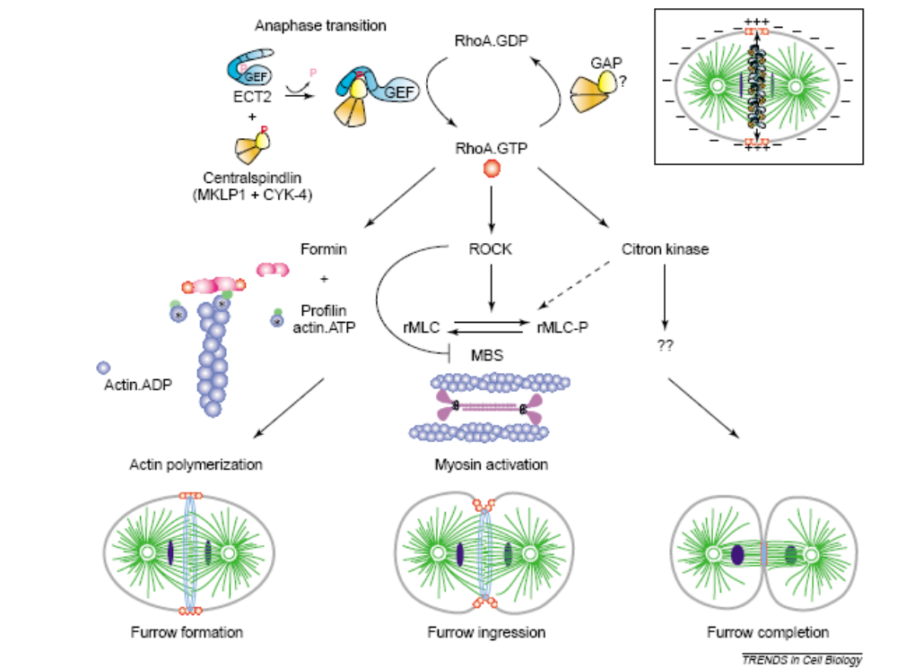
Cytokinesis: Rho regulation
Piekny, Werner, Glotzer 2005

Slide 8
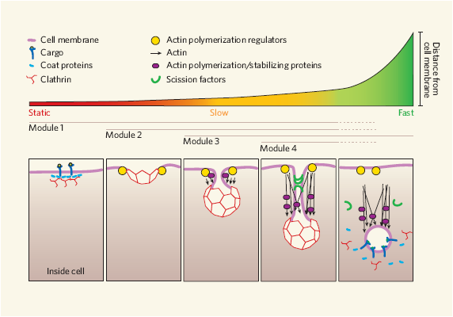
Endocytic vesicle formation
Duncan & Payne 2005

Slide 9
But: Few temporal databases?!
Temporal: 't' as an essential parameter
Temporal relationships
  During
  Before
  After

Slide 10
"Can computers help to explain biology?"
...biological narratives of cause and effect are readily systematizable by computers.
Happily, there is considerable interest in wanting to build one element of biological semantics — the passage of time — into information theory.
[This] might help biologists to go beyond quantifying reaction rates and molecular species of biological systems to understand their dynamic behaviour.
R. Brent & J. Bruck, Nature (440) 23 March 2006, 416-417

Slide 11
Computable temporal data
Required for simulation
  Initial values
  To test model against
Appropriate data model
  Events during a process
  Context, preconditions
  Duration
  Property = f(t)

Slide 12
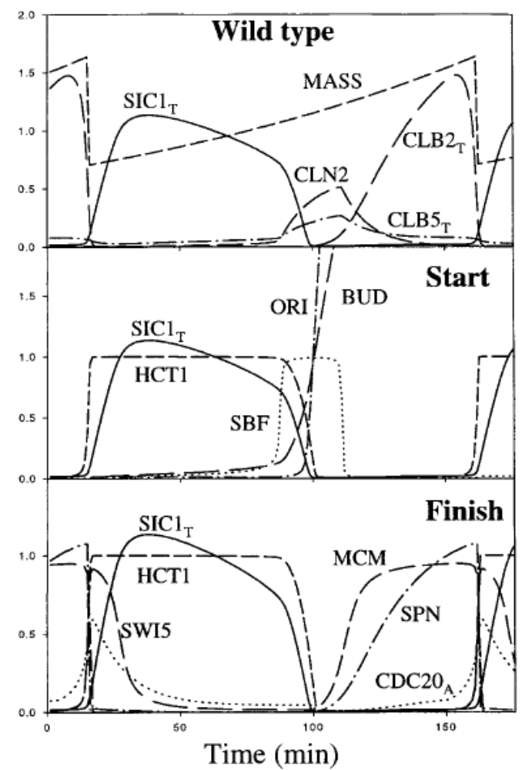
Kinetic analysis of budding yeast cell cycle: Chen et al 2000

Slide 13
Work in other fields
Geographical Information Science, GIS
Artificial Intelligence
  Knowledge Representation
  Temporal Logic
  Automated planning, scheduling
Temporal databases
Project management

Slide 14
Allen's temporal relationships
before
meets
overlaps
starts
during
finishes
equals

Slide 15
Project: BioChronicle
Data model, implementation
Handle temporal biological information
  Events, subevents
  Relationships
  Duration
  Properties, dynamics
  Preconditions, context
Test case: Cell cycle

Slide 16
Project: GeneCV
Entities
  Genes
  Proteins
  Molecules
  Complexes
States
  Complexes, member of
  Modifications
  Location
Transitions
  Creation
  Destruction
  Interactions
  Regulation
  Transport
Ras p21
Expression
Cell: fibroblast
TF: xxx
Ras p21
Chem: unmodified
Location: cytosol
Modification
Enzyme: FT
Ras p21
Chem: farnesylated
Location: membrane

Slide 17
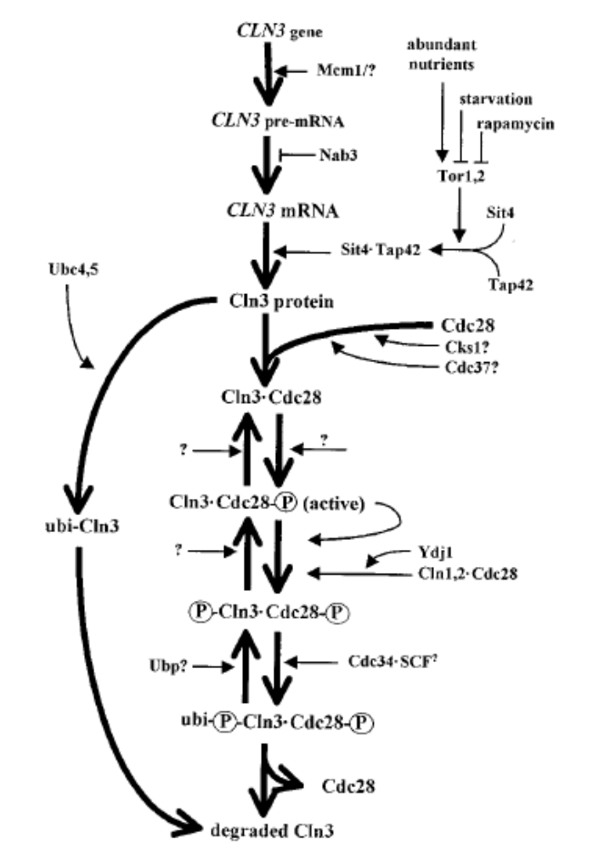
GeneCV
The life of a biomolecule
Molecular data only!
Creation
Maturation
Transport
Interactions
Destruction
Mendenhall & Hodge 1998
Notes:
The inspiration for GeneCV: describe the life and times of a single biomolecule.
This should be viewed as one specific layer of information about biological processes.
The explicit limitation is important: all-encompassing systems are notoriously difficult to implement.

Slide 18
Statecharts
David Harel, 1987
Describe reactive computer systems
  Event-driven
  Responding to external and internal stimuli
State-transition diagrams extended with:
  Hierarchy
  Orthogonality
  Communication

Slide 19
Statecharts: states and events
On
Inactive
Active
Reset
Off
Fault
Error

Slide 20
Statecharts: state hierarchy
On
Active
Inactive
Measure
Reset
Off
Write
Fault
Error

Slide 21
Statecharts: state orthogonality
Active
On
Mode
Debug
Inactive
Measure
Normal
Reset
Off
Write
Debug
Fault
Error

Slide 22
Statecharts: conditions
Debug_command
[User_is_admin]
Normal
Debug

Slide 23
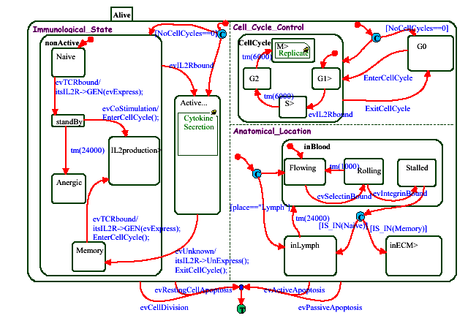
Modeling T-cell transformations
Kam, Cohen, Harel 2001

Slide 24
Example: Lysine post-transl mod's
Methylase
Lys-Me
Lys-NH₃⁺
Lys-NH₂⁺-CH₃
Demethylase
Deacetylase
Acetylase
Lys-NH⁺(CH₃)₂
Lys-NH-COCH₃
Lys-N⁺(CH₃)₃
Notes:
This statechart contains much implicit information:
Methylases cannot act on acetylated lysines.
Both acetylation and methylation are reversible.
Methylation is a stepwise affair, where Me1, Me2 and Me3 variants should be possible to isolate.

Slide 25
www.reactome.org
CSHL, EBI, GO collaboration
Entities
  No explicit state; no hierarchy of states
Events
  Hierarchy
  Molecular as well as macroscopic (processes)
Notes:
Entities and events are central. Not strictly molecular. Also attempts to model higher-level processes. No explicit state model, as far as I can tell.

Slide 26
www.signaling-gateway.org
Alliance for Cell Signaling, AfCS
Molecules
  Proteins
States
  No hierarchy
  Molecular only; complexes are states
  Location is not state
Transitions
  Conditions?
Notes:
Entities and states are central. Flat state model, no hierarchy. Therefore has problems with scalability, already. Does not model upper-level events or structures.

Slide 27
Computable information
Free text
Unwritten
Keyword/value data
Annotated text
Ontology
Relational DB
Petri Net, logic
Statecharts
Simulation
Diff equ model
Notes:
Systems biology can't be puritanical if it is to be useful. Currently, there is a feeling that one must have a full-blown simulation model (diff equ, or maybe even stochastic) to be serious about Systems biology. My point is that systems biology absolutely requires computable information as a basis. This basis can be useful before we reach the simulation stage. And it is a continuum. GeneCV and my suggestion about viewing macroscopic biology as a project aim to become one part of this continuum.

