Slide 1
Bioinformatics for biomedicine
Gene expression data, methods of analysis
Lecture 7, 2006-10-31
Per Kraulis
http://biomedicum.ut.ee/~kraulis

Slide 2
Course design
What is bioinformatics? Basic databases and tools
Sequence searches: BLAST, FASTA
Multiple alignments, phylogenetic trees
Protein domains and 3D structure
Seminar: Sequence analysis of a favourite gene
More annotation, Gene Ontology and pathways
Gene expression data, methods of analysis
Seminar: Further analysis of a favourite gene

Slide 3
Task
Locate protein in GO, Reactome, etc
Wee1
SREBP1
Your own

Slide 4
Task: Wee1
GO via
  UniProt (WEE1_HUMAN)
    Protein kinase; cell cycle; nucleus
  Ensembl
    Mitosis (code IEA: Inferred from Electronic Annotation)
Reactome
  Phosphorylated by Chk1, Plk1; inactivation
  Phosphorylates cyclins B1, E1, E2, A

Slide 5
Task: SREBP1
GO
  via UniProt
    ER membrane, nuclear envelope, nucleus
    Transcription factor; lipid metabolism
  Via Ensembl
    Steroid metabolism (IEA)
Reactome: nothing
KEGG: Insulin signaling pathway
  Downstream of PI3K, PIP3, PKC iota
  Regulates metabolic enzymes PFK, PyK, GK

Slide 6
Gene activity; expression
Gene expression = mRNA level
Proxy for gene activity
  Approximation (usually reasonable)
Many technologies for measurement
  Performance
    Absolute leve/relative change
    Accuracy
    Throughput (arrays vs. samples)
    Predefined gene set, or identification of new genes
  Cost
    Investment vs. running cost

Slide 7
Microarrays for gene expression
Attach known oligonucleotides on a surface, spot by spot
Hybridize with color-labelled sample
  Relative: two samples with different color
  Absolute: one single color
Read off intensity of color in each spot
  Convert to expression value for each gene
  Relative change or absolute level

Slide 8
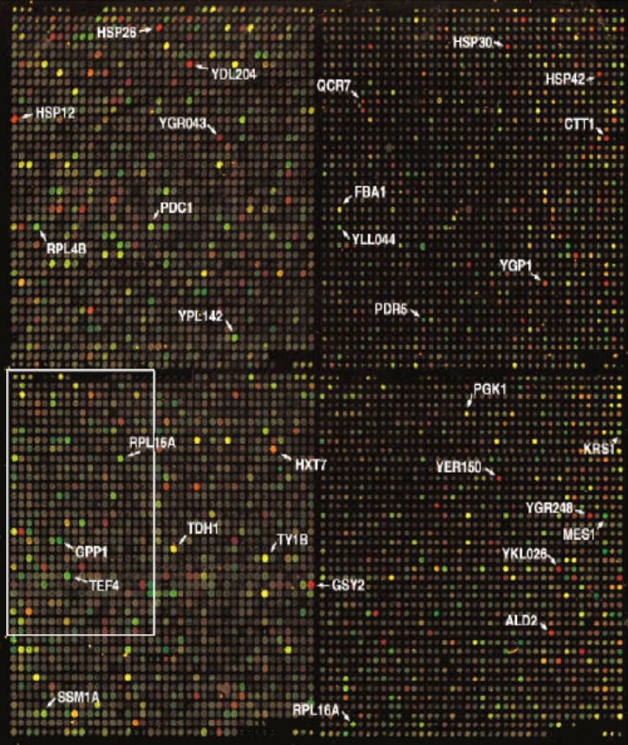
cDNA microarray
Pat Brown’s lab, Stanford
Glass slide, cDNA spots
Two-color approach: relative change
Sample 1 (ref) is labelled green (Cy3)
Sample 2 (exp) is labelled red (Cy5)
Spot colors:
Black: no mRNA; no change
Green: exp mRNA downregulated
Red: exp mRNA upregulated
Yellow: ref and exp mRNA; no change
Yeast genome
DeRisi, Iyer & Brown
Science 278 (1997) 680-686

Slide 9
Why not absolute values?
C = k * Ic
  C : level of mRNA
  k : proportionality constant
  Ic : color intensity
Absolute value C requires k
  k different for each cDNA
  Calibration needed

Slide 10
Why relative values?
How to avoid calibration for k ?
Experiment relative to reference
  Measure up- or down-regulation
G = C_{exp}/C_{ref} = k*Ic_{exp}/k*Ic_{ref} = Ic_{exp}/Ic_{ref}
But: Equal amounts of total mRNA in the two samples (exp, ref)?

Slide 11
Data reduction issues
Treatment from raw data to useful value
  From spot shape/color to up/down regulation
  Similar problem in many technologies
Many steps
  Depends on microarray technology
  Define spot; shape, position
  Measure color intensity; background?
  Handle artifacts (damaged spots, etc)

Slide 12
Normalization
Goal: Make data sets comparable
Microarrays
  Between colors in chip
  Between chips in experiment
  Between genes in different experiments
Common approaches
  Use constant gene(s); “house-keeping” genes
    Ribosomal proteins
    Fundamental metabolic enzymes
  Danger: Based on assumptions!

Slide 13
Example analysis: Pathways
Up/down regulation of genes
Map onto known pathways
Indicates changes in flows or signals
Mechanistic information:
  Verification of known data
  Patterns
  Interesting anomalies
Assumes biological knowledge

Slide 14
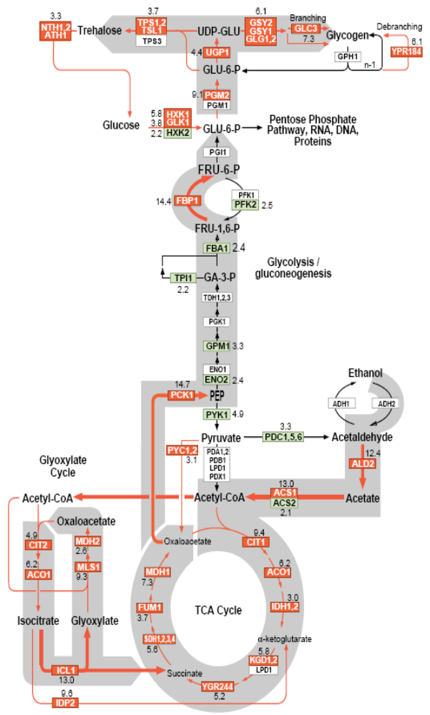
Yeast: diauxic shift
Green: anaerobic fermentation (glucose>ethanol)
Red: aerobic respiration (ethanol>TCA cycle)
Shows activation/ deactivation of pathways
Behaviour of gene copies
DeRisi, Iyer & Brown
Science 278 (1997) 680-686

Slide 15
Clustering 1
Groups according to some property
Computational
  Measure of relationship; distance(i,j)
  Many algorithms to form groups
Powerful data analysis technique
  Always some assumption on type of groups
  No single optimal clustering method

Slide 16
Clustering 2
A set of data points
Two dimensions (x, y)
How form groups?
All included
Roundness
Tightness
Roundness
All included
Any shape

Slide 17
Clustering 3
Depends on previous knowledge
  What groups are expected?
  How measure when assumptions violated?
Hierarchical
How notice problem?

Slide 18
Clustering 4
Hierarchical clustering
  Common in gene expression analysis
  Useful, but not necessary
    There is no intrinsic biological reason!
Possible problems
  Sensitive to minor errors
  At what level “natural” clusters?
  Hard to detect “strangely shaped” clusters

Slide 19
More than 2 dimensions
More than one treatment
  Ref + exp1 + exp2 + exp3 +…
Time course experiment
  Ref(t0), exp (t1), exp(t2), …
Add other parameters
  Anything of interest: pI, Mw,…
Very common, and very useful

Slide 20
Scaling problem
How to compare different dimensions?
  Expression value, pI, Mw,…
  Distance functions require scaling
    Making values comparable
Possible approaches
  Weights: Specific to each problem
  Recalculation: Statistical
    Same average
    Same standard deviation

Slide 21
Clustering in many dimensions
Can be generalized into N dimensions
Each point a vector (s_{i}, s_{j}, …s_{n})
Distance between two points
  Many possible functions; also called “metric”
    Euclidean: d = sqrt(d_{i}² + d_{j}² + …d_{n}²)
    Manhattan: d = |d_{i} | + |d_{j}| + … |d_{n}|
    Correlation: similar “tendency” for values s

Slide 22
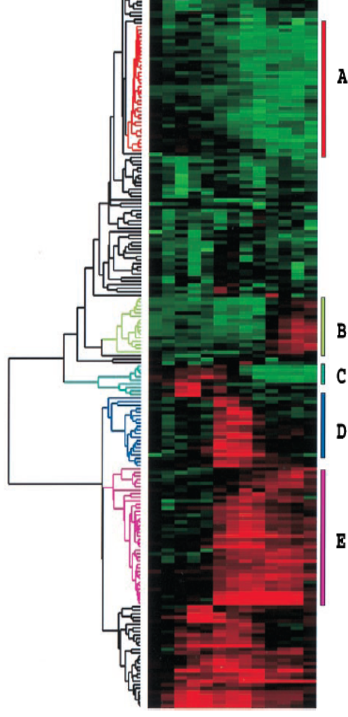
Example: Hierarchical clustering
12 values per gene
  Time course, 0-24 hrs
Clustering
  Correlation coefficient metric
  Hierarchical; dendrogram
  No cutoff level
  No test of significance
Eisen et al
PNAS 95 (1998) 14863-14868

Slide 23
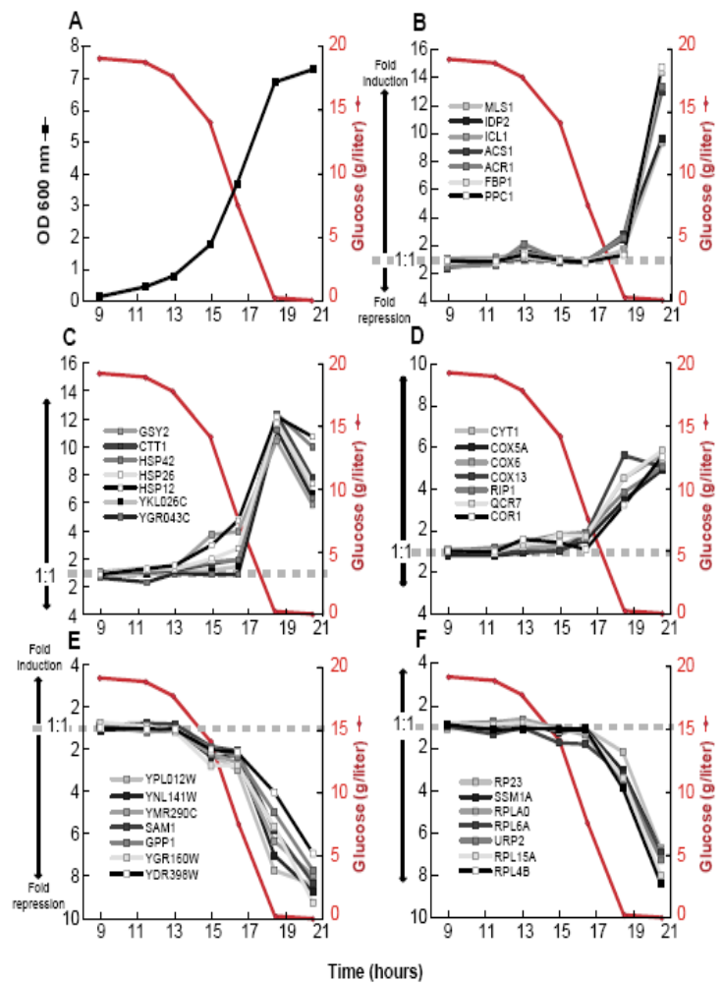
Time course experiment 1
Yeast diauxic shift
  t=9: high glucose
  t=19: low glucose
Small sets of genes behaving similarly
Biological analysis
  F) Ribosomal proteins
  E) Several uncharacterized
DeRisi, Iyer & Brown
Science 278 (1997) 680-686

Slide 24

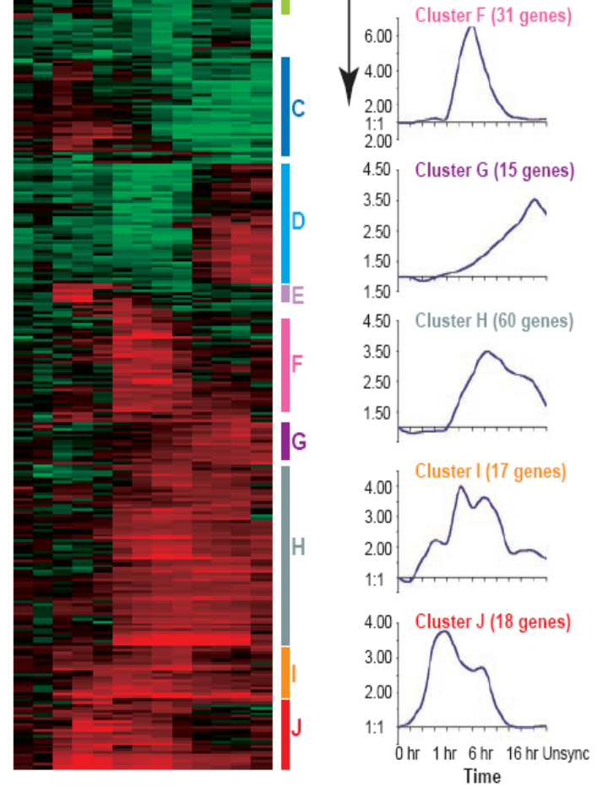
Time course experiment 2
Human fibroblasts
Serum treatment
Time course; 0-24 hrs
  12 time points
Hierarchical clustering
  Ordered by expression similarity
Iyer, et al
Science 283 (1999) 83-87

Slide 25
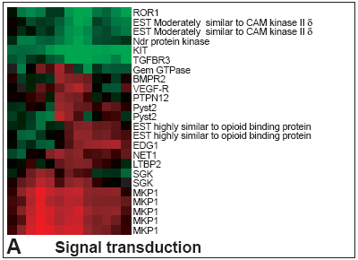
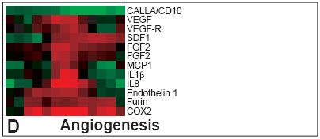
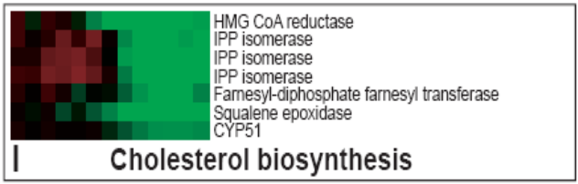
Time course experiment 3
Human fibroblasts
Sorted according to gene function (pre-GO)
Iyer, et al
Science 283 (1999) 83-87

Slide 26
Other approaches
A set of “related” genes
  Simplified clustering; in the set, or not
“Related” using any criterion:
  Enriched in EST data
  Cluster from gene expression
  Sequence similarity
  Contains a specific sequence pattern
  Forms a complex
  …

Slide 27
Uncharacterized genes 1
Goal: Identify possible classification of a previously uncharacterized gene
“Guilt by association”
  If your friend is guilty, then so are you!
  If gene X and Y behave similarly in an experiment, then both may be involved in the same biological process

Slide 28
Uncharacterized genes 2
Similar gene behavior is significant if…
  Statistically significant
  Some genes well-characterized, as basis
  Well-designed experiment
Still, may be artifact
  Spurious correlations
    Price of Cuban rum vs. Swedish pharmacist salary
  Indirectly related

Slide 29
Uncharacterized genes 3
But: Other types of correlation?
  Anti-correlated
  Phase-shifted
  Other possibilities?
Depends on biology

Slide 30
GOSt
Data mining tool
  Gene Ontology
  Start from a set of genes
    E.g. co-regulated in gene expression
    Any other selection criterion
  Find “enriched” GO terms
    Give hints for uncharacterized genes
http://www.bioinf.ebc.ee/GOST/
Jüri Reimand, Jaak Vilo (Tartu)

Slide 31
Data mining 1
Given large amount of data…
  Many different dimensions (types)
  Many data points
How to find interesting features
  Correlations
  Patterns
  Outliers

Slide 32
Data mining 2
Visualization is fundamental
  Look at the data!
  Look again, different angle!
  Clustering, and similar, are never enough
Many dimensions
  Increasingly common in clinical setting
  Novel tools
    Commercial: Spotfire, AVS,…
    Open source: Mondrian,…

Slide 33
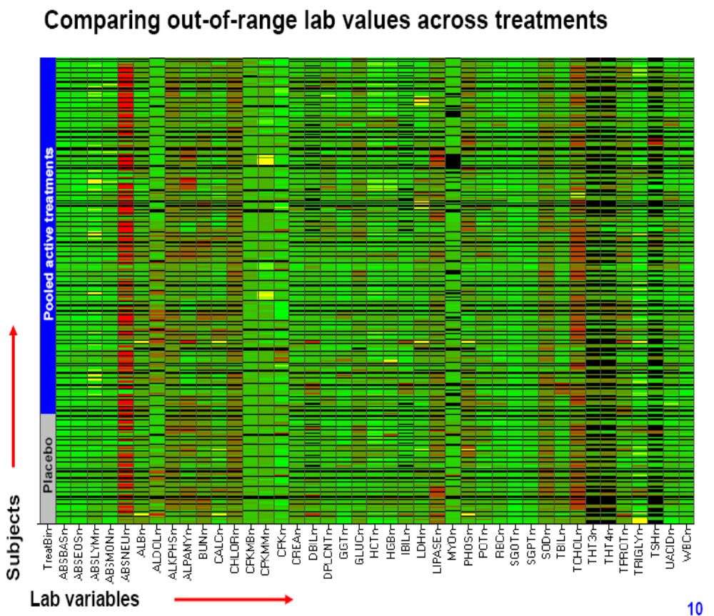
Data mining 3
Patients
Parameters
  Clinical data
  Biomarkers
  Treatment
Spotfire visualisation
Michael Merz, Novartis
Presentation 2006
Spotfire web site

Slide 34
Data mining 4
Clustering is an example of data mining
Useful in many contexts
  Gene expression
  Clinical data
  Text analysis; text mining
Also with smallish data sets
  Example: 20 patients, 8 parameters
    Found 1 clear outlier using Spotfire visualization

Slide 35
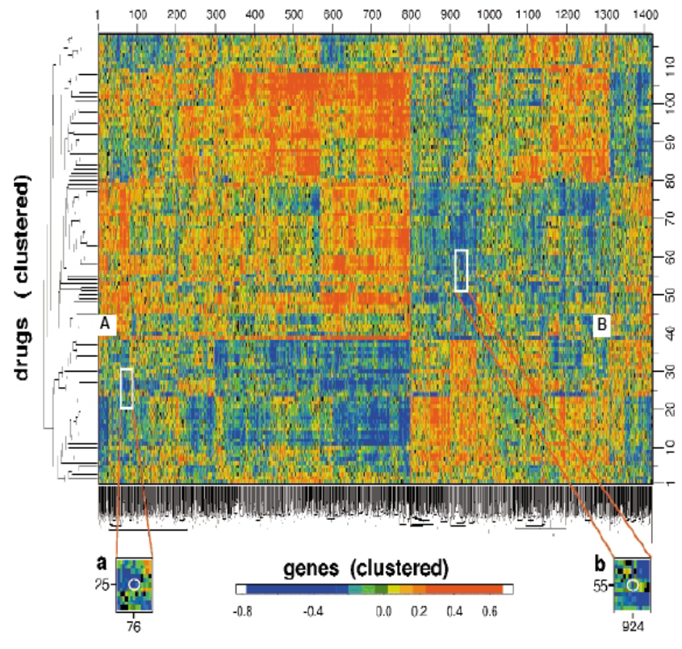
Data mining 5
NCI cancer drugs
  118 drugs
  60 human cancer cell lines
  8000 genes
Correlation values
Clustering
Scherf et al
Nature Genetics 24 (2000) 236-244

Slide 36
Gene expression data
Databases
  Gene Expression Omnibus at NCBI http://www.ncbi.nlm.nih.gov/geo/
  ArrayExpress at EBI http://www.ebi.ac.uk/arrayexpress/
  GNF SymAtlas (Novartis Research Foundation) http://symatlas.gnf.org/SymAtlas/
Molecular Pharmacology of Cancer (NCI) http://discover.nci.nih.gov/nature2000/

