Slide 1

Introducing the Acacia Object Storage Service
4 April 2022. Version 1.00
Notes:
Welcome to this short video. This is the first in a series of videos on the topics of object storage in general and Acacia as Pawsey’s object storage service.

Slide 2

Focus for this module
At the end of this module, you will be able to:
Define the terms:
  Object storage
  Buckets
  Objects
Compare and contrast object storage and filesystems
Discuss the benefits of using object storage
Identify Pawsey’s new object storage system, called Acacia
The backplane of Acacia, Pawsey's new object storage system for research, exposes the cabling and high speed networking essential to building this new, state of the art infrastructure.
Introducing Acacia Object Storage Service
Notes:
In this video, I’ll introduce several object storage-specific terms. That will set the context for a comparison of filesystems and object storage, before we end with a short introduction to Acacia.

Slide 3
Introduction to Filesystems
Section 1
Notes:
Let’s start by talking about filesystems and the idea of hierarchical storage.

Slide 4

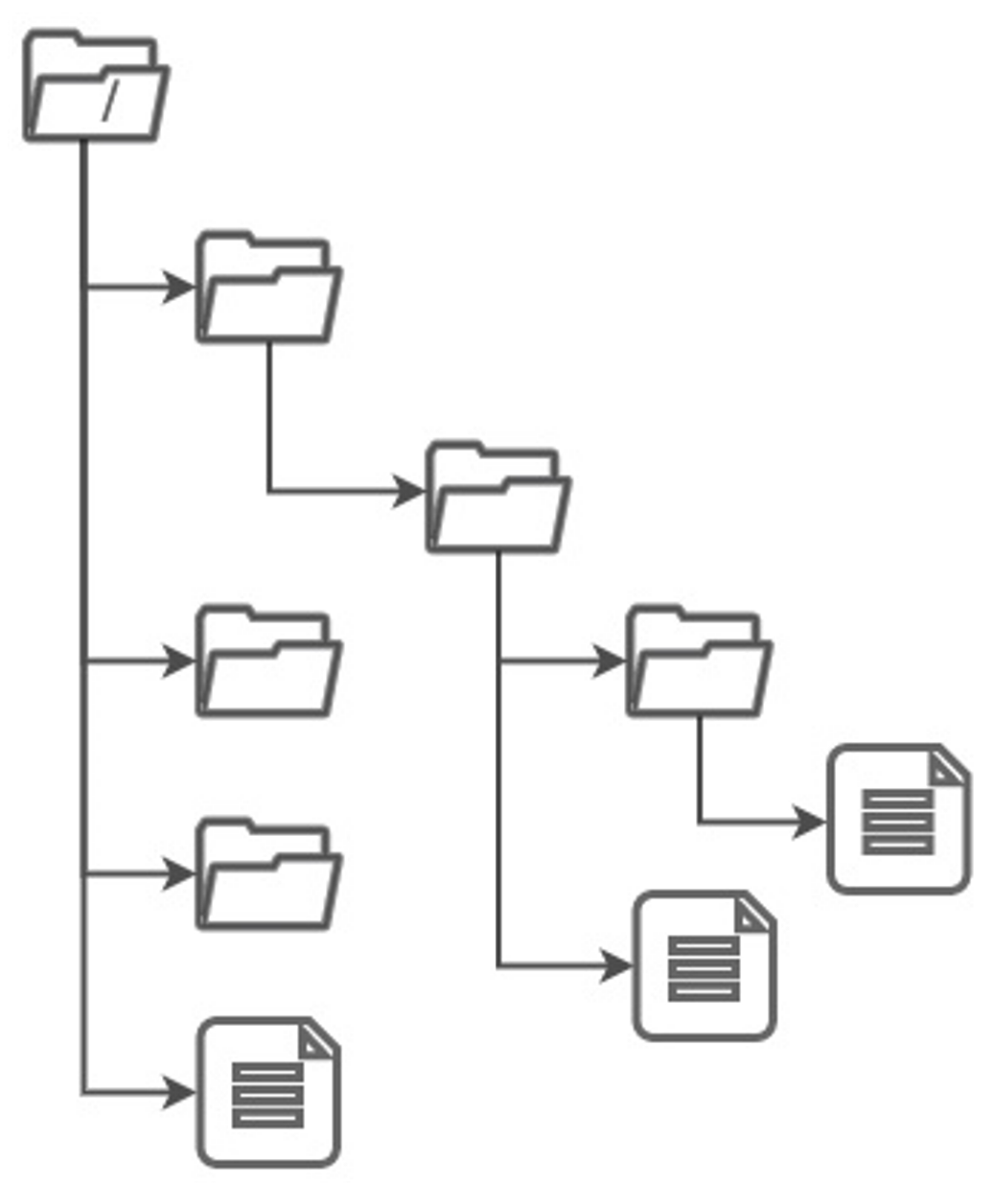
What is a filesystem?
Simply stated, a filesystem is a system or way of grouping and storing files that is hierarchical.
A filesystem groups data together in files. You can interactively perform actions on files (e.g., edit) them right where they are in the filesystem.
You can organise files into directories (or folders). You can use this as a visual aid in grouping together files.
Filing cabinets, folders and files – the ‘old’ way of organising
Translated online into…. filesystems, directories
and files
Pawsey supercomputers like Magnus, Zeus, Topaz, and Setonix use shared filesystems to store data.
Introducing Acacia Object Storage Service
Notes:
A filesystem is called such, based on how we manage paper-based information, such as paper reports and memos, that is, we have a filing system, such as a cabinet, in which we group paper into folders. In filesystem language, we group files into directories.
A filesystem is a hierarchical way to store and access data. That data is grouped together into a file. If you want to change or update a file, you can do so without having to leave the filesystem.
Files are often organised into directories. You can see here several directories, illustrated as folders, which contain data, or files.

Slide 5
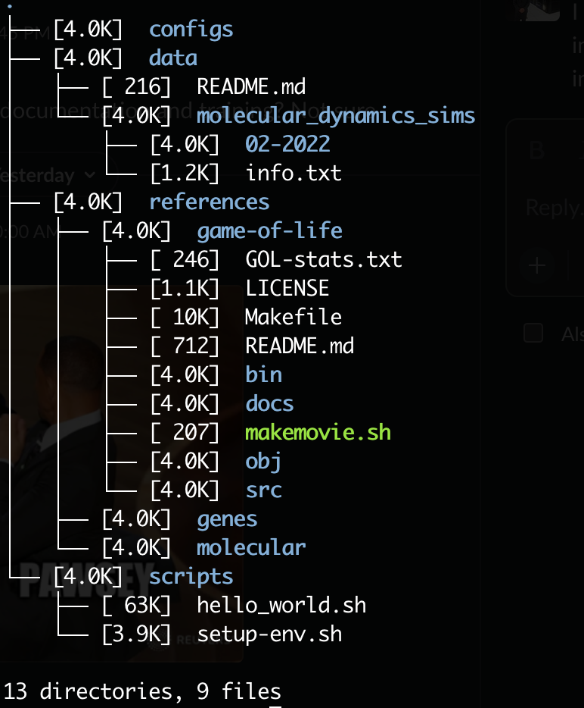
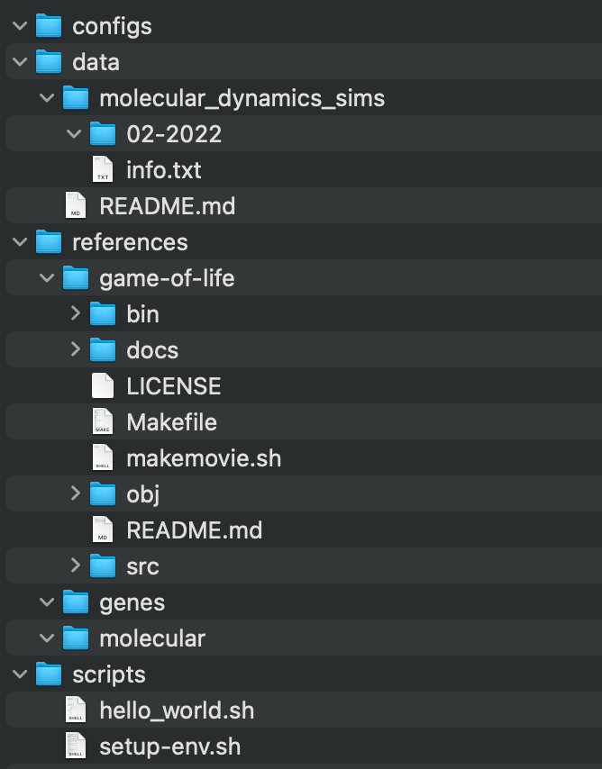
More about Filesystems
Filesystem Examples
A file has associated with it metadata, such as file name, timestamp, location of the file in the folder hierarchy, file attributes (read, write), etc.
You use metadata for such actions as searching for a file.
A directory is a hierarchical approach to file management. The hierarchy that you establish is arbitrary, that is, it can be as deep or shallow as you want. E.g., It can have only 1 level or many levels.
Directories
3 levels
of
Hierarchy
Directories
Files
Files
Directories
Introducing Acacia Object Storage Service
Notes:
Associated with each file is metadata, such as the name of the file and when it was created or last updated. You can use metadata for a number of reasons, but most often for searching.
Another way to find files is through the hierarchical structure imposed by directories, into which you place files. You can have as many or as few levels of directory hierarchy as you want. Having a deep hierarchy may make it difficult to use the directory structure – visually – to find files. You can see here 1, 2 and 3 levels of directory hierarchy.

Slide 6
Introduction to Object Storage
Section 2
Notes:
Let’s now briefly introduce terms and concepts relating to object storage.

Slide 7
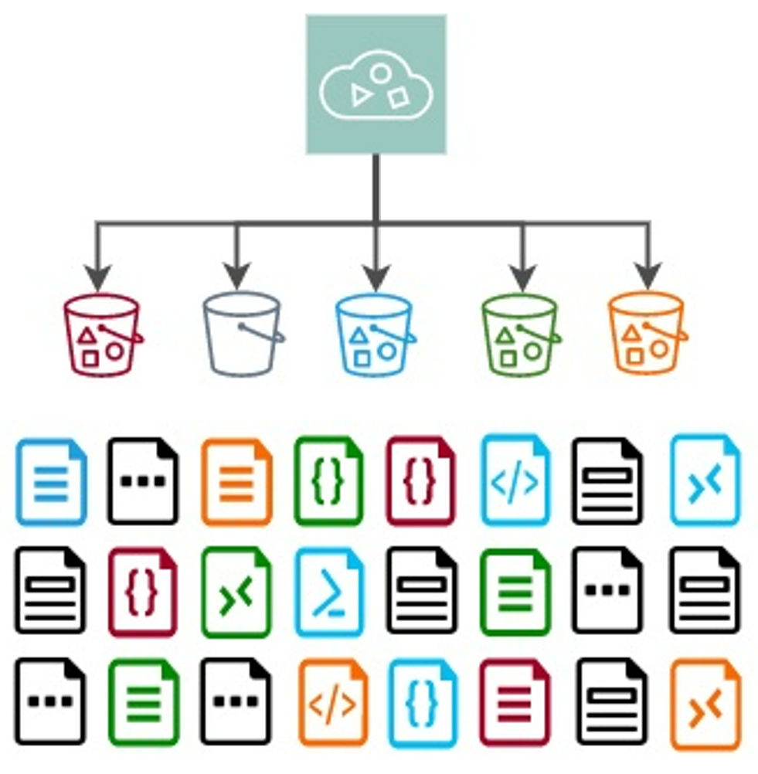
What is object storage?
Simply stated, object storage is a way of grouping and storing files that is flat (not hierarchical).
The same functionality of a hierarchy can achieved by prepending subfolder names to an object name.
Object storage is a collection of unique objects. You cannot interactively perform actions on objects (e.g., edit them) in object storage. You must remove them to do so.
You can organise objects into buckets using object naming. You can use this as an aid in visualising object groupings within a bucket.
The buckets and objects here are colour coded. E.g., green objects go in green buckets. An object must be in a single bucket.
Object Storage Illustration
Buckets
Objects
Pawsey will use object storage (called Acacia) for use with its post-Capital Refresh resources (e.g., Setonix).
Introducing Acacia Object Storage Service
Notes:
Object storage is a way of grouping files that is NOT hierarchical; rather it is flat. That means that all files are equivalent. They are not children or parents of another file or directory.
In object storage, the term object is used when talking about a grouping of data. The term file is not used. The term directory is also not used.
In object storage, objects or individual data items, are stored in scalable collections, called buckets.
In object storage, an object cannot be changed. It is immutable. To change an object, you must move (?) the object of our object storage. Take Acacia for example, to work with an object in a Setonix workflow, you must move that object from Acacia and put it into /scratch.
Think about object storage like as one massive collection of objects, without a hierarchical structure. Because of this flat structure, each data must have a unique identifier. You can put an object away into a bucket. There are a limit on the number of objects you can put into a bucket, which we’ll talk about later.
You use metadata to identify an object. That metadata is stored separate from the object itself.
As part of Pawsey’s Capital Refresh, we have brought online Acacia, which is our new scalable object storage platform.

Slide 8


More about Object Storage
Object storage does not allow you to interactively change objects. To change an object, you must first get it from storage. When you finish, you put it back.
Since every object must have a globally unique identifier (key), you will know exactly the object you are getting.
If you do not know the key, you can search using robust metadata.
To help you organise your objects, you can use buckets. Buckets are for organisational reference only, all objects (including buckets) are simply stored equally as data objects.
All objects and buckets are “equivalent” data items with unique keys. There is no hierarchy.
Introducing Acacia Object Storage Service
Notes:
In contrast to filesystems where you can interactively edit a file, in object storage you cannot interactively edit an object. Objects are immutable, or unchangeable. To change an object, you must first get it from object storage, then edit it, then put it back into object storage. Object storage is exactly as the name implies – a location to store objects, not modify them.
Every object has a unique identifier – called a key. An object’s key is unique not only to the bucket and the project but to the whole of the object storage system. So, for instance, if my object is named ProjectHealthPerth01.txt – that can be THE ONLY object with that name in all of Acacia.

Slide 9
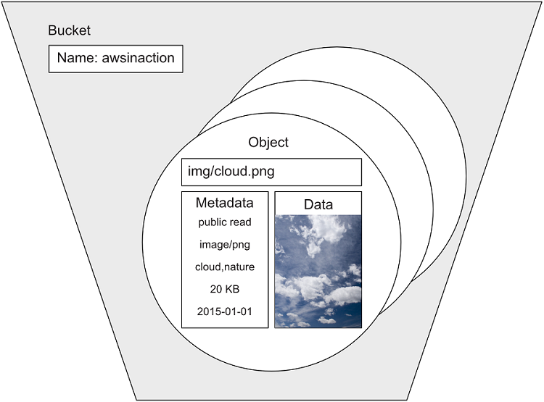
More about Objects
An object has associated with it, three things:
  Content, or data. This is often a file or an image, but it may also be a part of a file or simply a sequence of bytes.
  Metadata. This contains information about the data to help with searching.
  A globally unique identifier (key).
An object’s metadata is stored separate from an object.
Metadata Example
Globally unique key
Metadata
Data / Content
Image: Storing your objects
Introducing Acacia Object Storage Service
Notes:
Each object has associated with it three things:
First, the content or data itself. That content may be a document, a text file, an image or any part of those items.
Second, metadata. An object’s metadata is critical in helping identify, locate and describe an object. Giving your objects meaningful metadata underpins your ability to efficiently and effectively work with that object, or data. Without effective metatagging, you’re left with a data swamp, unable to navigate the murky insides of an object storage system.
Third, and last, is the object’s globally unique identifier called the key.

Slide 10
Analogy: Filesystems and
Object Storage
Section 3
Notes:
In this section I’ll briefly summarise the differences between filesystems and object storage, and I’ll use an analogy to help visualise those differences.

Slide 11


Filing Cabinet vs Bank Vault
Filing Cabinet
You can locate, copy, edit, and remove files from the filing cabinet.
The filing cabinet is easily accessible to you and your colleagues, but difficult to access for people outside the office.
A filing cabinet can only hold a limited number of files before you need a new filing cabinet.
It is hard to keep and search notes about the files themselves.
Bank Vault
Once you deposit an object in the vault, you cannot do anything to it until you take it out of the vault.
Anyone, anywhere can access the bank vault if they have the right authorization and key.
The vault is shared with all the other Bank customers, so objects need unique names.
Vaults can hold a lot of objects and can be readily expanded by making the vault bigger.
Notes about objects are easily created when you deposit an object. You can search and sort notes.
Introducing Acacia Object Storage Service
Notes:
An easy-to-understand analogy for filesystems and object storage is a filing cabinet and a bank vault.
To summarise:
The filing cabinet is easy to access for you and your colleagues, but difficult for colleagues who are outside the office. It is also limited as to the number of files it can hold and the ability to keep notes about the files themselves.
A bank vault is easy to access for anyone, anywhere as long as they have the correct authorisation and key. Since the vault is shared with other Bank customers, each object must be carefully named and uniquely identifiable. Finally, you can readily create notes about objects when you deposit them, so you can easily search and sort.

Slide 12
Filesystems & Object Storage: A Review
Section 4
Notes:
Let’s take a quick look at what we learned in this short video.

Slide 13
Filesystems and Object Storage in Review
Filesystems | Object Storage
Stores data in files | Stores data and custom metadata in objects
Allows you to make changes to a file “in-place” (within filesystem) | Does not allow you to make changes to objects (immutable)
Has fixed attributes (metadata) for folders and files (e.g., filename, time stamps) | Supports custom metadata for buckets and objects to enable easier searching and retrieval
Manages data within a file hierarchy, where each file has a unique identifier for the lowest (sub)level of hierarchy | Manages data in a flat repository / no hierarchy, where each object has a globally unique identifier (key)
Are best suited for simplified access and management of shared files Are best used for maintaining a single, accurately updated version of a file | Is best suited for retaining massive amounts of unstructured data
Have upper limits for expansion, which put a cap on (unlimited) scalability | Is ill-suited for frequently changing, transactional data
Introducing Acacia Object Storage Service
Notes:
You can pause the video here to review this table in more detail.
This video is not meant to be an exhaustive training on object storage – those trainings already exist elsewhere.
Rather, this short video is a quick look at concepts and terms used in object storage, before we introduce the Acacia Object Storage Service at Pawsey.
In summary, Pawsey has chosen object storage for several reasons, including its accessibility, shareability, and scalability.

Slide 14
Introducing Acacia
Section 5
Notes:
Let’s now introduce you to Acacia and the central role it plays in Pawsey’s overall resources.

Slide 15
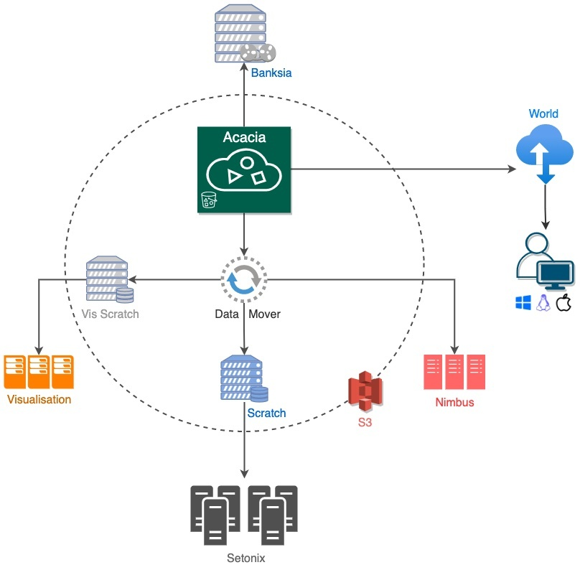
Acacia @ Pawsey
As seen here, Acacia:
Is the central object storage service for Pawsey projects
Interconnects all Pawsey services
Connects with Setonix (super compute), Nimbus (cloud compute) and Banksia (cold storage)
Is accessible from both inside Pawsey (Pawsey resources) and outside Pawsey (World)
Notes:
As shown here, Acacia is central to Pawsey’s researcher resources, connecting all Pawsey resources as well as being accessible outside of Pawsey.
Acacia provides users with 60PB of high-speed object storage for hosting research data online. This multi-tiered cluster separates different types of data to improve data availability.
You may be wondering what Acacia means? Acacia is Australia’s national floral emblem - the Golden Wattle – or Acacia pycnantha.

Slide 16
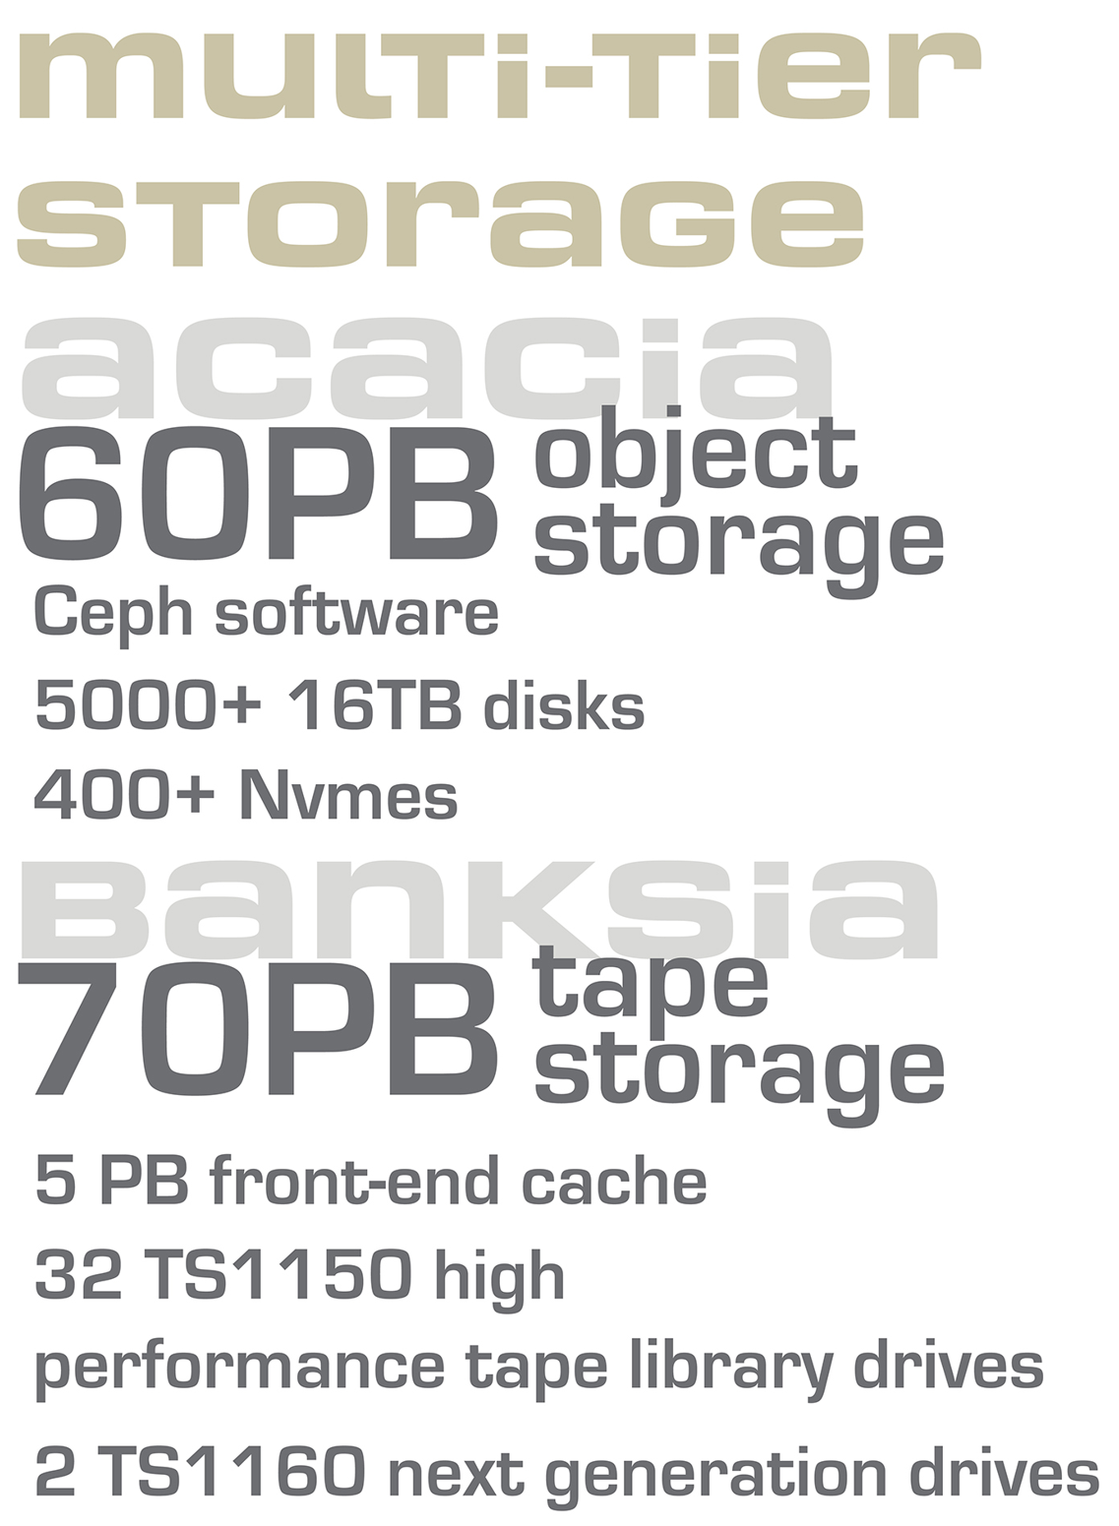
Introducing Acacia Object Storage
Acacia allows for up to 1000 buckets per user.
Pawsey recommends no more than 100,000 objects per bucket, after which performance will degrade. There is a hard limit of 1 million objects.
Users are given 100 GB of Acacia storage per user.
Projects are given 1 TB of Acacia storage per project.
The access key determines which storage is used.
Users interact with Acacia using S3 clients.
Introducing Acacia Object Storage Service
Notes:
Pawsey is home to one of the largest research-focused object storage systems in the world, and at the center of that storage is Acacia and Banksia. Together, Acacia and Banksia will provide 130 petabytes of online and offline storage.
On this slide, we provide a glimpse at some of the guidelines our Acacia users will follow. More information on these guidelines as well as the clients that users will use to interact with Acacia are covered in the next training in this Acacia video series.

Slide 17
Now we are going to walk through a series of tutorials on how to use Acacia, both from the command line and as part of your HPC workflows.
Notes:
Thank you for viewing this video. Join us for the next video in which we’ll talk more about Acacia, including the clients used to interact with it.

Slide 18
Tutorial outline
Get access to Acacia
  Setting up clients to access Acacia from your computer and Pawsey systems
Acacia from your computer
  Work with buckets and objects using mock data
  Create publicly accessible links to shared with your colleagues
Acacia on Pawsey systems
  Mini tutorial on using tar files effectively
  Integrate Acacia into your HPC workflows.
Tutorial Outline
Notes:
An easy-to-understand analogy for filesystems and object storage is a filing cabinet and a bank vault.
To summarise:
The filing cabinet is easy to access for you and your colleagues, but difficult for colleagues who are outside the office. It is also limited as to the number of files it can hold and the ability to keep notes about the files themselves.
A bank vault is easy to access for anyone, anywhere as long as they have the correct authorisation and key. Since the vault is shared with other Bank customers, each object must be carefully named and uniquely identifiable. Finally, you can readily create notes about objects when you deposit them, so you can easily search and sort.

